Slide 1
Consensus Equilibrium for Super-Resolution and Extreme-Scale CT Reconstruction
Xiao Wang¹, Venkatesh Sridhar², Zahra Ronaghi³, Rollin Thomas³, Jack Deslippe³, Dilworth Parkinson³, Gregery Buzzard², Samuel Midkiff², Charles Bouman², Simon Warfield¹
¹Harvard Medical School, Boston Children’s Hospital
²Purdue University
³Berkeley National Lab

Slide 2
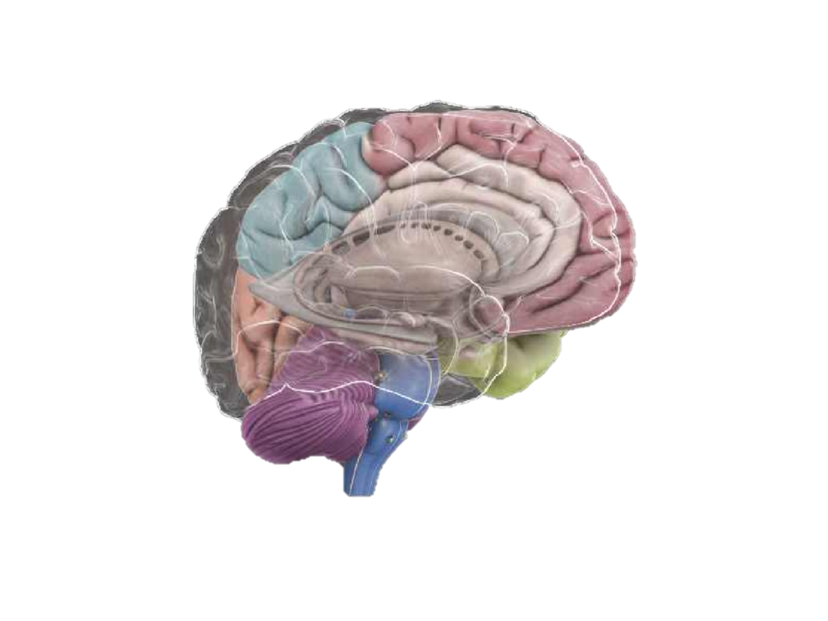
Computed Tomography (CT) Reconstruction
Detector
row
Detector
Detector
channel
Parallel X-ray Source
Detector
Parallel X-ray Source
Parallel X-ray Source
Parallel X-ray Source
Reconstruction

Slide 3
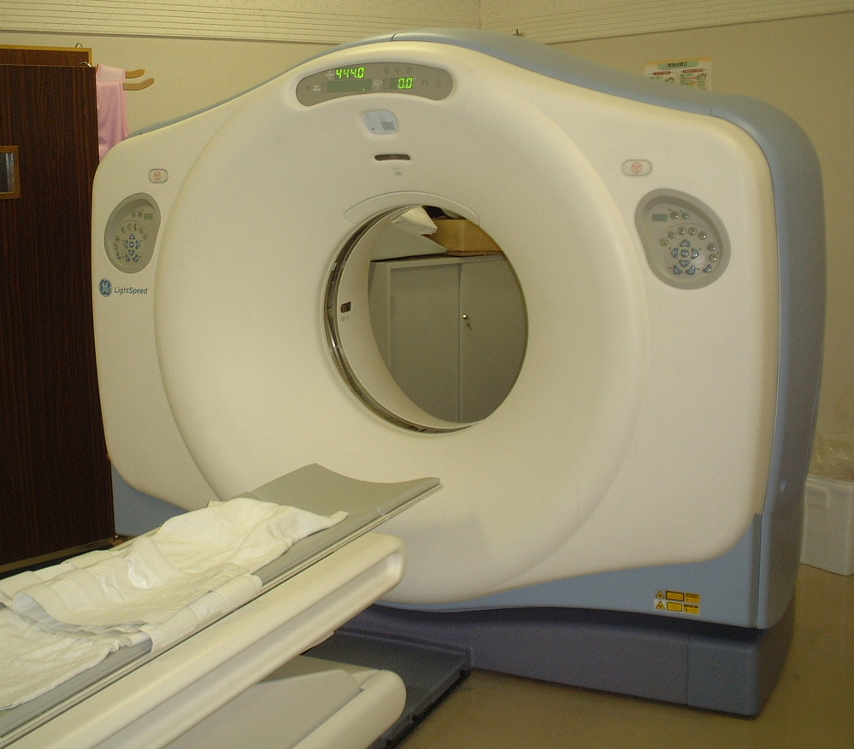
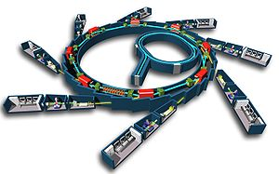
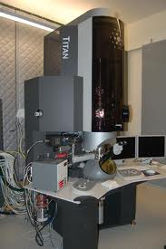



Tomographic Reconstruction
X-ray Detector
measurements
single measurement
rotation axis
Medical CT scanners
Sample Object
voxel $x_{3}$
voxel $x_{2}$
voxel
voxel $x_{1}$
Synchrotron Imaging
Sample Slice
X-rays
Electron Microscopy
X-ray Source

Slide 4
Two Approaches for Reconstruction
Filtered-back Projection (FBP)
Fourier transform and inverse Fourier transform
Feldkamp (FDK) Algorithm, Siemens ADMIRE, GE ASiR and etc. (clinical-standard IR)
advantage: light-weight, easy to implement
disadvantage: loss of resolution, and more image artifacts
Model Based Iterative Reconstruction (MBIR)
  Physics-geometry forward model
  Image spatial property prior model
  Linear algebra and Bayesian estimation
  advantage: higher spatial resolution, fewer artifacts
  disadvantage: complexity, computation time, memory requirement

Slide 5
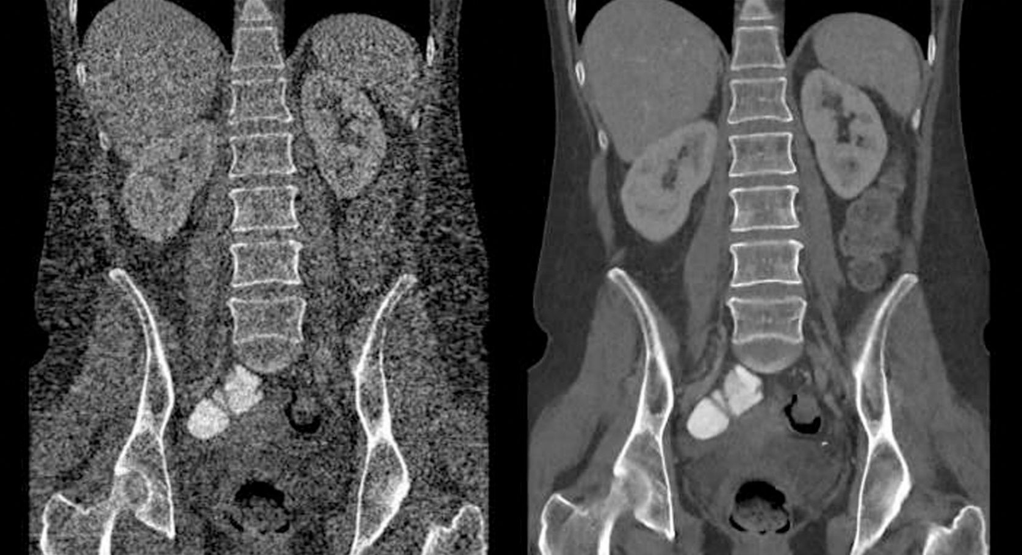
Model Based Iterative Reconstruction (MBIR)
traditional reconstruction (FBP)
MBIR reconstruction
¼ the X-ray dosage!

Slide 6
Siemens ADMIRE
MBIR

Slide 7
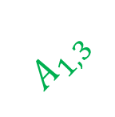

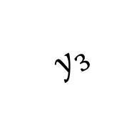



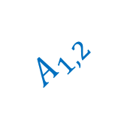






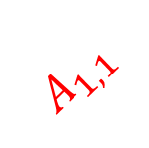

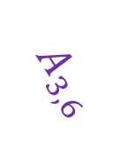


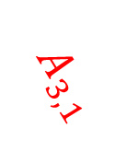





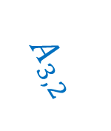

channels
Detector
channels
rows
$$y_{2}$$
rows
$$y_{3}$$
channels
$$y_{1}$$
rows
$$x_{6}$$
$$x_{3}$$
$$A_{1,4}$$
$$A_{2,6}$$
$$x_{6}$$
$$A_{3,6}$$
$$A_{1,3}$$
$$x_{4}$$
$$x_{2}$$
$$y_{1}={A_{1,1}x}_{1}+A_{1,2}x_{2}+A_{1,3}x_{3}+A_{1,4 }x_{4}+e_{1}$$
$$x_{1}$$
$$A_{1,2}$$
voxels
$$x_{1}$$
$$A_{1,1}$$
$$x_{1}$$
$$A_{2,1}$$
$$y_{2}=A_{2,5}x_{5}+A_{2,1}x_{1}+A_{2,6}x_{6}+e_{2}$$
$$x_{2}$$
$$A_{3,1}$$
$$A_{3,2}$$
X-ray
$$x_{5}$$
$$A_{2,5}$$
X-ray
X-ray
X-ray Source
X-ray Source
X-ray Source
$${45}^{°}$$
(b)
$${90}^{°}$$
(c)
$${135}^{°}$$

Slide 8

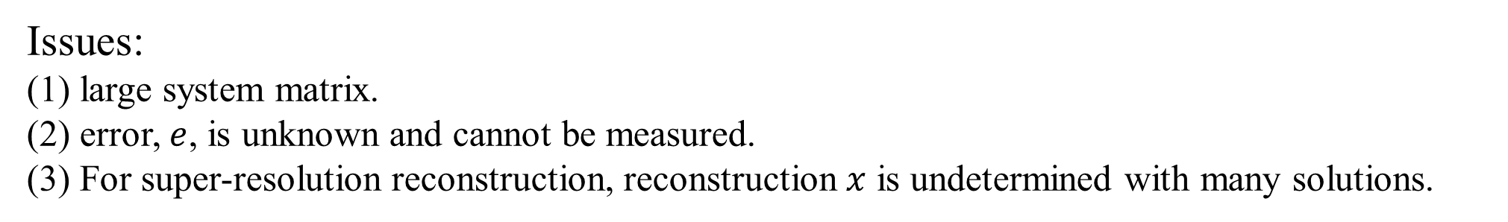


$$y_{1}={A_{1,1}x}_{1}+A_{1,2}x_{2}+A_{1,3}x_{3}+A_{1,4 }x_{4}+e_{1}$$
$$y_{2}=A_{2,5}x_{5}+A_{2,1}x_{1}+A_{2,6}x_{6}+e_{2}$$
$$y_{3}={A_{3,2}x}_{2}+{A_{3,1}x}_{1}+A_{3,6}x_{6}+e_{3}$$
Reconstruction vector
measurements vector
$$y=Ax+e$$
system matrix
error vector
Issues:
(1) large system matrix.
(2) error, $e$, is unknown and cannot be measured.
(3) For super-resolution reconstruction, reconstruction $x$ is undetermined with many solutions.

Slide 9
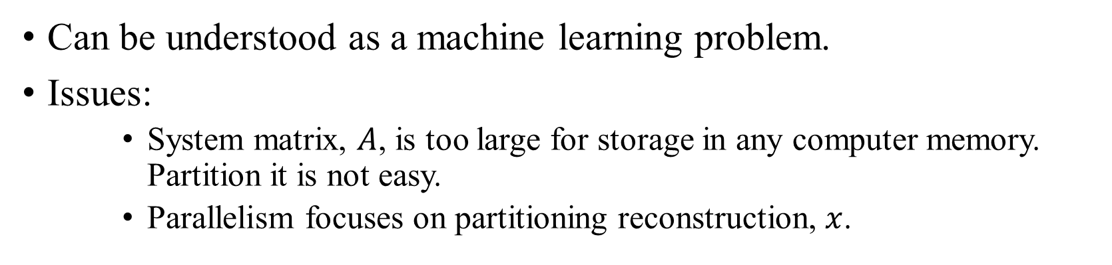
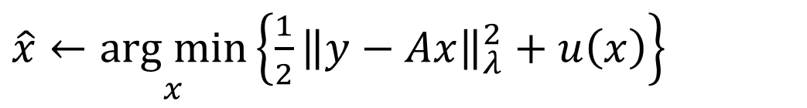
MBIR Cost Function
voxel x_{j}
$\hat{x}←\underset{x}{arg min}\left\{{\frac{1}{2}\left\|y−Ax\right\|}_{λ}^{2}+u\left(x\right)\right\}$
weight matrix
26 voxels local neighborhood
Can be understood as a machine learning problem.
Issues:
    System matrix, $A$, is too large for storage in any computer memory. Partition it is not easy.
    Parallelism focuses on partitioning reconstruction, $x$.

Slide 10
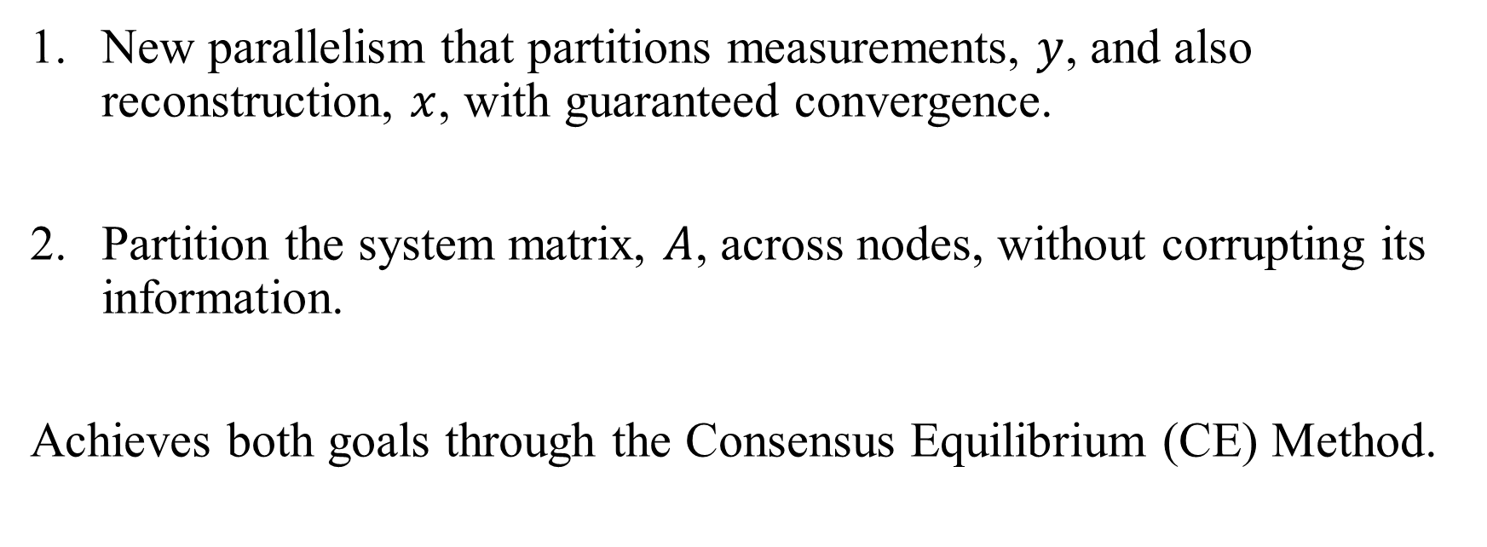
MBIR Good Performance
New parallelism that partitions measurements, $y$, and also reconstruction, $x$, with guaranteed convergence.
Partition the system matrix, $A$, across nodes, without corrupting its information.
Achieves both goals through the Consensus Equilibrium (CE) Method.

Slide 11
Contributions
For super-resolution CT reconstruction, the Asynchronous Consensus MBIR (AC-MBIR) has :
6.8 times smaller memory footprint
16 times more scalability, compared with the state-of-the-art MBIR implementation
maintains a 100% strong scaling efficiency at 146880 cores.
In addition, AC-MBIR achieves an average bandwidth of 3.5 petabytes per second at 587520 cores.

Slide 12







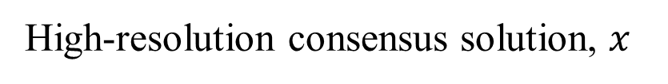


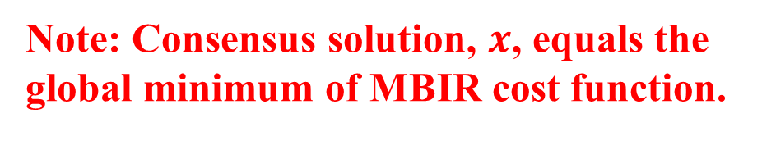
The Consensus Equilibrium Method (CE Method)
In any order
$$v^{1}$$
reconstruct
$$y^{1}$$
$$A^{1}$$
reconstruct
$$v^{2}$$
Repeat
$$y^{2}$$
Fuse
$$A^{2}$$
“Magical” Merge
High-resolution consensus solution, $x$
reconstruct
$$y^{3}$$
$$v^{3}$$
Note: Consensus solution, $x$, equals the global minimum of MBIR cost function.
$$A^{3}$$

Slide 13
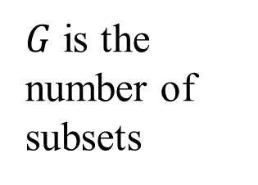
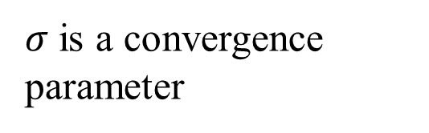
Low-Resolution Individual Reconstruction
consensus solution
$v^{i}←\underset{v^{i}}{arg min}\left\{{\frac{1}{2}\left\|y^{i}−A^{i}v^{i}\right\|}_{λ^{i}}^{2}+\frac{u\left(v^{i}\right)}{G}+\frac{{\left\|v^{i}−x\right\|}^{2}}{2σ^{2}}\right\}$
$G$ is the number of subsets
$σ$ is a convergence parameter
Individual reconstruction
measurement subset
system matrix subset

Slide 14



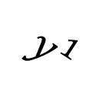
Uniform View Subsets
Detector
$$y^{2}$$
Detector
Detector
$$y^{1}$$
$$y^{1}$$
Parallel X-ray Source
Detector
$$y^{2}$$
Parallel X-ray Source
Parallel X-ray Source
Parallel X-ray Source
Reconstruction

Slide 15


Grouped View Subsets
Detector
$$y^{1}$$
Detector
Detector
$$y^{1}$$
$$y^{2}$$
Parallel X-ray Source
Detector
$$y^{2}$$
Parallel X-ray Source
Parallel X-ray Source
Parallel X-ray Source
Reconstruction

Slide 16
Smaller Memory Footprint with Grouped-View Subsets
reconstruction
uniform view subsets
voxels
SV
block¹
block²
block¹
block²
rows
view angles
subset 1
subset 2
grouped view subsets
measurements for an SV
channels
block¹
block²
block¹
block²
subset 1
subset 2

Slide 17

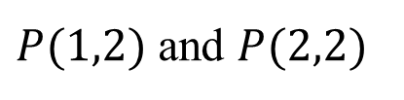
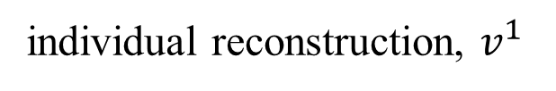

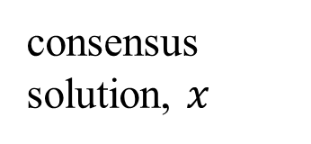

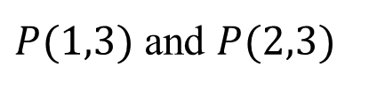



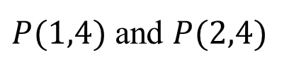

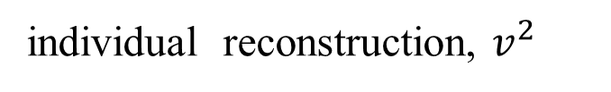

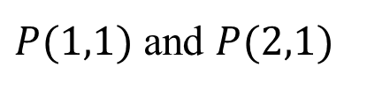
cluster
cabinet
$P(1,1)$ and $P(2,1)$
sub-volume
Parallelism
$P(1,2)$ and $P(2,2)$
consensus solution, $x$
sub-volume
$P(1,3)$ and $P(2,3)$
sub-volume
$P(1,4)$ and $P(2,4)$
Achieves measurement-partition parallelism and reconstruction volume partition at the same time.
sub-volume
Broadcast & Merge
Broadcast & Merge
$$P(1,1)$$
$$P(2,1)$$
sub-volume
sub-volume
$$P(1,2)$$
$$P(2,2)$$
sub-volume
sub-volume
$$P(1,3)$$
$$P(2,3)$$
sub-volume
sub-volume
$$P(1,4)$$
$$P(2,4)$$
sub-volume
sub-volume
individual reconstruction, $v^{1}$
individual reconstruction, $v^{2}$

Slide 18
Super-Resolution Benchmark Dataset
Ceramic matrix composite dataset, containing 2366 slices from Berkeley Lab Advanced Photon Source.
FBP interpolation method
The same area by MBIR

Slide 19
Benchmark Dataset
Dataset:
  Measurement size: 2560 channels; 2366 rows, 1024 views; parallel view
  Reconstruction size is 3600 x 3600 x 2366
  Processors:
  NERSC supercomputer from Berkeley National Lab (knights landing clusters)
  Each node: 68 cores Intel processors

Slide 20
Grouped-view subsets (uniform view subsets) | 1 | 2 | 4 | 8 | 16
Nodes | 108 | 216 | 432 | 864 | 1728
Memory footprint per node (GB) | 58 (58) | 31 (33) | 18 (21) | 11 (15) | 8 (11)
Memory reduction | 1x (1x) | 1.8x (1.7x) | 3.2x (2.7x) | 5.2x (3.9x) | 6.8x (5.1x)
Runtime (seconds) | 1681 (1681) | 779 (807) | 342 (385) | 258 (347) | 215 (347)
Computation Increase | 1 (1) | 1 (1) | 1 (1.2) | 1.1 (1.5) | 1.3 (2.1)
Parallel efficiency | 100% (100%) | 108% (104%) | 123% (131%) | 89% (91%) | 63% (63%)
Bandwidth (petabytes/ sec) | <0.1 (<0.1)

Slide 21
Number of Sub-volumes (4 view subsets) | 68 | 135 | 270 | 540 | 1080 | 2160
Nodes | 272 | 540 | 1080 | 2160 | 4320 | 8640
Memory footprint per node (GB) | 20 (23.7) | 17.4 (20.4) | 15.7 (18.7) | 14.9 (17.9) | 14.5 (17.5) | 14.3 (17.30)
Memory reduction | 2.8x (2.4x) | 3.3x (2.8x) | 3.7x (3.1x) | 3.9x (3.2x) | 4.0x (3.3x) | 4.1x (3.4x)
Runtime (seconds) | 558.0 (654.6) | 271 (326.4) | 147.2 (174.3) | 84.4 (159.2) | 51.4 (154.0) | 40.0 (154.0)
Computation Increase | 1 (1.2) | 1 (1.2) | 1 (1.2) | 1 (1.2) | 1 (1.2)
Parallel efficiency | 120% (122%) | 124% (124%) | 114% (116%) | 100% (63%) | 82% (33%) | 53% (16%)
Bandwidth (petabytes/ sec) | <0.1 (<0.1) | <0.1 (<0.1) | 0.1 (0.1) | 0.4 (0.3) | 1.4 (0.5) | 3.5 (1.1)

Slide 22
Grouped View Subsets Convergence

