Slide 1

PruneTrain: Fast Neural Network Training by Dynamic Sparse Model Reconfiguration
Sangkug Lym*, Esha Choukse*, Siavash Zangeneh*, Wei Wen⁺, Sujay Sanghavi*, Mattan Erez*
*
+

Slide 2
Deep learning is everywhere
A large
dataset
Millions of
parameters
* From a slide by Andrew Ng

Slide 3
Fast training is important
Fast providing of model deliverables
More hyperparameter search
Frequent model updates with new data and architectures

Slide 4

Training is costly and slow
High precision
  32-bit, mixed
High computation cost
  24 GFLOPs $×$ 1.2 million images $×$ $≥$90 epochs
Large communication volume
  26 Mparams

Slide 5
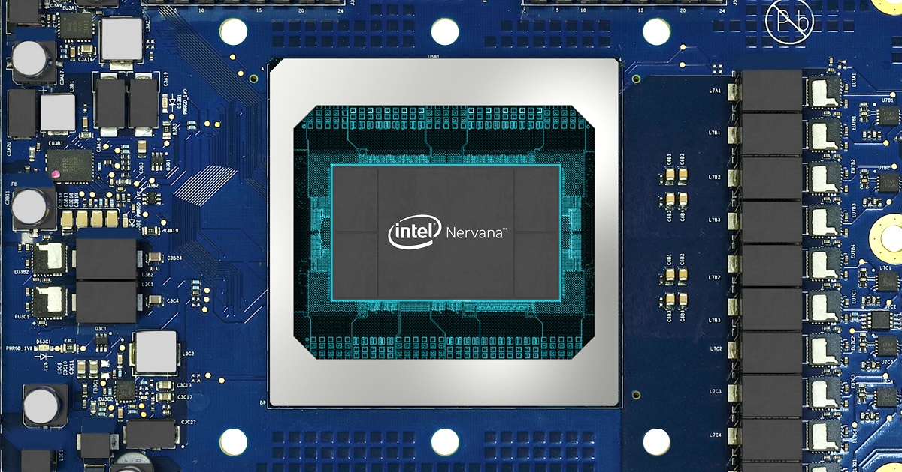
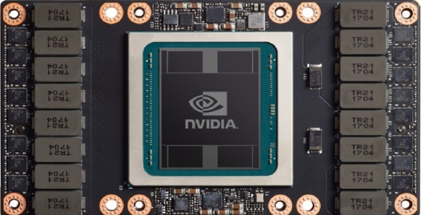
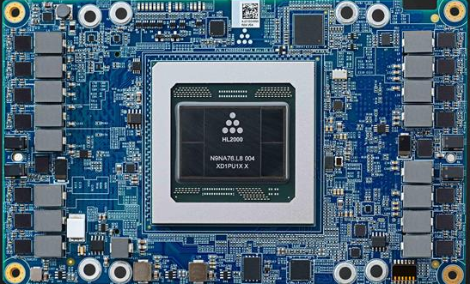
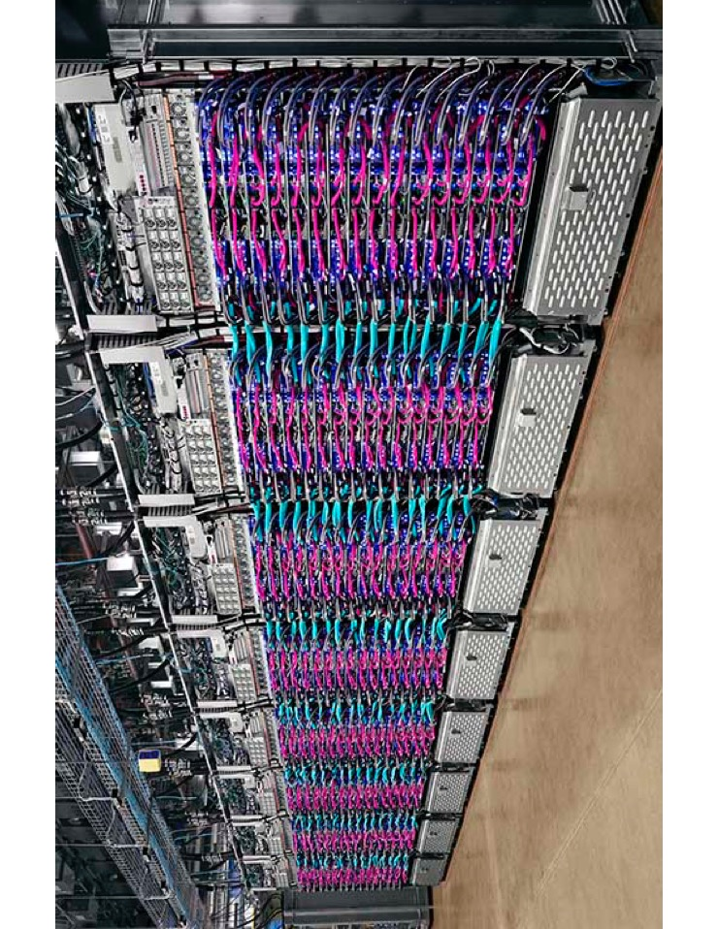

To reduce training time…
Massive matrix computing units
High BW memory system
Large-scale training

Slide 6
Not all parameters are equally important
Identify and remove unimportant parameters
Model pruning for low-cost inference

Slide 7
Need to train all parameters?
Remove unimportant parameters during training
Structurally prune and reconfigure
  Maintain a dense form

Slide 8
Need to train all parameters?
Remove unimportant parameters during training
Structurally prune and reconfigure
  Maintain a dense form
PruneTrain:
Model pruning for faster training

Slide 9




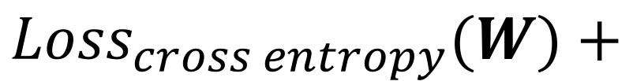

Group lasso regularization for channel pruning
$$λ\sum_{l}^{L}{\sum_{c}^{C_{l}}{∥W_{c}∥_{2}}}$$
$$)$$
$$($$
$$\min_{W}{ }$$
$${Loss}_{cross entropy}(W)+$$
Regularization coefficient
$l2 norm$ of weights
per channel
  Regularization loss

Slide 10
Group lasso regularization for channel pruning
Parameter sparsification → prune sparsified channels
$$λ\sum_{l}^{L}{\sum_{c}^{C_{l}}{∥W_{c}∥_{2}}}$$
$$)$$
$$($$
$$\min_{W}{ }$$
$${Loss}_{cross entropy}(W)+$$
Regularization coefficient
$l2 norm$ of weights
per channel
  Regularization loss

Slide 11
Prior work has limited performance gain
Maintain parameters for potential relearning ^{[1]}
Only skip computing but do not prune ^{[2]}
Prune just once ^{[3]}
[1] Wen, Wei, et al. "Learning structured sparsity in deep neural networks." Advances in neural information processing systems. 2016.
[2] Zhou, Hao, Jose M. Alvarez, and Fatih Porikli. "Less is more: Towards compact cnns." European Conference on Computer Vision. Springer, Cham, 2016.
[3] Alvarez, Jose M., and Mathieu Salzmann. "Compression-aware training of deep networks." Advances in Neural Information Processing Systems. 2017.
…

Slide 12
Channels
sparsified gradually
PruneTrain: Timely pruning
saves greater cost
Decreasing computing cost assuming sparsified channels are pruned
* ResNet50 on CIFAR10

Slide 13
Sparsified channels do not revive
Max. parameter value per channel over epochs
Convolution layer 5
Convolution layer 6
Convolution layer 7

Slide 14
Performance-friendly
channel sparsification

Slide 15
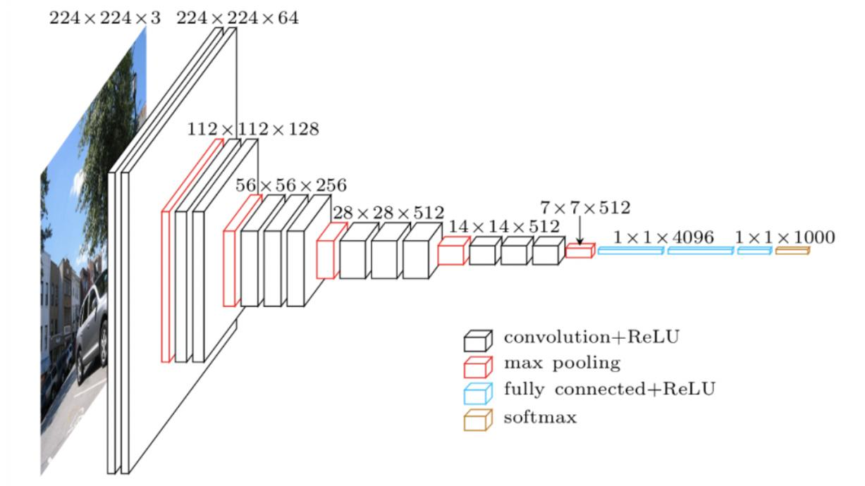
Stronger sparsification on early layers
Downsampling
*VGG architecture

Slide 16
Stronger sparsification on early layers
More computations per channel

Slide 17
Channel sparsification leads to layer pruning
No layer-wise sparsification needed for layer pruning ^{[1]}
[1] Wen, Wei, et al. "Learning structured sparsity in deep neural networks." Advances in neural information processing systems. 2016.

Slide 18
So far…
PruneTrain approach
Sparsification method

Slide 19
Pruning techniques for practical training speedup
Fast regularization coefficient search
Channel pruning with no costly tensor reshaping
High data-parallelism after pruning

Slide 20
Many training runs to find a good coefficient
High pruning rate + small accuracy drop
Each run needs many training epochs
Not discussed in prior work
  Training time was not a major concern

Slide 21
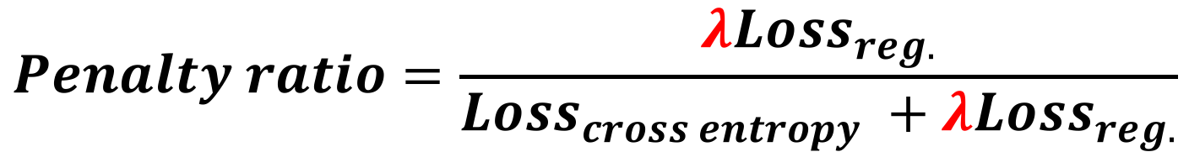

Fast regularization coefficient search
Use randomly initialized weight values
  Calculate reg. loss at the first forward-prop.
Balance reg. loss and cross entropy loss
  Set $λ$ that makes penalty ratio $≈$20%
$$Penalty ratio=\frac{λ{Loss}_{reg.}}{{Loss}_{cross entropy} +λ{Loss}_{reg.}}$$

Slide 22
Pruning techniques for practical training speedup
Fast regularization coefficient search
Channel pruning with no costly tensor reshaping
High data-parallelism after pruning

Slide 23
Matching channel indices
Modern CNNs use multi-branch modules
Layer branches share a node

Slide 24
Matching channel indices
Modern CNNs use multi-branch modules
Layer branches share a node
Channels sharing a node → Indices should match

Slide 25
Costly indexing is needed for channel pruning
Indexing needs tensor reshaping → numerous memory accesses
Process dense channels
[1]] He, Yihui, Xiangyu Zhang, and Jian Sun. "Channel pruning for accelerating very deep neural networks." Proceedings of the IEEE International Conference on Computer Vision. 2017.

Slide 26
Tensor reshaping cost > computation cost
Last convolution layers in each residual block
Residual block index
* ResNet50 on ImageNet, NVIDIA V100 GPU

Slide 27
No tensor reshaping with channel union
Prune only the intersection of sparsified channels
Process sparsified channels
Process sparsified channels
Union of all dense channels

Slide 28
2.2X speedup over channel indexing
* ResNet50 on ImageNet, NVIDIA V100 GPU

Slide 29
Pruning techniques for practical training speedup
Fast regularization coefficient search
Channel pruning with no costly tensor reshaping
High data-parallelism after pruning

Slide 30
Channel pruning reduces data parallelism
Lower compute resource utilization

Slide 31
Dynamic mini-batch adjustment keeps compute units busy
Use larger mini-batches to fill device memory
  Pruning reduces activations to keep for back-prop
  Adjust learning rate using the linear scaling rule
  Increase data-parallelism in the batch dimension

Slide 32
Dynamic mini-batch adjustment keeps compute units busy
Device memory capacity = 11GB
Memory utilization [GB]
64
LR=0.1
Epoch
* ResNet50 on ImageNet, NVIDIA 1080Ti

Slide 33
Dynamic mini-batch adjustment keeps compute units busy
Device memory capacity = 11GB
128
96
LR=0.02
LR=0.15
Memory utilization [GB]
64
LR=0.1
Epoch
* ResNet50 on ImageNet, NVIDIA 1080Ti

Slide 34
Further training time saving with
negligible impact to accuracy and pruning
14%
8%
* ResNet50 on CIFAR100 (Titan Xp), ImageNet (V100)

Slide 35
Evaluation
CIFAR10/100 | ResNet32/50, VGG11/13
 | Mini-batch = 128
 | 180 epochs
 | NVIDIA Titan Xp GPU x1
ImageNet | ResNet50 (penalty ratios = 0.1, 0.2, and 0.25)
 | Mini-batch (per GPU) = 256 (64)
 | 90 epochs
 | NVIDIA V100 GPU x4

Slide 36
Training FLOPs vs. training time
PruneTrain saves up to 43% training time for CIFAR
PruneTrain saves up to 34% training time for ImageNet

Slide 37
Inference performance
Up to 55% inf. cost saving with increasing accuracy loss
Penalty ratio = 0.1, 0.2, and 0.25
* ResNet50 on ImageNet

Slide 38
Inference performance
Up to 55% inf. cost saving with increasing accuracy loss
Fine-tuning recovers ~0.5% accuracy
Penalty ratio = 0.1, 0.2, and 0.25
* ResNet50 on ImageNet

Slide 39
Comparison to pruning with a pre-trained model
PruneTrain shows higher accuracy for similar inference cost
ResNet50 on CIFAR10
ResNet32 on CIFAR10
Validation accuracy
Validation accuracy
[1]
[1]
Inference cost [MFLOPs]
Inference cost [MFLOPs]
[1] Wen, Wei, et al. "Learning structured sparsity in deep neural networks." Advances in neural information processing systems. 2016

Slide 40
Comparison to pruning with a pre-trained model
PruneTrain shows higher accuracy for similar inference cost
ResNet50 on CIFAR10
ResNet32 on CIFAR10
  Pruning during training is fine!
Validation accuracy
Validation accuracy
[1]
[1]
Inference cost [MFLOPs]
Inference cost [MFLOPs]
[1] Wen, Wei, et al. "Learning structured sparsity in deep neural networks." Advances in neural information processing systems. 2016

Slide 41
Communication saving in distributed training
Mini-batch adjustment reduces communication further
Avg. 90%
Norm. communication cost
Avg. 54%
Avg. 40%
* ResNet50 on ImageNet
* Ring-allreduce using 128 GPUs

Slide 42
Individual parameter sparsity
Avg. ~50% of weights in remained channels are zeroed
* ResNet50 on ImageNet

Slide 43
Summarizing PruneTrain
Sparsified channels do not revive
Saves large training computation cost
  With gradual structured pruning and reconfiguring
Realize practical training speedup
  With key algorithmic techniques
Overall, PruneTrain achieves
  Up to 1.6X training speedup
  Up to 60% communication cost saving

