Slide 1




A Versatile Software Systolic Execution Model for GPU Memory-bound Kernels
${Peng Chen}^{1,3 },{\text{Mohamed} \text{Wahib}}^{ 3 },{\text{Shinichiro} \text{Takizawa}}^{ 3 },$ ${\text{Ryousei} \text{Takano}}^{ 2 },{\text{Satoshi} \text{Matsuoka}}^{1,4 }$
Tokyo Institute of Technology, Dept. of Mathematical and Computing Science, Tokyo, Japan
National Institute of Advanced Industrial Science and Technology, Tokyo, Japan
AIST-Tokyo Tech Real World Big-Data Computation Open Innovation Laboratory, National Institute of Advanced Industrial Science and Technology
RIKEN Center for Computational Science, Hyogo, Japan

Slide 2





Background
Post-Moore era: Specialization
Memory-bound problems [1, 2]
Solutions
  Reducing required memory bandwidth
  Improving data locality
  Efficient Inter-thread communication
Data
Post-Moore
Computing Systems
Specialization
(Low/Mixed Precision)
Inaccurate
Hardware
Reconfigurable
Unreliable
Low-power
Memory
Neuromophic
Computing
Quantum
Computing
Reliable
Moore’s Era
Computing
Systems
Compute
Exact
Inexact
[1] M. Wahib and N. Maruyama, "Scalable Kernel Fusion for Memory-Bound GPU Applications," SC '14: Proceedings of the International Conference for High Performance Computing, Networking, Storage and Analysis, New Orleans, LA, 2014, pp. 191-202.
[2] J. Domke et al., "Double-Precision FPUs in High-Performance Computing: An Embarrassment of Riches?," 2019 IEEE International Parallel and Distributed Processing Symposium (IPDPS), Rio de Janeiro, Brazil, 2019, pp. 78-88.

Slide 3
Memory-bound kernels on GPUs
Memory-bound problem on GPUs
  Very high flops-to-bytes ratio
Typical memory bound kernels
  Scan operator
  Summed Area Table (SAT) [1]
  Convolution
  Stencils
Flops to Bytes ratio of GPUs in single precision
  [1] P. Chen, M. Wahib, S. Takizawa, R. Takano and S. Matsuoka, "Efficient Algorithms for the Summed Area Tables Primitive on GPUs," 2018 IEEE International Conference on Cluster Computing (CLUSTER), Belfast, 2018, pp. 482-493.

Slide 4
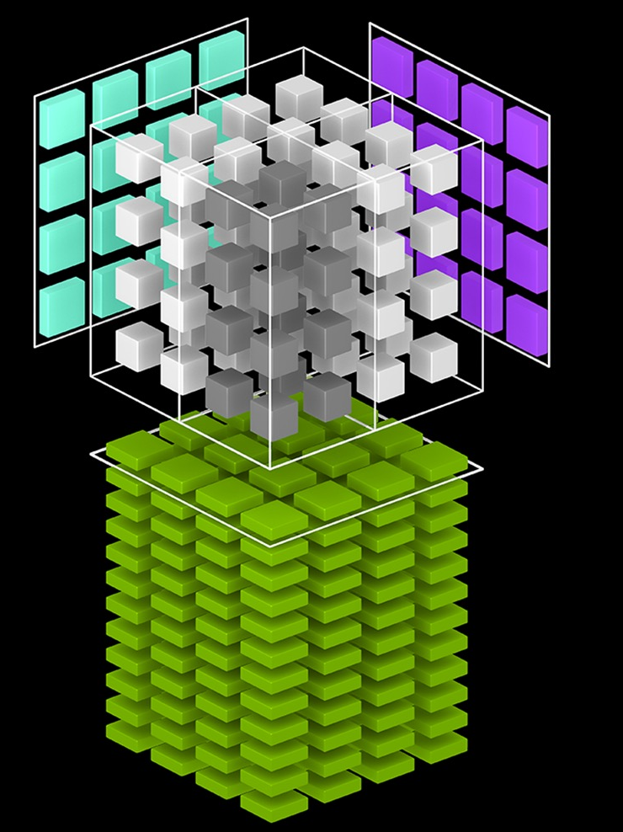
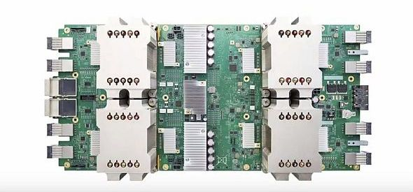
Motivation
Systolic array architecture
  Heavily-researched parallel computer architecture
  Simple yet effective to optimize applications
  Outstanding performance with limited memory bandwidth
    High FLOPS, High Flops/wat
A revived architecture
  Driven by the compute-intensive workload
    Google TPU, Nvidia Tensor core
  Should we embrace systolic Arrays?
    Specialization
Innovate to build a software systolic array (SSAM)
  Why is SSAM needed?
    Programmability, generality
    High performance
Nvidia Tensor Core
Google TPU

Slide 5
Problem statement
  How to mimic the behavior of systolic array?
      Understanding memory-bound kernels
      Understanding hardware systolic array
      How to achieve high performance by software systolic array?
      How to qualify the performance advance?
  How to take advantage of CUDA architecture?
      Register cache & shared memory cache
      In-register partial sums computation
      Coalesced access to global memory
      Shuffle intrinsic for intra-warp communication
  Note : SSAM is not limited to Nvidia GPUs

Slide 6
Contributions
We design a versatile software systolic array execution model on CUDA for optimizing memory-bound kernels
We build performance model for analyzing the data reuse and qualifying the efficiency and limitations of SSAM
We map typical memory-bound algorithms in SSAM
  2D convolution, 2D/3D stencils
  Achieve outstanding performance
    2.5x faster than Nvidia’s NPP library for 2D convolution
    Outperform the state of the art stencil libraries for a wide range of stencils

Slide 7
Nvidia CUDA
CUDA
  Built around an array of multi-threaded streaming processors (SMs)
CUDA execution hierarchy
  Thread
  Warp
  Block
  Grid
CUDA memory hierarchy
  Global memory
  Shared memory
  Constant memory
  Register memory
  L1/L2 cache
Global GPU memory
GPU Kernel
Shared memory
Shared memory
Shared memory
Thread block
Thread block
Thread block
Warp
Warp
Warp
Registers
Registers
Registers
Thread
Thread
Thread
Memory hierarchy in CUDA GPUs

Slide 8
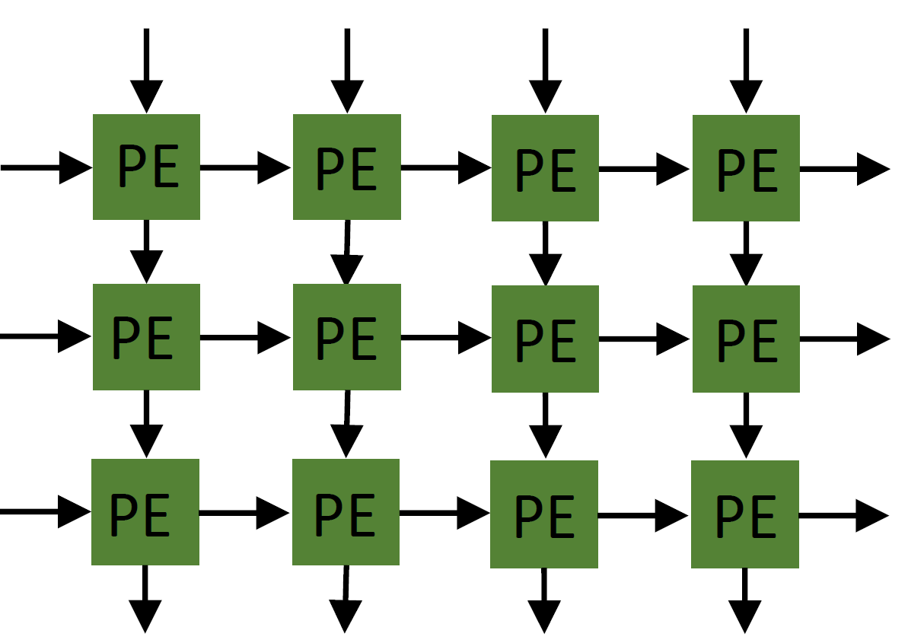
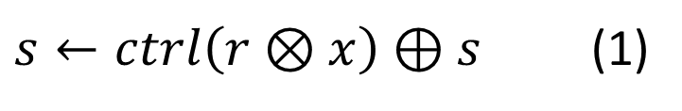
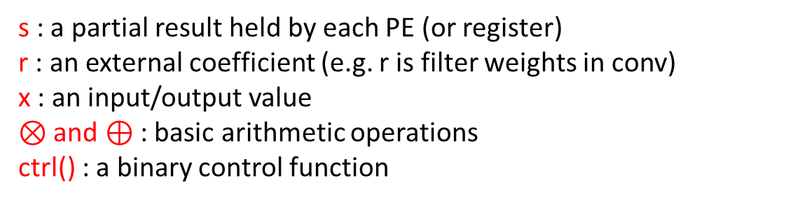
Software Systolic Array Model (SSAM)
CUDA threads in a warp
Partial Sums intra-warp
reg
reg
reg
reg
Partial Sums in
a thread
reg
reg
reg
reg
reg
reg
reg
reg
(a) Hardware Systolic Array
(b) Software Systolic Array Execution Model
(SSAM)
$s←ctrl\left(r⊗x\right)⊕s$ (1)
Warp
s : a partial result held by each PE (or register)
r : an external coefficient (e.g. r is filter weights in conv)
x : an input/output value
$⊗$ and $⊕$ : basic arithmetic operations
ctrl() : a binary control function
SSAM
Register cache
Partial sums

Slide 9
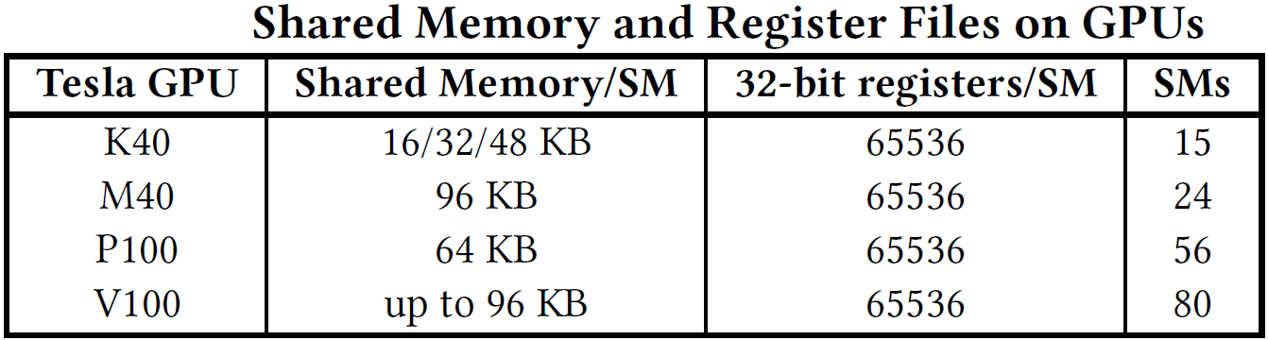
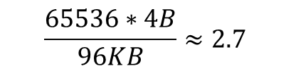
Register cache Vs. Shared memory cache
  Advantages of register cache
    High bandwidth
    Low latency (Register is 1 cycle Vs. shared mem is 27 cycles on V100)
    Large capacity
  Disadvantages of register cache
    Only threads in a warp can exchange data
    WarpSize is limited as 32
$$\frac{65536∗4B}{96KB}≈2.7$$

Slide 10

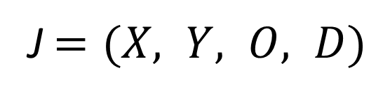



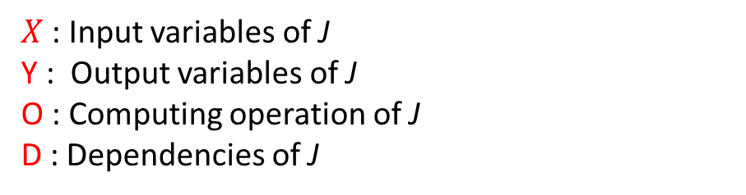
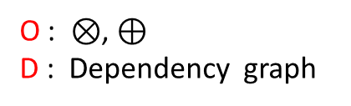
Mapping Algorithms in SSAM
A regular algorithm can be formulated as a four-tuple:
J $=(X, Y, O, D)$
$X$ : Input variables of J
Y : Output variables of J
O : Computing operation of J
D : Dependencies of J
Illustrative Example: 1D Convolution/Stencil
X :
$$⊗$$
$$⊗$$
$$⊗$$
O : $⊗$, $⊕$
D : Dependency graph
$$⊕$$
Y :

Slide 11
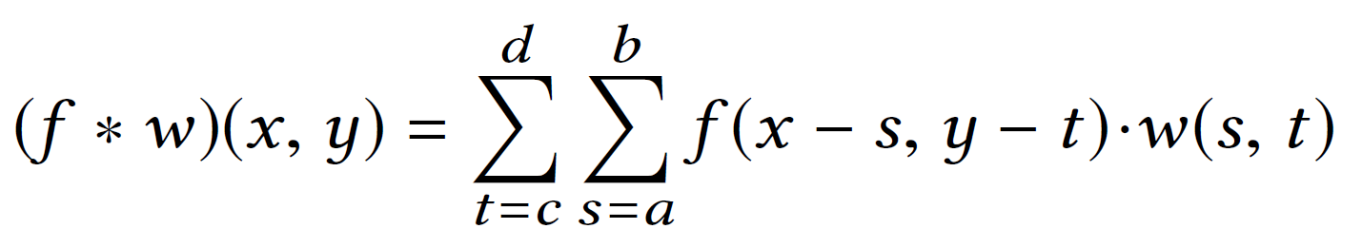



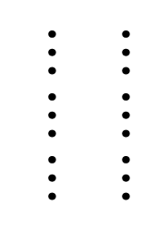




























SSAM-based 2D convolution
2D convolution
(1)
Where, M=d-c+1, N=b-a+1,
* means convolution, . is multiplication
Implementation
A CUDA Warp
Thread 5
A CUDA Warp
Thread 4
Thread 3
Thread 2
Thread 30
A CUDA thread
Thread 1
Thread 0
Thread 31
Thread 5
Thread 30
Thread 4
Thread 31
Thread 3
Thread 0
Thread 2
Sliding Window
Thread 1
$$v_{1}$$
$$w_{1}$$
$$w_{2}$$
$$w_{M}$$
$$v$$
$$w$$
$$v_{2}$$
$$⋯⋯⋯$$
$$⋯⋯⋯$$
#1
$$⋯⋯⋯$$
$$⋯⋯⋯$$
$$⋯⋯⋯⋯ ⋯$$
$$s_{1}$$
e31
$$s_{1}$$
$$s_{1}$$
$$s_{1}$$
$$v_{1}$$
e0
e1
e2
e4
e5
e6
e30
$$v_{N}$$
$$s_{2}$$
#2
+
+
+
+
+
+
+
+
$$∗$$
$$s_{2}$$
$$s_{2}$$
$$s_{2}$$
$$v_{2}$$
$$⋯⋯⋯$$
e0
e1
e3
e4
e5
e6
e30
e31
$$s_{3}$$
$$s_{3}$$
$$s_{3}$$
$$⋯$$
#3
+
+
+
+
+
+
+
$$⋯$$
e0
e1
e3
e4
e5
e6
e30
e31
$$v_{C}$$
$$s_{N}$$
$$s_{N}$$
$$s_{N}$$
$$v_{N}$$
$$s_{N}$$
$$32×C Register Matrix$$
$${sum}_{k}←{v_{k}×{ s}_{k}+sum}_{k−1}$$
Convolution Results
$$M×N size filter$$
(a) Register Cache
(b) Compute partial sums
(c) Transfer partial sums

Slide 12


















































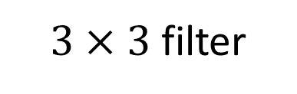




An example of partial sums
8 threads in a single warp
$e←0$
0
1
2
3
4
5
6
7
$$e=v_{0}∗f_{00}+e$$
$$e=v_{1}∗f_{10}+e$$
e
e
e
e
e
e
e
e
$$e=v_{2}∗f_{20}+e$$
$$v_{0}$$
$$v_{0}$$
$$v_{0}$$
$$v_{0}$$
$$v_{0}$$
$$v_{0}$$
$$v_{0}$$
$$v_{0}$$
$$e=shfl_up(e)$$
$$v_{1}$$
$$v_{1}$$
$$v_{1}$$
$$v_{1}$$
$$v_{1}$$
$$v_{1}$$
$$v_{1}$$
$$v_{1}$$
$$e=v_{0}∗f_{01}+e$$
$$e=v_{1}∗f_{11}+e$$
$$f_{00}$$
$$f_{01}$$
$$f_{02}$$
$$e=v_{2}∗f_{21}+e$$
$$v_{2}$$
$$v_{2}$$
$$v_{2}$$
$$v_{2}$$
$$v_{2}$$
$$v_{2}$$
$$v_{2}$$
$$v_{2}$$
$$f_{10}$$
$$f_{11}$$
$$f_{12}$$
$$e=shfl_up(e)$$
$$v_{3}$$
$$v_{3}$$
$$v_{3}$$
$$v_{3}$$
$$v_{3}$$
$$v_{3}$$
$$v_{3}$$
$$v_{3}$$
$$e=v_{0}∗f_{02}+e$$
$$f_{20}$$
$$f_{21}$$
$$f_{22}$$
$$e=v_{1}∗f_{12}+e$$
Register cache
$3×3$ filter
$$e=v_{2}∗f_{22}+e$$
$v_{0}←s$

Slide 13
An example of partial sums
8 threads in a single warp
$e←0$
0
1
2
3
4
5
6
7
$$e=v_{0}∗f_{00}+e$$
$$e=v_{1}∗f_{10}+e$$
$$e=v_{2}∗f_{20}+e$$
$$v_{0}$$
$$v_{0}$$
$$v_{0}$$
$$v_{0}$$
$$v_{0}$$
$$v_{0}$$
$$v_{0}$$
$$v_{0}$$
e
e
e
e
e
e
e
e
$$e=shfl_up(e)$$
$$v_{1}$$
$$v_{1}$$
$$v_{1}$$
$$v_{1}$$
$$v_{1}$$
$$v_{1}$$
$$v_{1}$$
$$v_{1}$$
$$e=v_{0}∗f_{01}+e$$
$$e=v_{1}∗f_{11}+e$$
$$f_{00}$$
$$f_{01}$$
$$f_{02}$$
$$e=v_{2}∗f_{21}+e$$
$$v_{2}$$
$$v_{2}$$
$$v_{2}$$
$$v_{2}$$
$$v_{2}$$
$$v_{2}$$
$$v_{2}$$
$$v_{2}$$
$$f_{10}$$
$$f_{11}$$
$$f_{12}$$
$$e=shfl_up(e)$$
$$v_{3}$$
$$v_{3}$$
$$v_{3}$$
$$v_{3}$$
$$v_{3}$$
$$v_{3}$$
$$v_{3}$$
$$v_{3}$$
$$e=v_{0}∗f_{02}+e$$
$$f_{20}$$
$$f_{21}$$
$$f_{22}$$
$$e=v_{1}∗f_{12}+e$$
Register cache
$3×3$ filter
$$e=v_{2}∗f_{22}+e$$
$v_{0}←s$

Slide 14
An example of partial sums
8 threads in a single warp
$e←0$
0
1
2
3
4
5
6
7
$$e=v_{0}∗f_{00}+e$$
$$e=v_{1}∗f_{10}+e$$
$$e=v_{2}∗f_{20}+e$$
$$v_{0}$$
$$v_{0}$$
$$v_{0}$$
$$v_{0}$$
$$v_{0}$$
$$v_{0}$$
$$v_{0}$$
$$v_{0}$$
$$e=shfl_up(e)$$
$$v_{1}$$
$$v_{1}$$
$$v_{1}$$
$$v_{1}$$
$$v_{1}$$
$$v_{1}$$
$$v_{1}$$
$$v_{1}$$
$$e=v_{0}∗f_{01}+e$$
e
e
e
e
e
e
e
e
$$e=v_{1}∗f_{11}+e$$
$$f_{00}$$
$$f_{01}$$
$$f_{02}$$
$$e=v_{2}∗f_{21}+e$$
$$v_{2}$$
$$v_{2}$$
$$v_{2}$$
$$v_{2}$$
$$v_{2}$$
$$v_{2}$$
$$v_{2}$$
$$v_{2}$$
$$f_{10}$$
$$f_{11}$$
$$f_{12}$$
$$e=shfl_up(e)$$
$$v_{3}$$
$$v_{3}$$
$$v_{3}$$
$$v_{3}$$
$$v_{3}$$
$$v_{3}$$
$$v_{3}$$
$$v_{3}$$
$$e=v_{0}∗f_{02}+e$$
$$f_{20}$$
$$f_{21}$$
$$f_{22}$$
$$e=v_{1}∗f_{12}+e$$
Register cache
$3×3$ filter
$$e=v_{2}∗f_{22}+e$$
$v_{0}←s$

Slide 15
An example of partial sums
8 threads in a single warp
$e←0$
0
1
2
3
4
5
6
7
$$e=v_{0}∗f_{00}+e$$
$$e=v_{1}∗f_{10}+e$$
$$e=v_{2}∗f_{20}+e$$
$$v_{0}$$
$$v_{0}$$
$$v_{0}$$
$$v_{0}$$
$$v_{0}$$
$$v_{0}$$
$$v_{0}$$
$$v_{0}$$
$$e=shfl_up(e)$$
$$v_{1}$$
$$v_{1}$$
$$v_{1}$$
$$v_{1}$$
$$v_{1}$$
$$v_{1}$$
$$v_{1}$$
$$v_{1}$$
$$e=v_{0}∗f_{01}+e$$
$$e=v_{1}∗f_{11}+e$$
$$f_{00}$$
$$f_{01}$$
$$f_{02}$$
$$e=v_{2}∗f_{21}+e$$
$$v_{2}$$
$$v_{2}$$
$$v_{2}$$
$$v_{2}$$
$$v_{2}$$
$$v_{2}$$
$$v_{2}$$
$$v_{2}$$
e
e
e
e
e
e
e
e
$$f_{10}$$
$$f_{11}$$
$$f_{12}$$
$$e=shfl_up(e)$$
$$v_{3}$$
$$v_{3}$$
$$v_{3}$$
$$v_{3}$$
$$v_{3}$$
$$v_{3}$$
$$v_{3}$$
$$v_{3}$$
$$e=v_{0}∗f_{02}+e$$
$$f_{20}$$
$$f_{21}$$
$$f_{22}$$
$$e=v_{1}∗f_{12}+e$$
Register cache
$3×3$ filter
$$e=v_{2}∗f_{22}+e$$
$v_{0}←s$

Slide 16
An example of partial sums
8 threads in a single warp
$e←0$
0
1
2
3
4
5
6
7
$$e=v_{0}∗f_{00}+e$$
$$e=v_{1}∗f_{10}+e$$
$$e=v_{2}∗f_{20}+e$$
$$v_{0}$$
$$v_{0}$$
$$v_{0}$$
$$v_{0}$$
$$v_{0}$$
$$v_{0}$$
$$v_{0}$$
$$v_{0}$$
$$e=shfl_up(e)$$
$$v_{1}$$
$$v_{1}$$
$$v_{1}$$
$$v_{1}$$
$$v_{1}$$
$$v_{1}$$
$$v_{1}$$
$$v_{1}$$
$$e=v_{0}∗f_{01}+e$$
$$e=v_{1}∗f_{11}+e$$
$$f_{00}$$
$$f_{01}$$
$$f_{02}$$
$$e=v_{2}∗f_{21}+e$$
$$v_{2}$$
$$v_{2}$$
$$v_{2}$$
$$v_{2}$$
$$v_{2}$$
$$v_{2}$$
$$v_{2}$$
$$v_{2}$$
e
e
e
e
e
e
e
e
$$f_{10}$$
$$f_{11}$$
$$f_{12}$$
$$e=shfl_up(e)$$
$$v_{3}$$
$$v_{3}$$
$$v_{3}$$
$$v_{3}$$
$$v_{3}$$
$$v_{3}$$
$$v_{3}$$
$$v_{3}$$
$$e=v_{0}∗f_{02}+e$$
$$f_{20}$$
$$f_{21}$$
$$f_{22}$$
$$e=v_{1}∗f_{12}+e$$
Register cache
$3×3$ filter
$$e=v_{2}∗f_{22}+e$$
$v_{0}←s$

Slide 17
An example of partial sums
8 threads in a single warp
$e←0$
0
1
2
3
4
5
6
7
$$e=v_{0}∗f_{00}+e$$
$$e=v_{1}∗f_{10}+e$$
$$e=v_{2}∗f_{20}+e$$
$$v_{0}$$
$$v_{0}$$
$$v_{0}$$
$$v_{0}$$
$$v_{0}$$
$$v_{0}$$
$$v_{0}$$
$$v_{0}$$
e
e
e
e
e
e
e
e
$$e=shfl_up(e)$$
$$v_{1}$$
$$v_{1}$$
$$v_{1}$$
$$v_{1}$$
$$v_{1}$$
$$v_{1}$$
$$v_{1}$$
$$v_{1}$$
$$e=v_{0}∗f_{01}+e$$
$$e=v_{1}∗f_{11}+e$$
$$f_{00}$$
$$f_{01}$$
$$f_{02}$$
$$e=v_{2}∗f_{21}+e$$
$$v_{2}$$
$$v_{2}$$
$$v_{2}$$
$$v_{2}$$
$$v_{2}$$
$$v_{2}$$
$$v_{2}$$
$$v_{2}$$
$$f_{10}$$
$$f_{11}$$
$$f_{12}$$
$$e=shfl_up(e)$$
$$v_{3}$$
$$v_{3}$$
$$v_{3}$$
$$v_{3}$$
$$v_{3}$$
$$v_{3}$$
$$v_{3}$$
$$v_{3}$$
$$e=v_{0}∗f_{02}+e$$
$$f_{20}$$
$$f_{21}$$
$$f_{22}$$
$$e=v_{1}∗f_{12}+e$$
Register cache
$3×3$ filter
$$e=v_{2}∗f_{22}+e$$
$v_{0}←s$

Slide 18
An example of partial sums
8 threads in a single warp
$e←0$
0
1
2
3
4
5
6
7
$$e=v_{0}∗f_{00}+e$$
$$e=v_{1}∗f_{10}+e$$
$$e=v_{2}∗f_{20}+e$$
$$v_{0}$$
$$v_{0}$$
$$v_{0}$$
$$v_{0}$$
$$v_{0}$$
$$v_{0}$$
$$v_{0}$$
$$v_{0}$$
$$e=shfl_up(e)$$
$$v_{1}$$
$$v_{1}$$
$$v_{1}$$
$$v_{1}$$
$$v_{1}$$
$$v_{1}$$
$$v_{1}$$
$$v_{1}$$
$$e=v_{0}∗f_{01}+e$$
e
e
e
e
e
e
$$e=v_{1}∗f_{11}+e$$
e
e
$$f_{00}$$
$$f_{01}$$
$$f_{02}$$
$$e=v_{2}∗f_{21}+e$$
$$v_{2}$$
$$v_{2}$$
$$v_{2}$$
$$v_{2}$$
$$v_{2}$$
$$v_{2}$$
$$v_{2}$$
$$v_{2}$$
$$f_{10}$$
$$f_{11}$$
$$f_{12}$$
$$e=shfl_up(e)$$
$$v_{3}$$
$$v_{3}$$
$$v_{3}$$
$$v_{3}$$
$$v_{3}$$
$$v_{3}$$
$$v_{3}$$
$$v_{3}$$
$$e=v_{0}∗f_{02}+e$$
$$f_{20}$$
$$f_{21}$$
$$f_{22}$$
$$e=v_{1}∗f_{12}+e$$
Register cache
$3×3$ filter
$$e=v_{2}∗f_{22}+e$$
$v_{0}←s$

Slide 19
An example of partial sums
8 threads in a single warp
$e←0$
0
1
2
3
4
5
6
7
$$e=v_{0}∗f_{00}+e$$
$$e=v_{1}∗f_{10}+e$$
$$e=v_{2}∗f_{20}+e$$
$$v_{0}$$
$$v_{0}$$
$$v_{0}$$
$$v_{0}$$
$$v_{0}$$
$$v_{0}$$
$$v_{0}$$
$$v_{0}$$
$$e=shfl_up(e)$$
$$v_{1}$$
$$v_{1}$$
$$v_{1}$$
$$v_{1}$$
$$v_{1}$$
$$v_{1}$$
$$v_{1}$$
$$v_{1}$$
$$e=v_{0}∗f_{01}+e$$
$$e=v_{1}∗f_{11}+e$$
$$f_{00}$$
$$f_{01}$$
$$f_{02}$$
$$e=v_{2}∗f_{21}+e$$
$$v_{2}$$
$$v_{2}$$
$$v_{2}$$
$$v_{2}$$
$$v_{2}$$
$$v_{2}$$
$$v_{2}$$
$$v_{2}$$
e
e
e
e
e
e
e
e
$$f_{10}$$
$$f_{11}$$
$$f_{12}$$
$$e=shfl_up(e)$$
$$v_{3}$$
$$v_{3}$$
$$v_{3}$$
$$v_{3}$$
$$v_{3}$$
$$v_{3}$$
$$v_{3}$$
$$v_{3}$$
$$e=v_{0}∗f_{02}+e$$
$$f_{20}$$
$$f_{21}$$
$$f_{22}$$
$$e=v_{1}∗f_{12}+e$$
Register cache
$3×3$ filter
$$e=v_{2}∗f_{22}+e$$
$v_{0}←s$

Slide 20
An example of partial sums
8 threads in a single warp
$e←0$
0
1
2
3
4
5
6
7
$$e=v_{0}∗f_{00}+e$$
$$e=v_{1}∗f_{10}+e$$
$$e=v_{2}∗f_{20}+e$$
$$v_{0}$$
$$v_{0}$$
$$v_{0}$$
$$v_{0}$$
$$v_{0}$$
$$v_{0}$$
$$v_{0}$$
$$v_{0}$$
$$e=shfl_up(e)$$
$$v_{1}$$
$$v_{1}$$
$$v_{1}$$
$$v_{1}$$
$$v_{1}$$
$$v_{1}$$
$$v_{1}$$
$$v_{1}$$
$$e=v_{0}∗f_{01}+e$$
$$e=v_{1}∗f_{11}+e$$
$$f_{00}$$
$$f_{01}$$
$$f_{02}$$
$$e=v_{2}∗f_{21}+e$$
$$v_{2}$$
$$v_{2}$$
$$v_{2}$$
$$v_{2}$$
$$v_{2}$$
$$v_{2}$$
$$v_{2}$$
$$v_{2}$$
e
e
e
e
e
e
e
e
$$f_{10}$$
$$f_{11}$$
$$f_{12}$$
$$e=shfl_up(e)$$
$$v_{3}$$
$$v_{3}$$
$$v_{3}$$
$$v_{3}$$
$$v_{3}$$
$$v_{3}$$
$$v_{3}$$
$$v_{3}$$
$$e=v_{0}∗f_{02}+e$$
$$f_{20}$$
$$f_{21}$$
$$f_{22}$$
$$e=v_{1}∗f_{12}+e$$
Register cache
$3×3$ filter
$$e=v_{2}∗f_{22}+e$$
$v_{0}←s$

Slide 21
An example of partial sums
8 threads in a single warp
$e←0$
0
1
2
3
4
5
6
7
$$e=v_{0}∗f_{00}+e$$
$$e=v_{1}∗f_{10}+e$$
$$e=v_{2}∗f_{20}+e$$
$$v_{0}$$
$$v_{0}$$
$$v_{0}$$
$$v_{0}$$
$$v_{0}$$
$$v_{0}$$
$$v_{0}$$
$$v_{0}$$
e
e
e
e
e
e
e
e
$$e=shfl_up(e)$$
$$v_{1}$$
$$v_{1}$$
$$v_{1}$$
$$v_{1}$$
$$v_{1}$$
$$v_{1}$$
$$v_{1}$$
$$v_{1}$$
$$e=v_{0}∗f_{01}+e$$
$$e=v_{1}∗f_{11}+e$$
$$f_{00}$$
$$f_{01}$$
$$f_{02}$$
$$e=v_{2}∗f_{21}+e$$
$$v_{2}$$
$$v_{2}$$
$$v_{2}$$
$$v_{2}$$
$$v_{2}$$
$$v_{2}$$
$$v_{2}$$
$$v_{2}$$
$$f_{10}$$
$$f_{11}$$
$$f_{12}$$
$$e=shfl_up(e)$$
$$v_{3}$$
$$v_{3}$$
$$v_{3}$$
$$v_{3}$$
$$v_{3}$$
$$v_{3}$$
$$v_{3}$$
$$v_{3}$$
$$e=v_{0}∗f_{02}+e$$
$$f_{20}$$
$$f_{21}$$
$$f_{22}$$
$$e=v_{1}∗f_{12}+e$$
Register cache
$3×3$ filter
$$e=v_{2}∗f_{22}+e$$
$v_{0}←s$

Slide 22
An example of partial sums
8 threads in a single warp
$e←0$
0
1
2
3
4
5
6
7
$$e=v_{0}∗f_{00}+e$$
$$e=v_{1}∗f_{10}+e$$
$$e=v_{2}∗f_{20}+e$$
$$v_{0}$$
$$v_{0}$$
$$v_{0}$$
$$v_{0}$$
$$v_{0}$$
$$v_{0}$$
$$v_{0}$$
$$v_{0}$$
$$e=shfl_up(e)$$
$$v_{1}$$
$$v_{1}$$
$$v_{1}$$
$$v_{1}$$
$$v_{1}$$
$$v_{1}$$
$$v_{1}$$
$$v_{1}$$
$$e=v_{0}∗f_{01}+e$$
e
e
e
$$e=v_{1}∗f_{11}+e$$
e
e
e
e
e
$$f_{00}$$
$$f_{01}$$
$$f_{02}$$
$$e=v_{2}∗f_{21}+e$$
$$v_{2}$$
$$v_{2}$$
$$v_{2}$$
$$v_{2}$$
$$v_{2}$$
$$v_{2}$$
$$v_{2}$$
$$v_{2}$$
$$f_{10}$$
$$f_{11}$$
$$f_{12}$$
$$e=shfl_up(e)$$
$$v_{3}$$
$$v_{3}$$
$$v_{3}$$
$$v_{3}$$
$$v_{3}$$
$$v_{3}$$
$$v_{3}$$
$$v_{3}$$
$$e=v_{0}∗f_{02}+e$$
$$f_{20}$$
$$f_{21}$$
$$f_{22}$$
$$e=v_{1}∗f_{12}+e$$
Register cache
$3×3$ filter
$$e=v_{2}∗f_{22}+e$$
$v_{0}←s$

Slide 23
An example of partial sums
8 threads in a single warp
$e←0$
0
1
2
3
4
5
6
7
$$e=v_{0}∗f_{00}+e$$
$$e=v_{1}∗f_{10}+e$$
$$e=v_{2}∗f_{20}+e$$
$$v_{0}$$
$$v_{0}$$
$$v_{0}$$
$$v_{0}$$
$$v_{0}$$
$$v_{0}$$
$$v_{0}$$
$$v_{0}$$
$$e=shfl_up(e)$$
$$v_{1}$$
$$v_{1}$$
$$v_{1}$$
$$v_{1}$$
$$v_{1}$$
$$v_{1}$$
$$v_{1}$$
$$v_{1}$$
$$e=v_{0}∗f_{01}+e$$
$$e=v_{1}∗f_{11}+e$$
$$f_{00}$$
$$f_{01}$$
$$f_{02}$$
$$e=v_{2}∗f_{21}+e$$
$$v_{2}$$
$$v_{2}$$
$$v_{2}$$
$$v_{2}$$
$$v_{2}$$
$$v_{2}$$
$$v_{2}$$
$$v_{2}$$
e
e
e
e
e
e
e
e
$$f_{10}$$
$$f_{11}$$
$$f_{12}$$
$$e=shfl_up(e)$$
$$v_{3}$$
$$v_{3}$$
$$v_{3}$$
$$v_{3}$$
$$v_{3}$$
$$v_{3}$$
$$v_{3}$$
$$v_{3}$$
$$e=v_{0}∗f_{02}+e$$
$$f_{20}$$
$$f_{21}$$
$$f_{22}$$
$$e=v_{1}∗f_{12}+e$$
Register cache
$3×3$ filter
$$e=v_{2}∗f_{22}+e$$
$v_{0}←s$

Slide 24
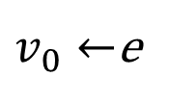
An example of partial sums
8 threads in a single warp
$e←0$
0
1
2
3
4
5
6
7
$$e=v_{0}∗f_{00}+e$$
$$e=v_{1}∗f_{10}+e$$
$$e=v_{2}∗f_{20}+e$$
$$v_{0}$$
$$v_{0}$$
$$v_{0}$$
$$v_{0}$$
$$v_{0}$$
$$v_{0}$$
$$v_{0}$$
$$v_{0}$$
e
e
e
e
e
e
e
e
$$e=shfl_up(e)$$
$$v_{1}$$
$$v_{1}$$
$$v_{1}$$
$$v_{1}$$
$$v_{1}$$
$$v_{1}$$
$$v_{1}$$
$$v_{1}$$
$$e=v_{0}∗f_{01}+e$$
$$e=v_{1}∗f_{11}+e$$
$$f_{00}$$
$$f_{01}$$
$$f_{02}$$
$$e=v_{2}∗f_{21}+e$$
$$v_{2}$$
$$v_{2}$$
$$v_{2}$$
$$v_{2}$$
$$v_{2}$$
$$v_{2}$$
$$v_{2}$$
$$v_{2}$$
$$f_{10}$$
$$f_{11}$$
$$f_{12}$$
$$e=shfl_up(e)$$
$$v_{3}$$
$$v_{3}$$
$$v_{3}$$
$$v_{3}$$
$$v_{3}$$
$$v_{3}$$
$$v_{3}$$
$$v_{3}$$
$$e=v_{0}∗f_{02}+e$$
$$f_{20}$$
$$f_{21}$$
$$f_{22}$$
$$e=v_{1}∗f_{12}+e$$
Register cache
$3×3$ filter
$$e=v_{2}∗f_{22}+e$$
$v_{0}←$e

Slide 25
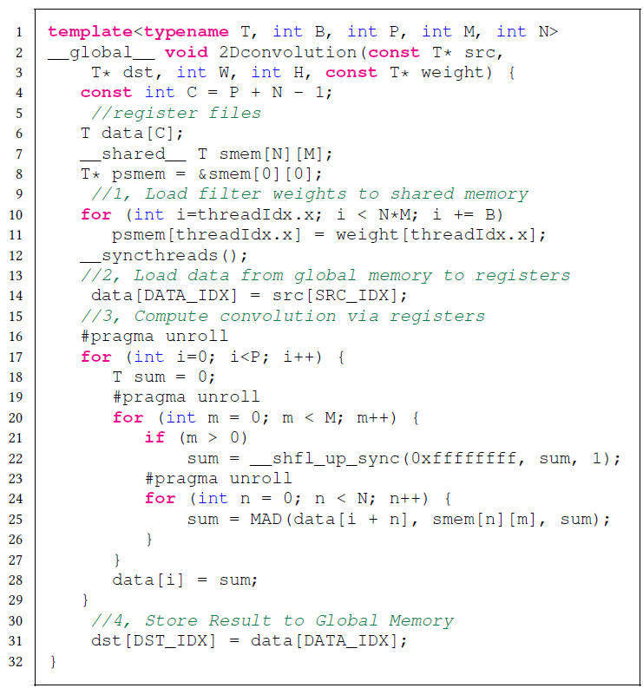
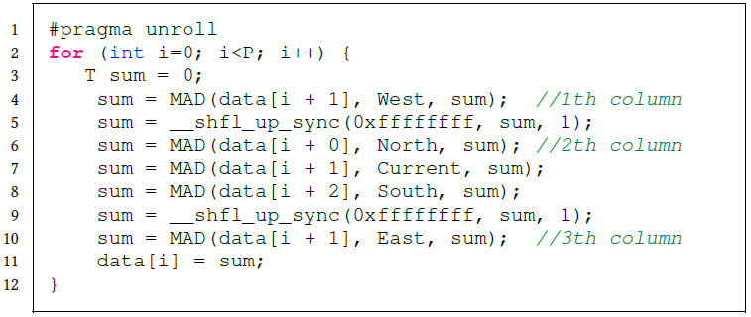
Proposed algorithm on CUDA
T : data type
B : block size
P : number of processed elements by each thread
M : filter width
N : filter height
Registers
Load
Compute
Store
2D convolution CUDA kernel
2D stencil CUDA kernel

Slide 26
Performance model
Micro-benchmarking [1]
  Understand the characteristics of GPUs
  Measure the constant parameters
    Latency of arithmetic operations
    Latency of shared memory
    Latency of shuffle
Justify the performance advance of in-register computation in SSAM
  Convolution kernel as example
  Partial Sums Computation for an element
Guide the design of partial sums transfer path
    The partial sums transfer path is critical to the performance of SSAM
[1] H. Wong, M. Papadopoulou, M. Sadooghi-Alvandi and A. Moshovos, "Demystifying GPU microarchitecture through microbenchmarking," 2010 IEEE International Symposium on Performance Analysis of Systems & Software (ISPASS), White Plains, NY, 2010, pp. 235-246.

Slide 27
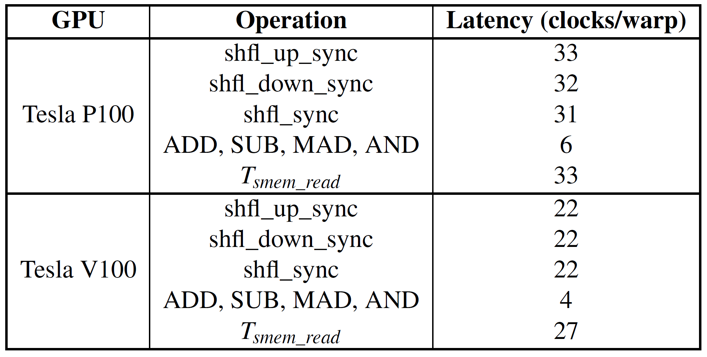
The measured latency of different operations
We report the measured latency results as in table

Slide 28
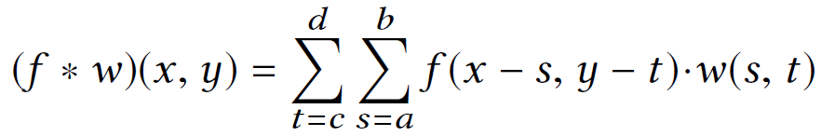
Efficient Partial Sums Computation in SSAM
Where, M=d-c+1, N=b-a+1,
* means convolution, . is multiplication
Using shared memory Latency :
(1)
Using shuffle Latency (SSAM) :
(2)
Carefully design SSAM such that:
  (2) < (1)
  With optimal partial sum paths
  With highest locality

Slide 29
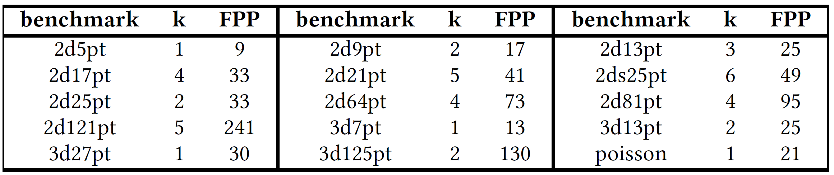
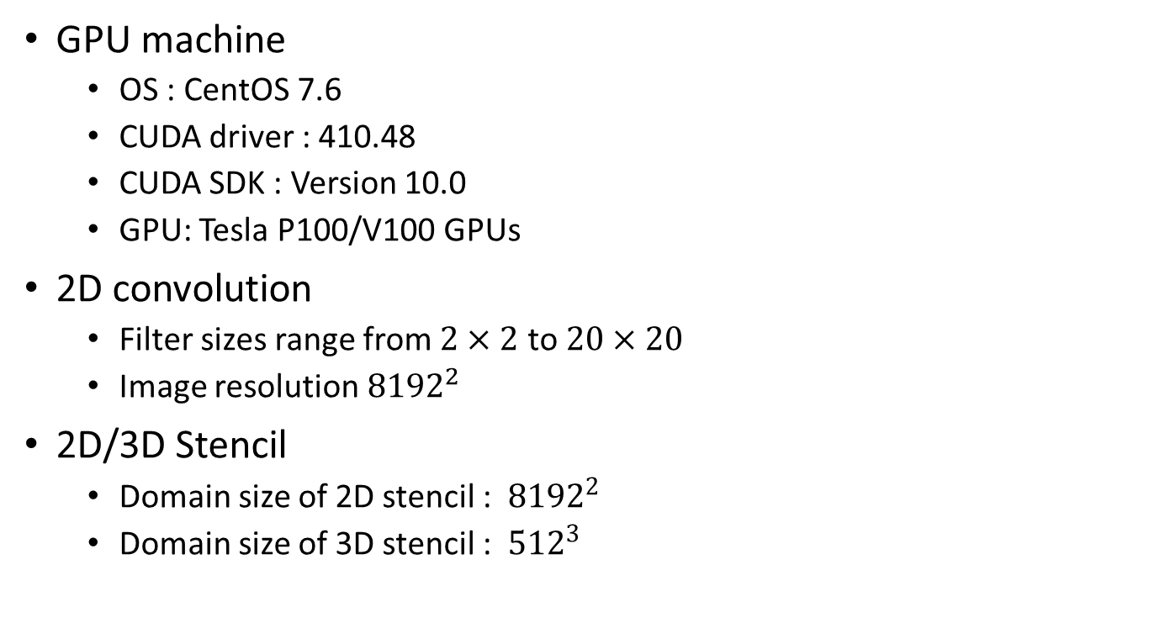
Evaluation Environment
GPU machine
  OS : CentOS 7.6
  CUDA driver : 410.48
  CUDA SDK : Version 10.0
  GPU: Tesla P100/V100 GPUs
2D convolution
  Filter sizes range from $2×2$ to $20×20$
  Image resolution ${8192}^{2}$
2D/3D Stencil
  Domain size of 2D stencil : ${8192}^{2}$
  Domain size of 3D stencil : ${512}^{3}$
k : stencil order
FPP : FLOP per point

Slide 30
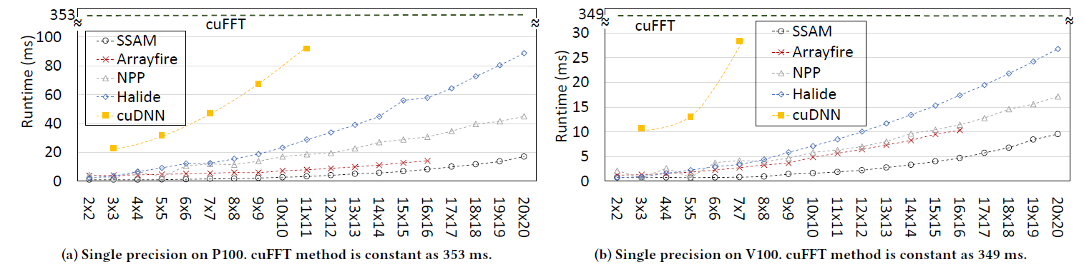
Evaluation for 2D Convolution
2D convolution evaluation in single precision
  Arrayfire, Nvidia NPP, Halide, cuDNN, cuFFT
Observation
  SSAM achieves the highest performance & scalability
  Performance gap become smaller on V100 GPU than P100
The lower, the better

Slide 31
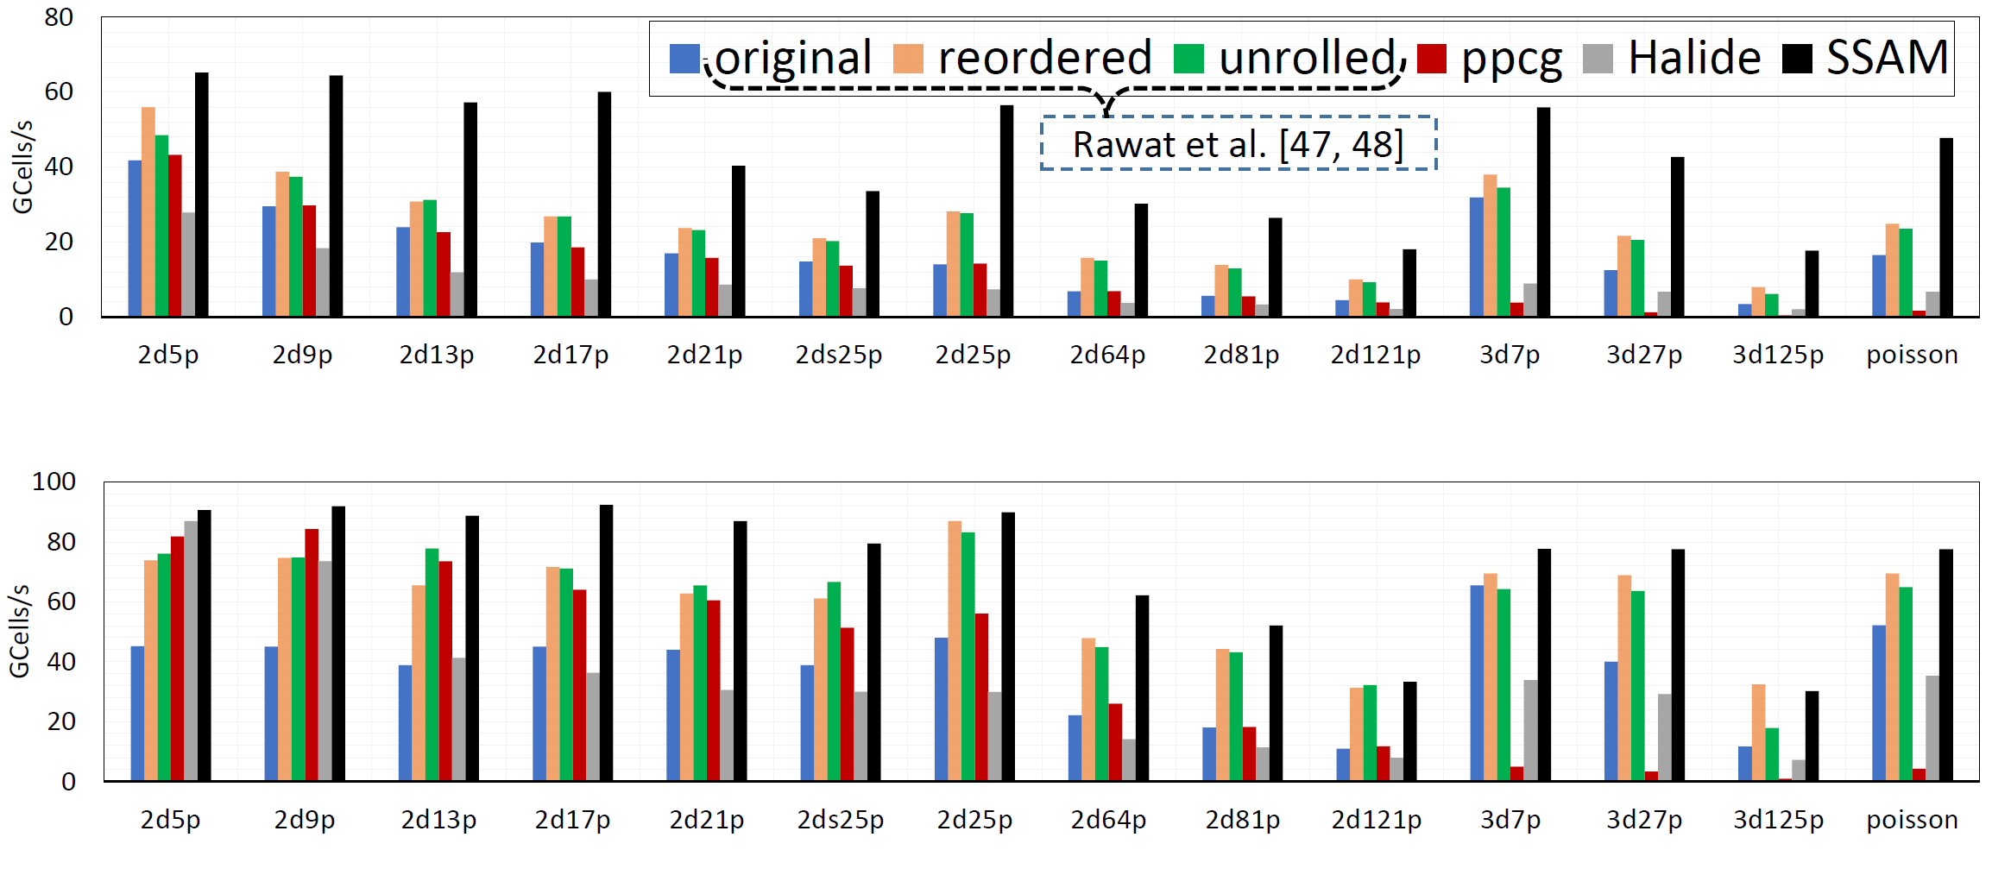
Evaluation for Stencils in Single Precision
Stencils: low order & high order, star shape & box shape , 2D & 3D
“original”, “reordered”, “unrolled” are provided by Rawat et al.
Halide and ppcg can automatically generate code for GPUs
The higher, the better
Single precision on P100 GPU
Single precision on V100 GPU

Slide 32
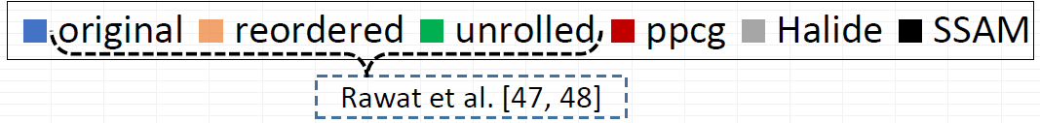
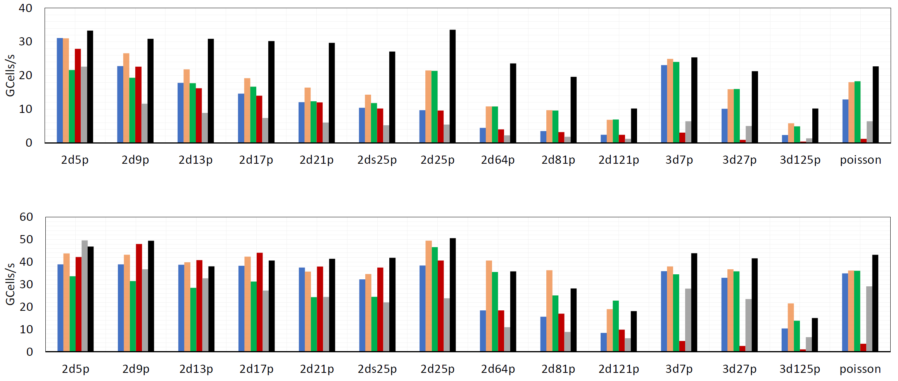
Evaluation for Stencil in Double Precision
Stencils: low order & high order, star shape & box shape , 2D & 3D
“original”, “reordered”, “unrolled” are provided by Rawat et al.
Halide and ppcg can automatically generate code for GPUs
The higher, the better
Double precision on P100 GPU
Double precision on V100 GPU

Slide 33
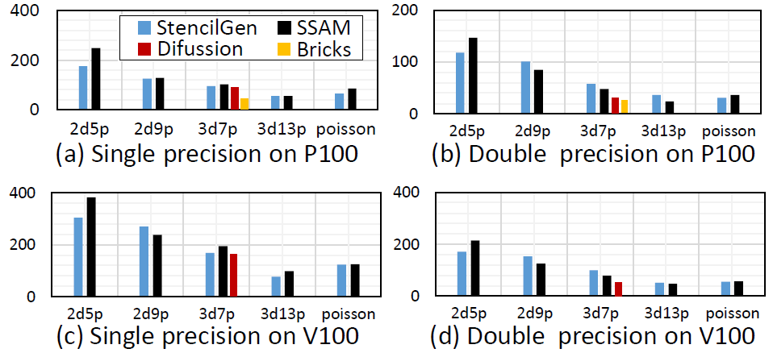
Evaluation for Stencil with Temporal/Spatial Blocking
STENCILGEN, domain-specified DSL for stencil computation (Rawat et al.)
Diffusion, a 3d7pt stencil library, proposed Maruyama, et al.
Bricks, a general stencil library targeting both CPUs and GPUs
GCells/s
The higher, the better
GCells/s

Slide 34
Insight into Pascal and Volta architecture
L1 cache in Volta is enhanced
  The capacity of L1 cache in Volta is more than 7 times larger than Pascal
    V100 has increased up to 128KB
  Access latency of L1 cache, V100 is about 2.8 times faster than the P100
    V100 is 28 cycles vs. P100 is 82 cycles
L2 cache in Volta is improved
  The capacity of L2 cache in V100 increases by 50%
    P100 is 4096KB vs. V100 is 6144KB
  Access latency improves by up to 10%
    P100 is ≤234 cycles vs. V100 is ≤193 cycles
Resulting in narrowing the gap between applications
  Those manually optimized by caching data in registers (or shared memory)
  Those access global memory directly

Slide 35
Conclusion
  Inspired by the mechanism of hardware systolic array
    Build a versatile software systolic array execution model
  Outstanding performance for memory-bound kernels
    2D convolution, 2D/3D stencils, SCAN, Summed Area Table [1], etc.
    Performance of 2D convolution
      2.5x faster than Nvidia’s NPP library
      Up to 1.5x faster than the ArrayFire library
  We should embrace systolic array architecture
    Efficient specialization
  [1] P. Chen, M. Wahib, S. Takizawa, R. Takano and S. Matsuoka, "Efficient Algorithms for the Summed Area Tables Primitive on GPUs," 2018 IEEE International Conference on Cluster Computing (CLUSTER), Belfast, 2018, pp. 482-493.

Slide 36

Future work
Generate SSAM codes automatically using polyhedral model
  Polyhedral model extracts the dependency
Overlap operations
  Load, compute, and store
Register optimization
  Register allocation
  Alleviate register pressure
Experiment with SSAM for compute-bound problems
  Matrix Multiplication
  3D convolution
https://github.com/pengdada/ssam-sc19

