Slide 1








OpenKMC: a KMC Design for a Hundred-Billion-Atom Simulation Using Millions of Cores on Sunway Taihulight
Kun Li*, Honghui Shang*, Yunquan Zhang, Shigang Li, Baodong Wu, Dong Wang, Libo Zhang, Fang Li, Dexun Chen, Zhiqiang Wei
Institute of Computing Technology, CAS
Dalian Ocean University
University of Chinese Academy of Sciences
Jiangnan Institute of Computing Technology
ETH Zurich
National Supercomputing Center in Wuxi
Sensetime Research
Ocean University of China
SC 19
Notes:
Good morning, everyone! My name is LiKun and I’m from Institute of Computing Technology in Chinese Academy of Sciences. The title of our paper is OpenKMC: a KMC Design for a Hundred-Billion-Atom Simulation Using Millions of Cores on Sunway Taihulight. In our work, we design a new software for kinetic Monte Carlo simulation, and propose a series of methods to accelerate it, especially on Sunway Taihulight.

Slide 2
1
INTRODUCTION
2
BACKGROUND
CONTENTS
3
OPTIMIZATION
4
EXPERIMENTS

Slide 3

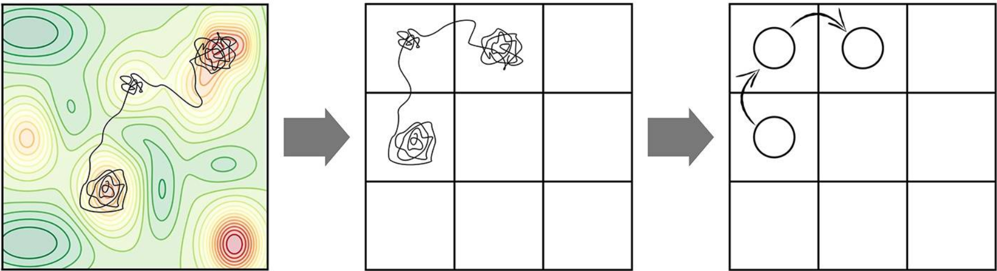
INTRODUCTION
MULTI-SCALE MATERIALS SIMULATION
PHENOMENA
Single displacement cascade
Multiple cascades,
Cascade overlap
Defect and solute migration and clustering
fs
s
TIMESCALE
Molecular dynamics
Kinetic Monte Carlo
LENGTHSCALE
10⁻⁹m
10⁻⁶m
Notes:
Multi-scale materials simulation includes many methods to bridge the wide range of time and length scales. Typical example at the small scale is molecular dynamics, i.e., MD, to describe Single displacement cascade; Slow processes, such as diffusion, cannot be modeled by md. Therefore, At the large scale, kinetic Monte Carlo (kMC) method is used to describe Defect and solute migration and clustering.

Slide 4
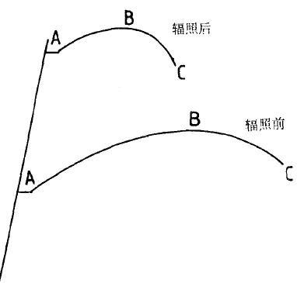
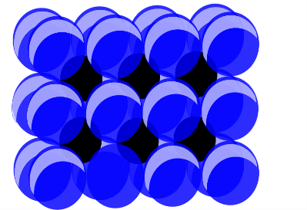
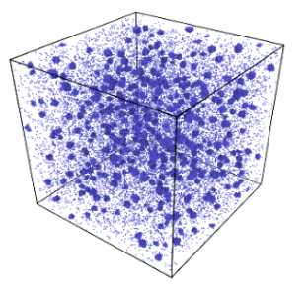
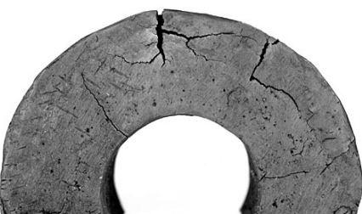
INTRODUCTION
IRRADIATION DAMAGE
Solute atoms (e.g. Cu) in RPV
Point defects jump under neutron irradiation.(e.g. vacancies, interstitials, dislocation loops and debris)
Formation of nanoscale clusters enriched in solute.
Embrittlement of material.
Long term degradation of RPV Steels.
Irradiated
STRESS
Unirradiated
STRAIN
FeCu Alloys
Point defects jump
Cu Precipitates
Embrittlement
Notes:
IRRADIATION DAMAGE can be simulated with the kinetic Monte Carlo software. /Qualitative Representation of Irradiation Effect on Many Metals，For stainless steel exposed to a thermal reactor fluence, the tensile properties show some increase in ultimate strength, an almost twofold gain, and a drop of about a half in ductility.

Slide 5








BACKGROUND
KMC COMPUTATION PROCEDURE
Fe
Cu
Vacancy
Compute the probabilities of all possible hops.
Determine a transition direction.
Perform a hopping diffusion.
Calculate a time increment Δt.
Repeat until the end time.
P₃
P₀
P₂
P₂
P₁
End
Start
Elapsed
Δt

Slide 6
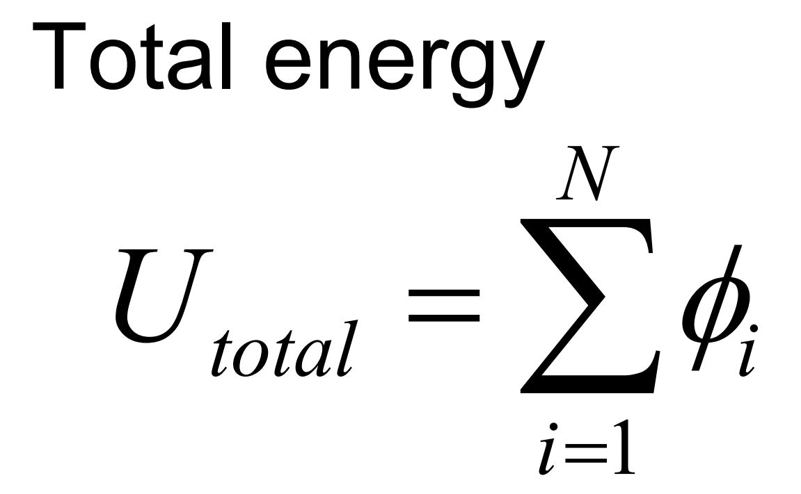
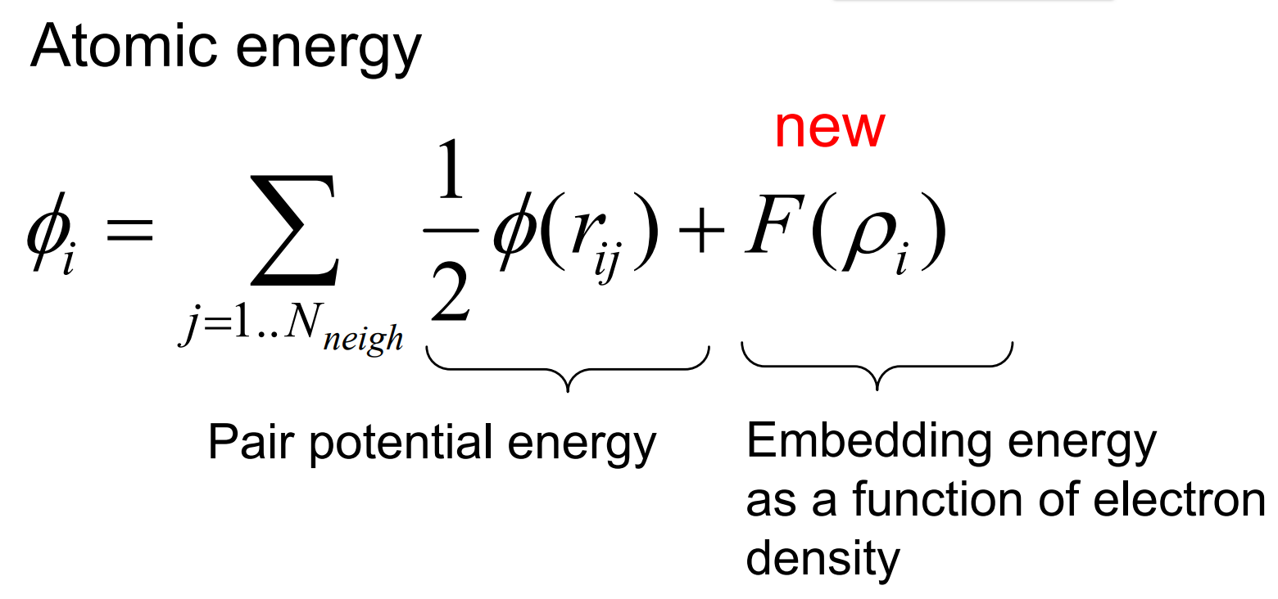
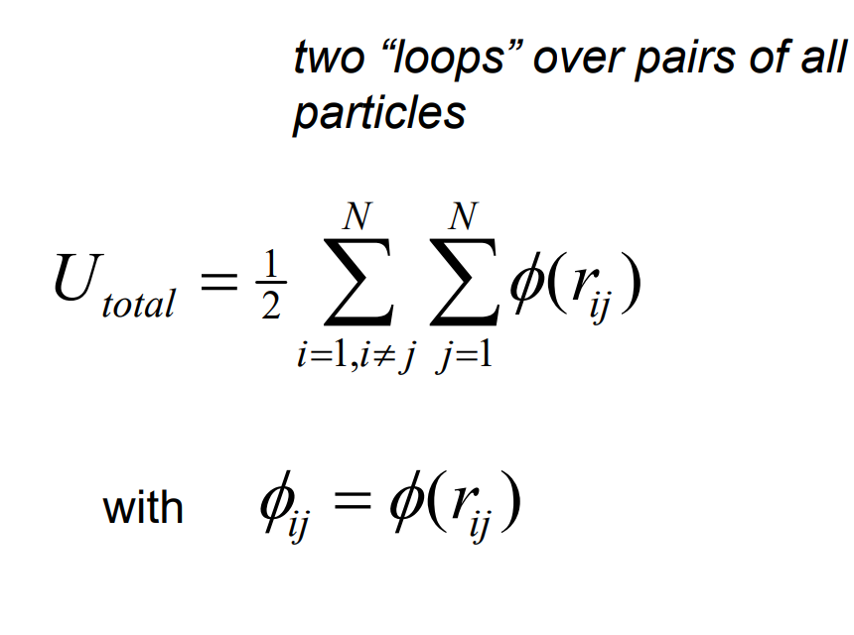
BACKGROUND
POTENTIAL FUNCTION
EAM potential (Embedded-atom Method)
  √ Describe the variation of the bond strength with coordination.
  × Needs to be generated from ab initio calculations.
  × No EAM potential for complex alloys and interstitials.
Pairwise potential
Many-body potential
Pair potential
  √ Deal with complex alloys and the interstitials.
  √ Fast Computational speed.
  × Do not have environmental dependence.
Notes:
When computing energies in the first step, many models have been proposed by using the empirical interatomic potentials. One of the empirical potentials is the embedded-atom method~(EAM)~, where the interaction energy of atoms is contributed by both the pairwise potential and the many-body potential.//Thus we implement the pair potential as shown in the bottom. //The pair potential parameters used in our paper are taken from vincent’s work, and it can reproduce the EAM model result exactly and also be extended in the dilute alloy studies.

Slide 7

BACKGROUND
SYNCHRONOUS SUBLATTICE METHOD
Advantages:
Avoid boundary conflicts for parallelism.
Reduce massive communication in each step.
Synchronous sublattice method:
Data are distributed on all processes.
Processes are organized as a grid.
Each process is divided into sectors.
Simulate in sectors successively.
8 processes
3D processes grid
Sector
______________
Yunsic Shim and Jacques G. Amar. 2005. Semirigorous synchronous sublattice algorithm for parallel kinetic Monte Carlo simulations of thin film growth. Phys.Rev. B 71 (Mar 2005), 125432. Issue 12.
Notes:
To extend the time and length scales of KMC simulation, the parallel KMC algorithm is designed. Here we implement the optimized algorithms based on SPPARKS, and adapted the synchronous sublattice method to solve boundary conflicts. First,~ and second, Consider 8 processes, they are split across a 2*2*2 grid to simulate in 3 dimensions. Then each sub-domain on every process is divided into more fine-grained sectors, typically 8 in 3d. At last, All processes execute events in sequence according to sector number on own sub-domain independently for a period of time. When moving to the computation of the next sector, sites in the boundary region must be updated in advance. Since the sector being simulated is not adjacent on the whole domain, the boundary conflicts are solved.

Slide 8


BACKGROUND
Ghost communication
Simulate in sectors.
Divide ghost regions.
Communication begins every a period t_{syn} .
Update the whole ghost regions for all neighbors in sequence.
1
2
1
2
3
4
3
4
1
2
1
2
3
4
3
4
End
Start
t_{syn}
Notes:
The synchronous time of subdomains is a crucial factor forghost communication. A smaller value of tsyn means the ghost cells are updated frequently, and accurate simulation results are obtained. However, frequent communication brings a poor parallel efficiency since not all communication is necessary. By increasing tsyn, the parallel efficiency is greatly improved, while the lower accuracy of simulation results is now much more pronounced.

Slide 9


OPTIMIZATION
GROUP REACTION STRATEGY
Motivation:
Randomly select and update events in simulation.
Linear scanning scales O(N).
8p_{min}
Selected Group
Group reaction strategy :
N propensities are grouped into G groups.
A group G_{s} is chosen randomly.
Pick i from 1 to N_{local} , r from 0 to p_{localmax}.
If p_{i}<r, reject; p_{i}≥r, accept.
4p_{min}
2p_{min}
p_{min}
2
7
6
1
4
3
9
10
5
8
11
______________
Alexander Slepoy, Aidan P Thompson, and Steven J Plimpton. 2008. A constanttime kinetic Monte Carlo algorithm for simulation of large biochemical reaction networks. The journal of chemical physics 128, 20 (2008), 05B618
Notes:
In each iteration of the KMC simulation, we need to Randomly select and update events according to their probabilities. A common choice is to perform a linear scanning over all the events to select one, which scales as O(N) for the total N events. Here the group strategy is used to reduce the selection time. Firstly, total N propensities from p_{min} to $p_{max}(8p_{min})$ are grouped to G groups. In this case, the upper bounds for each group are $2p_{min}$, $4p_{min}$ and $8p_{min}$ respectively. Secondly, a group Gs is chosen randomly in selection step. Then, within the selected group, we consider a set of 4 reaction propensities with largest value $p_{localmax}$. We pick a uniform random integer $i$ from 1 to 4 and a random value $r$ from 0 to $p_{localmax}$ in this group. A reaction $i$ is rejected if $p_{i}<r$, such as the black minus symbol in Figue. This step will loop until $p_{i}\ge r$ like the green tick symbol, which means the event with the propensity $p_{4}$ is chosen. The time complexity for group strategy is reduced from O(n) to o(1).

Slide 10

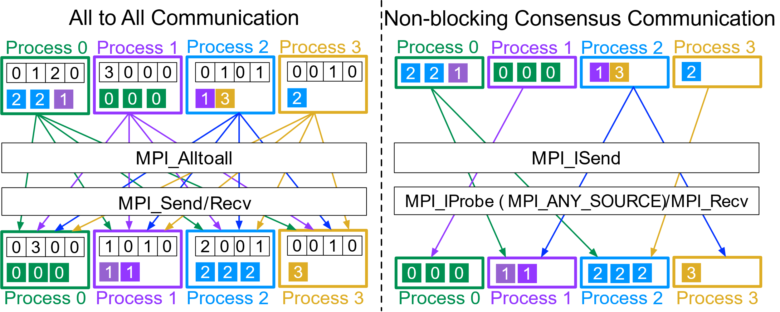

OPTIMIZATION
SELF-ADAPTIVE COMMUNICATION
Motivation:
√ Communication adaptively when boundary updates.
√ Not all neighbor processes are required for communication.
Self-adaptive communication:
Boundary events, communication.
Send data for actual neighbor processes.
Receive data by arrival sequence.
Update in local process.
End
End
Start
Start
For 1 to All Neighbors.
MPI_Send/Recv.
Data>0, MPI_Isend.
MPI_ANY_SOURCE, MPI_Irecv.
Boundary
events
t_{syn}
Self-adaptive communication
Implementation
Notes:
As discussed previously, the ghost communication is hard to guarantee the efficiency and accuracy at the same time. Therefore, we propose a selfadaptive communication algorithm by utilizing the current state of the system including the propensities and hops number to perform communication adaptively.//By using the adaptive algorithm, OpenKMC could obtain a good balance between accuracy and efficiency.

Slide 11
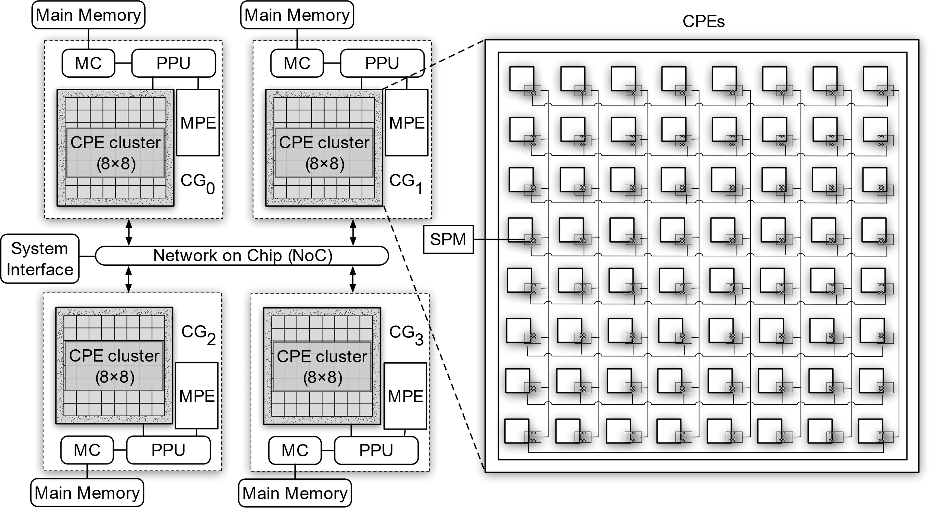
OPTIMIZATION
SUNWAY TAIHULIGHT ARCHITECTURE
Sunway Taihulight:
Peak performance over 125 Pflops.
Enabled by China's custom SW26010 many-core processor.
Each processor consists of 4 core groups (CGs).
Each CG includes 65 cores: 1 management processing element (MPE), and 64 Computing Processor Elements (CPEs).
Fast register communication on CPE mesh.
Notes:
The worldleading supercomputer, Sunway TaihuLight, ranks as the third machine currently in the world and achieves a peak performance over 125 Pflops.It is mainly enabled ~.//For the internal communication of CPE mesh, we have a register communication mechanism including 8column and 8row communication buses respectively.

Slide 12
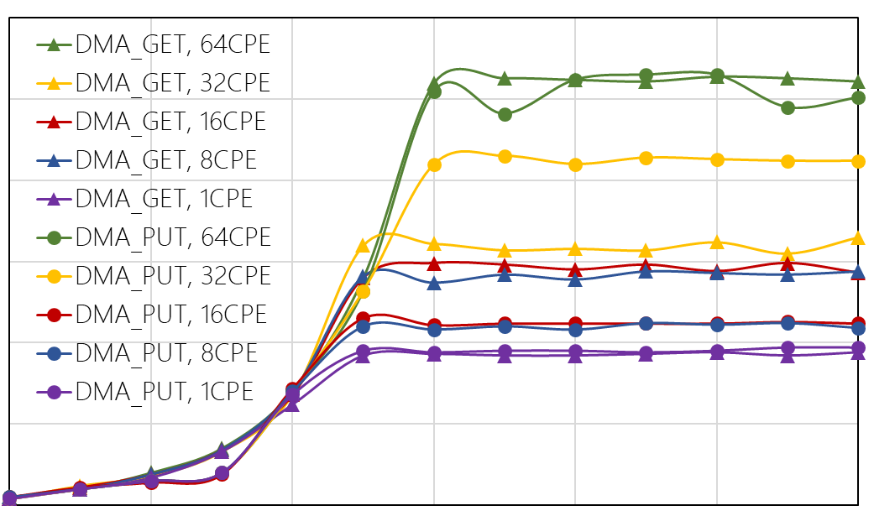
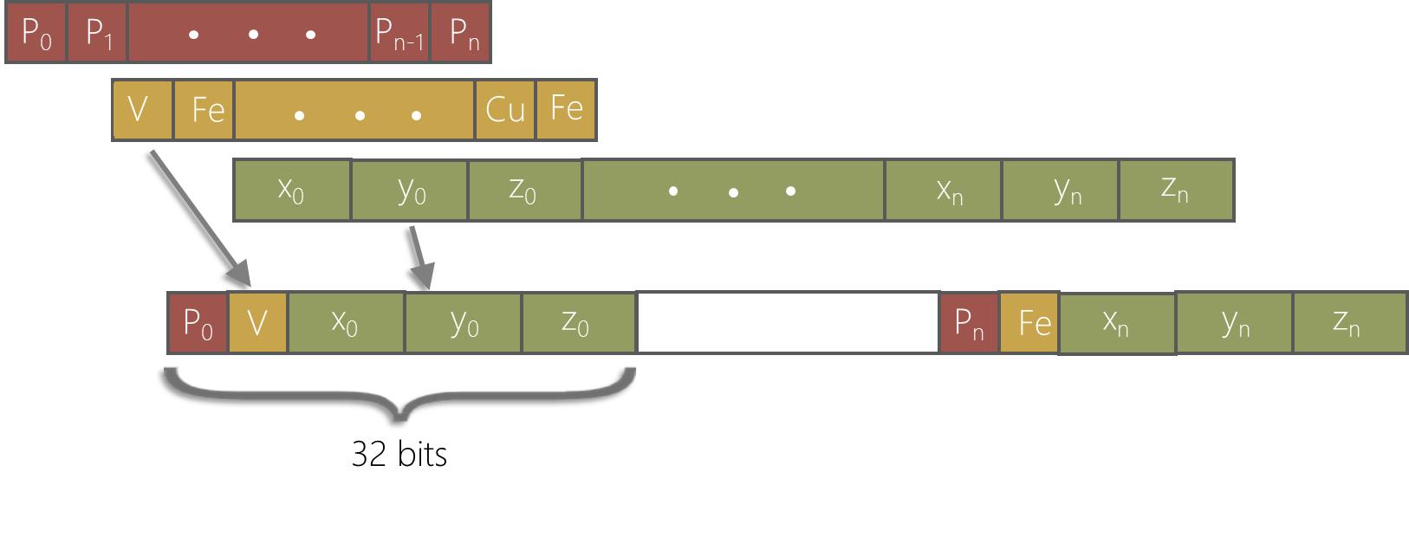
OPTIMIZATION
CACHE OPTIMIZATION STRATEGY
Motivation:
The alignment and size of block is related to performance.
Unformatted block size leads low efficiency.
SoA to AoS:
Reorganize the atom data to new atom data structure of 32 bytes.
Align memory access blocks by 256 bytes (8 atoms).
256 bytes
Bandwidth
block size
Notes:
The left figure shows how bandwidth varies with the data block sizes of strided DMA access for each CPE, when the total accessed data size of each CPE is 32 KB. On Sunway processor, when cache line size is 256 bytes, it will reach the peak bandwidth even if the accessed address is distributed randomly. We consider reorganizing the atom data from soa to aos form and thus, a ~. We extract the essential attributes of a lattice site including ID, type and position, and pack them together into a new atom data structure of 32 bytes for ghost cells. When we fetch cache lines from memory, memory access blocks are always aligned since cache lines are formed by 8 atom data structures. At the same time, we can also make full use of spatial locality of cache because adjacent ghost cells are generally accessed successively.

Slide 13
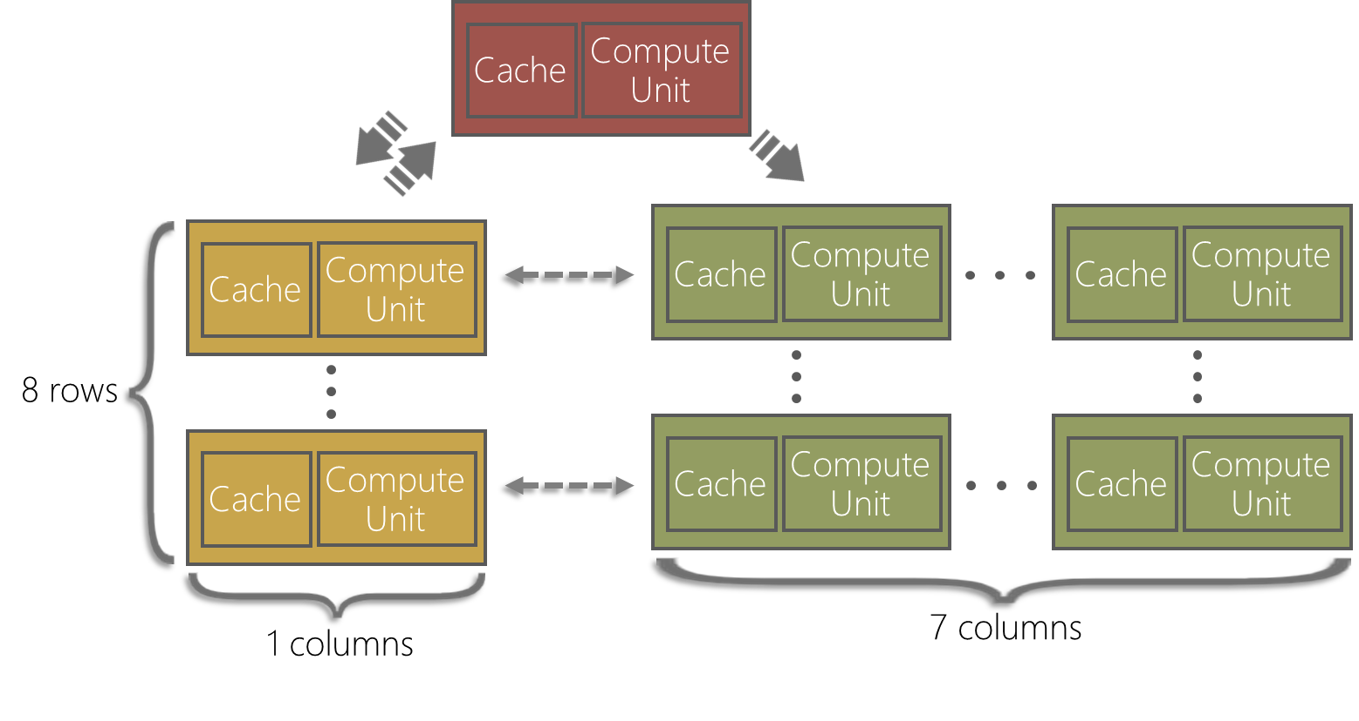
OPTIMIZATION
MANY-CORE OPTIMIZATION
Motivation:
Complex probability and distance computation in KMC.
Powerful computation ability on CPEs.
Many-core accelation:
Data are copied from MPE to CPEs.
Computing on CPEs.
Further judgement and formatting via fast register communication.
Results return to MPE.
Notes:
In order to further improve the performance of OpenKMC, we propose an algorithm to utilize the CPEs on Sunway processor. First, we define the MPE as a template, the left 8 CPEs in yellow color as messengers, and the right 7*8 CPEs as translation CPEs. Then the data are copied from MPE to CPEs; Next, the data are computed on translation CPEs and then copied to messenger CPEs for further judgement and formating via fast register communication; finally, the results are transferred back from the messenger CPEs to the MPE. Through decoupling the computation process of MPE and assigning different roles on CPEs precisely, all CPEs work with its own designated task, and the KMC simulation is accelerated efficiently by very fast register communication.

Slide 14
OPTIMIZATION
VECTORIZATION Ⅰ
Motivation:
Cache efficiency: A single atom is on a single cache line with 256 bytes.
Memory access efficiency: Load coordinates by a single vector-load instruction.
Vectorization for distance calculation :
Calculating the difference between the coordinates of the hop and vacancy.
Perform 4 times for 4 vacancies.
4 registers are transposed to obtain 3 registers.
Obtain 4 squared distances for 4 pairs.
d₁
d_{x1}
d_{y1}
d_{z1}
d_{x}
h
x_{h}
y_{h}
z_{h}
d_{x4}
d_{x3}
d_{x2}
d_{x1}
d₂
d_{x2}
d_{y2}
d_{z2}
2
2
2
2
2
d₄
d₃
d₂
d₁
x_{v}
y_{v}
z_{v}
d_{y}
d_{y4}
d_{y3}
d_{y2}
d_{y1}
d
v
d₃
d_{x3}
d_{y3}
d_{z3}
d
d_{x}
d_{y}
d_{z}
d_{z}
d_{z4}
d_{z3}
d_{z2}
d_{z1}
d₄
d_{x4}
d_{y4}
d_{z4}
Notes:
We also implement vectorization in our work using the vector registers on Sunway processors. One is the cache efficiency. This data structure ensures that the data for a single atom will be on a single cache line with 256- bit width. The other is the memory-access efficiency. Since the data are aligned on 256-bit boundaries, the coordinates or momenta of a single atom can be moved to the vector register by a single vector-load instruction.

Slide 15
OPTIMIZATION
VECTORIZATION Ⅱ
Vectorization for probability calculation :
Determine the vacancy and its neighbors.
8 neighbors in a cache line.
Transpose on 4 neighbors a time;
Vectorization for parameters in formula.
Obtain 4 probabilities for 4 pairs.
Repeat once for the other 4 pairs.
E_{v}
EV_{v}
ER_{v}
ES_{v}
EV_{v}
EV_{v}
EV_{v}
EV_{v}
EV_{v}
P₁₄
p₄
p₃
p₂
p₁
E₁
EV₁
ER₁
ES₁
EV_{n}
EV₄₄
EV₃
EV₂
EV₁
P₅₈
p₈
p₇
p₆
p₅
E₂
EV₂
ER₂
ES₂
E₃
EV₃
ER₃
ES₃
Jump probabilities
E₄
EV₄
ER₄
ES₄
Notes:
The figure shows ~. By using SIMD operations, we exploit data-level parallelism and it leads a more efficient computation on CPEs.

Slide 16
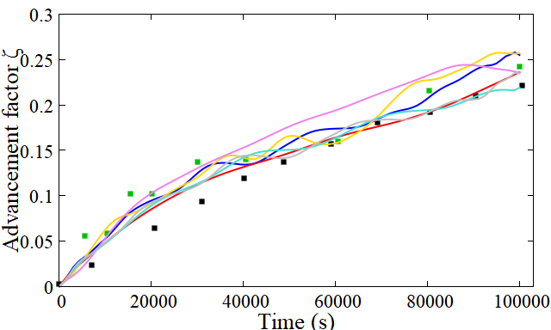
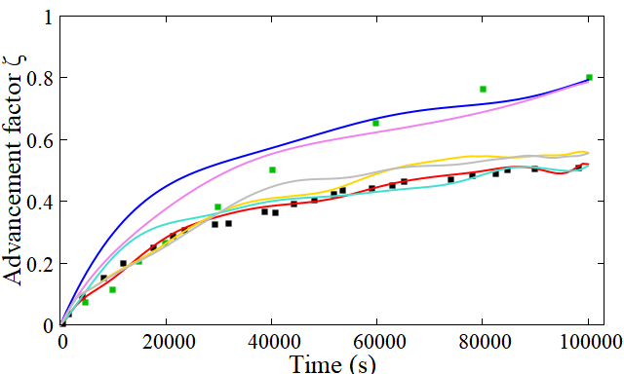
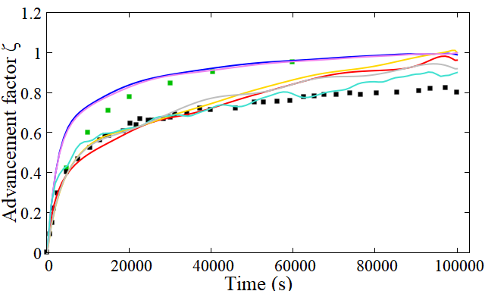
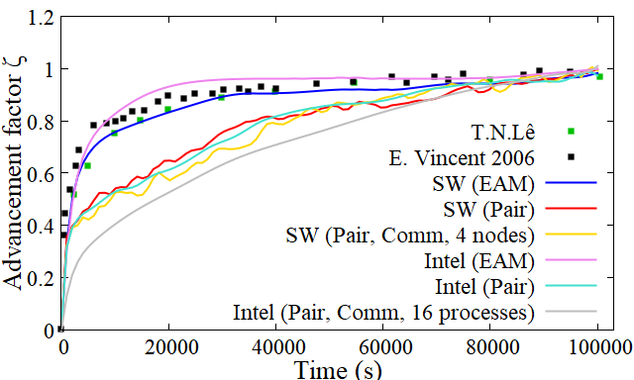
EXPERIMENTS
CORRECTNESS VALIDATION
Thermal ageing simulations between 663 and 773 K on different architectures.
Cu precipitates progressively and the OpenKMC reproduce globally well the Vincent’s work.
Describe well with the experimental results in a qualitative way.
663K
693K
733K
773K
Notes:
In order to validate the accuracy of OpenKMC,a series of thermal ageing simulations have been performed between 663 and 773 K on Sunway and Intel architecture compared to the experiments of TN as well as the simulation results of Vincent.
It is clear that the Cu precipitates progressively during the thermal aging simulation and the precipitation kinetics predictions of our OpenKMC reproduce globally well the Vincent's work on both architectures. As for the comparison with the experimental results,the simulation well describes the evolution of the system in a qualitative way, although some deviation still exists, which comes from the simplified model.

Slide 17
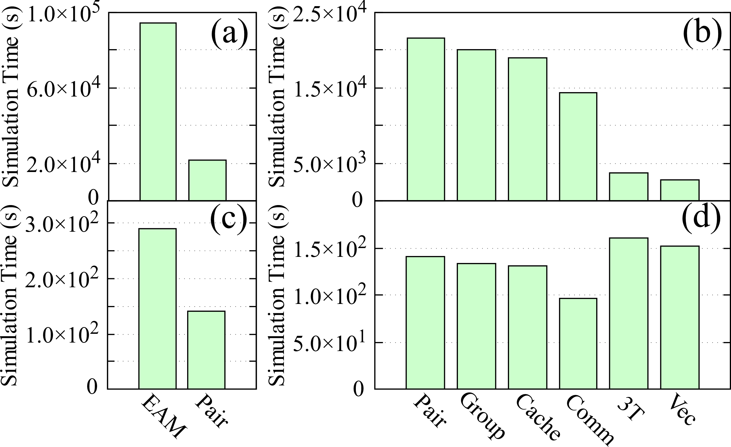
EXPERIMENTS
SINGLE NODE EVALUATION Ⅰ
High concentration(a,b) vs Low concentration(c,d) .
Dramatic acceleration for pair potential.
Reduced communication time.
Different effects by many-core optimization.
Negative optimization caused by insufficient computation task.
4.4x
7.8x
vacancy concentration: 12.8%
vacancy concentration: 8×10−4%
Notes:
demonstrates the performance improvements for different kinds of optimization methods with high and low concentration respectively on one SW26010 node.// the potential of many-core resources is not fully tapped and the employment of CPEs brings in extra overhead. //At last, the final design is 7.76 times faster than the first pair potential version in b) and gain a more than 33.88 fold overall speedup compared to the original EAM version in (a) with a higher vacancy concentration.

Slide 18
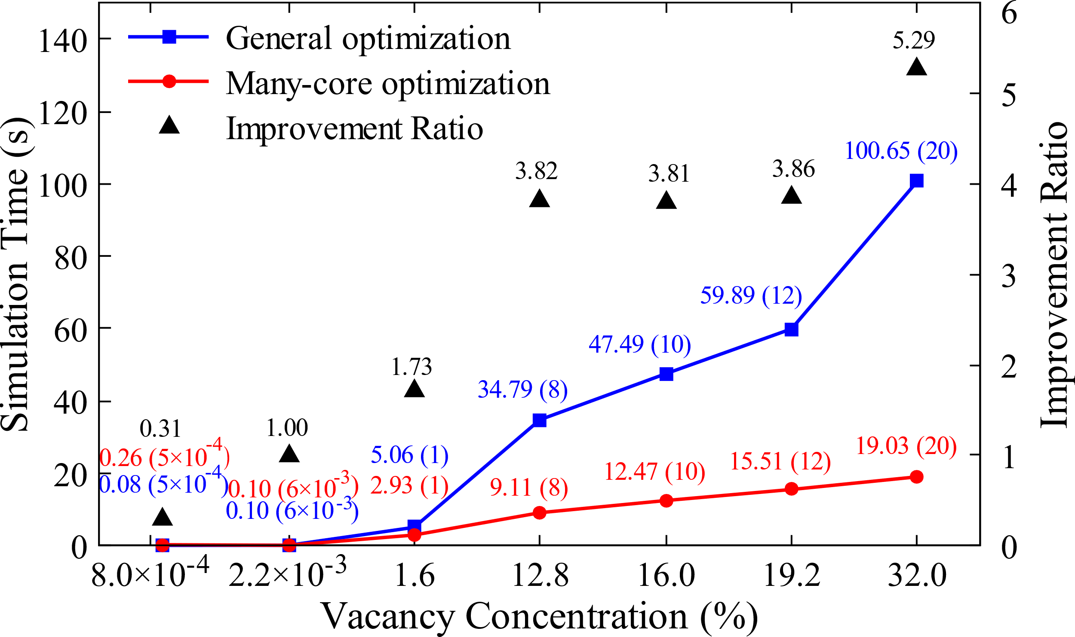
EXPERIMENTS
SINGLE NODE EVALUATION Ⅱ
Negative optimization occurs when vacancy concentration less than 2.2×10⁻³%.
Speedup: 5.29x to general optimization.
Performance depends on the number of vacancies per CPE (The time for many-core initialization and data communication neutralize benefits in small computation task).
Notes:
It is because when the number of the vacancies is too low, the amount of the computational tasks allocated to each core is so small, the time for many-core initiation and data communication occupies a large proportion of the simulation time.// when the vacancy concentration increases to 32.0 at.\%, the performance number even reach 5.29. //Therefore, when the total number of atoms in the system is sufficiently large, the performance number of the many-core optimization can still be satisfactory even at a very low concentration of vacancies.

Slide 19
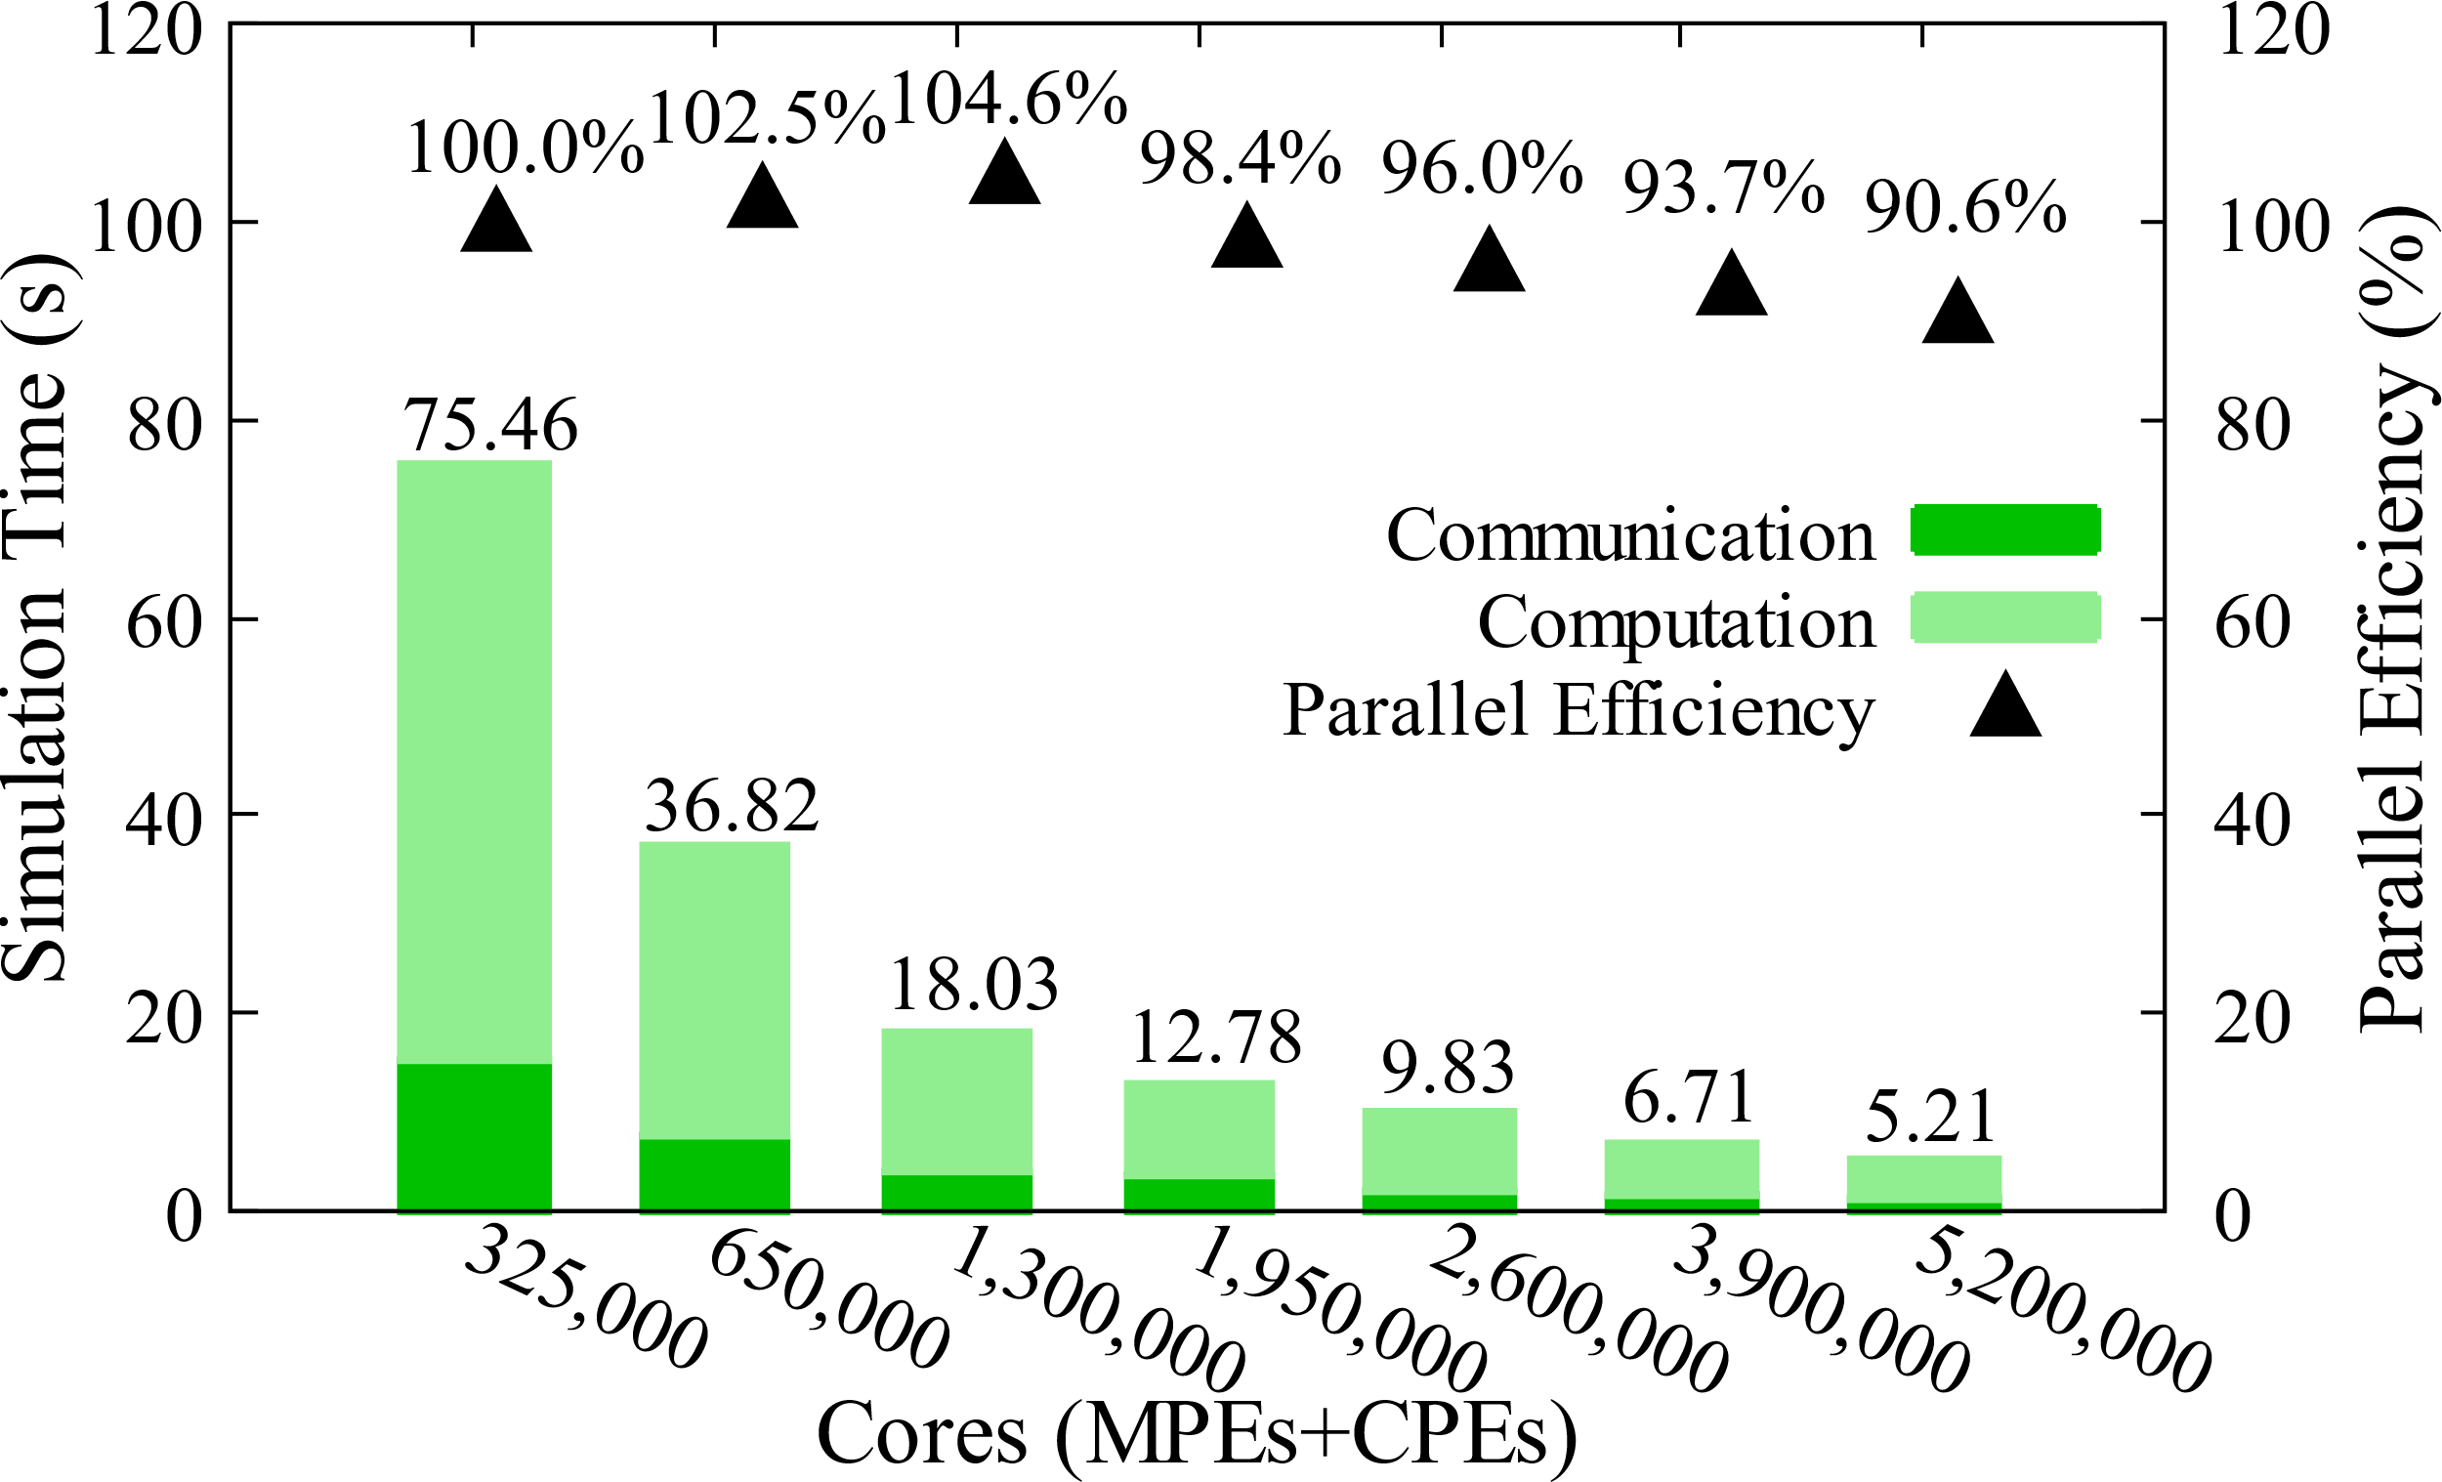
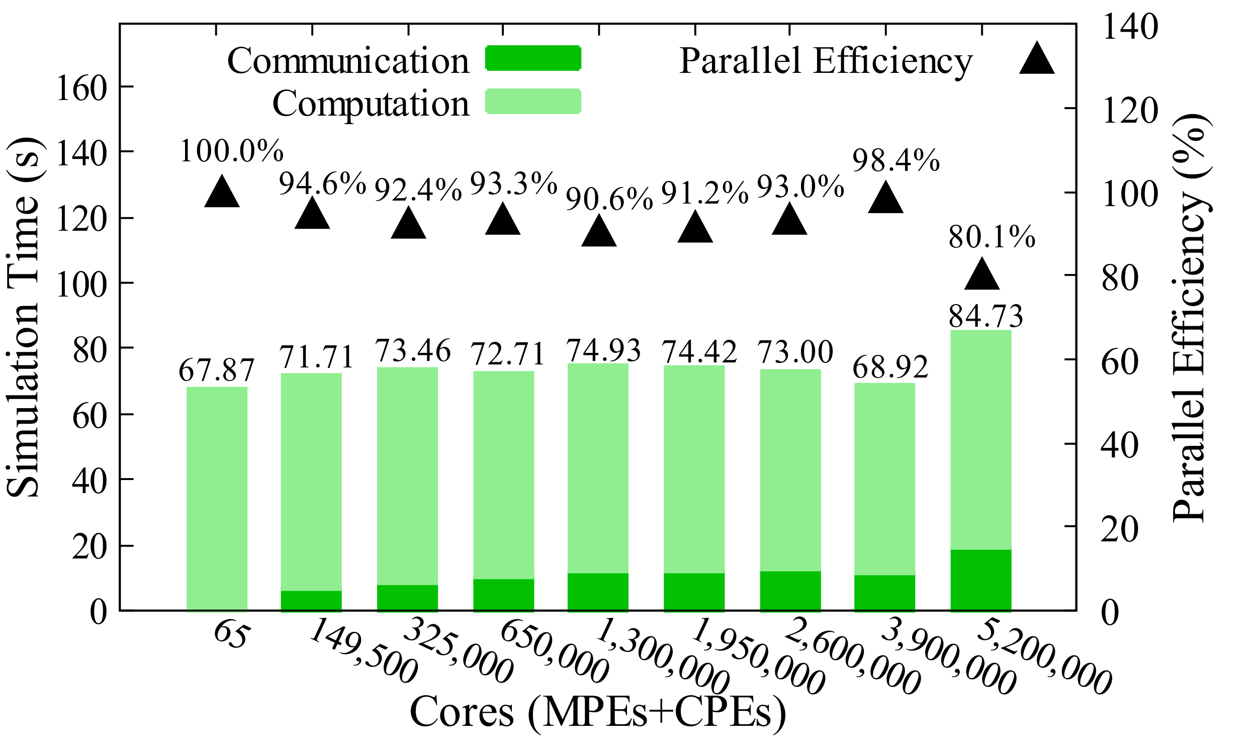
EXPERIMENTS
SCALABILITY Ⅰ
Strong scaling:
A case of 54 billion (5.4×10¹⁰) atoms is presented.
Length scale: 86 um
Parallel efficiency is around 90% for 5.2 million cores.
Weak scaling:
11 million (1.1×10⁷) atoms per process, total 840 billion (8.4×10¹¹) atoms finally.
Length scale: 214 um
Parallel efficiencies above 90% when cores less than 3.9 billion.
Notes:
we introduce a larger number of vacancies within these configurations.// This illustrates that OpenKMC has the ability to simulate a large-scale physical system with large-scale parallelism.

Slide 20
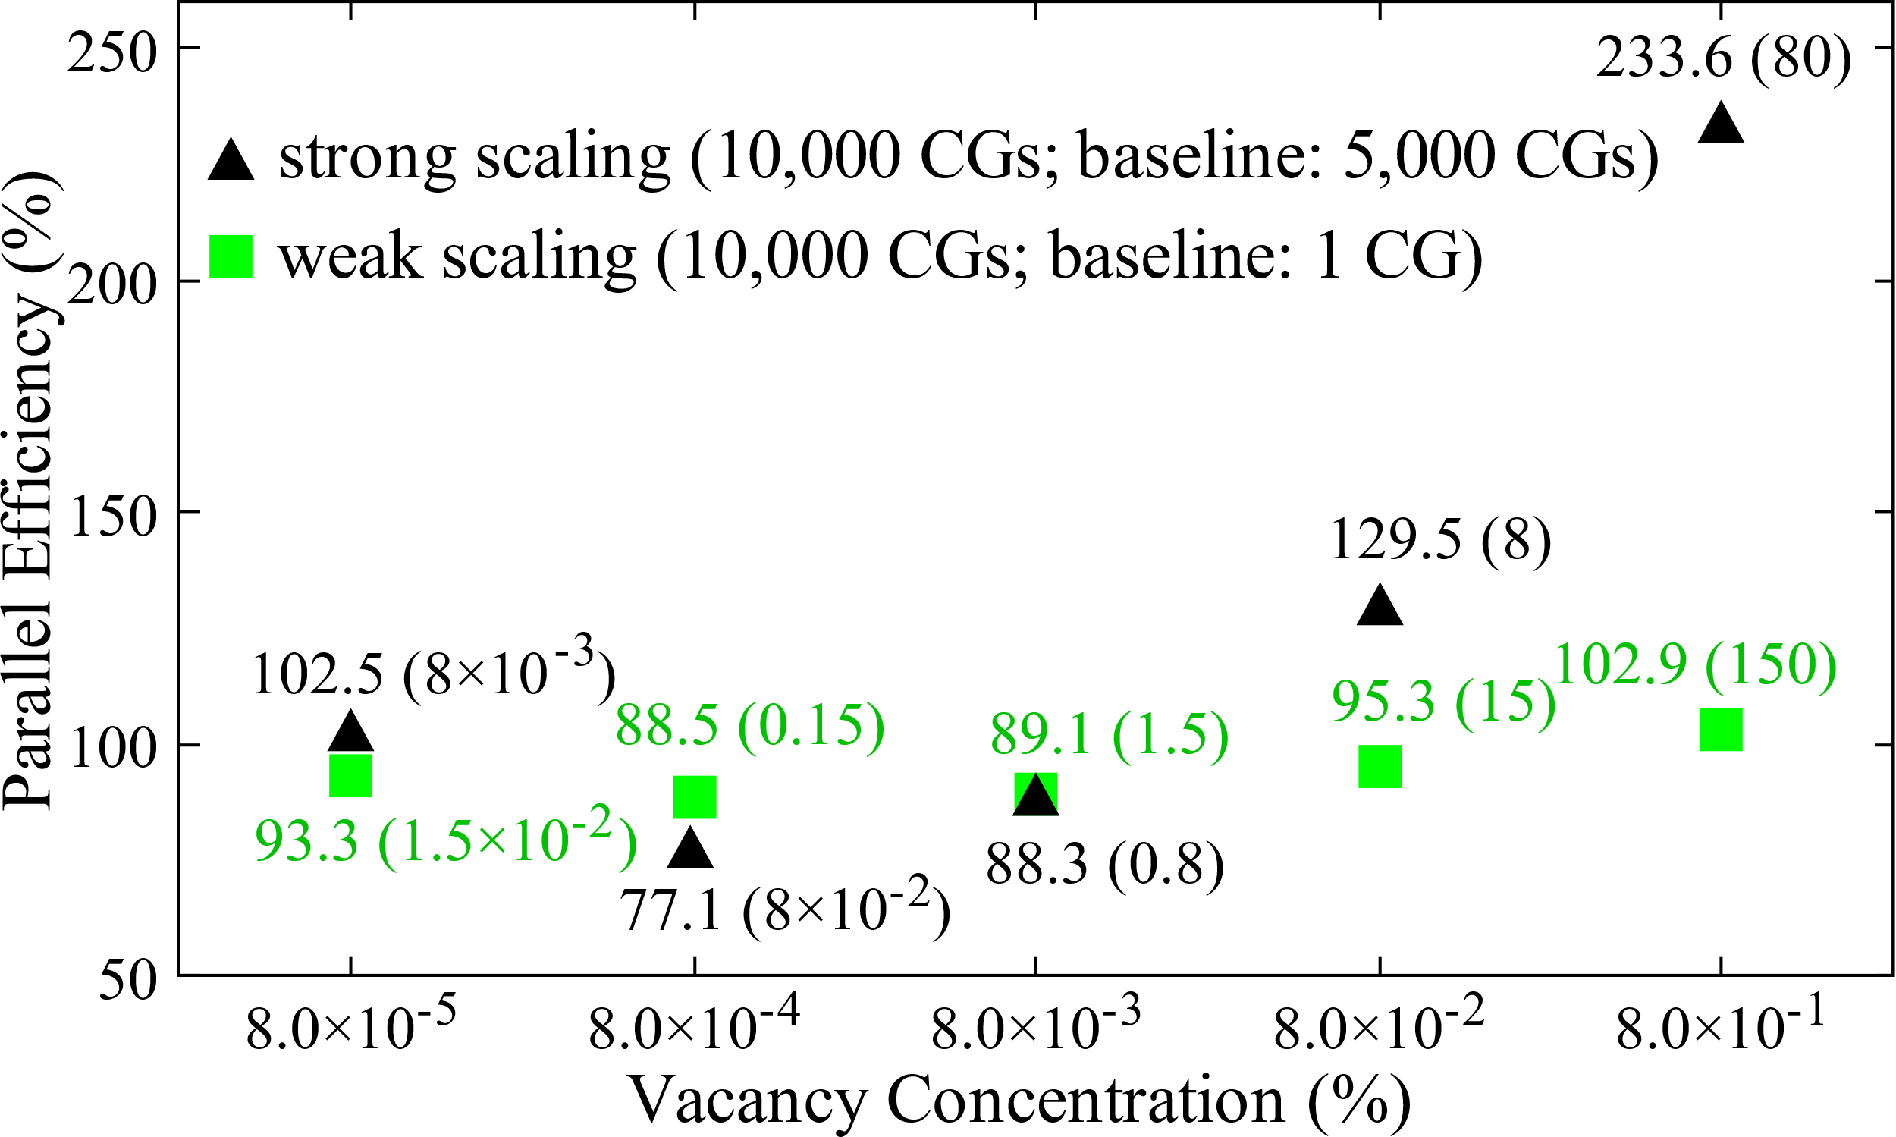
EXPERIMENTS
SCALABILITY Ⅱ
Scaling studies at various vacancy concentrations.
Lowest parallel efficiencies are 77.1% and 88.5% at 8.0×10⁻⁴% for both scalabilities.
Strong scaling is 233.6% at 8.0×10⁻¹% due to sufficient vacancies (80 per CPE).
Notes:
we have also performed the scaling studies at various vacancy concentrations with the Cu concentration and the temperature (573 K) fixed.

Slide 21
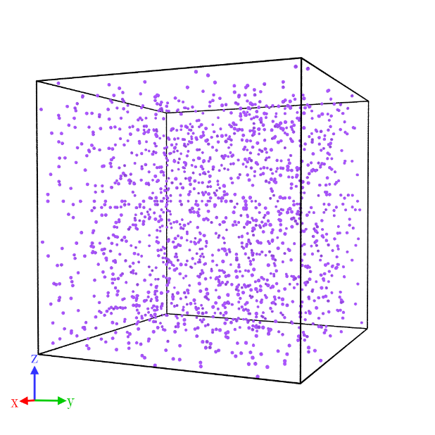
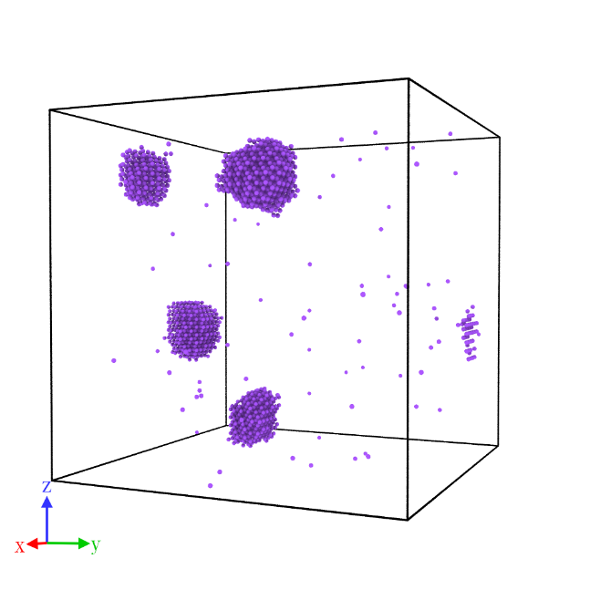
EXPERIMENTS
VISUALIZATION
Thermal aging of Fe-1.34Cu(at.%) at 663K for 100 years (Simulation time: 13.07s).
Cu atoms are distributed randomly in original state.
Precipitations with the biggest Cu clusters composed of 542 atoms in final state.
(a) Original State
(b) Final State
Notes:
The formation of Cu precipitates in different size is coherent with the thermodynamic theory, as was explained by Vincent’s work. Thus, the result obtained with long-time evolution is another powerful evidence for the validity of OpenKMC.

Slide 22
Thanks!

Slide 23
Q&A
OpenKMC: a KMC Design for a Hundred-Billion-Atom Simulation Using Millions of Cores on Sunway Taihulight
Kun Li*, Honghui Shang*, Yunquan Zhang, Shigang Li, Baodong Wu, Dong Wang, Libo Zhang, Fang Li, Dexun Chen, Zhiqiang Wei
Institute of Computing Technology, CAS
Dalian Ocean University
University of Chinese Academy of Sciences
Jiangnan Institute of Computing Technology
ETH Zurich
National Supercomputing Center in Wuxi
Sensetime Research
Ocean University of China
SC 19
Notes:
Good morning, everyone! My name is LiKun and I’m from Institute of Computing Technology in Chinese Academy of Sciences. The title of our paper is OpenKMC: a KMC Design for a Hundred-Billion-Atom Simulation Using Millions of Cores on Sunway Taihulight. In our work, we design a new software for kinetic Monte Carlo simulation, and propose a series of methods to accelerate it, especially on Sunway Taihulight.

Slide 24
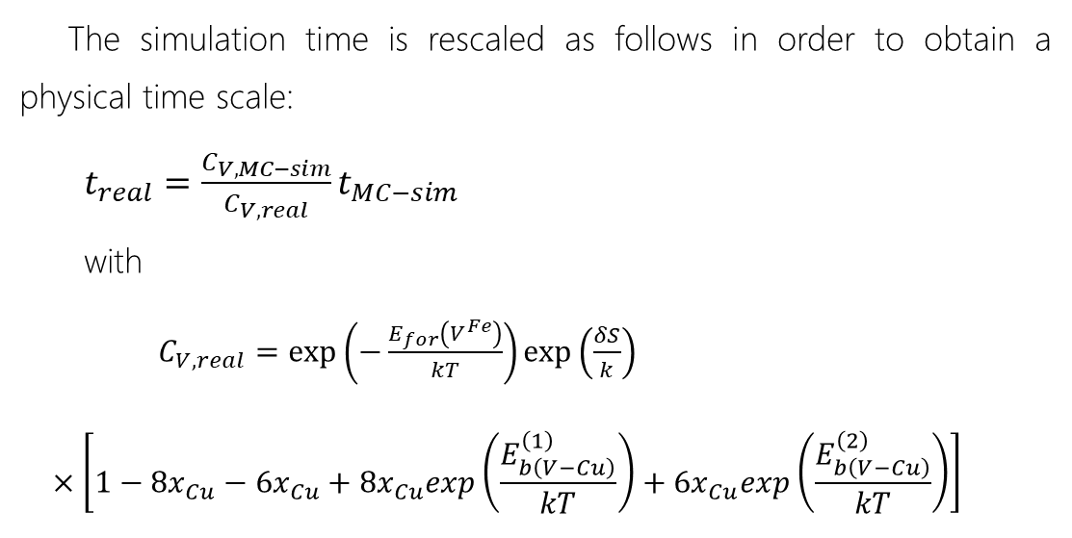
Q&A
RESCALED TIME
The simulation time is rescaled as follows in order to obtain a physical time scale:
$t_{real}=\frac{C_{V,MC−sim}}{C_{V,real}}t_{MC−sim}$
with
$C_{V,real}=\exp\left(−\frac{E_{for}\left(V^{Fe}\right)}{kT}\right)\exp\left(\frac{δS}{k}\right)$
$$×\left[1−{8x}_{Cu}−{6x}_{Cu}+{8x}_{Cu}exp\left(\frac{E_{b\left(V−Cu\right)}^{\left(1\right)}}{kT}\right)+{6x}_{Cu}exp\left(\frac{E_{b\left(V−Cu\right)}^{\left(2\right)}}{kT}\right)\right]$$
______________
Vincent, E and Becquart, CS and Domain, C. 2006. Solute interaction with point defects in a Fe during thermal ageing: A combined ab initio and atomic kinetic Monte Carlo approach. Journal of nuclear materials 351, 20 (2006)
Notes:
The equation giving Cv,real takes into account the solute X concentration, xx, and the vacancy-solute binding energies in order to obtain, from the vacancy formation energy in the Fe-X binary alloy. ^S/k equals 2 after the work of Mathon on the Fe-Cu system.

