Slide 1
Understanding Congestion in High Performance Interconnection Networks Using Sampling
SC’19
Philip A. Taffet, John Mellor-Crummey
Rice University
November 20th, 2019

Slide 2
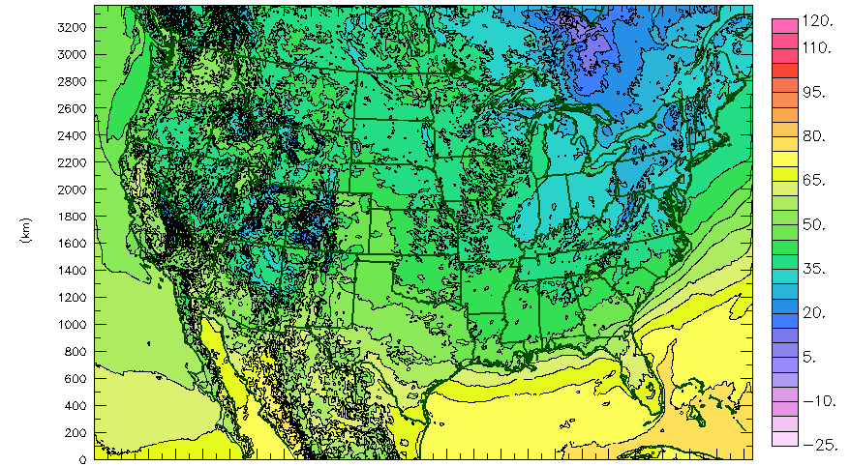
Motivation
Image source: www.caps.ou.edu

Slide 3

Motivation

Slide 4
% Runtime
 | 5%
 | 3%
 | 11%
 | 9%
 | 42%
compute_atmosphere_temp();
compute_ground_temp();
compute_wind_speed();
move_clouds();
send_boundary_to_neighbors();
Why?
Notes:
You bought a really fast network. Why isn’t it working like a really fast network?
This is a problem we kept running into with HPCToolkit. If we treat the network as a black box, it’s hard to get much insight. We talked to the vendors, but they didn’t know how (or were unwilling) to give us more diagnostic information with a low enough cost that they’d find it acceptable.

Slide 5
High level goal
Enable tools that help developers analyze and tune the communication performance of their applications
Capture information about where, when, and why congestion is occurring
Notes:
If they can understand their performance problems, they can fix the performance problems, so their programs will run faster, and they can do more science, whether that’s predicting the weather with higher accuracy, or building a better rechargeable battery.

Slide 6
State of the art in communication performance analysis tools
Correlate per-packet stage latencies, events on switches, calling contexts based on ID stored in packet [Yoga, Perf. Modeling, Benchmarking and Simulation of HPC Systems, 2017]
INAM² combines normal InfiniBand switch counters, MPI process-level counter, and static route information. [Subramoni, High Performance Computing 2016]
Notes:
Polls switches to inspect traffic and congestion counters
INAM can’t relate measurements back to program
Wrapping MPI calls
Yoga & Chabbi not available on current hardware
Out of band data
We can tied back measurement about the packet to the code

Slide 7
Weaknesses of the current state of the art
Centralized collection server, privileged system access
INAM:
  Traffic and congestion not associated with program context
Yoga & Chabbi:
  Collected information is O(path length), not O(1)
Node-level tools:
  Traffic and congestion information not associated with network topology
Notes:
If we can store data in packets themselves, that solves the first two problems, as we’ll see, but since packets can’t change length, how can we store variable length data in them? What about storing a fixed-sized random sample of all the data we want? Is there an algorithm for taking a random sample on-the-fly from a variable amount of data?

Slide 8
High level goal
Enable tools that help developers analyze and tune the communication performance of their applications
Capture information about where, when, and why congestion is occurring
Sample the links through which a packet passes
  Collect a small amount of performance information about one link
  Store performance information in the packet itself
Notes:
If they can understand their performance problems, they can fix the performance problems, so their programs will run faster, and they can do more science, whether that’s predicting the weather with higher accuracy, or building a better rechargeable battery.

Slide 9
Outline
Background and motivation
Reservoir sampling for measuring network traffic and congestion
Low-overhead variant using compact probabilistic encoding
Diagnosing communication performance issues
Case Study: miniGhost
Conclusions and future work

Slide 10

Reservoir sampling
Collect a uniform random sample of size $n=3$ from sequence of arbitrary length
Sequence might be too large to store; collect sample on the fly as sequence streams by
Red
Blue
Green
Black
Orange
Purple
Reservoir
[Knuth, TAOCP, 1981]

Slide 11

Reservoir sampling
Step 1: Fill the reservoir with the first $n$ elements
Red
Blue
Green
Black
Orange
Purple
Reservoir
[Knuth, TAOCP, 1981]

Slide 12
Reservoir sampling
Step 1: Fill the reservoir with the first $n$ elements
Black
Orange
Purple
Red
Blue
Green
Reservoir
[Knuth, TAOCP, 1981]

Slide 13

Reservoir sampling
Step 2: The $t$^{th} record enters the reservoir with probability $n/t$ ($3/4$ for indicated record)
  Step 2a: If it will be stored in the reservoir, pick an element to replace uniformly randomly
Black
Orange
Purple
Red
Blue
Green
Step 2: YES
Step 2a: Replace 2nd element
Reservoir
[Knuth, TAOCP, 1981]

Slide 14

Reservoir sampling
Step 2: The $t$^{th} record enters the reservoir with probability $n/t$ ($3/5$ for indicated record)
  Step 2a: If it will be stored in the reservoir, pick an element to replace uniformly randomly
Orange
Purple
Red
Blue
Black
Green
Step 2: NO
Step 2a: -
Reservoir
[Knuth, TAOCP, 1981]

Slide 15

Reservoir sampling
Step 2: The $t$^{th} record enters the reservoir with probability $n/t$ ($3/6$ for indicated record)
  Step 2a: If it will be stored in the reservoir, pick an element to replace uniformly randomly
Orange
Purple
Red
Blue
Black
Green
Step 2: YES
Step 2a: Replace 1st element
Reservoir
[Knuth, TAOCP, 1981]

Slide 16
Reservoir sampling
Step 2: The $t$^{th} record enters the reservoir with probability $n/t$ ($3/6$ for indicated record)
  Step 2a: If it will be stored in the reservoir, pick an element to replace uniformly randomly
Orange
Red
Purple
Blue
Black
Green
Reservoir
[Knuth, TAOCP, 1981]

Slide 17
Reservoir sampling
Step 3: Return final reservoir contents
Purple
Orange
Black
Green
Red
Reservoir
Blue
We employ reservoir sampling with a reservoir of size 1
[Knuth, TAOCP, 1981]

Slide 18
Reservoir sampling for measuring network traffic and congestion
Packet
Source: 0, destination: 99, sequence #, other headers
Switch 2
Traffic Reservoir
Link: — hop count: 1
Congested?: No
!
!
Leaf Switch 1
Leaf Switch 3
Packet data
Packet
Compute Node 0
Compute Node 99
Notes:
We’re taking a sample of size 1 from the set of links that the packet passes through
Understand how often packets pass through individual links, and where congestion arises
Adaptive routing means path is not deterministic. If there’s a single path, we want to see that. If adaptive routing is in use, we want to see the cloud

Slide 19
Reservoir sampling for measuring network traffic and congestion
Packet
Source: 0, destination: 99, sequence #, other headers
Switch 2
Traffic Reservoir
Link: — hop count: 2
Congested?: No
!
!
Packet
Leaf Switch 1
Leaf Switch 3
Packet data
Compute Node 0
Compute Node 99
Notes:
We’re taking a sample of size 1 from the set of links that the packet passes through
And another sample of size 1 from the set of links that are congested
Understand how often packets pass through individual links, and where congestion arises
Adaptive routing means path is not deterministic. If there’s a single path, we want to see that. If adaptive routing is in use, we want to see the cloud

Slide 20
Reservoir sampling for measuring network traffic and congestion
Packet
Source: 0, destination: 99, sequence #, other headers
Switch 2
Traffic Reservoir
Link: — hop count: 3
Congested?: Yes
Packet
!
!
Leaf Switch 1
Leaf Switch 3
Packet data
Compute Node 0
Compute Node 99
Notes:
We’re taking a sample of size 1 from the set of links that the packet passes through
And another sample of size 1 from the set of links that are congested
Understand how often packets pass through individual links, and where congestion arises
Adaptive routing means path is not deterministic. If there’s a single path, we want to see that. If adaptive routing is in use, we want to see the cloud

Slide 21
Reservoir sampling for measuring network traffic and congestion
Packet
Source: 0, destination: 99, sequence #, other headers
Switch 2
Traffic Reservoir
Link: — hop count: 4
Congested?: Yes
!
!
Leaf Switch 1
Leaf Switch 3
Packet data
Packet
Compute Node 0
Compute Node 99
Notes:
We’re taking a sample of size 1 from the set of links that the packet passes through
And another sample of size 1 from the set of links that are congested
Understand how often packets pass through individual links, and where congestion arises
Adaptive routing means path is not deterministic. If there’s a single path, we want to see that. If adaptive routing is in use, we want to see the cloud

Slide 22
Reservoir sampling for measuring network traffic and congestion
Packet
Source: 0, destination: 99, sequence #, other headers
Switch 2
Traffic Reservoir
Link: — hop count: 4
Congested?: Yes
!
!
Leaf Switch 1
Leaf Switch 3
Packet data
Packet
Compute Node 0
Compute Node 99
Notes:
We’re taking a sample of size 1 from the set of links that the packet passes through
And another sample of size 1 from the set of links that are congested
Understand how often packets pass through individual links, and where congestion arises
Adaptive routing means path is not deterministic. If there’s a single path, we want to see that. If adaptive routing is in use, we want to see the cloud

Slide 23
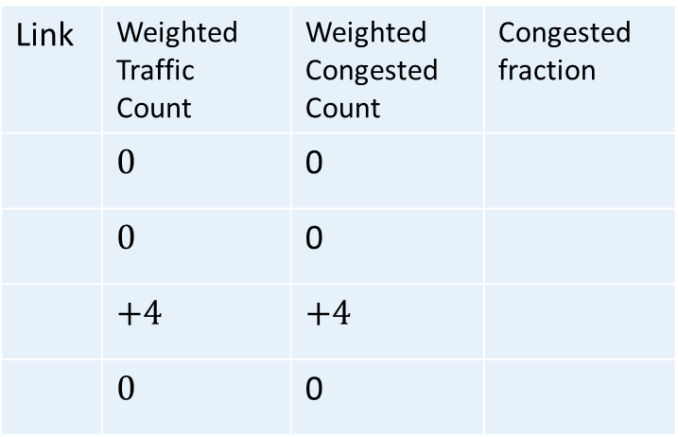
Reservoir sampling for measuring network traffic and congestion
Traffic Reservoir
Link: — hop count: 4
Congested?: Yes
Switch 2
!
!
Table stored on Compute Node 99:
Leaf Switch 1
Leaf Switch 3
Link | Weighted Traffic Count | Weighted Congested Count | Congested fraction
 | $$0$$ | 0
 | $$0$$ | 0
 | $$+4$$ | $$+4$$
 | $$0$$ | 0
Packet
Compute Node 0
Compute Node 99
Notes:
We’re taking a sample of size 1 from the set of links that the packet passes through
And another sample of size 1 from the set of links that are congested
Understand how often packets pass through individual links, and where congestion arises
Adaptive routing means path is not deterministic. If there’s a single path, we want to see that. If adaptive routing is in use, we want to see the cloud

Slide 24
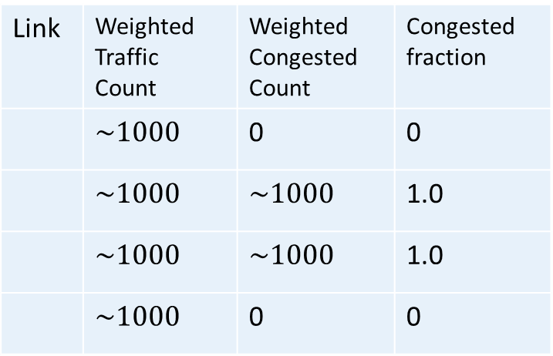
Reservoir sampling for measuring network traffic and congestion
Switch 2
!
!
Table stored on Compute Node 99:
Leaf Switch 1
Leaf Switch 3
Link | Weighted Traffic Count | Weighted Congested Count | Congested fraction
 | $$\sim 1000$$ | 0 | 0
 | $$\sim 1000$$ | $$\sim 1000$$ | 1.0
 | $$\sim 1000$$ | $$\sim 1000$$ | 1.0
 | $$\sim 1000$$ | 0 | 0
Packet
Packet
Compute Node 0
Compute Node 99
Packet
Packet
Packet
Packet
Packet
X 1000
Notes:
We’re taking a sample of size 1 from the set of links that the packet passes through
And another sample of size 1 from the set of links that are congested
Understand how often packets pass through individual links, and where congestion arises
Adaptive routing means path is not deterministic. If there’s a single path, we want to see that. If adaptive routing is in use, we want to see the cloud

Slide 25
Why are these measurements useful?
Weighted traffic count: how many packets traversed each link
Congested fraction: a measure of link congestion
Recording measurement data in each packet lets us associate link data with:
      Program context (e.g. MPI call and calling context)
      MPI tag
      Collective vs. point to point
Polling switch counters gives 1 and 2 but not 3

Slide 26
Outline
Background and motivation
Reservoir sampling for measuring network traffic and congestion
Low-overhead variant using compact probabilistic encoding
Diagnosing communication performance issues
Case Study: miniGhost
Conclusions and future work

Slide 27
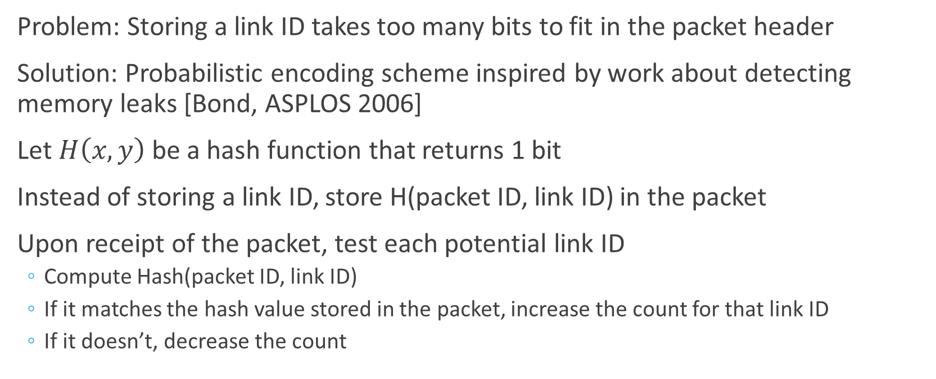
Compact probabilistic encoding
Problem: Storing a link ID takes too many bits to fit in the packet header
Solution: Probabilistic encoding scheme inspired by work about detecting memory leaks [Bond, ASPLOS 2006]
Let $H\left(x,y\right)$be a hash function that returns 1 bit
Instead of storing a link ID, store H(packet ID, link ID) in the packet
Upon receipt of the packet, test each potential link ID
  Compute Hash(packet ID, link ID)
  If it matches the hash value stored in the packet, increase the count for that link ID
  If it doesn’t, decrease the count

Slide 28

Reservoir sampling for measuring network traffic and congestion
Packet
Src: 0, dest: 99, Packet ID: 0xCAFE, other headers
Switch 2
$$H\left(0xCAFE, \right)=0$$
Traffic Reservoir
Link hash: 0 hop count: 1
Congested?: No
!
!
Leaf Switch 1
Leaf Switch 3
Packet data
Packet
Compute Node 0
Compute Node 99
Notes:
We’re taking a sample of size 1 from the set of links that the packet passes through
And another sample of size 1 from the set of links that are congested
Understand how often packets pass through individual links, and where congestion arises
Adaptive routing means path is not deterministic. If there’s a single path, we want to see that. If adaptive routing is in use, we want to see the cloud

Slide 29
Reservoir sampling for measuring network traffic and congestion
Packet
Src: 0, dest: 99, Packet ID: 0xCAFE, other headers
Switch 2
Hash not computed
Traffic Reservoir
Link hash: 0 hop count: 2
Congested?: No
!
!
Packet
Leaf Switch 1
Leaf Switch 3
Packet data
Compute Node 0
Compute Node 99
Notes:
We’re taking a sample of size 1 from the set of links that the packet passes through
And another sample of size 1 from the set of links that are congested
Understand how often packets pass through individual links, and where congestion arises
Adaptive routing means path is not deterministic. If there’s a single path, we want to see that. If adaptive routing is in use, we want to see the cloud

Slide 30

Reservoir sampling for measuring network traffic and congestion
Packet
Src: 0, dest: 99, Packet ID: 0xCAFE, other headers
Switch 2
$$H\left(0xCAFE, \right)=1$$
Traffic Reservoir
Link hash: 1 hop count: 3
Congested?: Yes
Packet
!
!
Leaf Switch 1
Leaf Switch 3
Packet data
Compute Node 0
Compute Node 99
Notes:
We’re taking a sample of size 1 from the set of links that the packet passes through
And another sample of size 1 from the set of links that are congested
Understand how often packets pass through individual links, and where congestion arises
Adaptive routing means path is not deterministic. If there’s a single path, we want to see that. If adaptive routing is in use, we want to see the cloud

Slide 31
Reservoir sampling for measuring network traffic and congestion
Packet
Src: 0, dest: 99, Packet ID: 0xCAFE, other headers
Switch 2
Hash not computed
Traffic Reservoir
Link hash: 1 hop count: 4
Congested?: Yes
!
!
Leaf Switch 1
Leaf Switch 3
Packet data
Packet
Compute Node 0
Compute Node 99
Notes:
We’re taking a sample of size 1 from the set of links that the packet passes through
And another sample of size 1 from the set of links that are congested
Understand how often packets pass through individual links, and where congestion arises
Adaptive routing means path is not deterministic. If there’s a single path, we want to see that. If adaptive routing is in use, we want to see the cloud

Slide 32
Reservoir sampling for measuring network traffic and congestion
Packet
Src: 0, dest: 99, Packet ID: 0xCAFE, other headers
Switch 2
Hash not computed
Traffic Reservoir
Link hash: 1 hop count: 4
Congested?: Yes
!
!
Leaf Switch 1
Leaf Switch 3
Packet data
Packet
Compute Node 0
Compute Node 99
Notes:
We’re taking a sample of size 1 from the set of links that the packet passes through
And another sample of size 1 from the set of links that are congested
Understand how often packets pass through individual links, and where congestion arises
Adaptive routing means path is not deterministic. If there’s a single path, we want to see that. If adaptive routing is in use, we want to see the cloud

Slide 33
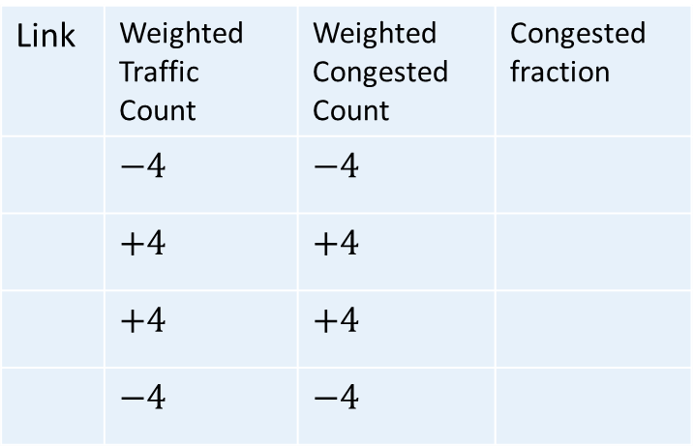




Reservoir sampling for measuring network traffic and congestion
Src: 0, dest: 99, Packet ID: 0xCAFE, other headers
Switch 2
Traffic Reservoir
Link hash: 1 hop count: 4
Congested?: Yes
!
!
Leaf Switch 1
Leaf Switch 3
Table stored on Compute Node 99:
Link | Weighted Traffic Count | Weighted Congested Count | Congested fraction
 | $$−4$$ | $$−4$$
 | $$+4$$ | $$+4$$
 | $$+4$$ | $$+4$$
 | $$−4$$ | $$−4$$
Compute Node 0
Packet
Compute Node 99
$$H\left(0xCAFE, \right)=0$$
$$H\left(0xCAFE, \right)=1$$
$$H\left(0xCAFE, \right)=1$$
$$H\left(0xCAFE, \right)=0$$
Notes:
We’re taking a sample of size 1 from the set of links that the packet passes through
And another sample of size 1 from the set of links that are congested
Understand how often packets pass through individual links, and where congestion arises
Adaptive routing means path is not deterministic. If there’s a single path, we want to see that. If adaptive routing is in use, we want to see the cloud

Slide 34
Reservoir sampling for measuring network traffic and congestion
Switch 2
!
!
Table stored on Compute Node 99:
Leaf Switch 1
Leaf Switch 3
Link | Weighted Traffic Count | Weighted Congested Count | Congested fraction
 | $$\sim 1000$$ | 0 | 0
 | $$\sim 1000$$ | $$\sim 1000$$ | 1.0
 | $$\sim 1000$$ | $$\sim 1000$$ | 1.0
 | $$\sim 1000$$ | 0 | 0
Packet
Packet
Compute Node 0
Compute Node 99
Packet
Packet
Packet
Packet
Packet
X 1000
Notes:
We’re taking a sample of size 1 from the set of links that the packet passes through
And another sample of size 1 from the set of links that are congested
Understand how often packets pass through individual links, and where congestion arises
Adaptive routing means path is not deterministic. If there’s a single path, we want to see that. If adaptive routing is in use, we want to see the cloud

Slide 35
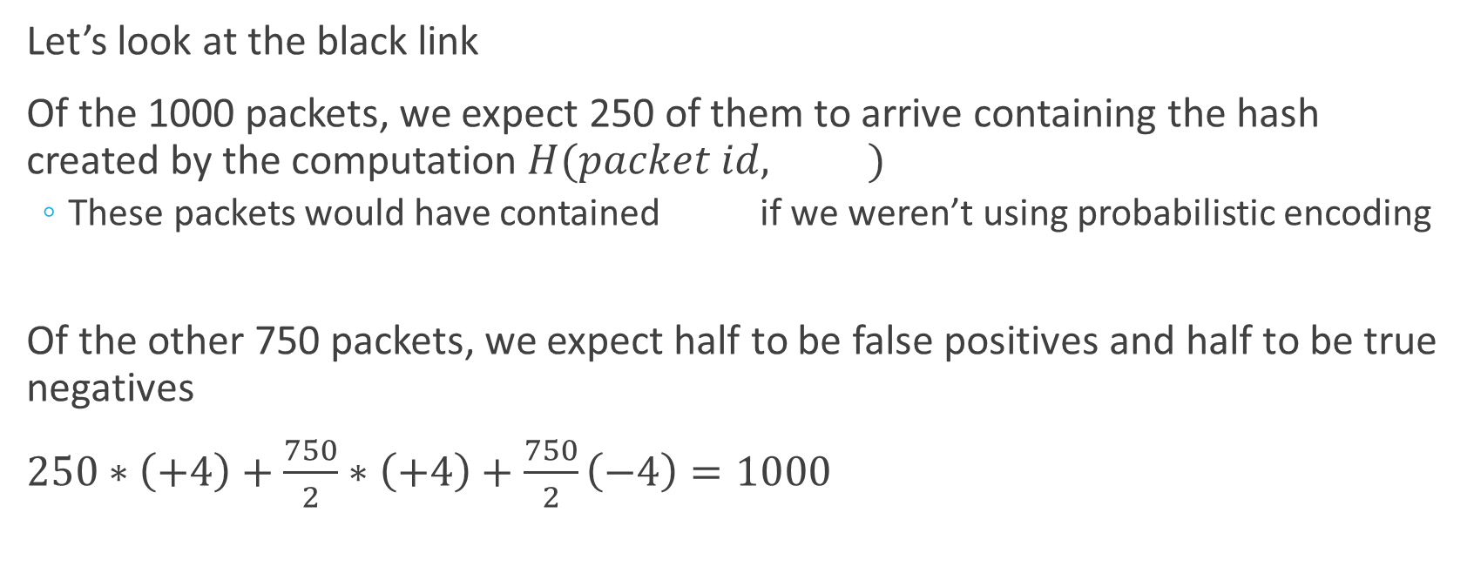
Statistical Intuition: true negatives cancel false positives
Let’s look at the black link
Of the 1000 packets, we expect 250 of them to arrive containing the hash created by the computation $H(packet id, )$
  These packets would have contained if we weren’t using probabilistic encoding
Of the other 750 packets, we expect half to be false positives and half to be true negatives
$250∗\left(+4\right)+\frac{750}{2}∗\left(+4\right)+\frac{750}{2}\left(−4\right)=1000$

Slide 36
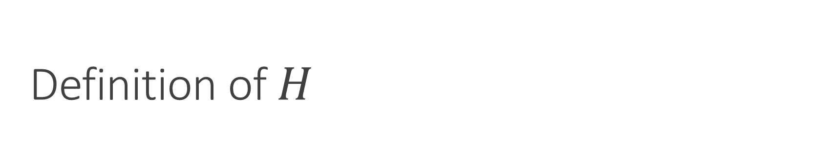

Definition of $H$
Requirements
Must be very cheap to compute
Should behave like a pseudo-random function
  Returns 0 for half of inputs
  Uncorrelated when one parameter is fixed
We use multiplication in a finite field $GF(2^{32})$
Proofs that our $H$ satisfies these properties are short
With a small amount of pre-computation, computing $H$ is 1 AND and a few XORs
In software, using CPU vector instructions, testing a link takes ~1 cycle
  Embarrassingly parallel, very amenable to hardware acceleration
Approach
Notes:
Bond and McKinley’s hash functions did not satisfy these properties!

Slide 37



Visualizing $H$
H(14, 1..1024)
H(15, 1..1024)

Slide 38
Same benefits as non-probabilistic approach
Trades higher variance for fewer bits in each packet
  5-6 bits inside the packet header suffice
Same benefits from storing performance data inside the packet
See the paper for analysis of error and convergence

Slide 39
Outline
Background and motivation
Reservoir sampling for measuring network traffic and congestion
Low-overhead variant using compact probabilistic encoding
Diagnosing communication performance issues
Case Study: miniGhost
Conclusions and future work

Slide 40
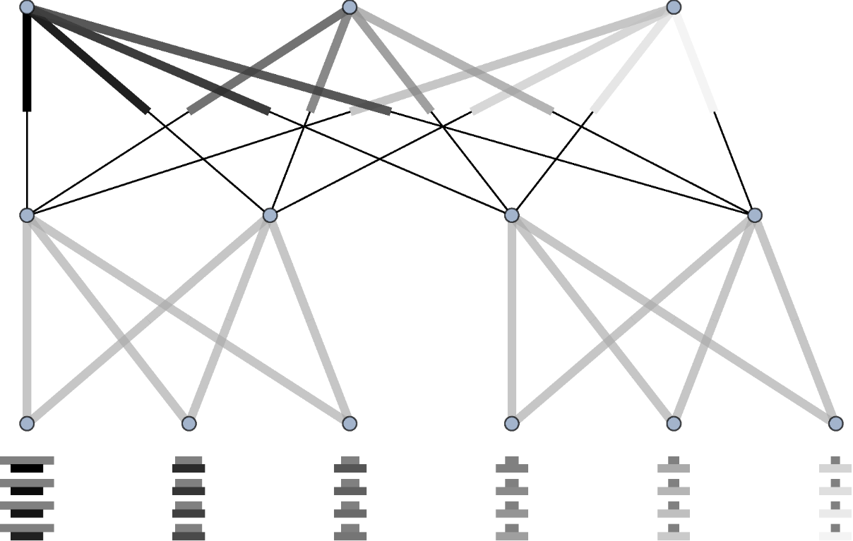
Analyzing communication performance with congested fraction plots
Overlay measurements on network topology
Top half of edge corresponds to down-pointing link
Thicker = More traffic
Darker = More congested
More, darker black is worse
Links to compute nodes shown as boxes

Slide 41
Diagnosing communication performance problems with congested fraction plots
Congestion often backs up, forming tree-like patterns
We look for congestion roots
Congestion rooted in interior of the network
  May be a problem with the mapping onto the physical network topology
  Try optimizing the mapping
Congestion rooted at an endpoint
  Communication pattern problem
  Code changes likely needed
Dark and thin links in the congested fraction plot
  External interference from background traffic

Slide 42
Outline
Background and motivation
Reservoir sampling for measuring network traffic and congestion
Low-overhead variant using compact probabilistic encoding
Diagnosing communication performance issues
Case Study: miniGhost
Conclusions and future work

Slide 43
Experimental Setup Overview
Experiments are simulated with TraceR/CODES network simulator
Network
  Using a 100 Gbps 2:1 tapered fat tree network
    Based on Quartz at LLNL (#71 on TOP500)
  Adaptive routing
Application
  miniGhost: a stencil proxy app
  27 point, 3d stencil
  Simulating 27k MPI ranks = 24 full leaf switches
Additional case study with pF3D is in the paper

Slide 44
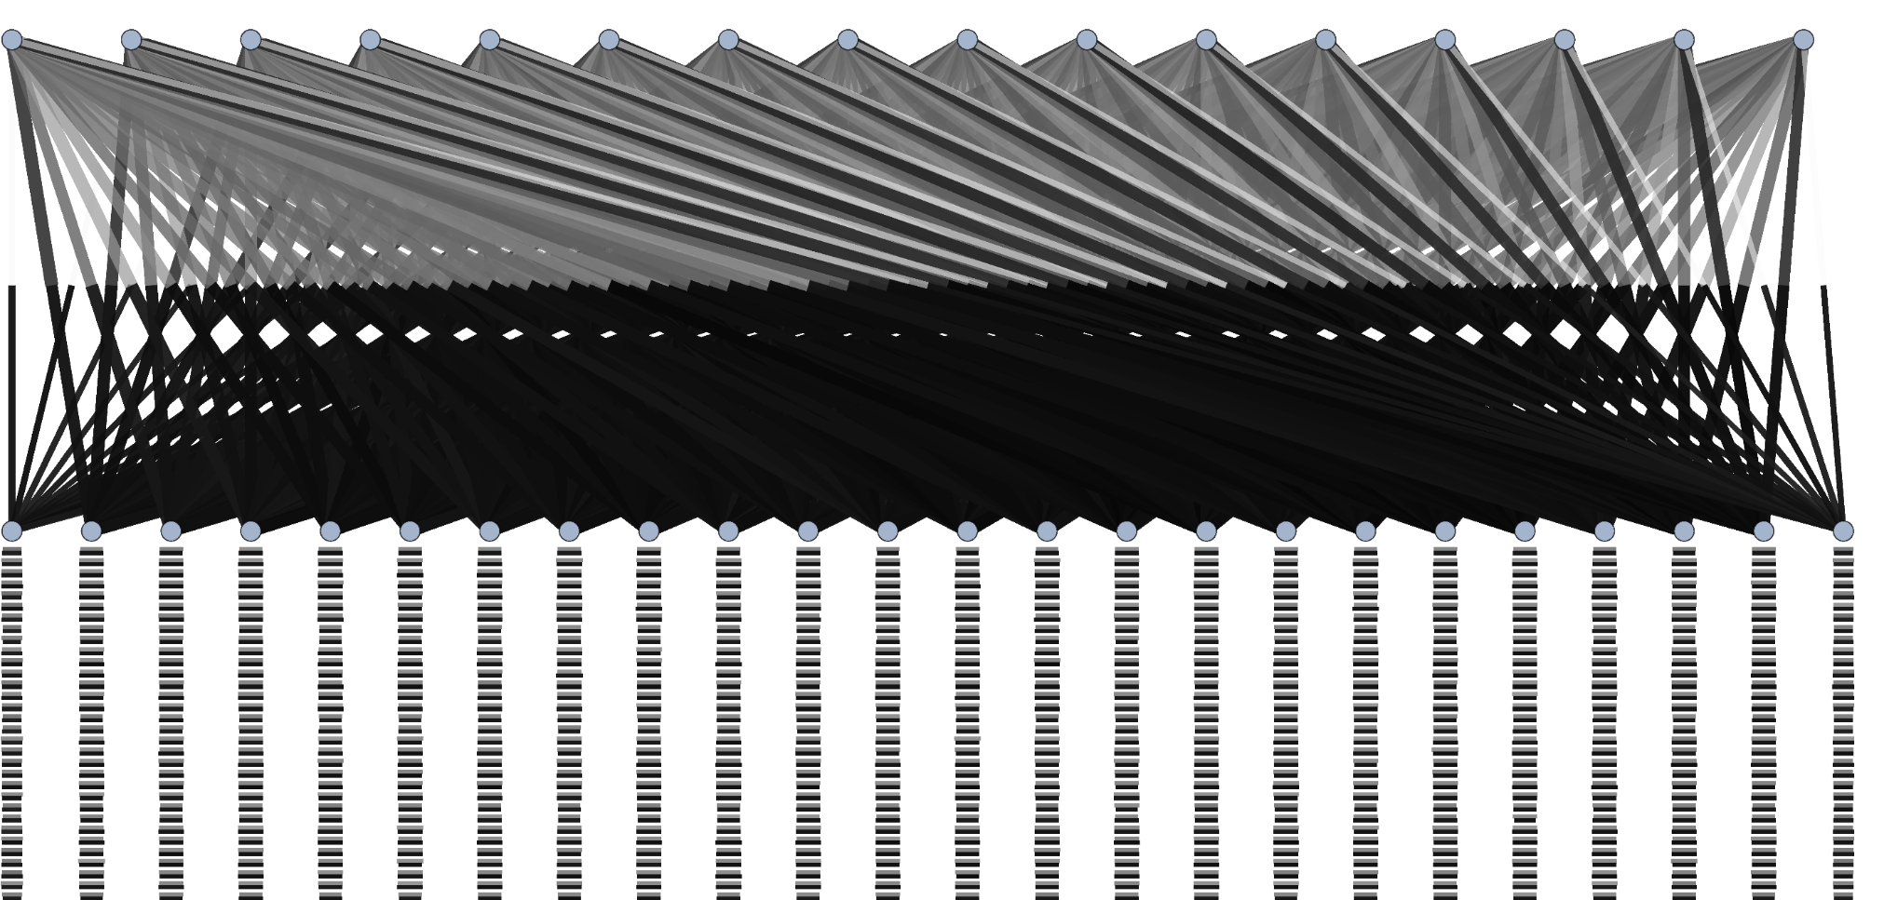
miniGhost congested fraction plot: default configuration

Slide 45
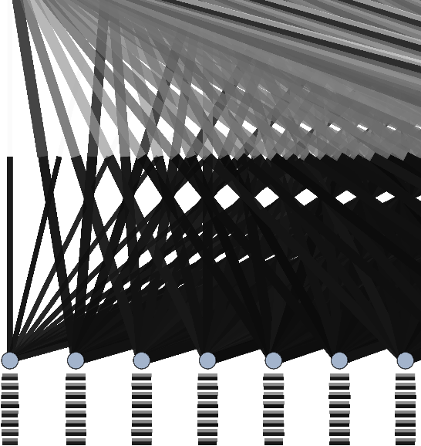
All links are fairly thick
  Lots of traffic on all links
Up-pointing links are heavily congested
Down-pointing links show less congestion
Root of congestion tree in interior
  Interpretation rules suggest trying a new mapping

Slide 46
All links are fairly thick
  Lots of traffic on all links
Up-pointing links are heavily congested
Down-pointing links show less congestion
Root of congestion tree in interior
  Interpretation rules suggest trying a new mapping

Slide 47
All links are fairly thick
  Lots of traffic on all links
Up-pointing links are heavily congested
Down-pointing links show less congestion
Root of congestion tree in interior
  Interpretation rules suggest trying a new mapping

Slide 48
All links are fairly thick
  Lots of traffic on all links
Up-pointing links are heavily congested
Down-pointing links show less congestion
Root of congestion tree in interior
  Interpretation rules suggest trying a new mapping

Slide 49
All links are fairly thick
  Lots of traffic on all links
Up-pointing links are heavily congested
Down-pointing links show less congestion
Root of congestion tree in interior
  Interpretation rules suggest trying a new mapping

Slide 50
All links are fairly thick
  Lots of traffic on all links
Up-pointing links are heavily congested
Down-pointing links show less congestion
Root of congestion tree in interior
  Interpretation rules suggest trying a new mapping

Slide 51
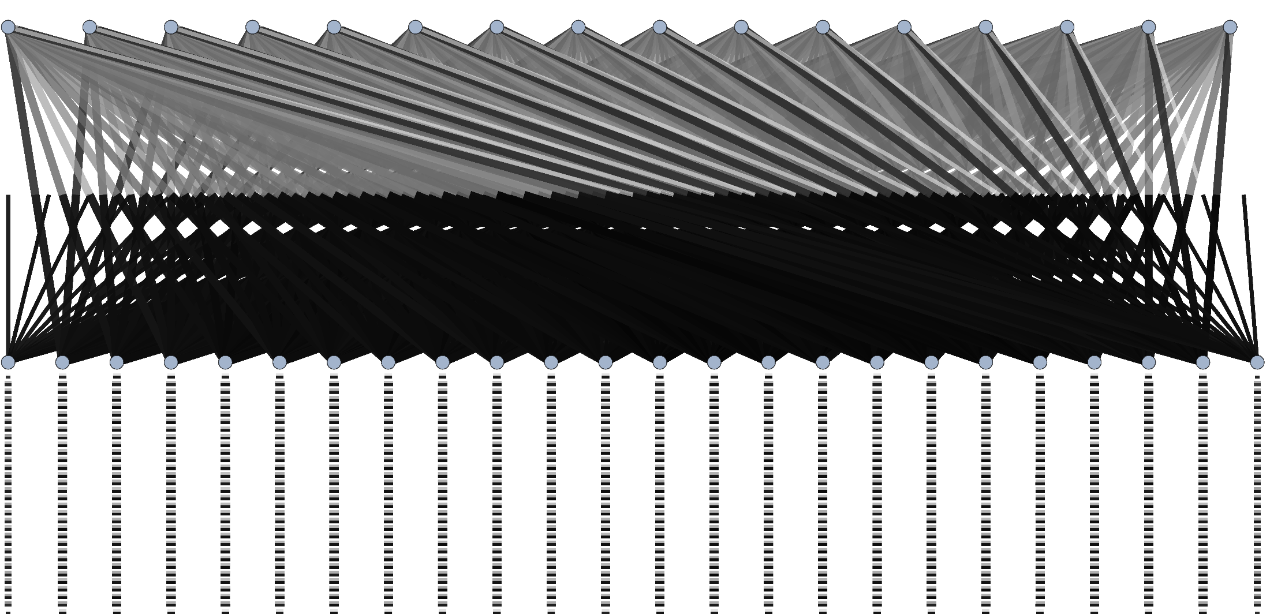
miniGhost congested fraction plot: linear mapping

Slide 52
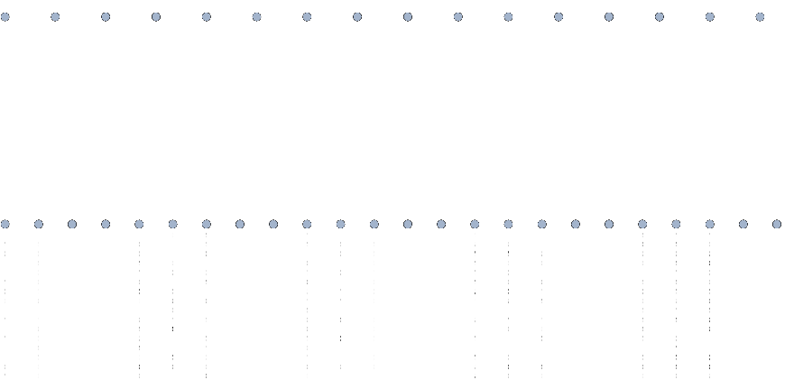
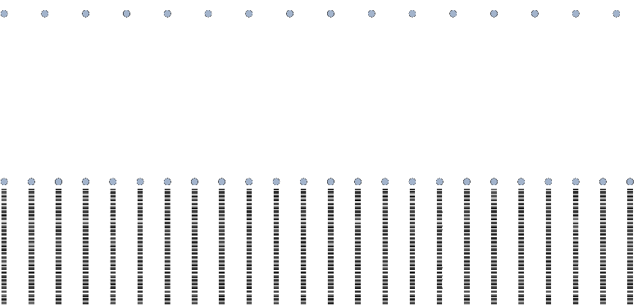
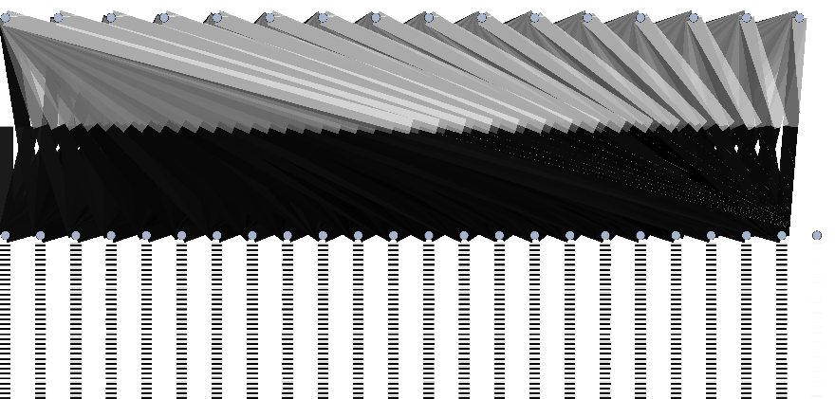



What’s wrong with a linear mapping?
$−x$ communication phase
$−y$ communication phase
$+z$ communication phase
Packet-centric data collection enables us to split into phases based on MPI tag
  Phases can (and do) overlap in time
We need a mapping that balances locality in all three dimensions
  Try mapping with geometric tiling

Slide 53
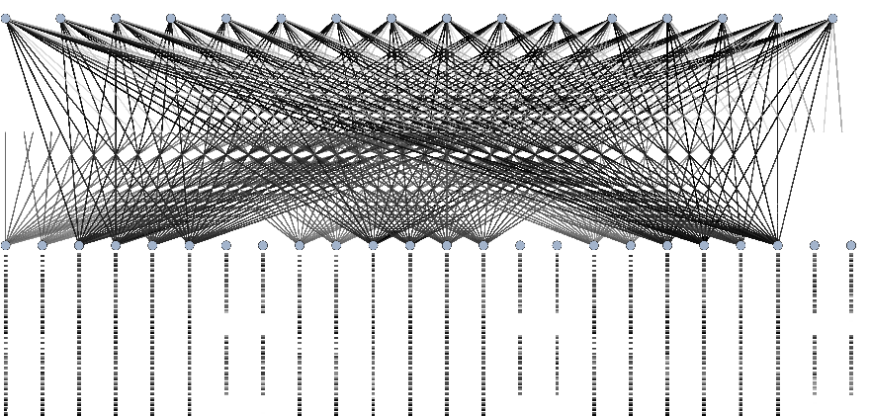
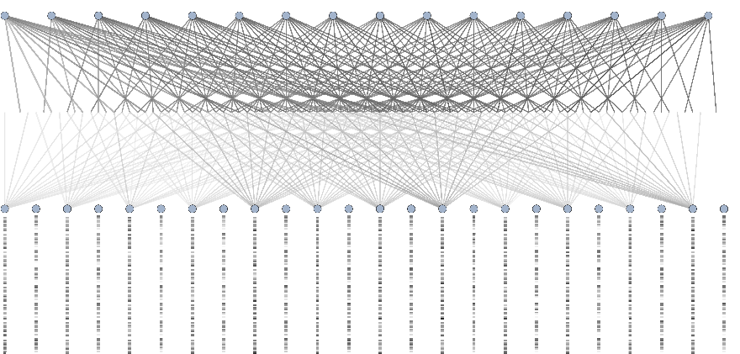
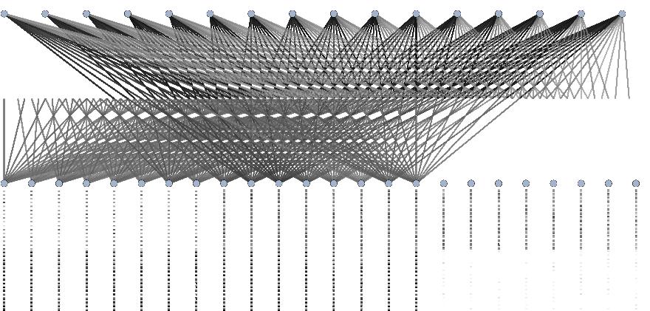
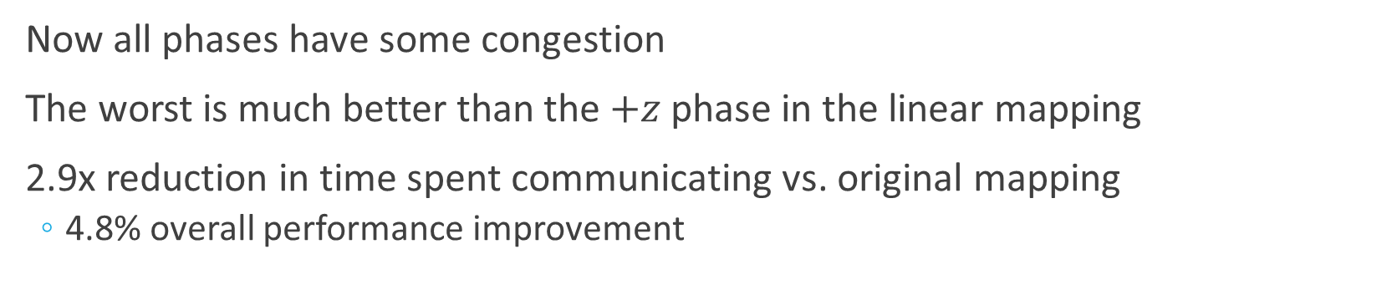
Geometric tiling mapping is better
$−x$ communication phase
$−y$ communication phase
$+z$ communication phase
Now all phases have some congestion
The worst is much better than the $+z$ phase in the linear mapping
2.9x reduction in time spent communicating vs. original mapping
  4.8% overall performance improvement

Slide 54
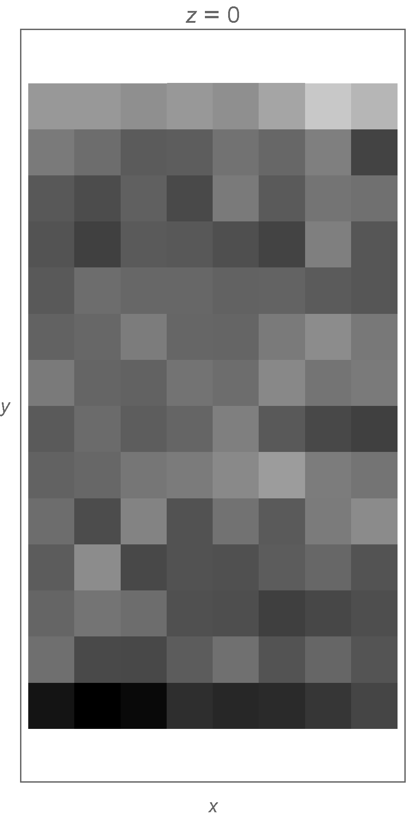




But there’s still a lot of congestion
No longer clear congestion trees rooted in the interior
There appears to be some scattered congestion rooted at endpoints
  Pattern appears somewhat regular, but complicated
If we consider the mapping, the roots form a pattern
$z=0$ plane
$$y$$
Heaviest congestion when $y=14$
$$x$$

Slide 55

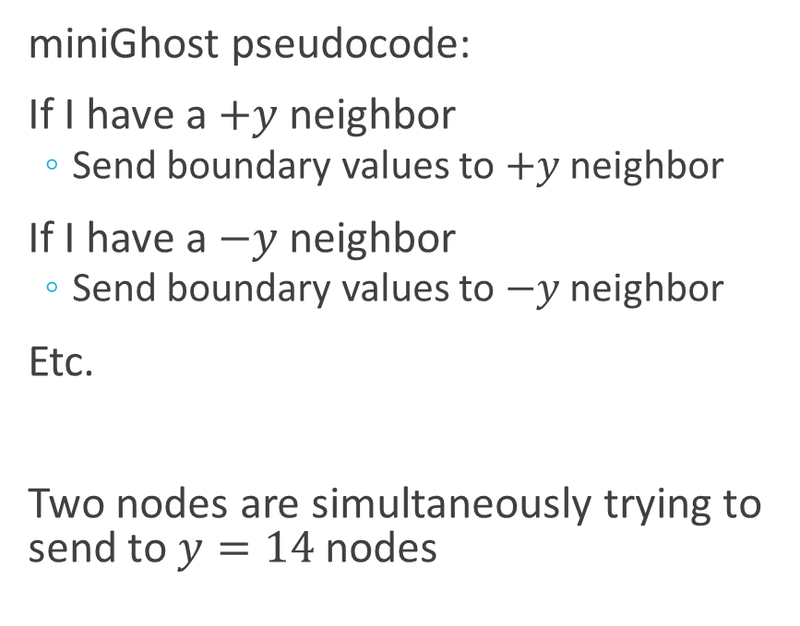


Boundary conditions causing congestion
miniGhost pseudocode:
If I have a $+y$ neighbor
  Send boundary values to $+y$ neighbor
If I have a $−y$ neighbor
  Send boundary values to $−y$ neighbor
Etc.
Two nodes are simultaneously trying to send to $y=14$ nodes
$$y=13$$
!
$$y=14$$
$$y=15$$

Slide 56
Can we fix this?
This is a problem because point-to-point communication is preceded almost immediately by a global Allreduce
Two possible solutions:
  Wait instead of skipping non-existing neighbors
  Introduce asynchrony
Split long communication, compute phases into multiple smaller phases, only synchronize at the end
Notes:
We’re not the first to notice this problem with stencil communication patterns, but the intuition we get from the measurements helped guide us to this diagnosis and reduced the amount of expert knowledge we needed.

Slide 57
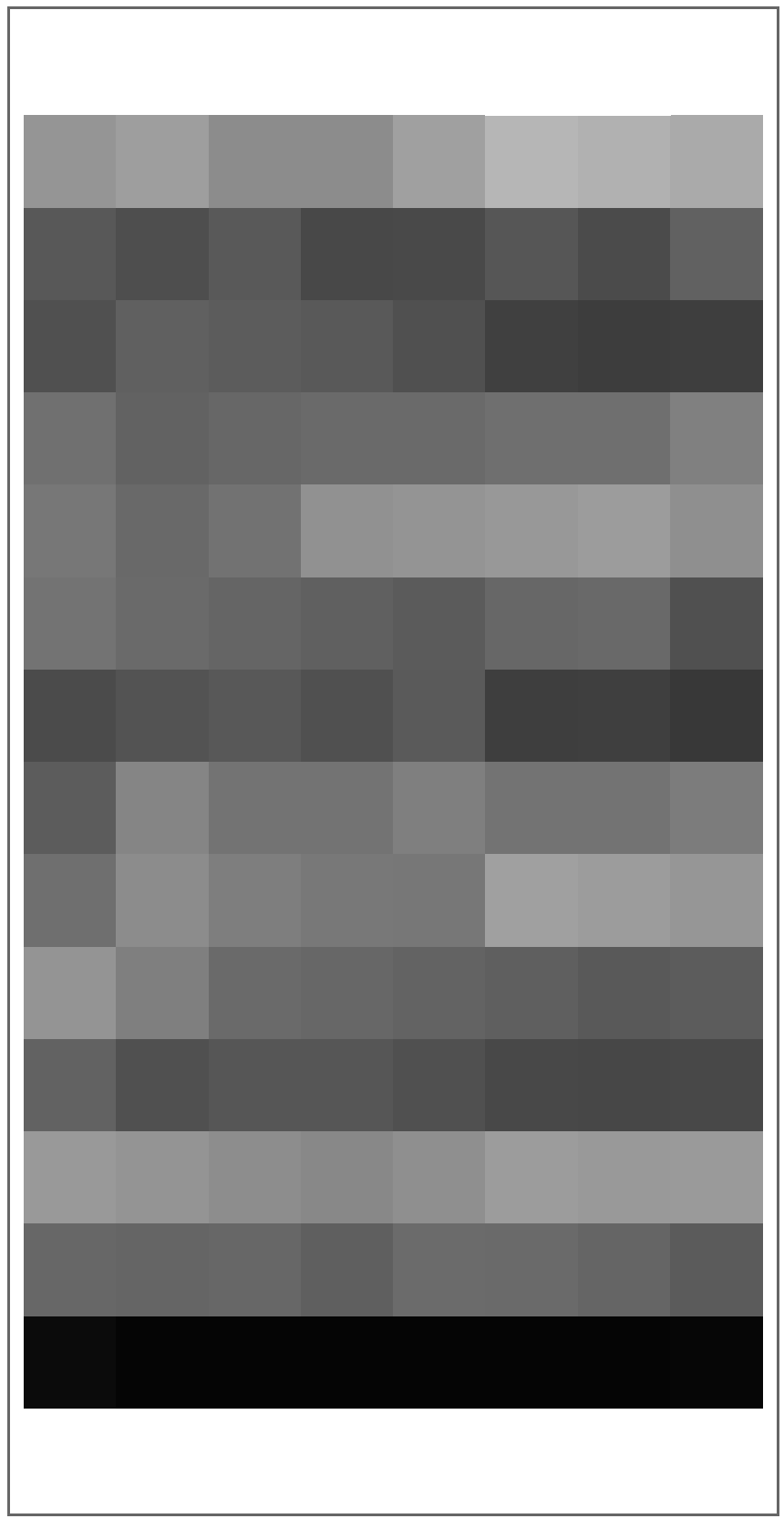
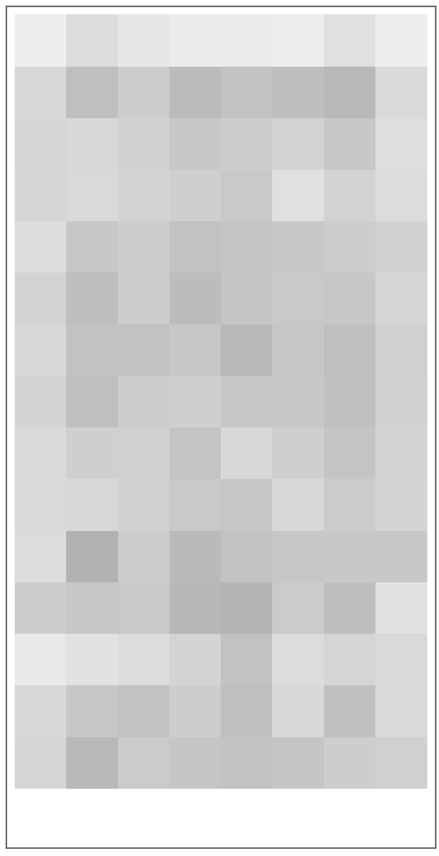
Modified communication pattern reduces congestion
60% reduction in communication time
1.9% overall performance improvement
Original
Small phases, sync after each phase
Small phases, sync after each timestep

Slide 58
MiniGhost summary
Measurements from reservoir sampling gave us insights to improve performance
  Congestion rooted in network interior indicated a mapping problem
  Splitting congested fraction plots by phases showed congestion imbalance between phases
    Using a block mapping balanced locality, distributed the congestion better among phases
  Congestion rooted at endpoints indicated a latent communication pattern problem for nodes on domain boundary
Overall improvement: nearly 5x reduction in communication time

Slide 59
Outline
Background and motivation
Reservoir sampling for measuring network traffic and congestion
Low-overhead variant using compact probabilistic encoding
Diagnosing communication performance issues
Case Study: miniGhost
Conclusions and future work

Slide 60
Conclusions
Using reservoir sampling, we can collect information about the path a packet takes and any congestion it encounters
Measurements are useful, effective, and cheap
  This information helps application developers understand communication performance in the context of a network’s physical topology and of their application
  Diagnosis based on information collected with reservoir sampling explained the problem, guided to a fix
  A probabilistic variant dramatically reduces the data added to a monitored packet while still delivering useful measurements
Requires modifications to networking hardware, but we’ve shown they are simple and fast
  [Taffet, Mellor-Crummey HOTI’19]
Notes:
Analyze data both quantitatively and qualitatively

Slide 61
Future work
Analyze communication performance of other applications
Automate diagnosis
Test with programmable Ethernet switches
Explore tradeoffs to reduce number of hashes required
Notes:
Basically, we want to continue
to increase the value of the performance measurements we get with this scheme,
and also to continue to make the scheme even easier to implement.
We think this approach is practical for implementation in future hardware,
and if implemented, will give developers deeper insights into their communication performance and how to improve it.
Thanks, and I’d be happy to take any questions.

Slide 62
Contributions
New packet-centric approach to measuring congestion using reservoir sampling
  Capture where in the network congestion is occurring
  Capture why in the application congestion is occurring
Distinguish three types problems with different fixes
  External interference (even without monitoring other jobs)
  Problems with logical to physical mapping
  Problems with communication pattern
Probabilistic scheme for more practical implementation
Hash function

Slide 63
Mapping to InfiniBand Packet Header
1 bit: Hash of a link ID selected with reservoir sampling
1 bit: Was that link congested
3-4 bits: current hop count
  Incremented using saturating arithmetic
Fits in 6 reserved bits just after FECN bits, not protected by invariant CRC
Packet Sequence Number used as packet ID

Slide 64
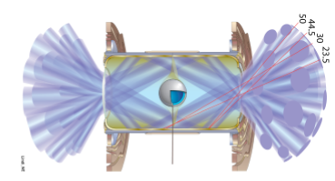


Case Study I: pF3D
pF3D is a multiphysics code used to simulate laser-plasma interactions at NIF
Communication dominated by 2d FFT in x-y planes
$$x$$
$$z$$
Image source: Langer, Bhatele, Still 2014

Slide 65
Case Study I: pF3D
Under heavy background congestion, pF3D’s parallel FFTs run 24% slower.
The section takes 24.6s with no congestion and 30.4s with heavy background congestion.
Can we understand why? Can we improve the performance?

Slide 66
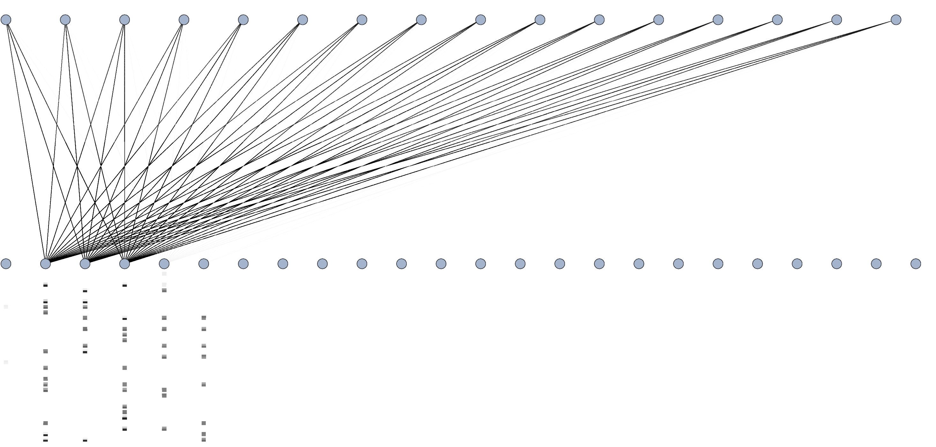

Slide 67
Insights from the congested fraction plot
Congestion must be due to background traffic
  Lots of dark and thin links
  High congested fraction but low traffic
  pF3D drives an average of 2.0 Gbps per link
Reservoir sampling lets us implicitly detect traffic from other jobs on the network without needing to bug the sysadmins

Slide 68
Insights from the congested fraction plot
Congestion must be due to background traffic
  Lots of dark and thin links
  High congested fraction but low traffic
  pF3D drives an average of 2.0 Gbps per link
Reservoir sampling lets us implicitly detect traffic from other jobs on the network without needing to bug the sysadmins
Can we make pF3D more robust to external interference?

Slide 69
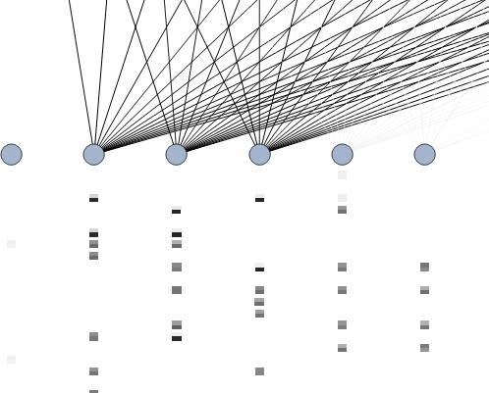
Looking for a second diagnosis
3
2
Link | Congested fraction
1 | 0.86
2 | 1.00
3 | 0.94
4 | 0.06
4
1
Root
Root of a congestion tree

Slide 70
Looking for a second diagnosis
Root is in network interior
Interpretation rules suggest trying to solve congestion with mapping
In particular, we need a mapping that reduces traffic entering circled switches
3
2
4
1
Root of a congestion tree

Slide 71


Designing a new mapping
Size of an x-y plane is 144 MPI ranks = 4 nodes
Most communication happens in 4 node groups
By shifting the node numbering, we keep FFT traffic off congested links
LS 0 | LS 1 | LS 2 | LS 3 | LS 4 | LS 5
LS 0 | LS 1 | LS 2 | LS 3 | LS 4 | LS 5
Original mapping
Shifted mapping
Each rectangle represents 4 nodes

Slide 72
Performance improvement
 | Time (s) | % difference
Congestion, default mapping | 30.40 | -
Congestion, shifted mapping | 25.50 | 16.1%
No Congestion | 24.60 | 19.1%
16% performance improvement
Same allocation from the scheduler
New mapping was simple, but congested fraction plot helped us know how to change the mapping
Performance is almost as good as when run in isolation

Slide 73
Comparison with Yoga & Chabbi
More flexible, but higher cost
  Additional SRAM in each switch
  Drainer component to forward performance information
They could produce congested fraction plots
Their work is also still theoretical, only evaluated in simulation
Our work does not require a central collection server
  No security/permission challenges
  Your job automatically gets the data it can use
Their work is designed for Gen-Z, though can be ported to InfiniBand with a specification change

Slide 74
Background on high performance interconnection networks for supercomputers
We focus on fat trees but almost everything is generalizable
Cut through routing
  Under light load, message spends very little time in the buffers
  Packets can’t change length
Adaptive routing potentially in use
Unlike Ethernet, switch can’t drop packets to deal with congestion
  Buffer occupancy kept under control with credit-based flow control
Switch
Crossbar network
Input buffers
Output buffers
Incoming links
Outgoing links
Notes:
Adaptive routing makes the problem more difficult

Slide 75
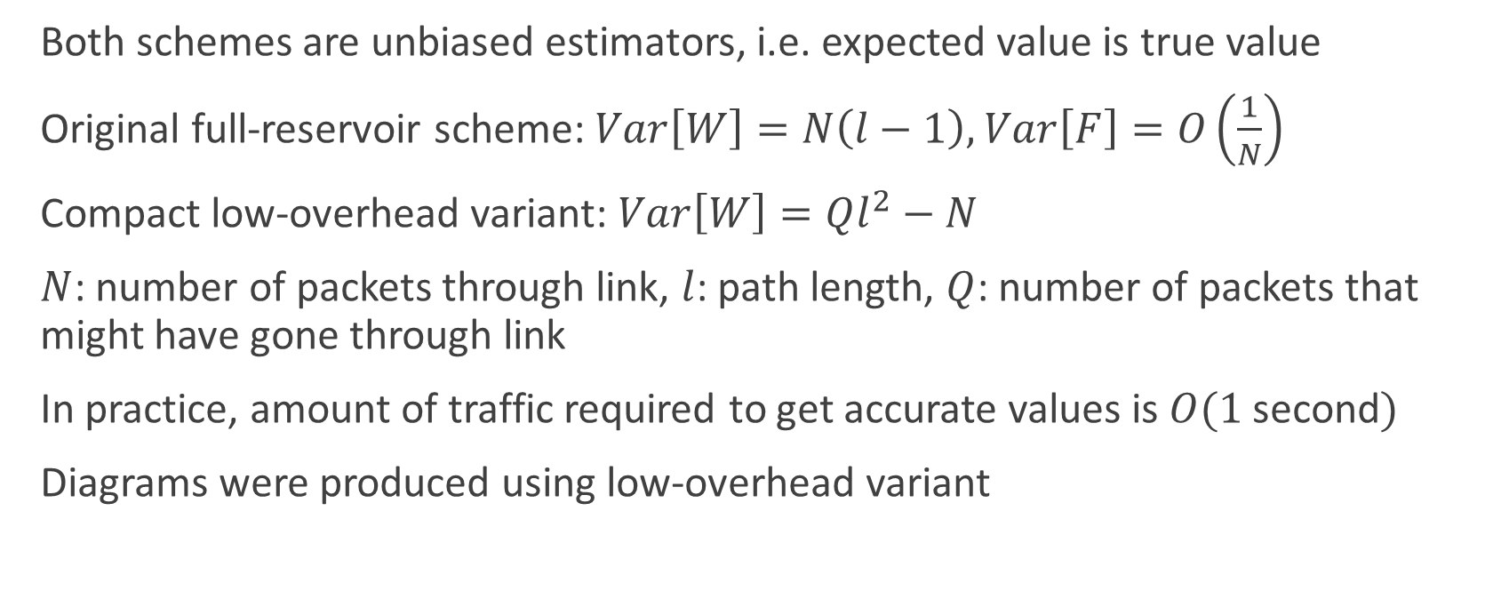
Convergence analysis
Both schemes are unbiased estimators, i.e. expected value is true value
Original full-reservoir scheme: $Var\left[W\right]=N\left(l−1\right),$ $Var\left[F\right]=O\left(\frac{1}{N}\right)$
Compact low-overhead variant: $Var\left[W\right]=Ql^{2}−N$
$N$: number of packets through link, $l$: path length, $Q$: number of packets that might have gone through link
In practice, amount of traffic required to get accurate values is $O(1$second$)$
Diagrams were produced using low-overhead variant

Slide 76
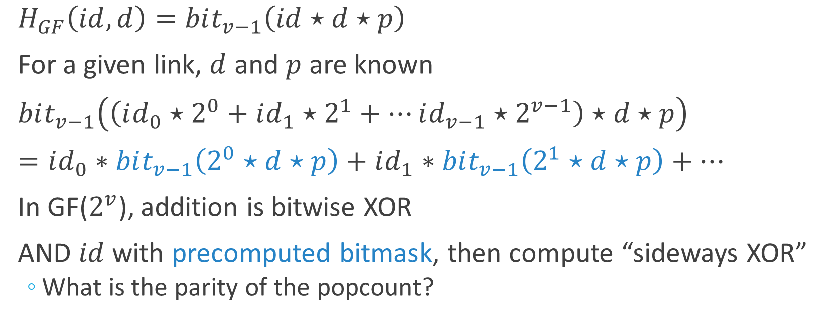
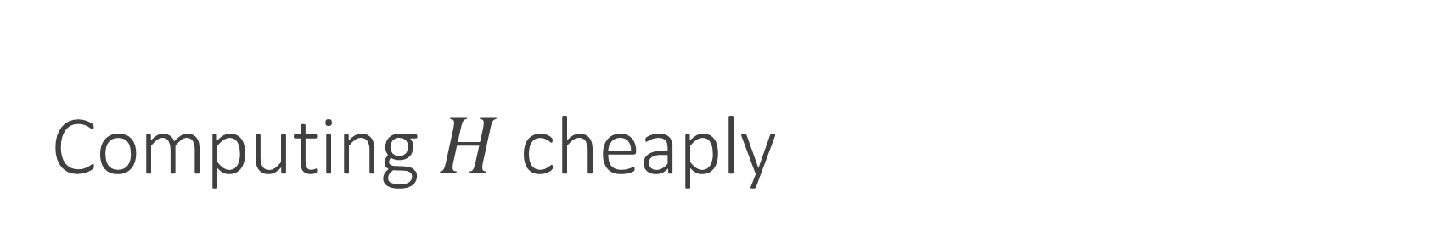
Computing $H$ cheaply
$H_{GF}\left(id, d\right)=bit_{v−1}\left(id⋆d⋆p\right)$
For a given link, $d$ and $p$ are known
$bit_{v−1}\left(\left(id_{0}⋆2^{0}+id_{1}⋆2^{1}+…id_{v−1}⋆2^{v−1}\right)⋆d⋆p\right)$
$=id_{0}∗bit_{v−1}\left(2^{0}⋆d⋆p\right)+id_{1}∗bit_{v−1}\left(2^{1}⋆d⋆p\right)+…$
In GF($2^{v}$), addition is bitwise XOR
AND $id$ with precomputed bitmask, then compute “sideways XOR”
  What is the parity of the popcount?

