Slide 1


PoDD: Power-Capping
Dependent Distributed Applications
Huazhe(Harper) Zhang,
Henry(Hank) Hoffmann

Slide 2
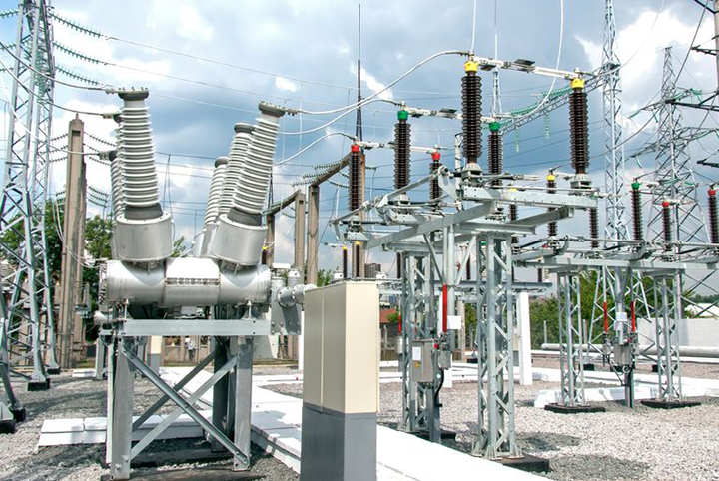
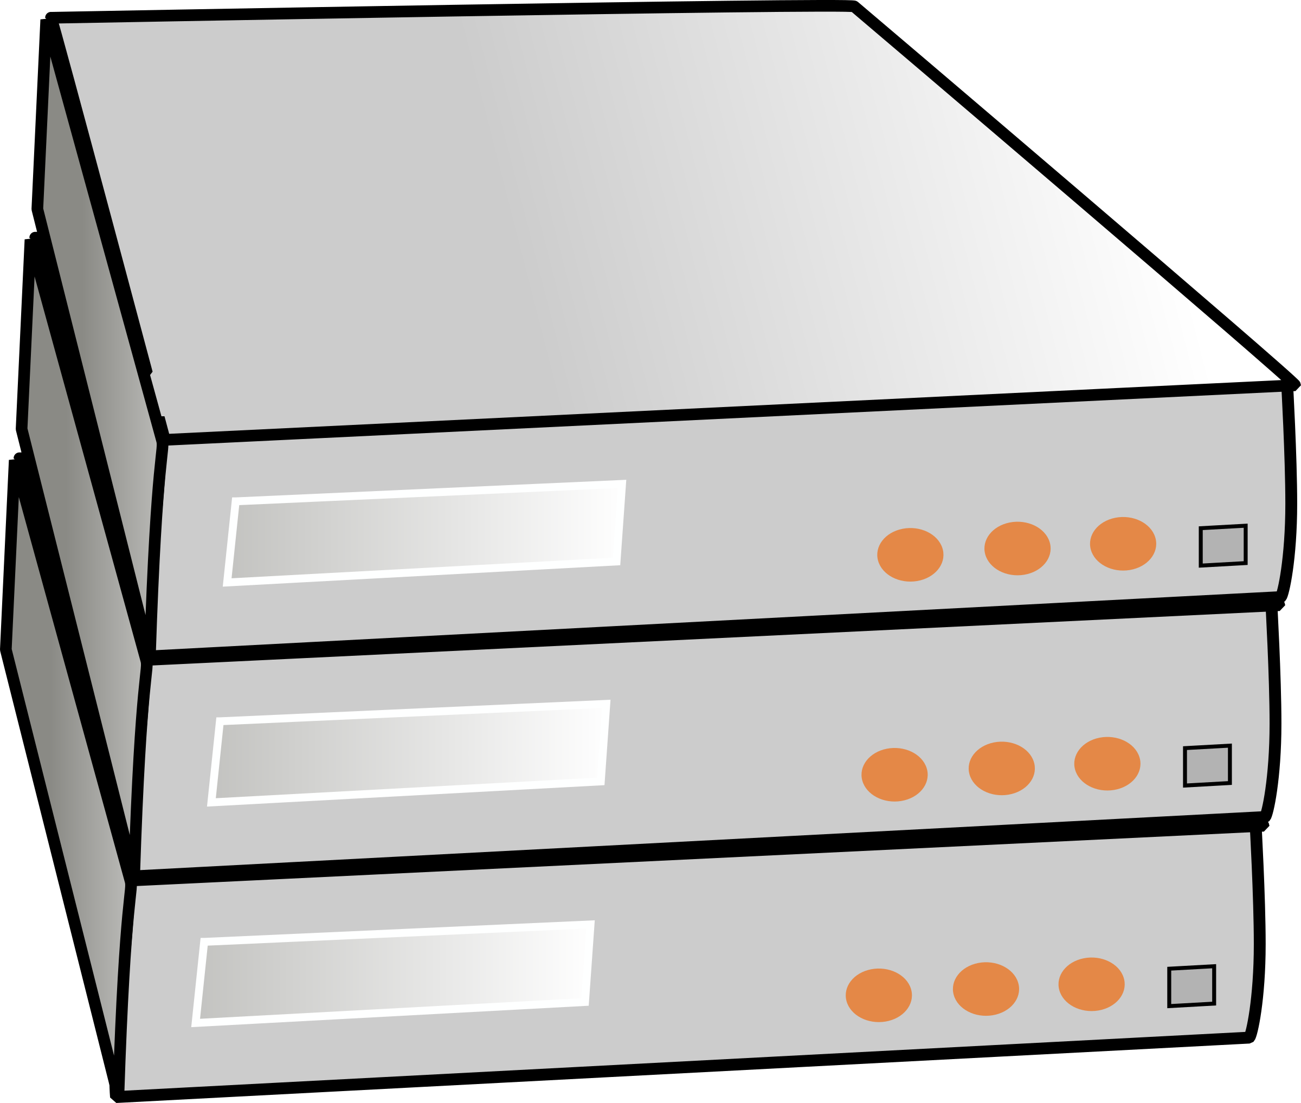

Why power cap is important?
At large-scale computing systems, power is usually budgeted by peak usage NOT maximum usage.
Higher computing capacity per datacenter =
Lower cost/computing
5MW
Budget by
Max Usage
Budget by
Peak Usage
BUT…
6K
9K
Notes:
The picture here is the power supply infrastructure of datacenter, let’s assume it can provide 5MW of power.
For this power budget, how many we should put into it?
OK, here’s 2 choices:servers
So which one is the datacenter using?
At large-scale computing systems, power is usually budgeted by peak usage NOT maximum usage.
This increases the computing capacity, however, risks of tripping power breakers.

Slide 3
Why power cap is important?
Power capped!
Power Budget
Power
Time
What happens when servers draw power more than the Peak Usage?
Power cap is necessary to avoid Power Outage
It trips the power breaker!
Notes:
So if we don’t budget for worst case, what happens when worst case shows up?

Slide 4


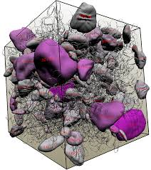
What is
Dependent Distributed Application(DDA)?
Disk
Output
Input
Now in parallel
Scientific Simulation
Visualization
DOE has declared resource management for DDA as a challenge for exascale computing!
Notes:
We used to run this type of workloads sequentially, which means we execute and finish the simulation first and dump the results to some disks through IO and then visualization application picks up the results from the disk again through network, to visualize it.
But now, as we have more hardware resources, we are able to run them simultaneously, which means simulation passes its output to visualization as it goes. And scientists can look at the visualization results at runtime and even be able to interact with simulation.
So DDA means some applications running in parallel with input/output dependency.
Data analysis pipeline; in-situ visualization, and so on

Slide 5
PoDD
A power management system…
Enforcing strict power budget
Delivering high Performance
Dependency-aware
No code instrumentation
No offline profiling
Dynamically adaptive
$1,000
$99.99
Free!!!

Slide 6
Outline
Architecture Overview
Configuration Classifier
High performance
No code instrumentation
Online Model Builder
Dependency-aware
No Profiling
Power Pool Shifter
Dynamic adjustment
Evaluation

Slide 7
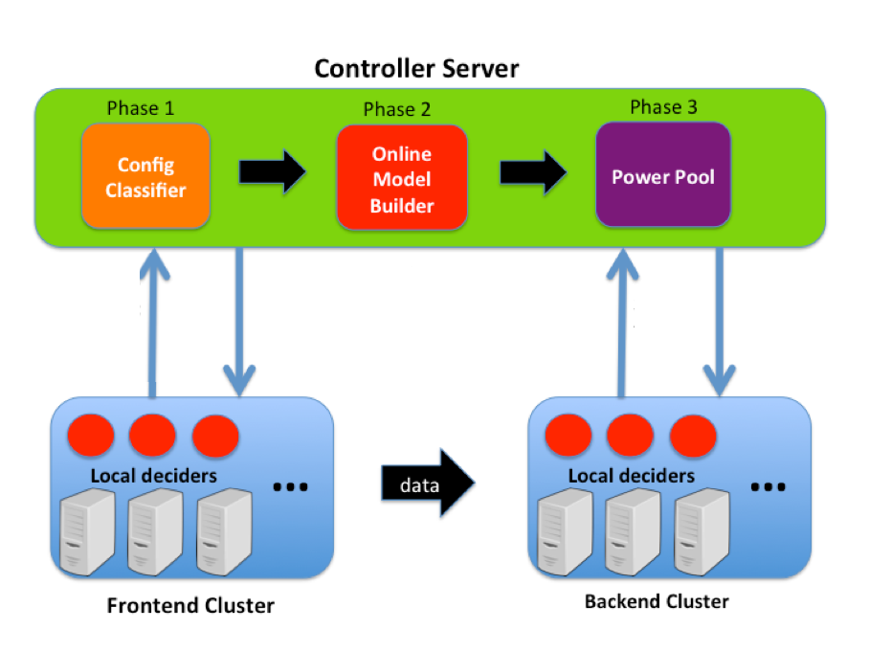
Architecture
Info exchange
Info exchange
Notes:
Here’s the architecture of PoDD, don’t worry about how exactly each component works for now, just want you to have a high level picture of the system.
The green box stands for controller server, which runs with 3 key component: a,b,c
The blue boxes stands for the computing clusters, where the applications are executed and each node runs a local decider, and they communicate with controller at runtime to manage the power.

Slide 8

1
Configuration Classifier
High Performance
No code instrumentation

Slide 9
Performance Challenge
Many research have shown: ([S. Reda. MICRO 2012], [J. Chen. ICS 2011], [J. Chen. ICS 2011]…)
To achieve high performance under a power cap,
One needs to find the right node-level configuration.
1. Configuration space is huge
2. Existing approaches often require instrumentation
to measure performance feedback
Notes:
The performance challenge has been well studied, that

Slide 10
Configuration Classifier
a learning classifier X hardware hybrid approach
Learning Classifier
Predicts optimal resource allocation
E.g. whether to use hyper-thread,
whether to use dual memory-controller
Hardware(RAPL)
Enforce power limit
Notes:
Configuration classifier tries to address this by

Slide 11
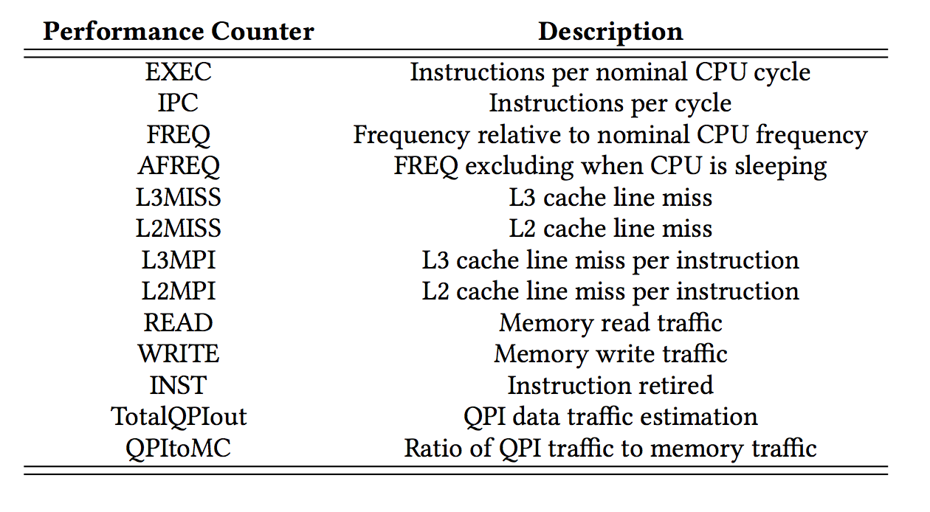
Configuration Classifier
No code instrumentation
Input: runtime collected performance counter info
low overhead
Output: optimal hardware configuration
High performance

Slide 12
Configuration Classifier: Pipeline
Pre-learning process
Raw
data
classifier
Noise
filter
Data standardization
PCA
Feature selection
Gathered from each computing node
Remove
noised
outlier
Bring features into same order of magnitude
Remove correlation
Remove noise feature
Increase computing
efficiency
Notes:
Whole learning pipeline
Common Orthogonal transformation approach PCA
Reduce computing complexity

Slide 13
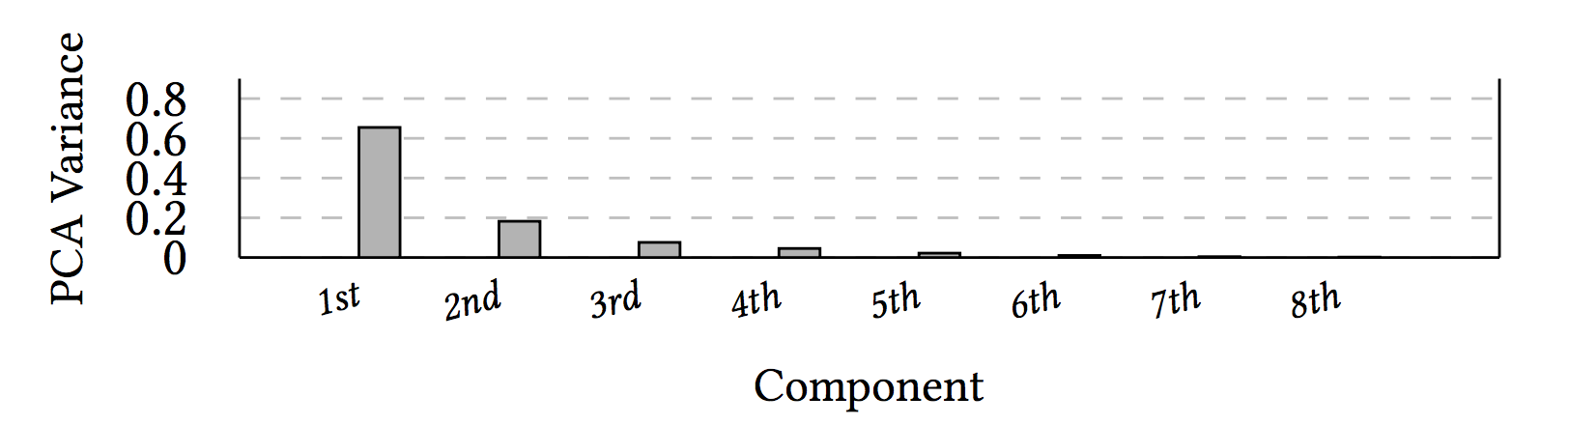
Configuration Classifier
Pre-learning process
Raw
data
classifier
Noise filtering
Data standardization
PCA
Feature selection
Selected features > 98% variance
Filter out noise
Dimension reduction:
13 down to 5
Notes:
PCA variance explained for each component of PCA,
First 5 copmpennt can explain for 98% of the vairablity
Feature dimesion comes down to 5 from 13

Slide 14
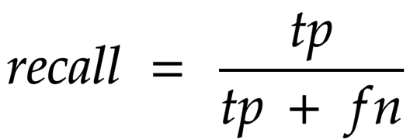
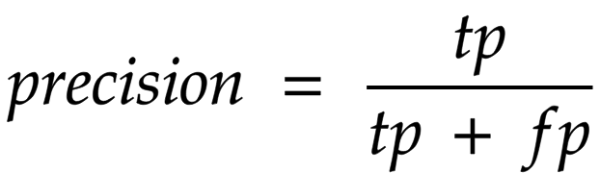
Configuration Classifier
Important performance criteria for classifier:
Able to find almost all optimal allocation
Must be high
will make false positives, but it is okay
Best-effort
Thanks to feedback control system, we are able to roll back when false positive happens
Notes:
Recall : among those actually favors a non-default resource usage, how many percent of those we have capture?
Precision: among those the classifier thinks favoring a resource, how many percent of those is correctly predicted?

Slide 15
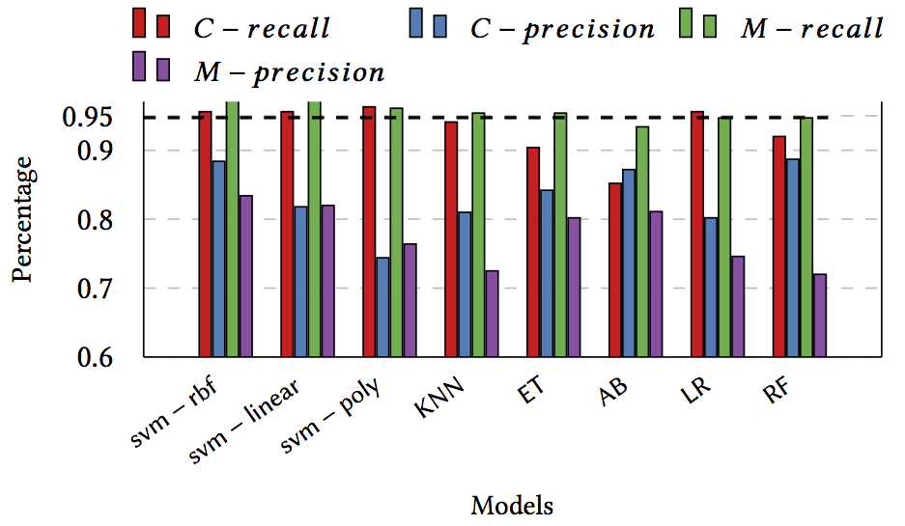
Configuration Classifier
Recall > 95%
Notes:
For the evaluation, we try to tune each model to hit at least 95% recall and compare the precision

Slide 16
2
Online Model Builder
Dependency-aware
No offline profiling

Slide 17
Online Model Builder
To be dependency-aware, PowerShift [H.Zhang ICPP 2018] has shown:
Coordinate applications to run at the same speed
To achieve this, it needs the performance/power profile of the applications.
Online Model Builder profiles the applications online

Slide 18
Online Model Builder
Online Model Builder collects <power, performance> online to build the profile of each application.
Model exploration by 2 metrics:
  #data points(observations) needed
  Accuracy(power error)

Slide 19
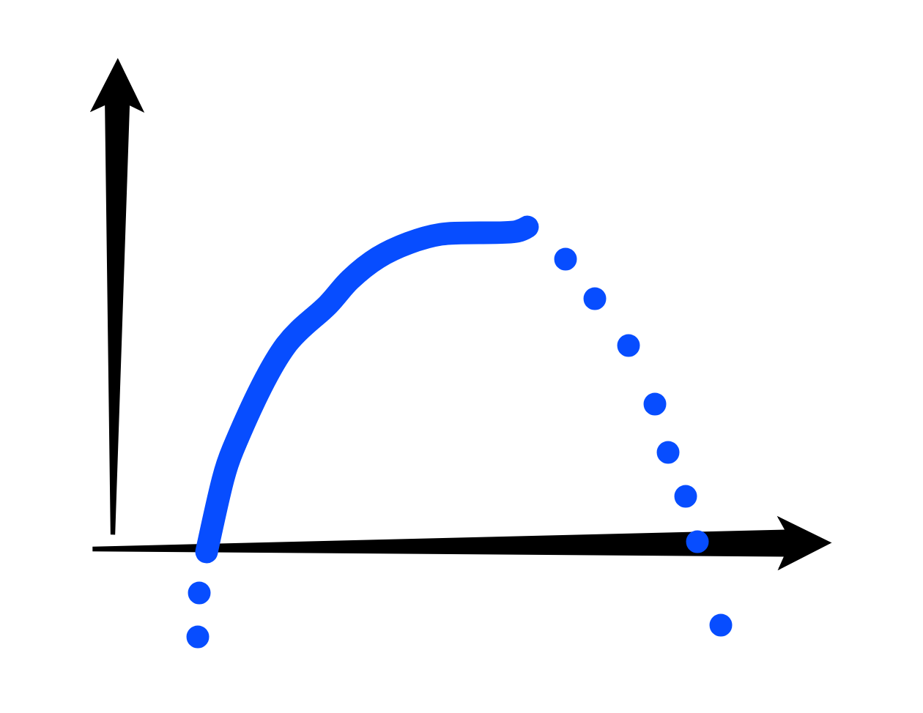
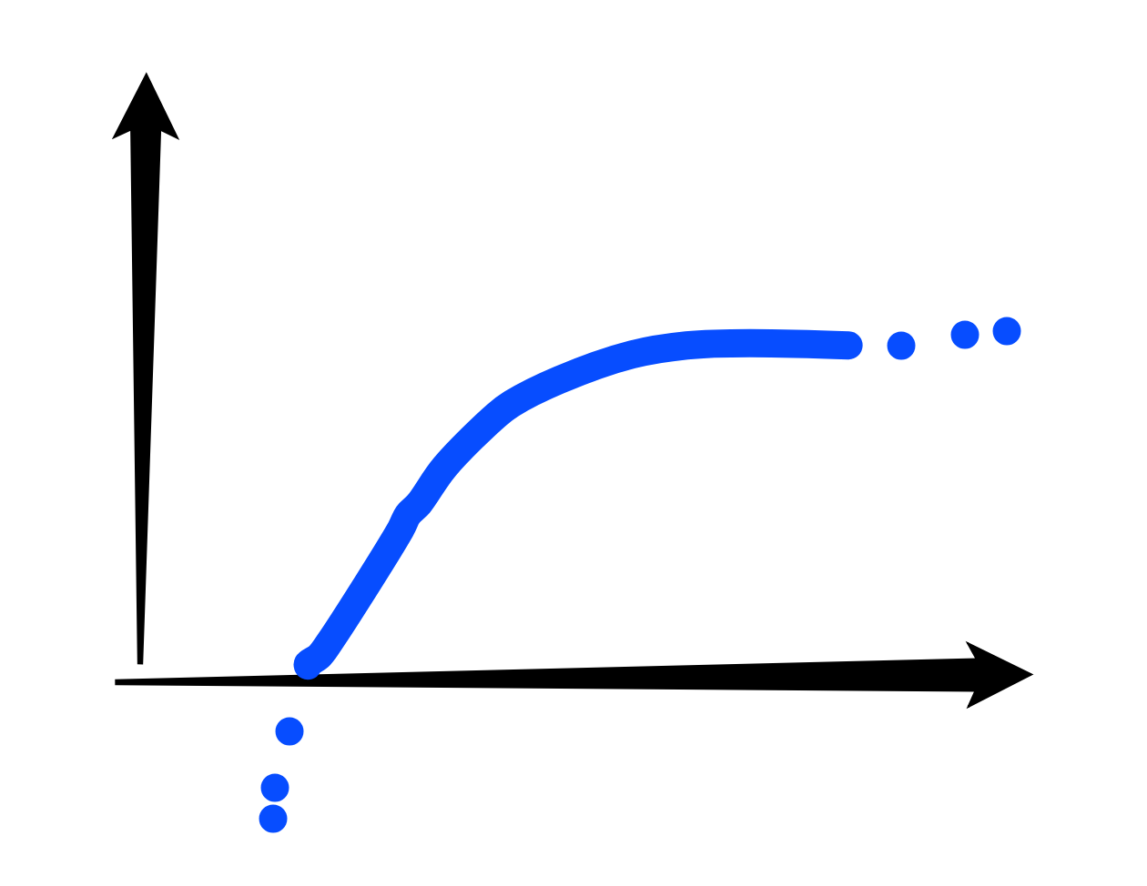
Online Model Builder
Minimum assumption
Approach | #Data points | Power error
Binary-search | 4 | <2W
Quadratic | 3 | ~3W
Logarithm | 4 | ~2W
Complex Learning | >=3 | X
Too expensive!!
Notes:
Performance is non-decreasing with power grows
Fits into part of the quadratic function
Too ex to fit into our realtime control system

Slide 20
3
Power Pool Shifter
Dynamic adjustment

Slide 21
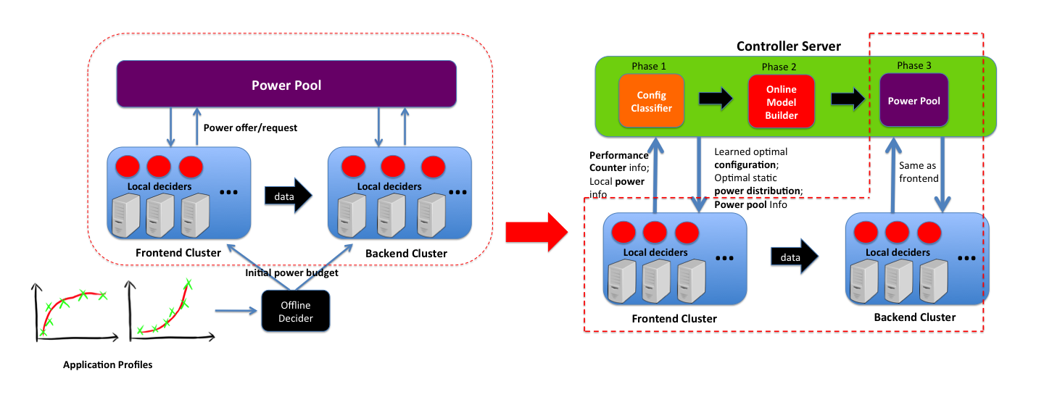
Power Pool extended from PowerShift [H.Zhang ICPP 2018]
Notes:
Power pool component is an extension work from PowerShift. As shown in the figure, left side is the architecture of power pool from PowerShift.
Each local decider gets initialized with offline profile and make local decisions based on local feedback and informantion exchange with Power Pool. Power Pool keeps track of total extra power and key power states of the nodes. It only updates after local deciders have taken actions, which enforces a strict power budget.
And in PoDD, the only difference is, instead of taking in offline profiles, it consumes the power model from online model builder. At runtime, it adapts to dynamic change by shifting the power to where needed.

Slide 22
Architecture
Get hardware counter info from each node
Info exchange
Info exchange
Learn and output to each node the
optimal configuration

Slide 23
Architecture
Build the model to initialize power pool
Info exchange
Info exchange

Slide 24
Architecture
Periodically exchange information with each local deciders to reallocate power
Info exchange
Info exchange

Slide 25
Evaluation
Experiment Setup
49-node on Chameleon cluster, one of them serves as controller node
Each node is a dual-socket server with Intel Skylake Gold 6126 processors, supporting Intel RAPL technology
Each processor is 12 cores, with Hyperthreading, giving a total of 48 virtual cores across both sockets
We partition 48 nodes into frontend and backend cluster, each with 24 nodes

Slide 26
Evaluation
Comparison systems:
Fair -> Baseline
SLURM -> State-of-the-art for non-DDA
PowerShift-S -> Static for DDA
PowerShift-D -> Dynamic for DDA
Benchmarks:
Scientific simulation(Gadget2.0 suite, Lulesh)
Visualization(VisIt)
Data compression(Pigz), data analysis(Kmeans)
SPARK

Slide 27
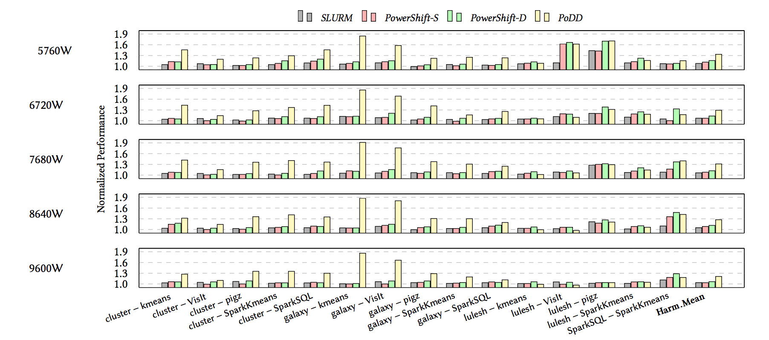
Evaluation: Performance
On average
28% over Fair
21% over SLURM
19% over PowerShift-S
14% over PowerShift-D
Galaxy, Cluster
Greater performance
Default configuration is optimal
Slightly worse than powershift
Notes:
For 15 pairs
Scientific simulation, Visualization, Spark, Distributed compression, Data mining
Some insights of this results: cluster and galaxy are two applications favoring using less computing resources, so not only their performance is boosted by tuning node-level configuration, but also they offer a lot of extra power to the other end, the overall performance of the pair is generally pretty high.
In cases, where default configuration is the optimal one, podd performs slightly worse than pwoershift-D because of the overhead of searching for optimal configuration and building online model. For example, lulesh-kmeans, lulesh-visit
Also in very high power cap, the speedup is lower, simple because of there is not much power to be shifted around since both end has been running near max power.

Slide 28
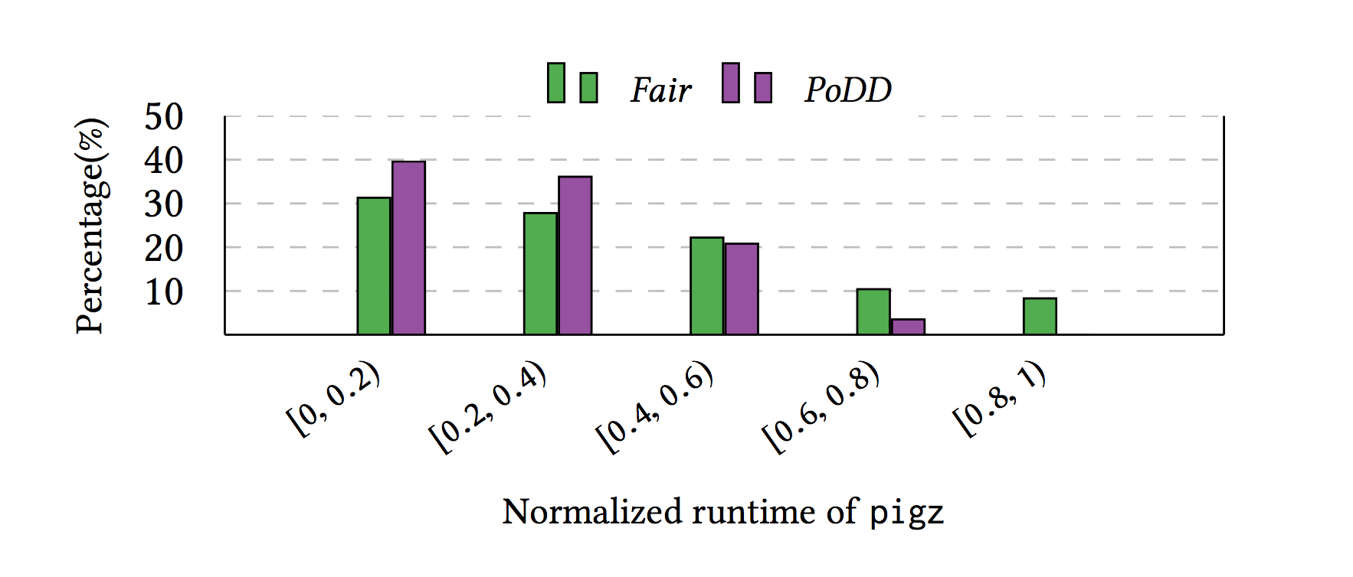
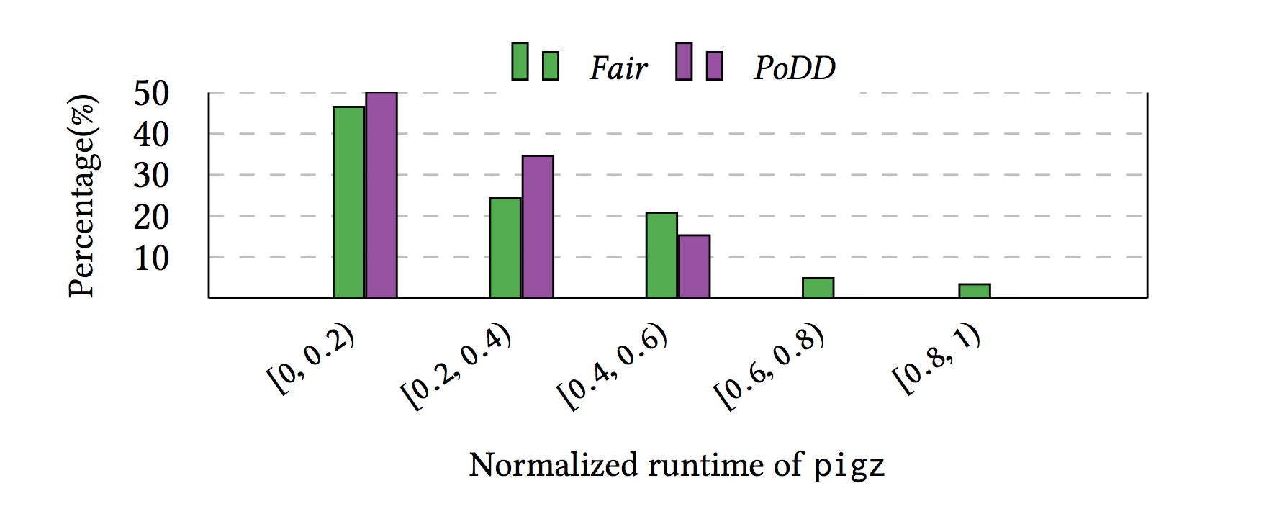
Evaluation: Tail Effect and System Noise
~ 31% speedup
System noise added:
~ 44% speedup
Notes:
This figure shows the normalized runtime of the nodes in pigz, which is an application known to have tail behavior b/c of workload imbalance.
X: a range of normalized runtime Y: accumulated node number in terms of percentage of all nodes
The next figure shows the senario when system noise exists. We achieves this by manually adding 2 stress program randomly onto the nodes running pigz. This will create even more dramatic tail effect.

Slide 29
Evaluation: Scalability
PoDD is designed for simplicity and optimized message size for less network stress.
Network Bottleneck Analysis:
Classifier:
It collects 150B data from each node per iteration(>1 minute), For 1M nodes, this is 150MB/minute(2.5MB/s).
Power pool:
32B data per request(round trip) per node, at 1M nodes with 1s control frequency, generating 32MB/s traffic.
Easy for 10Gbps network.
Notes:
Network bottleneck is often the limiting factor for such control system.
The 2 most network stressing part comes from the communication between classifier and copmuting nodes; and between power pool and computing nodes.

Slide 30
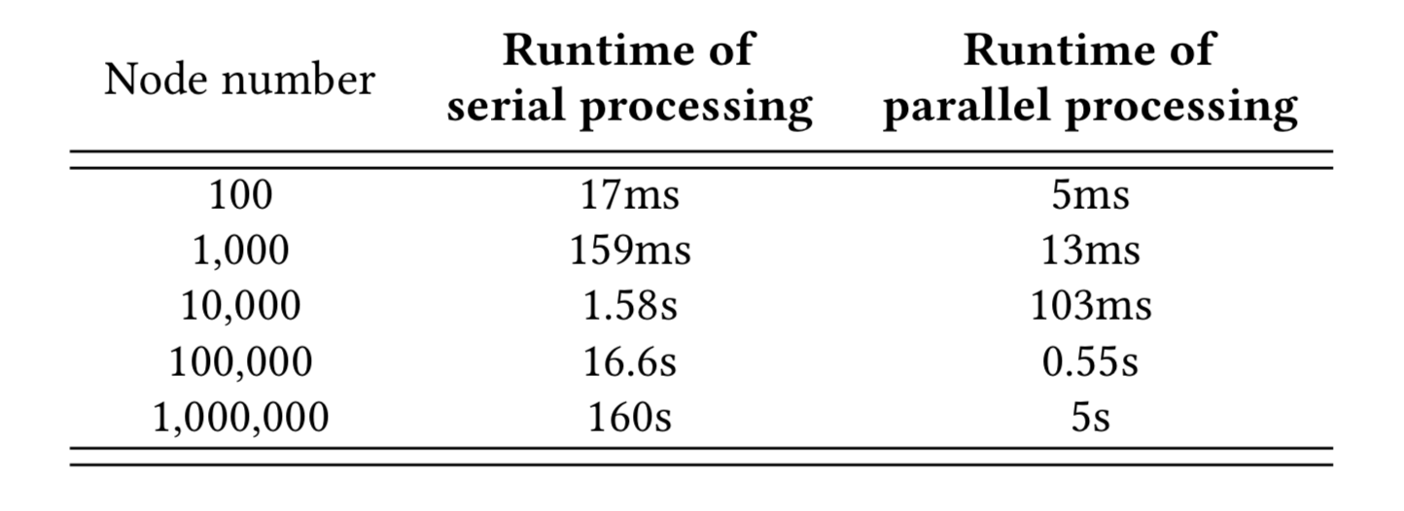
Evaluation: Scalability Emulation
Classifier at scale
Classifier
Hardware
Info
msg
100K node with < 1s
Notes:
Given we don’t have access to thousands of node, we emulate the largescale stress.
We emulate it by feeding the classifier more inputs remotely as if they come from a lot of local deciders.

Slide 31
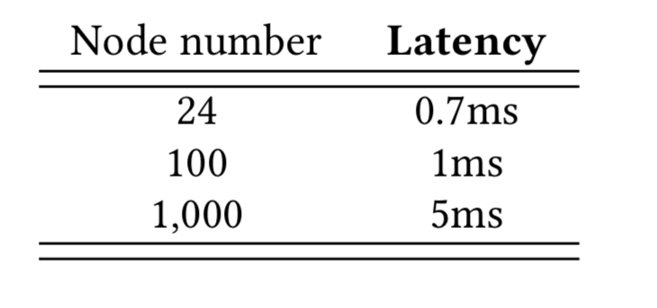
Evaluation: Scalability Emulation
Power Pool at scale
Power Pool
Local deciders
Latency : average latency of local decider receiving a response from the power pool
PoDD is expected to scale well up to at least thousands of nodes
Notes:
We emulate power pool at scale by running multiple local deciders per node, tested up to 1000 local decider instances, until local decider is too overloaded to be reliable.

Slide 32
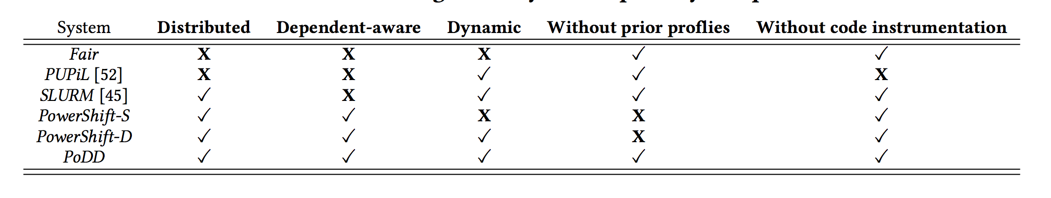
In Summary
Power capping system capability comparison
Scalability
Tail effect
System noise
DDA
Practical
Performance
Notes:
This comparison table between podd and existing systems, pretty well summarized the capability of PoDD

Slide 33
Acknowledgement
Big thanks to DOE, NSF, DARPA BRASS program for funding this project.
All results in this paper were collected on the Chameleon testbed supported by NSF. Please try it!
Notes:
We are extremely grateful to the Chameleon team for making large clusters of bare-metal machines available.

Slide 34
Q&A
Thank you!

Slide 35
Q&A
Thank you!

Slide 36
PoDD

Slide 37
Configuration Classifier
Raw
data
Two-level
classifier
Noise filtering
Data standardization
PCA
Feature selection
Computing
Resource
Classifier
Memory
Resource
Classifier
1. multi-class is harder
2. multi-class has interference
Why not just
one level?
Low
Performance
Notes:
Instead of predicting computing and memory resources all together, we predict them serially
There is interference between computing and memory resource: low IPC can be caused by either bad computing or
Memory resource allocation, or boh.

Slide 38
Configuration Classifier
Pre-learning process
Raw
data
Two-level
classifier
Noise filtering
Data standardization
PCA
Feature selection
The first component accounts for more than 60% variance!
Table shows values in Component vector and corresponding original feature
Important
Less important
Original feature | L3MPI | READ | WRITE | L2MPI | IPC | EXEC
Component value | 0.51 | 0.50 | 0.46 | 0.46 | -0.13 | -0.13
Notes:
In hoping to give some insights which features are more important in making predication
LMPI, M, IPC

Slide 39
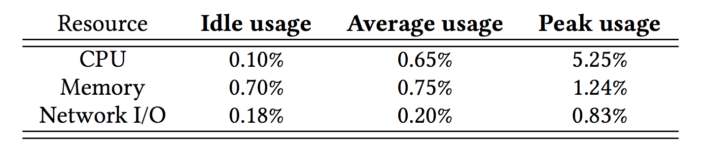
Evaluation: Scalability
Resource utilization of the controller node (48 computing node):
Scalability analysis for each component with growing number of node
Configuration Classifier: stress more network and CPU
Online Model Builder: fixed computation and network stress
Power Pool: stress more network
Notes:
The most stressed is cpu peak usage. This happened when the controller is running classifier model. However, notice that the computing workload does not increase proportionally to increased node number, b/c we run classifier for each application not each node.

Slide 40
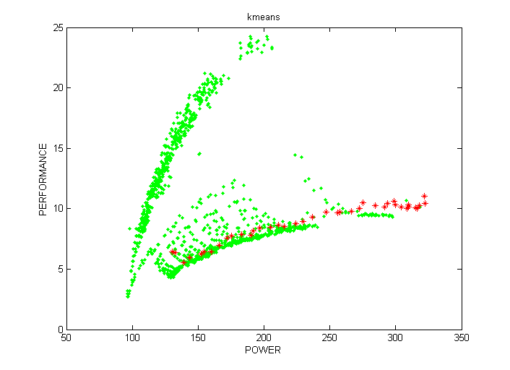
Performance Challenge
In the study of PUPiL:
1. Configuration space is huge
2. Optimal config accounts for a
small percentage
3. Speedup potential is promising
But, PUPiL solved this problem, why not just use it?

Slide 41
Quick proof
Big idea:
✔ PowerShift: pace application speed as even as possible → Optimal
A
B
Start
End

Slide 42
Quick proof
Big idea:
✔ PowerShift: pace application speed as even as possible → Optimal
Power
A
B
Start
End

Slide 43
Quick proof
Big idea:
✔ PowerShift: pace application speed as even as possible → Optimal
Power
A
B
Start
End

Slide 44
Quick proof
Big idea:
✔ PowerShift: pace application speed as even as possible → Optimal
Power
A
Maximal
Speedup
B
Start
End

Slide 45
Key design of dynamic mechanism for DDA
3 power priority groups: 1→2→3
Priority 1: Nodes running below power cap
Priority 2: Nodes running at power cap
Priority 3: Nodes running at power cap that are slowing down the overall execution
Prior works:
just want
throughput
Key group to handle DDA,
allowing power to be redirected to slower nodes not the power-hungry nodes
Notes:
3 power priority groups for power shifting, goes from lower to higher
We will have some examples to help us understand this in the following slides.

Slide 46
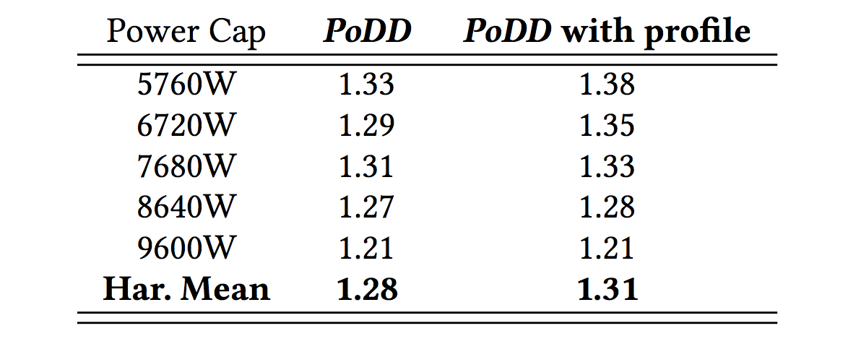
Evaluation --- profiles given
When given application profiles,
Skip phase1 – learning node-level resource allocation
Skip phase 2 – online model building
Notes:
This evaluation shows the extra speedup when the profiles exist.

Slide 47
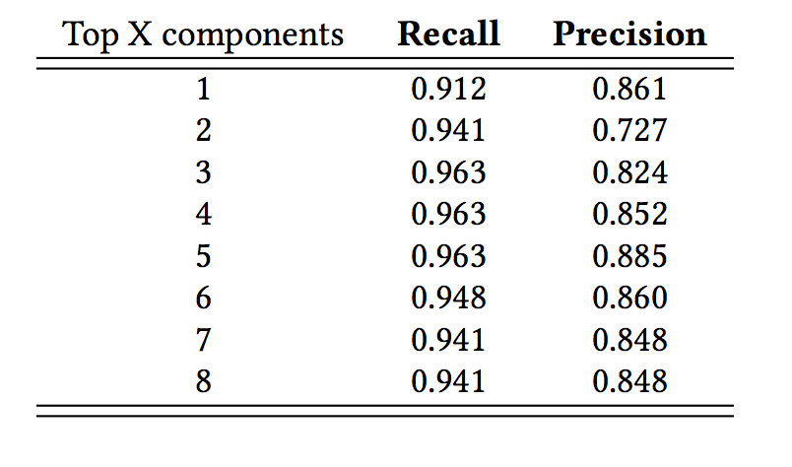

Slide 48
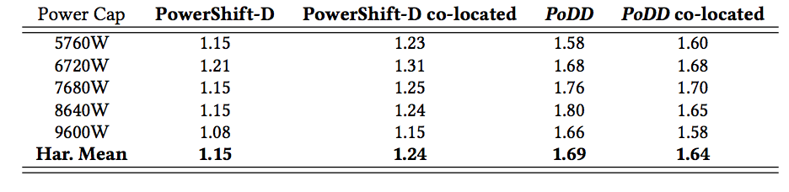

Slide 49
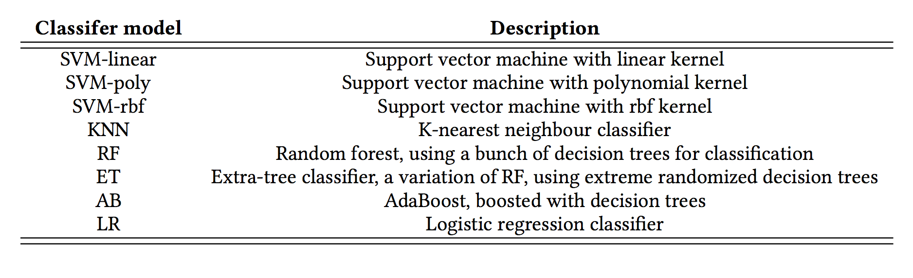
Configuration Classifier
8 popular models:

Slide 50
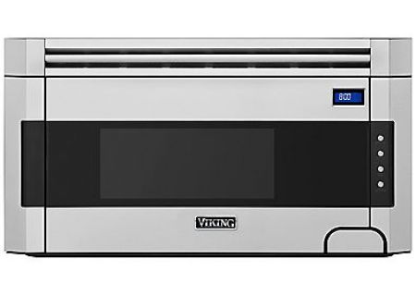
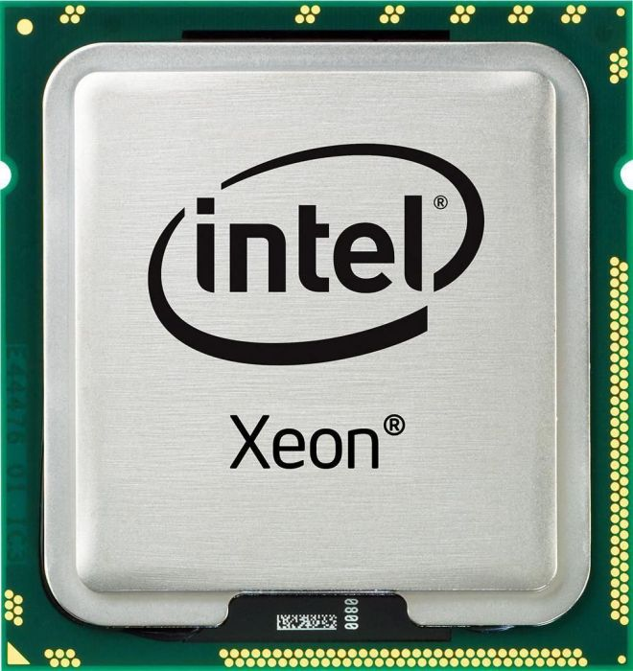

Why power cap is important?
$1,000 microwave oven
Power: 1.1 kW
Area ~ 1.1 foot^2
Intel Xeon Gold 6126
TDP: 125W
Turbo > 180W
Area ~ 6 inch^2
Heating per area:
30 Watts/inch^2
Heating per area:
6.9 Watts/inch^2
Power cap is necessary for Thermal Concerns
Notes:
To give you an idea of how much of heat a chip can generate, let’s compare a intel xeon processor 2017 to a powerful microwave oven I find on amazon

