Slide 1
Fully Integrated
FPGA Molecular Dynamics Simulations
Chen Yang§, Tong Geng§, Tianqi Wang*§, Rushi Patel§, Qingqing Xiong§,
Ahmed Sanaullah§, Chunshu Wu§, Jiayi Sheng†, Charles Lin‡,
Vipin Sachdeva‡, Woody Sherman‡, Martin Herbordt§
§Department of Electrical and Computer Engineering, Boston University, Boston, MA
*Department of Physics, University of Science and Technology of China, China
‡Silicon Therapeutics, Boston, MA
†Falcon Computing Solutions, Inc., Los Angeles, CA
11/21/2019

Slide 2
Context (1/4)
Over the last 15 years our group has shown that FPGA implementations of Molecular Dynamics components (LR, RL, bonded, etc.) require unique and sometimes surprising solutions
As technology has advanced, we have often revisited these implementations and found that the optimal choice has changed
The bulk of this paper is about design choices of the components and how those components fit together
So why is this an SC paper? (and not FPGA/FCCM, etc.?)
Notes:
The major result is
The bulk of the paper is design choices of the components, how we got it to fit together, and the results.
So why at SC rather than an FPGA conference (where we’ve published 20 MD papers previously)?
Because we believe that this is the final piece, not the first piece.

Slide 3
Context (2/4)
FPGAs are now plausible HPC devices with millions deployed (e.g., in the Microsoft cloud)
FPGAs are now big enough so that we can
  Fit all performance critical logic for MD on a single chip
  Run interesting applications without going off chip (around 100K particles)
  Get good performance!
This is the final piece to facilitate the building of FPGA clusters that support strong scaling even of small to medium sized molecules
And the possibility of achieving 10s of microseconds per day (at least) for those simulations
Our domain target here – long timescales for small’ish molecules
Notes:
The major result is
The bulk of the paper is design choices of the components, how we got it to fit together, and the results.
So why at SC rather than an FPGA conference (where we’ve published 20 MD papers previously)?
Because we believe that this is the final piece, not the first piece.

Slide 4
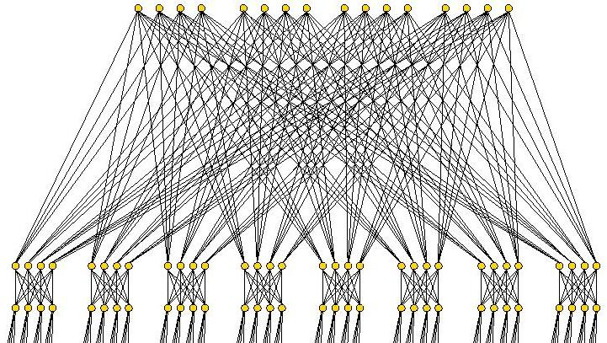
Where does FPGA efficiency come from?
….
~10,000
BRAM
BRAM
BRAM
BRAM
BRAM
BRAM
BRAM
BRAM
BRAM
BRAM
BRAM
BRAM
Resembles GPU, but
→ 10,000 independent scratchpads
→ Flexible custom pipelines (SPs)
Flexible custom interconnects
No restriction on inter-“block” communication!
….
f(A)
f(A)
f(A)
f(A)
f(A)
f(A)
f(A)
f(A)
f(A)
f(A)
f(A)
Configurable networks ...
….
f(A)
f(A)
f(A)
f(A)
f(A)
f(A)
f(A)
f(A)
f(A)
f(A)
f(A)
f(A)
f(A)
f(A)
f(A)
f(A)
f(A)
Key Idea: design so that all pipelines operate at nearly 100% efficiency
….
BRAM
BRAM
BRAM
BRAM
BRAM
BRAM
BRAM
BRAM
~10,000
Notes:
4
Like GPUs, FPGAs allow the programmer to use a huge number of FP pipelines. But it adds to that the capability of direct support for complex communication among all of those pipelines.

Slide 5
Key Idea → High efficiency extends to clusters of FPGAs
~10,000
144 x 40Gbs
….
….
BRAM
BRAM
BRAM
BRAM
BRAM
BRAM
NET
NET
NET
NET
Resembles GPU, but
→ 10,000 independent scratchpads
→ Flexible custom pipelines (SPs)
Flexible custom interconnects
No restriction on inter-“block” communication!
….
f(A)
f(A)
f(A)
f(A)
f(A)
f(A)
f(A)
f(A)
f(A)
f(A)
f(A)
Configurable networks ...
Key Idea: Direct, application-level, inter-node connectivity for ultra-low communication latency
….
f(A)
f(A)
f(A)
f(A)
f(A)
f(A)
f(A)
f(A)
f(A)
f(A)
f(A)
f(A)
f(A)
f(A)
f(A)
f(A)
f(A)
Key Idea: design so that all pipelines operate at nearly 100% efficiency
….
….
BRAM
BRAM
BRAM
BRAM
BRAM
BRAM
NET
NET
NET
NET
~10,000
144 x 40Gbs
Notes:
5
… and also directly among FPGAs.

Slide 6
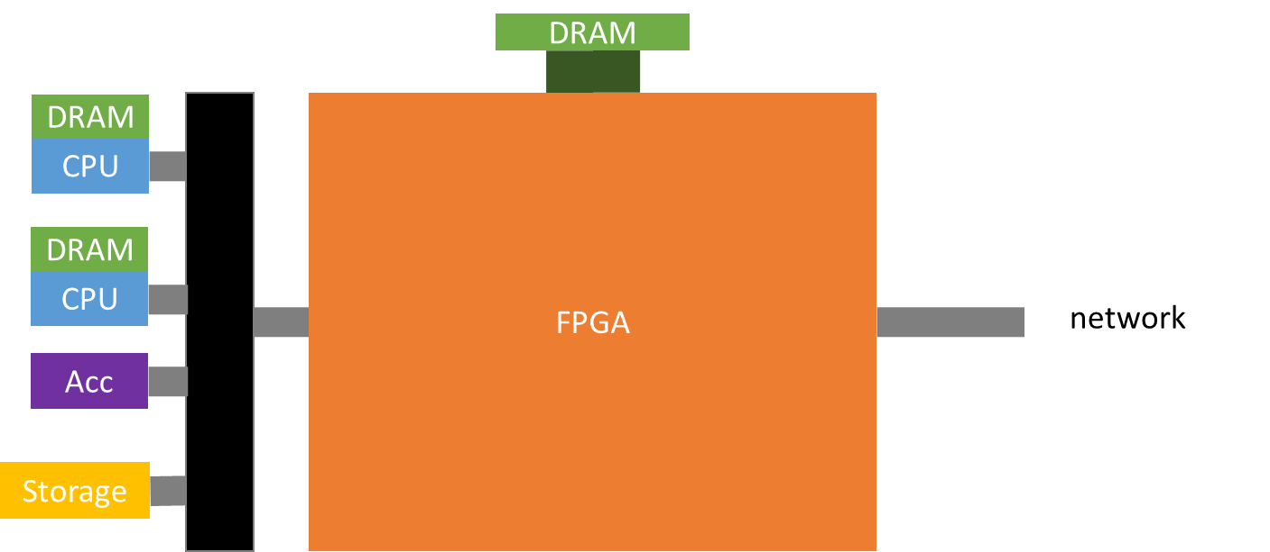
What FPGA-centric clouds and clusters look like*
…
Switch or direct connections
*Based on a Microsoft figure

Slide 7
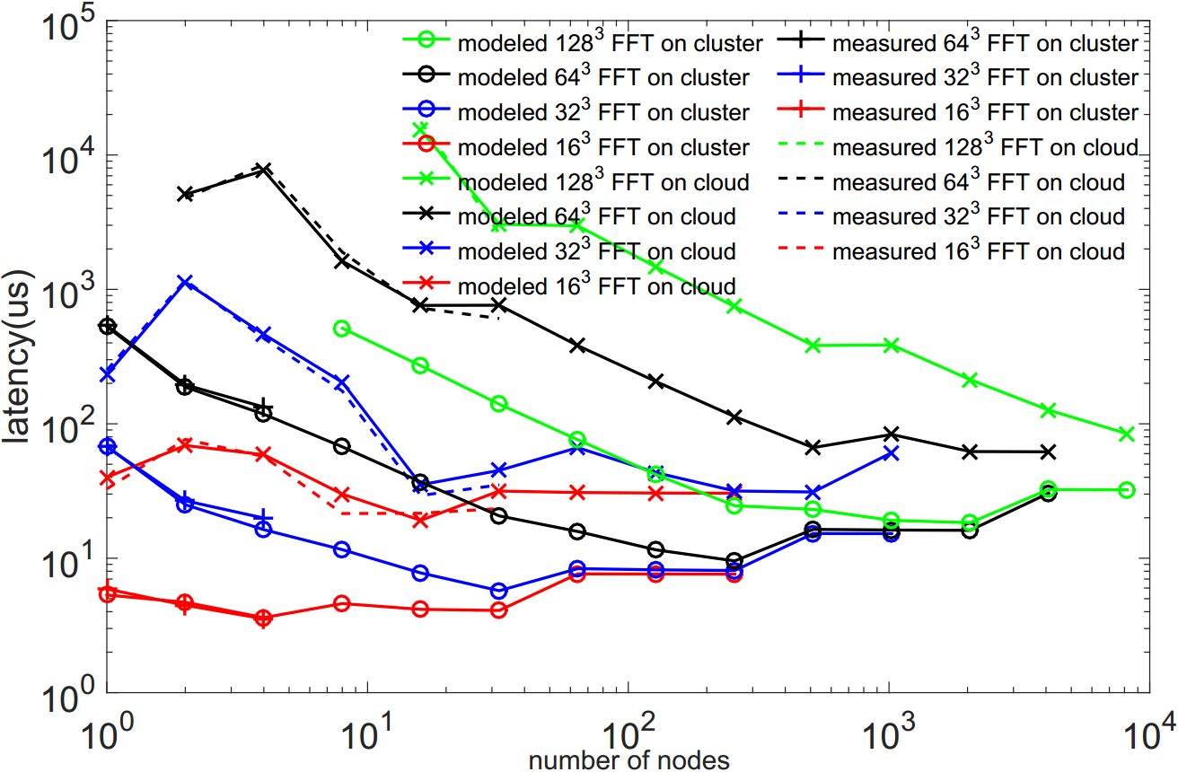
Context (3/4) – Strong Scaling of 3D FFT on FPGA Clusters and Clouds*
2014-era technology
Shows strong scaling of small 3D FFTs to hundreds of nodes
Significant space enables 10us/day throughput
10 us/day
*J. Sheng, C. Yang, A. Sanaullah, A. Caulfield, M. Papamichael, M.C. Herbordt (2017):
“HPC on FPGA Clouds and Clusters: 3D FFTs and Implications for Molecular Dynamics,”
Proc. Field Programmable Logic and Applications (FPL17)
Notes:
Previous work showed that the single chip performance is the hard part – FPGA clusters do really well when communication is needed.

Slide 8
Context (4/4) – Our goal here is …
Given the promise of FPGA-centric clusters,
Show that single node performance is sufficiently effective to enable this level of throughput
Notes:
Previous work showed that the single chip performance is the hard part – FPGA clusters do really well when communication is needed.

Slide 9
Outline
Context and motivation
MD & Spatial Computing Background
MD System Implementation
  Overall Architecture
  Range Limited Force Evaluation
  Long Range Interaction Evaluation
  Bonded Force Evaluation
  Motion Integration
FPGA Performance Evaluation
Future Work:
  Multi-FPGA Strong Scaling
  Communication Pattern Analysis

Slide 10
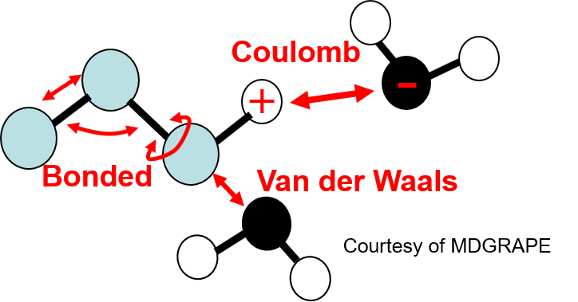

Molecular Dynamics Simulation
Why MD important?
  Core of Computational Chemistry
  Central to Computational Biology, with applications to
    Drug design
    Understanding disease processes
Generally O(n)
Initially O(n²), performed on accelerators
Why MD is hard?
All-to-all communication, hard to scale
What need to be done?
  Force Evaluation
    Bonded force
    Non-Bonded force
  Motion Update
Paradox:
  More compute nodes to shorten computation time
  Communication latency increases with # of hops
State-of-the-Art
?ms of simulated reality for a 90K particle
8 Cores (PC) | 4000 years
1K Cores (small HPC cluster) 10M Cores (large HPC cluster) | 50 years for 90K particles???
0.5K ASICs (Anton) | 0.1 year
$$F=m\frac{d^{2}r}{dt^{2}}$$
Force
Calculation
Motion
Update
90%
10%
Question: Can we get similar performance with COTs like FPGAs?
Notes:
Let’s have a look at one of the core HPC applications, Molecular Dynamics simulation.
MD is the core of computational chemistry that comprises a large fraction of supercomputing cycles. It plays an important role in drug design and understanding the chemical reactions behind disease.
Generally speaking, in order to observe the actual chemical process, we need to simulate interaction process long enough, usually in the level of us, even to ms.
MD use discrete time steps to model the motion of atoms. The timestep ppl generally use is on femtosecond level. And in each integration need to evaluation the mutual interaction for all particles in the simulation space, that involves a huge amount of calculations.
To date, 1 ms of simulation reality for a 90k particle sample takes years on conventional computers and clusters. Anton does a good job with a 512 asics. But it’s expensive and hard to get access to.
The question here is, can we get similar performance with COTS, like FPGA?

Slide 11
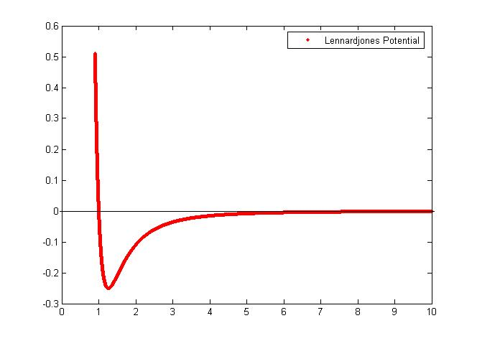
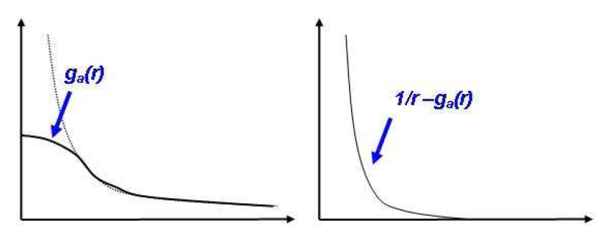

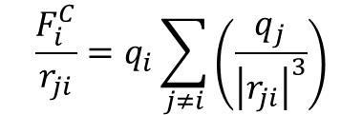
MD Background: Non-Bonded Force and O(N²) Complexity
Lennard-Jones Force:
  Decays quickly…. Cut-off !
Coulombic Force:
  Does not decay fast enough…..
  Partitions!
    Short-range part:
      Direct computation
    Long-range part:
      Smooth curve
      Particle mesh Ewald algorithm
      Update every few iterations
$$\frac{F_{i}^{LJ}}{r_{ji}}=\sum_{j≠i}{\frac{ε_{ab}}{σ_{ab}}\left\{12{\left(\frac{σ_{ab}}{\left|r_{ji}\right|}\right)}^{14}−6{\left(\frac{σ_{ab}}{\left|r_{ji}\right|}\right)}^{8}\right\}}$$
$$\frac{F_{i}^{C}}{r_{ji}}=q_{i}\sum_{j≠i}{\left(\frac{q_{j}}{{\left|r_{ji}\right|}^{3}}\right)}$$
Short-range
Lennard-Jones Force
Cut-off approximation
Long-range
Coulombic Force

Slide 12
MD Background: O(N) w/ Cutoff and Cell-lists
Cutoff Radius r_{c}:
  Evaluate the non-bonded force when distance within r_{c}
  F = 0 when r > r_{c}
Cell list:
  Cell size = r_{c}³
  Given reference particle P, only evaluate neighbor particles within 26 nearest neighbor cells
Newton’s 3rd Law:
  Particle interaction is mutual -> Only evaluate half particles within cutoff
Filtering (FPGA analog of neighbor lists):
  Remove unnecessary particles outside cutoff
r_{c}
P
Z
Y
X

Slide 13
Spatial Computing 101
Context switch is very time consuming – generally don’t do it within a single application run
  All modules always active
  Works best when data are streamed from module to module
Modules can be replicated
  Smaller “space” per module = more replication = better performance
Modules can be attenuated
  Per module – trade off space for performance.
  Per module – smaller space = less performance – but OK since …
  Off-critical-path modules can be reduced in size until nearly on critical path

Slide 14
Spatial Computing example 1 – RL force pipeline
Distance computation
Full force pipeline
Force computation
With cell lists, 85% of pairs still have zero force
→ BUT - This can be determined with low precision arithmetic and no multiplies

Slide 15
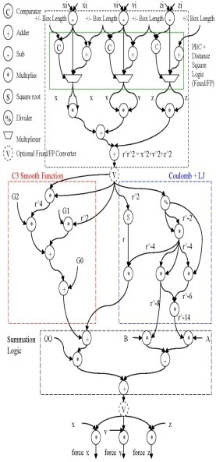
Low-cost filter removes unnecessary computations
Filter = Distance computation & threshold
Idea: ~6x as many “filters” as force pipelines
  Throughput improves by 6x (due to 15% efficiency)
  Cost is only the replicated simplified distance computation which is a fraction of the total pipeline cost
per 1x force pipeline
6-9x small low precision distance computations
Lesson: FPGAs/ASICs can do things easily that are inconceivable on CPUs/GPUs → no need for neighbor lists
Notes:
So this leads to the obvious change – replicate this distance computation 6 times per rest of force pipeline and only send the particle pairs that pass the filter on to the rest of the force pipeline.
15

Slide 16
Spatial Computing example 1 – Mapping particle pairs to filters
Particle Mapping (PM)
  Each filter is responsible for a different reference particle
  Each cycle, a single partner particle from the cell set is broadcast to all of the filters
  Particle pairs which satisfy filtering rules are stored into filter queues for force computations
Neighboring cells
Home cell
Reference particles are distributed into each filter
P
Lesson: Power of hardware broadcast to couple thousands of scratchpads with thousands of pipelines
8-9 Filters/bank
Notes:
Applicable for both double-buffering and continuous queuing schemes
16

Slide 17
Spatial Computing example 1 – Mapping particle pairs to filters
Cell Mapping (CM)
  Each filter bank consisting 6-9 filters is responsible for a different reference particle
  Each filter within a bank processes the same reference particle w.r.t. partners from its own subset of 2 or 3 cells
  Particle pairs which satisfy filtering rules are stored into filter queues for later process
Neighboring cells
Home cell
A single reference particle is broadcast to filters in a bank
P
Lesson: MD is a really complex problem with a large space of design variations
6-9 filters/bank
Notes:
Only applicable for continuous queueing (FIFO-based design) due to load balance concern
Mention about the property of PM and CM. The current design uses PM scheme since it provides better scalability.
17

Slide 18
Outline
Context & Motivation
MD & Spatial Computing Background
MD System Implementation
  Overall Architecture
  Range Limited Force Evaluation
  Long Range Interaction Evaluation
  Bonded Force Evaluation
  Motion Integration
FPGA Performance Evaluation
Future Work:
  Multi-FPGA Strong Scaling
  Communication Pattern Analysis

Slide 19
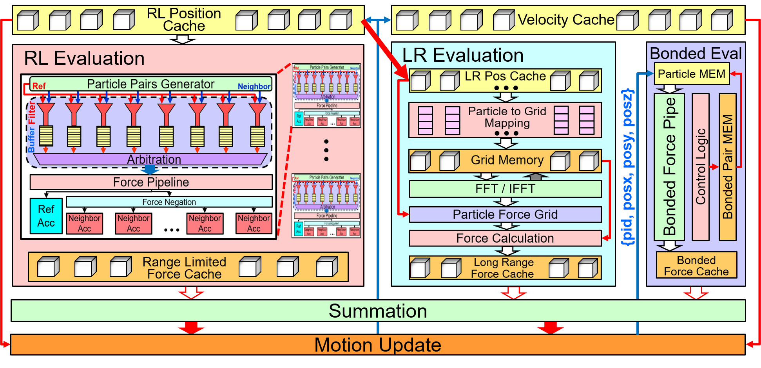
System Architecture
Notes:
Several major modules with many submodules. These can be sized according to area and time budgets.

Slide 20
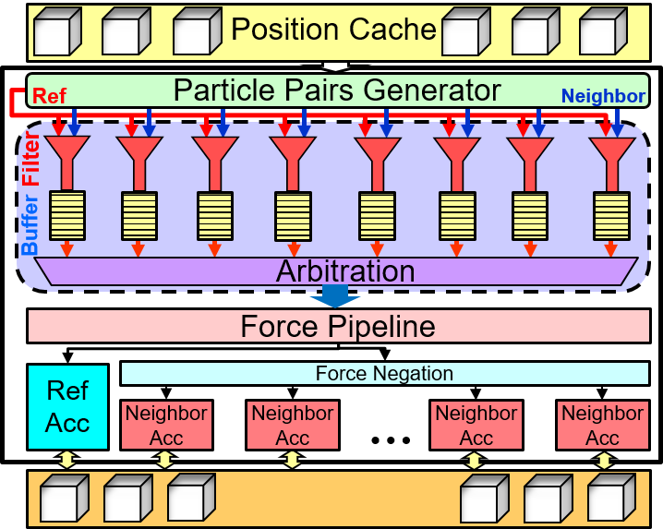
Range Limited (RL) Architecture
Particle Position Cache
  Particle Position Data (as well as Index Data)
Pair Generator
  Assemble pairs based on Cell Location
Filter Banks
  Multiple filters per pipeline with buffers
  Distance <= R_{cut-off} → Pass
Force Evaluation
  Non-bonded force evaluation
Accumulation
  Accumulate particle force to both reference particle and neighbor particles
RL Force Cache
  Holding Particle Force from RL interaction
F
F
Notes:
ADD ANIMATION HERE!

Slide 21
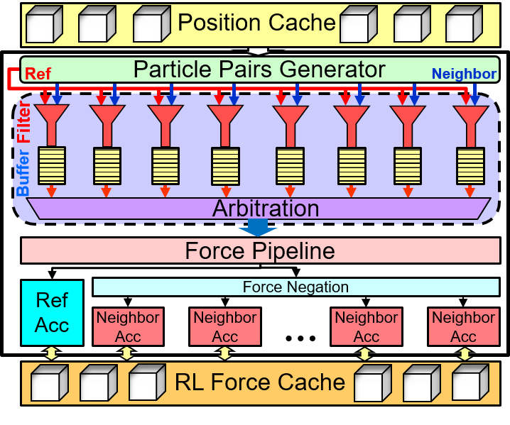
RL Mapping: Particles on Memory Modules
Q1: Which Memory Resource?
  MLAB: lut-based, suitable for small size
  M20K: flexible, large capacity, high-performance
  eSRAM: large capacity, low-latency, low flexibility, low availability
Q2: Unified Mem or Seperate Mem for Different Datatypes?
  Position, Velocity, Force
  Different access time & access frequency
Q3: Single Global Mem or Individual Cell Mem?
  Mem 1: Single Global Memory
    Simplified wiring, but limited rd&wr BW
  Mem 2: Individual Cell Memory
    Complex wiring, but sufficient BW
Global Position Cache
In Cache
In Cache
In Cache
Pair Gen
Pair Gen
…
Pair Gen
…
…
…
F
F
F
F
F
F
Force 1
Force 2
Force M
Mem 1: Single Global Memory
Cell 0
Cell 1
Cell N
Pair Gen
Pair Gen
…
Pair Gen
TBD
…
…
…
F
F
F
F
F
F
Force 1
Force 2
Force M
Mem 2: Individual Cell Memory

Slide 22
RL Mapping: Workload on Pipelines
sum
Filters
C_{N}
C₁
+
Distribution 1: Pipelines working on same reference particle
C_{N}
Force 1
+
C₂
…
…
Force 1
…
…
Force 1
C₁₄
…
…
Force 2
Adder Tree
+
C₂
+
Distribution 2: Pipelines working on same cell, but different reference particles
C₃
…
Force 2
…
…
Force 2
C_{N+1}
…
C₁₅
……
Force 3
…
+
…
…
…
Distribution 3: Pipelines working on different homecells
…
Force M
C_{N}
+
C_{N+13}
…
C_{N+1}
…
C_{N+1}
C_{N+13}
…
…
Force M
Force M
C_{N+13}
Distribution 1
Distribution 2
Distribution 3
Notes:
13-16 Merge into a single slides

Slide 23
RL Mapping: Workload on Pipelines
Filters
r_{c}
Distribution 1:
Pipelines working on same reference particle
C_{N}
Force 1
…
…
Force 2
Adder Tree
F1
F2
C_{N+1}
P
F3
…
……
Force 3
F4
…
…
F5
F6
F7
C_{N+13}
……
…
Force M
Z
F..
F..
FM
Y
X

Slide 24
Mapping: Workload on Pipelines
sum
r_{c}
C_{N}
Distribution 2:
Pipelines working on same cell, but different reference particles
+
…
Force 1
…
+
…
Force 2
…
+
…
Force M
…
C_{N+1}
C_{N+13}
Z
Y
Distribution 2
X

Slide 25
Mapping: Workload on Pipelines
C₁
+
r_{c}
Distribution 3:
Pipelines working on different homecells
C₂
…
…
Force 1
C₁₄
C₂
+
C₃
…
…
Force 2
C₁₅
…
C_{N}
+
C_{N+1}
…
…
Force M
C_{N+13}
Z
Y
Distribution 3
X

Slide 26

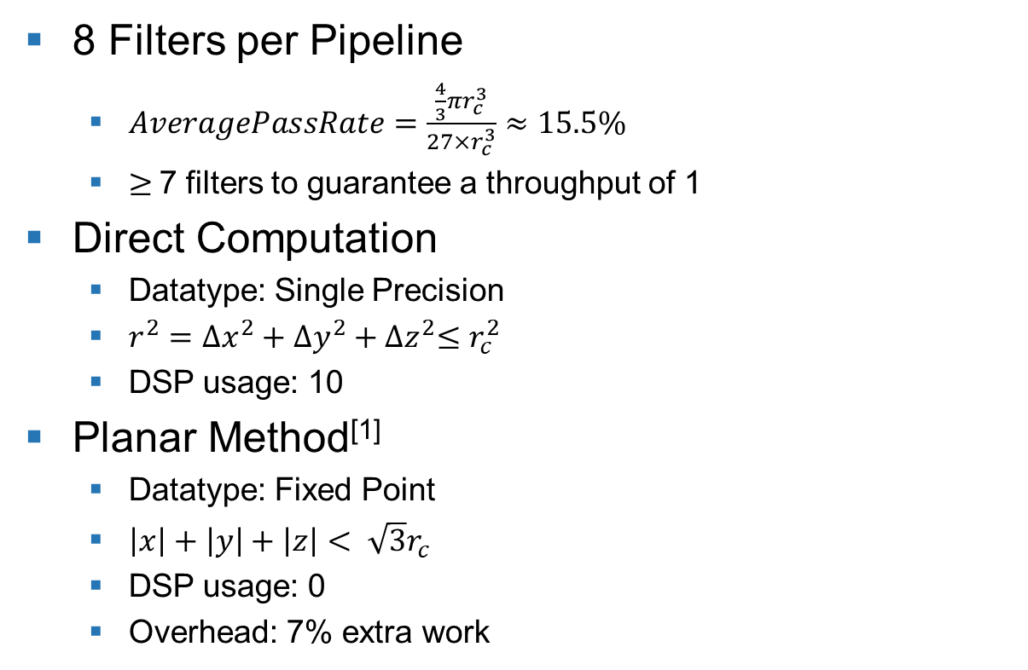


RL: Filter Logic
8 Filters per Pipeline
  $AveragePassRate=\frac{\frac{4}{3}πr_{c}^{3}}{27×r_{c}^{3}}≈15.5\%$
  $≥$7 filters to guarantee a throughput of 1
Direct Computation
  Datatype: Single Precision
  $r^{2}={∆x}^{2}+{∆y}^{2}+{∆z}^{2}≤r_{c}^{2}$
  DSP usage: 10
Planar Method^{[1]}
  Datatype: Fixed Point
  $\left|x\right|+\left|y\right|+\left|z\right|< \sqrt{3}r_{c}$
  DSP usage: 0
  Overhead: 7% extra work
Comparator
C
Floating-Point
Adder
+
$∆z^{2}+∆y^{2}+∆z^{2}<r_{c}^{2}$
Floating-Point
Subtractor
-
Direct Computation
Floating-Point
Multiplier
X
Fixed-Point
Adder
+
Fixed-Point
Subtractor
$$\sqrt{3}r_{c}$$
$$\left|x\right|+\left|y\right|+\left|z\right|<\sqrt{3}r_{c}$$
-
Planar Method
* M. Chiu, Molecular Dynamics Simulations on High Performance Reconfigurable Computing Systems, ACM-TRETS (2010)

Slide 27
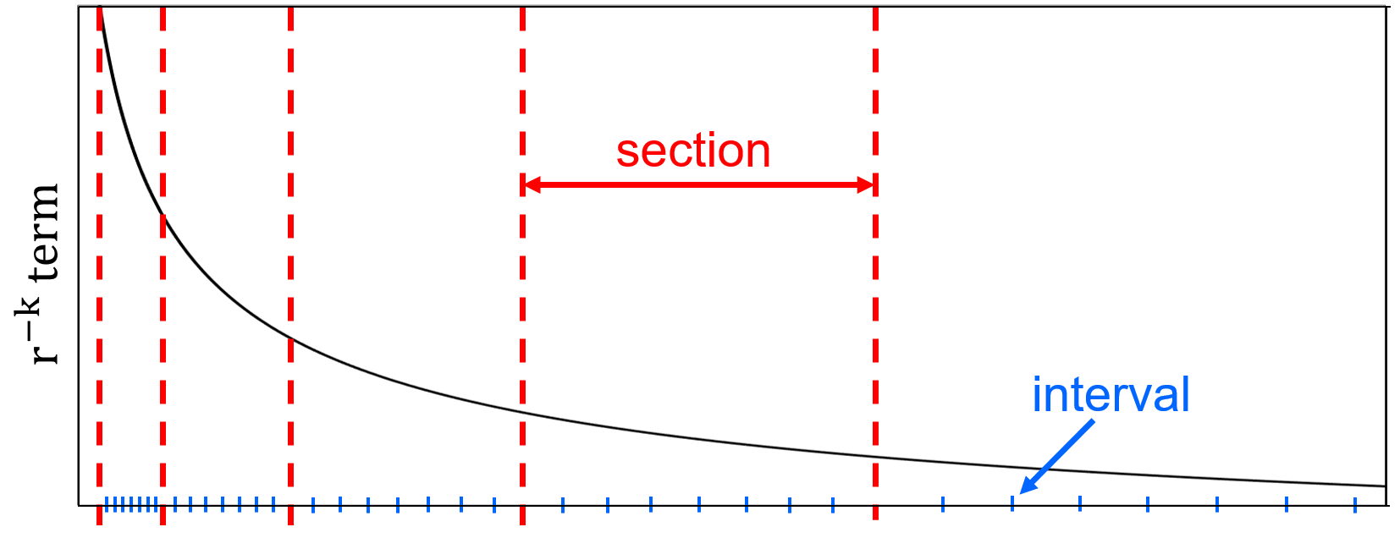
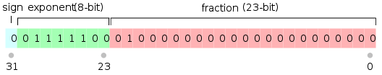
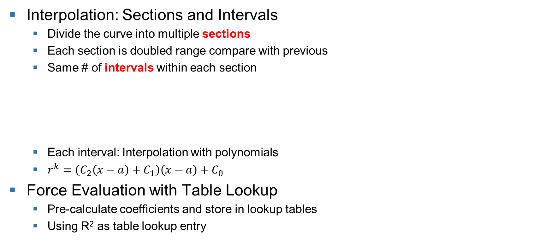

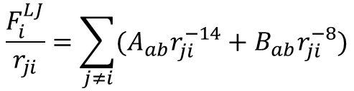
RL: Force Evaluation using Interpolation
Single Float
$$\frac{F_{i}^{LJ}}{r_{ji}}=\sum_{j≠i}{(A_{ab}r_{ji}^{−14}+B_{ab}r_{ji}^{−8})}$$
Interpolation: Sections and Intervals
  Divide the curve into multiple sections
  Each section is doubled range compare with previous
  Same # of intervals within each section
  Each interval: Interpolation with polynomials
  $r^{k}=\left(C_{2}\left(x−a\right)+C_{1}\right)\left(x−a\right)+C_{0}$
Force Evaluation with Table Lookup
  Pre-calculate coefficients and store in lookup tables
  Using R² as table lookup entry
Locate Segment
Locate intervals
$$\frac{F_{i}^{RL}}{r_{ji}}=A_{ab}R_{14}({\left|r_{ji}\right|}^{2})+B_{ab}R_{8}({\left|r_{ji}\right|}^{2})$$

Slide 28
RL: Partial Force Accumulation
Task:
  Accumulate to Reference & Neighbor Particles
Challenge:
  DSP Latency: 3 cycles
Reference Particle Acc
  Location: output side of force pipeline
  Accumulating to same value
  Sol: Accumulate to 3 different temp values
Neighbor Particle Acc
  Location: input side of force cache
  Accumulating to different values most of the time
  Chances accumulating to same value
  Sol: Data hazard detection by checking active ID
In Buffer
F4
F2
F3
F1
F
PID
Sum1
==?
acc3
acc2
acc1
FP Adder
Sum2
Sum3
PID
0
Sum Cache
+
SUM
Force Cache
Reference Particle Accumulator
In Buffer
Force Cache
F
PID
ReadEnable
FP Adder
PID Comp
PID1
PID2
PID3
Neighbor Particle Accumulator

Slide 29
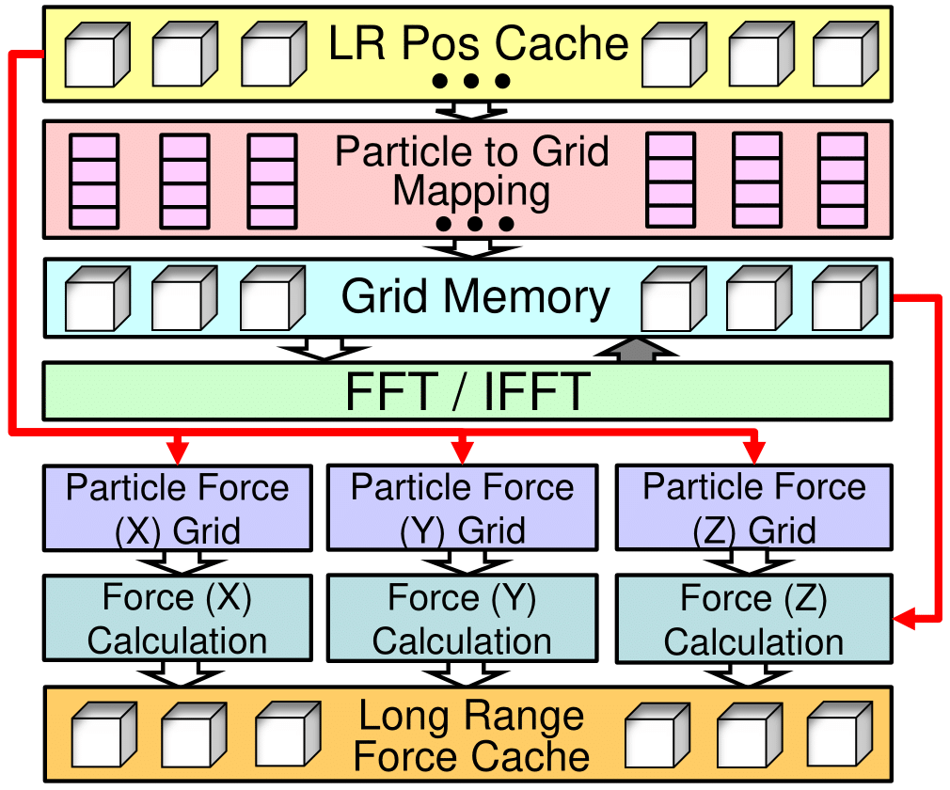
Long Range (LR) Architecture
LR Updating Frequency:
  Every other iteration
Based on Particle Mesh Ewald Summation Method
Individual LR Position Cache
  Organized in Cells
  Copied from RL every other iteration
Particle to Grid Mapping*
3D FFT
  Based on Intel FFT IP Core
Parameterized Design
  Dataset Size -> Grid Size -> FFT Size
  LR Latency ~= 2X RL Latency -> # FFT Units
* A. Sanaullah, A. Khoshparvar, M. Herbordt, FPGA-Accelerated Particle-Grid Mapping, FCCM (2016)

Slide 30
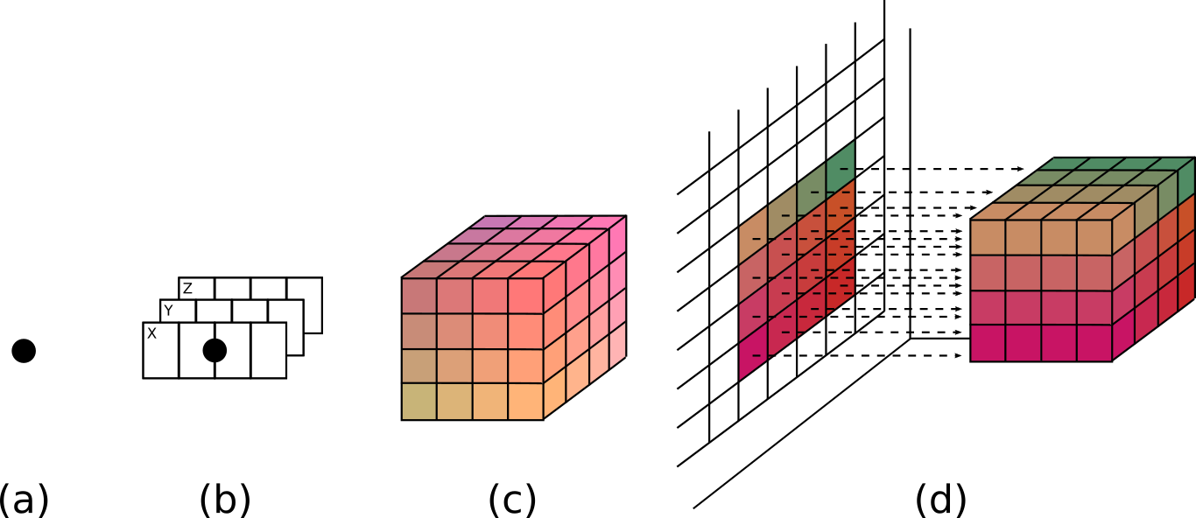
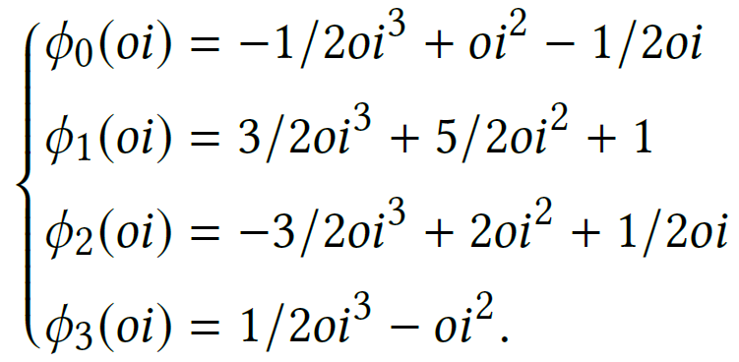
LR: Particle to Grid Conversion
Particle Charges to Grid -> 1D Interpolation on Each Dimension
  3rd Order -> Spread particle charge to four closest grid point
Accumulating mapped charges to each grid point (4*4*4)
Distributing grid point to 16 memory units
  Each memory units feeds the input of a FFT Unit

Slide 31
Particle-Grid & Grid-Particle Map Really Well to FPGAs …
Example: Trilinear Interpolation (tricubic actually used)
SW style: Sequential RAM access
HW style: App-specific interleaving
(x,y,z)
(x,y,z)
Notes:
This is perfect for FPGAs! Dedicated network, dedicated pipeline.

Slide 32
Map grid points in scratchpads to hardware “mapper” with interleaved memory read network
X
00
01
02
03
00
01
02
03
00
01
02
03
10
11
12
13
10
11
12
13
10
11
12
13
13
10
11
12
00
01
02
03
00
01
02
03
10
11
12
13
20
21
22
23
20
21
22
23
10
11
12
13
23
20
21
22
Y
30
31
32
33
30
31
32
33
20
21
22
23
10
11
12
13
10
11
12
13
20
21
22
23
00
01
02
03
00
01
02
03
33
30
31
32
10
11
12
13
10
11
12
13
20
21
22
23
30
31
32
33
20
21
22
23
20
21
22
23
30
31
32
33
20
21
22
23
20
21
22
23
03
00
01
02
00
01
02
03
00
01
02
03
30
31
32
33
30
31
32
33
30
31
32
33
30
31
32
33
30
31
32
33
00
01
02
03
10
11
12
13
13
10
11
12
10
11
12
13
20
21
22
23
23
20
21
22
20
21
22
23
30
31
32
33
33
30
31
32
30
31
32
33
00
01
02
03
03
00
01
02

Slide 33
3D FFT – please see FCCM14

Slide 34
Bonded Force Evaluation
Three Types of Interactions*:
  Bond, Angle, Dihedral
Memory Architecture:
  Bonded Pair Memory:
    Pairs remain fixed during simulation
    Each entry holds global particle IDs that contribute to the same interaction
  Bonded Particle Memory
    Holds Position Data
    Updated during Motion Integration
  Bonded Force Cache:
    Accumulate the partial forces from each contributed interaction
gid
Vector
Subtractor
Bonded Particle MEM
V-
Atom i
Atom j
Atom i
Atom j
Atom k
4 Atoms
Vector
Multiplication
Bonded Pair MEM
Vx
V-
V-
k_ub
V-
Len
3D Hypotenuse
Len
Ɵ routine
Arc
Len
Ψ routine
Dot Product
-
Sin
Cos
/
Len
…
X
X
X
Cross Product
…
…
/
f_ub
Sin
Sine
/
Vx
+
Bond
Angle
Dihedral
Cos
Cosine
f_bond
f_angle
f_dihedral
Bonded Force Cache
Arc
Arctangent
* Q. Xiong, M. Herbordt, Bonded Force Computation on FPGAs, FCCM (2017)

Slide 35
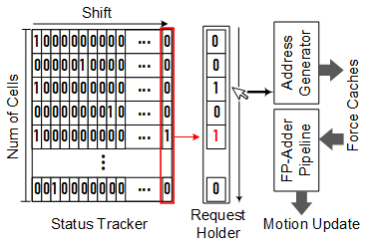
Summation Logic: Score Boarding
Task: Sum Up Particle Forces
Goal: Initiating Summation as soon as RL evaluation on a Home Cell and its 26 Neighbor Cells are done!
Status Tracker:
  27-bit Shift Register for each Cell
  Each time are participating cell finish evaluation -> Shift once
Request Holder:
  Detect “1” from output of Status Tracker
  Forward finished Cells to Force Summation
Force Summation:
  Sum up particle force: RL, LR, Bonded
Motion Update

Slide 36
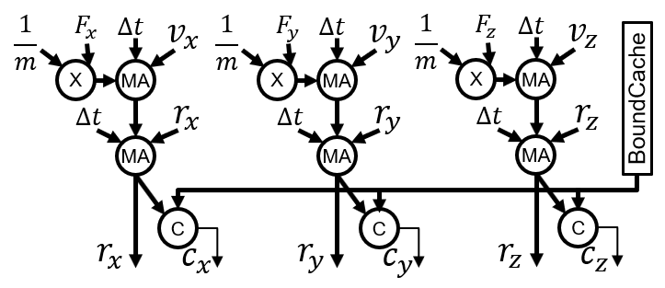
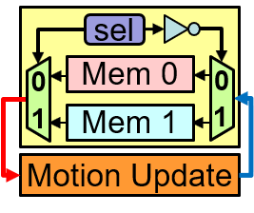



Motion Update & Particle Migration
$$\vec{a}\left(t\right)=\frac{\vec{F}(t)}{m}$$
$$\vec{v}\left(t+∆t\right)=\vec{v}\left(t\right)+\vec{a}(t)×∆t$$
$$\vec{r}\left(t+∆t\right)=\vec{r}\left(t\right)+\vec{v}(t+∆t)×∆t$$
Motion Update
  Classic Newtonian Law
  Frequency: once every simulation timestep
  Datatype: Floating Point
Particle Migration
  Small timestep -> Migrate within nearest neighbor
  Cell Boundary: Table lookup
  Cell Particle Update: double buffering in Pos&Vol Cache
    Write new particle to alternative set of memory
    Avoid maintaining list of vacant memory space
Motion Update Datapath
Position & Velocity Cache
C_{N-1}
C_{N}
C_{N+1}
C_{N-1}
C_{N}
C_{N+1}
P0
P0
P0
P0
PX
P0
P0
P1
P1
P1
P1
P1
P1
P2
P2
P2
P2
P2
P2
…
…
…
…
…
…
…
…
…
PM
PM
PM
PM
PX
On-Site Update
Update with Double Buffer

Slide 37
Parameterized Design
Resource Usage Estimator
Module Name | Per Unit Resource Usage |  |  | # Copies | Total Resource Usage
 | ALMs | M20Ks | DSP |  | ALMs | M20Ks | DSP
Dataset Caches | 280 | 1,137 | 3 | 1 | 96,040 | 2,736 | 1,029
Velocity Cache | 0 | 3 | 0 | 343 | 0 | 1,029 | 0
Short Range Position Cache | 0 | 226 | 0 | 1 | 0 | 226 | 0
Short Range Force Cache | 280 | 3 | 3 | 343 | 96,040 | 1,029 | 1,029
Long Range Postion Cache | 0 | 226 | 0 | 1 | 0 | 226 | 0
Long Range Result Cache | 0 | 226 | 0 | 1 | 0 | 226 | 0
Bonded Position Cache | 0 | 226 | 0 | 0 | 0 | 0 | 0
Bonded Result Cache | 0 | 226 | 0 | 0 | 0 | 0 | 0
MuxTree | 5,623 | 0 | 0 | 1 | 5,623 | 0 | 0
Short Range Part | 6,161 | 168 | 115 | 52 | 315,472 | 3,536 | 1,161
Input Cache | 0 | 3 | 0 | 52 | 0 | 156 | 0
Particle Pair Generator | 756 | 0 | 0 | 52 | 39,312 | 0 | 0
Evaluation Units | 5,305 | 65 | 15 | 52 | 275,860 | 3,380 | 780
Adder Tree | 100 | 0 | 127 | 3 | 300 | 0 | 381
Long Range Part | 57,950 | 127 | 514 | 1 | 209,284 | 2,608 | 1,845
Particle Position Cache | 0 | 90 | 0 | 0 | 0 | 0 | 0
Particle to Grid Assignment | 1,122 | 0 | 174 | 1 | 1,122 | 0 | 174
Particle to Grid Acc | 0 | 0 | 3 | 64 | 0 | 0 | 192
Memory Controller | 46,161 | 0 | 0 | 1 | 46,161 | 0 | 0
Grid Memory | 0 | 2 | 0 | 1,024 | 0 | 2,048 | 0
FFT/IFFT | 10,000 | 35 | 36 | 16 | 160,000 | 560 | 576
Force to Grid Calc | 667 | 0 | 174 | 3 | 2,001 | 0 | 522
Force Reduction Tree | 0 | 0 | 127 | 3 | 0 | 0 | 381
Bonded Force Part | 29,212 | 549 | 372 | 1 | 29,212 | 549 | 372
Control Logic and Misc | 213 | 0 | 0 | 1 | 213 | 0 | 0
Bond Pipeline | 1,481 | 10 | 18 | 1 | 1,481 | 10 | 18
Angle Pipeline | 13,691 | 77 | 153 | 1 | 13,691 | 77 | 153
Torsion Pipeline | 12,432 | 77 | 201 | 1 | 12,432 | 77 | 201
Position Mem | 578 | 100 | 0 | 1 | 578 | 100 | 0
Force Mem | 352 | 100 | 0 | 1 | 352 | 100 | 0
Summation | 598 | 0 | 6 | 1 | 598 | 0 | 6
Motion Update | 1,579 | 1 | 6 | 1 | 1,579 | 1 | 6
FULL DESIGN |  |  |  |  | 657,808 | 9,430 | 4,419
% |  |  |  |  | 70.5 | 80.46 | 76.72
Select number of units based on dataset and chip size
Resource Usage Estimator
  What: Spreadsheet provides coarse estimation on resource usage
  “Per Unit Resource Usage” extracted from post synthesis results
  Parameter: # of copies for each units
  Goal: Make sure design can fit on a single FPGA before moving on to compilation stage
Reduce Development Time!

Slide 38
Outline
Context & Motivation
MD & Spatial Computing Background
MD System Implementation
  Overall Architecture
  Range Limited Force Evaluation
  Long Range Interaction Evaluation
  Bonded Force Evaluation
  Motion Integration
FPGA Performance Evaluation
Future Work:
  Multi-FPGA Strong Scaling
  Communication Pattern Analysis

Slide 39
Evaluation: Experimental Setup
FPGA: Reflex XpressGX S10-FH200G Board
  Intel Stratix 10 1SG280LU2F50E2VG
  Abundant DSP and RAM Resources:
Host Environment (Silicon Therapeutics):
  Intel Xeon Platinum 8160
  GPU: Nvidia Titan XP (Pascal)
MD Dataset:
  Dihydrofolate Reductase (DFHR): 23,558 atoms^{[1]}
MD Benchmark:
  Amber 18: software-based benchmark, support CUDA
ALMs | RAM Blocks | DSP Units
933,120 | 11,721 | 5,760
[1] D.A. Case, I.Y. Ben-Shalom, S.R. Brozell, D.S. Cerutti, et. al., Amber 18, Technical report, University of California, 2018

Slide 40
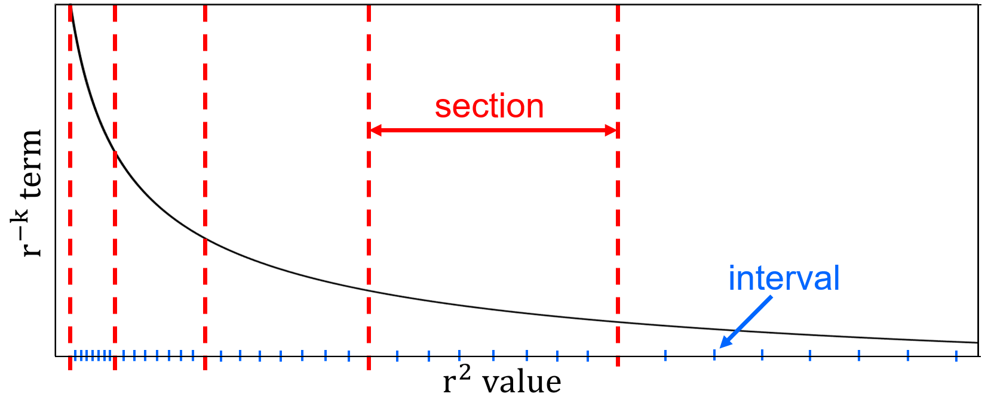
Evaluation: RL Interpolation Accuracy
Which interpolation order?
How many intervals per section?
More Memory Usage for Indexes
Interval | 16 | 32 | 64 | 128 | 256
1st Order | 99.7700 | 99.9336 | 99.9842 | 99.9960 | 99.9990
2nd Order | 99.9899 | 99.9988 | 99.9998 | 99.9999 | 99.9999
3rd Order | 99.9996 | 99.9999 | 99.9999 | 99.9999 | 99.9999
More DSP
Higher order More DSP usage & More index to store
More Intervals More memory usage
Tradeoff: DSP Block RAM

Slide 41
Evaluation: RL Resource Usage
Design | DataType | ALM | BRAM | DSP | Frequency (MHz) | Latency (CC)
Direct | 32-bit Fixed | 1365(0.15%) | 4(0.04%) | 19(0.33%) | 505 | 89
Interpolation | 32-bit Fixed | 866(0.09%) | 17(0.15%) | 10(0.17%) | 433 | 22
Direct | Single Float | 698(0.08%) | 3(0.03%) | 11(0.19%) | 486 | 59
Interpolation | Single Float | 462(0.05%) | 17(0.15%) | 6(0.09%) | 654 | 14
Design Options:
Evaluation Approach
  Direction Computation
  Interpolation:
    1st Order
    256 intervals
Data Types:
  32-bit fixed point
  Single Floating Point
Deciding Factor: DSP Usage!

Slide 42
Evaluation: LR Resource Usage
Grid Mapping Units # | ALM | BRAM | DSP | Latency (CC)
1 | 209,284 | 2,608 | 1,845 | 190,069
2 | 210,406 | 2,608 | 2,019 | 119,395
3 | 211,528 | 2,608 | 2,193 | 106,307
4 | 212,650 | 2,608 | 2,367 | 101,727
40%
Faster
Trade-off: Matching the evaluation time wrt to RL (twice as much latency)
Bottleneck: FFT cannot start until Grid Mapping finishes!
Grid Mapping Unit #:
  Limited impact to resource usage
  From 1 → 2: 40% less on latency

Slide 43
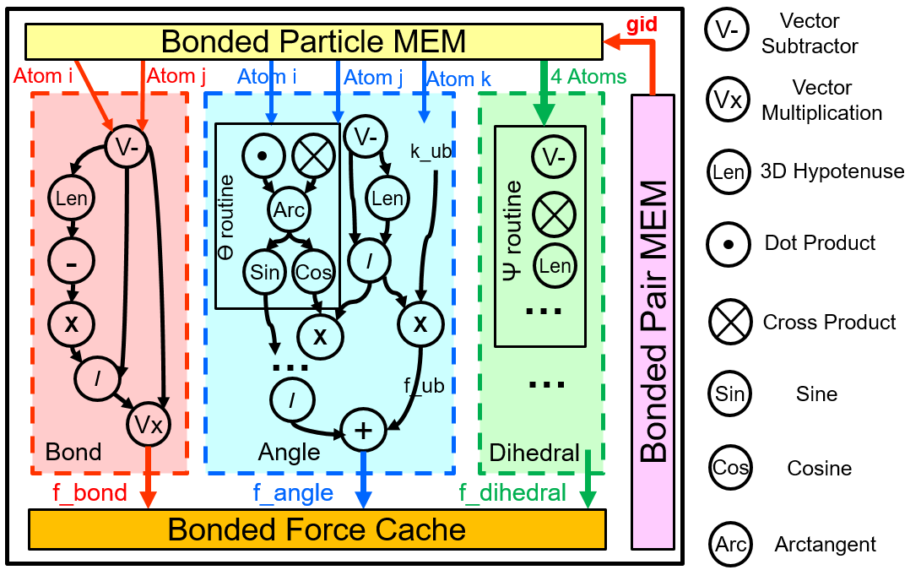
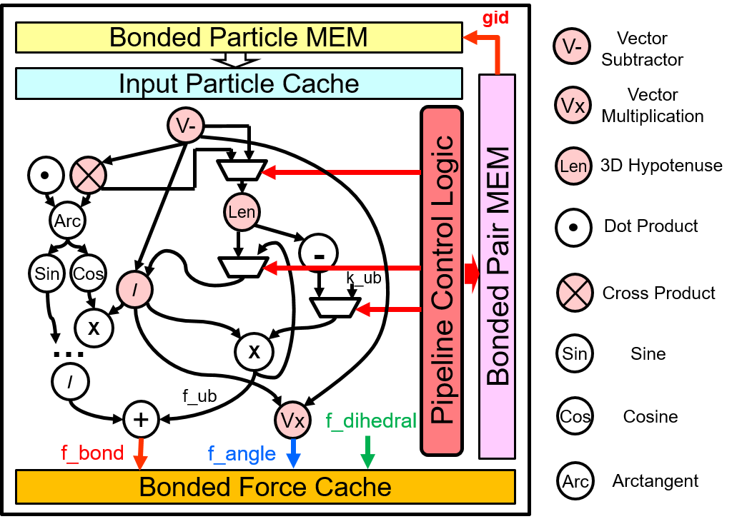
Evaluation: Bonded Resource Usage
 | ALM | BRAM | DSP | Latency (CC) | Freq (MHz)
Bond | 1,481 | 10 | 18 | 148 | 398
Angle | 13,691 | 77 | 153 | 187 | 401
Dihedral | 12,432 | 77 | 201 | 244 | 392
Merged | 20,109 | 93 | 278 | 276 | 330
Sequential Processing!
Bonded only consumes a small fraction of FLOPs

Slide 44
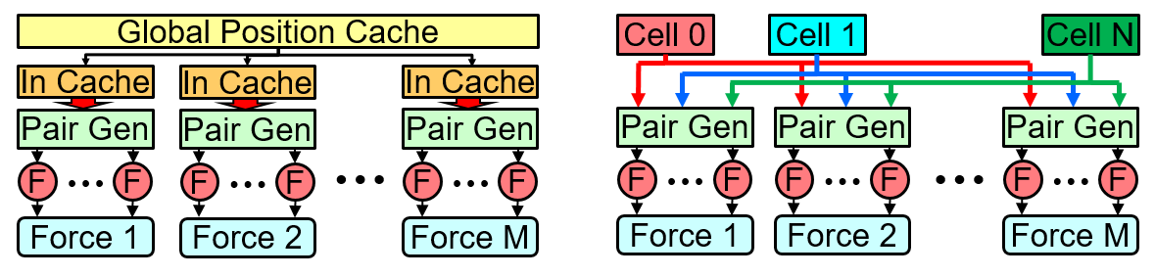
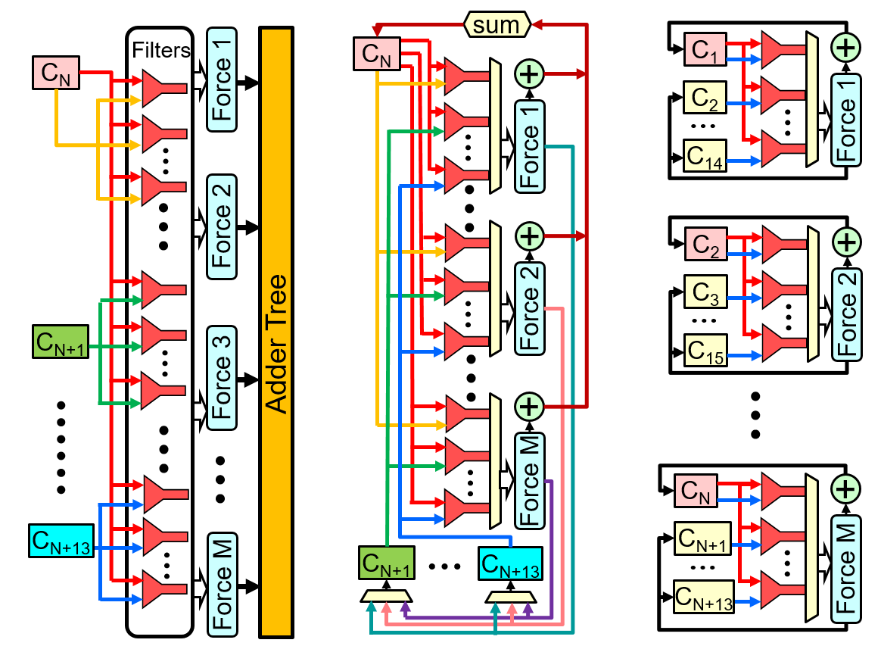
Evaluation: Recapping Design Variations
Design Variations Quick Recap (RL):
  2 particle-to-memory mapping:
    Mem 1: All particle in a single large memory unit
    Mem 2: Individual cell memory
  3 workload distributions:
    Distribution 1: All pipelines working on same reference particle
    Distribution 2: All pipelines working on same homecell, but different ref particle
    Distribution 3: Pipeline working on different homecells
Total of 6 combinations
Particle-to-Memory Mappings
Workload Distributions

Slide 45
Evaluation: Full System Resource Utilization
Design | ALM | BRAM | DSP | # RL | # LR | RL Time (us) | LR Time (us)
Design1: Mem1+Dist1 | 658K(78%) | 8,530(73%) | 2,772(48%) | 52 | 1 | 64,376.87 | 817.56
Design2: Mem2+Dist1 | 747K(79%) | 5,078(43%) | 2,037(35%) | 35 | 2 | 349.30 | 513.45
Design3: Mem1+Dist2 | 658K(78%) | 8,320(70%) | 2,391(42%) | 52 | 1 | 968.95 | 817.56
Design4: Mem2+Dist2 | 747K(79%) | 5,078(43%) | 1,656(29%) | 35 | 2 | 292.89 | 513.45
Design5: Mem1+Dist3 | 647K(80%) | 8,734(75%) | 2,436(42%) | 51 | 2 | 270.72 | 513.45
Design6: Mem2+Dist3 | 586K(80%) | 8,420(72%) | 2,466(43%) | 41 | 2 | 260.37 | 513.45
Limiting factor: RL Force Evaluation
Design 2&4: require all-to-all connection between distributed cell mem and pipelines
Design 1&3: Design 1 requires a large adder tree to sum up partial results from all pipelines, thus slight less pipelines
Design 5&6: no adder tree, no all-to-all connection
Resource Usage wise, Mem1 seems beneficial due to simplified interconnection
Global Memory is the way to go??

Slide 46
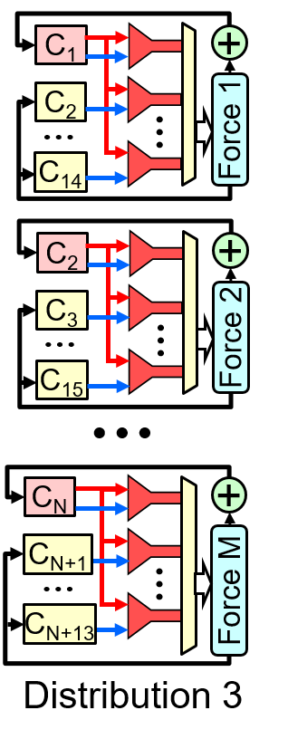
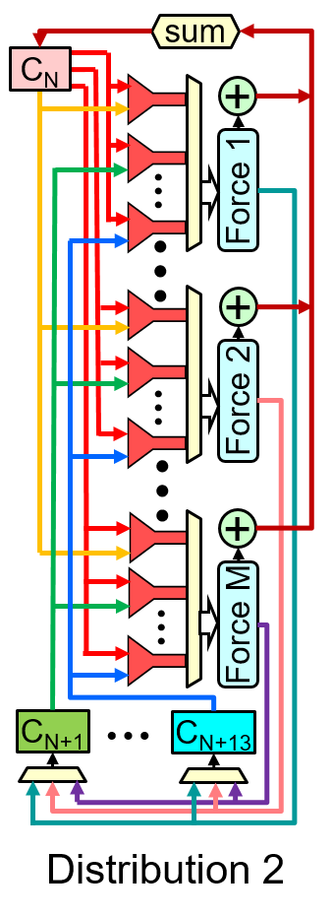
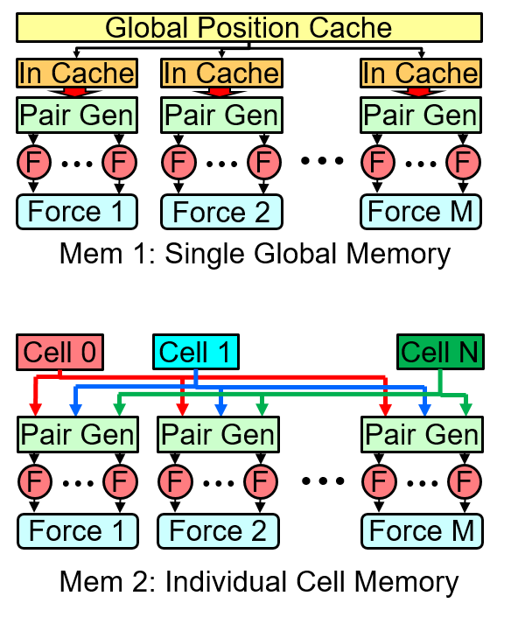
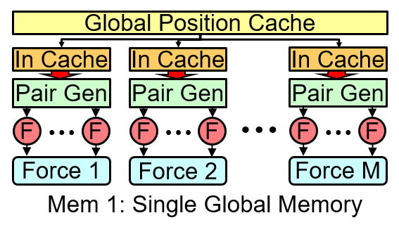
Evaluation: Simulation Time Performance
Platform | Iteration Time (µs) | Simulation Rate (ns/day)
CPU(Xeon Platinum) 1-core | 85,544 | 2.02
CPU(Xeon Platinum)16-core | 6,926 | 24.95
GPU (Titan RTX) | 304 | 567.53*
Design1: Mem1+Dist1 | 64,411 | 2.68
Design2: Mem2+Dist1 | 370 | 467.40
Design3: Mem1+Dist2 | 1,003 | 172.36
Design4: Mem2+Dist2 | 313 | 551.55
Design5: Mem1+Dist3 | 291 | 593.55
Design6: Mem2+Dist3 | 274 | 630.25
Design | #Pipe
Design 3 | 52
Design 4 | 35
Design 1: Memory bottleneck: loading time to fill the input cache cannot be hide by computation
Design 2: Distributed cell memory alleviate the bandwidth pressure

Slide 47
Evaluation: Simulation Time Performance
Platform | Iteration Time (µs) | Simulation Rate (ns/day)
CPU(Xeon Platinum) 1-core | 85,544 | 2.02
CPU(Xeon Platinum)16-core | 6,926 | 24.95
GPU (Titan RTX) | 304 | 567.53*
Design1: Mem1+Dist1 | 64,411 | 2.68
Design2: Mem2+Dist1 | 370 | 467.40
Design3: Mem1+Dist2 | 1,003 | 172.36
Design4: Mem2+Dist2 | 313 | 551.55
Design5: Mem1+Dist3 | 291 | 593.55
Design6: Mem2+Dist3 | 274 | 630.25
Design | #Pipe
Design 3 | 52
Design 4 | 35
Design 3 & 4: each cell has less particles (80) than the # of pipelines, some pipeline is idle
Design 3: also suffered from the bandwidth limit

Slide 48
Evaluation: Simulation Time Performance
Platform | Iteration Time (µs) | Simulation Rate (ns/day)
CPU(Xeon Platinum) 1-core | 85,544 | 2.02
CPU(Xeon Platinum)16-core | 6,926 | 24.95
GPU (Titan RTX) | 304 | 567.53*
Design1: Mem1+Dist1 | 64,411 | 2.68
Design2: Mem2+Dist1 | 370 | 467.40
Design3: Mem1+Dist2 | 1,003 | 172.36
Design4: Mem2+Dist2 | 313 | 551.55
Design5: Mem1+Dist3 | 291 | 593.55
Design6: Mem2+Dist3 | 274 | 630.25
Design | #Pipe
Design 3 | 52
Design 4 | 35
Design 5 & 6: similar performance: no memory bottleneck, same # of pipelines
Design 5: overhead of reading out the first set of input data is later hidden

Slide 49
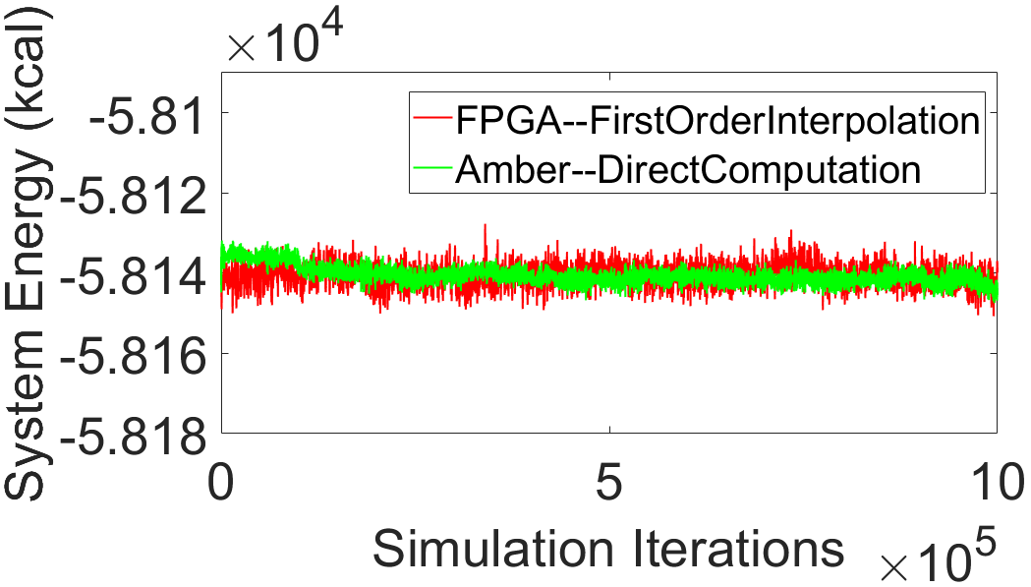
Evaluation: System Energy
System energy remains stable, but more experiments needed
Will add logic and/or bins as needed

Slide 50
Outline
Context & Motivation
MD & Spatial Computing Background
MD System Implementation
  Overall Architecture
  Range Limited Force Evaluation
  Long Range Interaction Evaluation
  Bonded Force Evaluation
  Motion Integration
FPGA Performance Evaluation
Future Work:
  Multi-FPGA Strong Scaling
  Communication Pattern Analysis

Slide 51
Future Work: Multi-FPGA Communication Pattern
r_{c}
Each FPGA Handles a Single Cell:
  Exchange with 26 neighbor nodes
Newton’s 3rd Law -> Half Shell Method*
  Exchange with 13
Data Movement:
r_{c}
P
Z
Y
X
  Export position data
  Import and sum partial forces
Multicast
P
Reduction
P
r_{c}
r_{c}
r_{c}
r_{c}
* D. Shaw, A Fast, Scalable Method for the Parallel Evaluation of Distance-Limited Pairwise Particle Interactions, Computational Chemistry, 2005

Slide 52
Future Work: Mapping Cell onto Multi-FPGA
Mapping cells to FPGA*
  Case 1: Single Cell per FPGA
    Multicasting to 13 neighbor nodes in 3D (single cell)
  Case 2: Multiple cells per FPGA
    Multicasting to 13 neighbor nodes in 3D (multiple cells)
  Case 3: Single cell on multiple FPGAs
    Multicasting to 62 neighboring nodes (partial cell)
R
R
R
c
c
c
* B. Towles, Unifying on-chip and inter-node switching within the Anton 2 network, Computer Architecture News, 2014

