Slide 1
Assessing the Impact of Timing Errors on HPC Applications
Chun-Kai Chang, Wenqi Yin, and Mattan Erez
Department of Electrical and Computer Engineering
The University of Texas at Austin
SC19 11/21/2019

Slide 2
Timing errors may impact system as a result of
  Technology scaling
  Run-time variations (e.g., voltage, temperature, etc.)
  Shallower guardbands due to power constraint
Voltage
Trace
Guardband
Failure region
Goals:
model and evaluate impact of timing errors on apps
and develop software-based error detection techniques
Notes:
As tech scales, runtime variations like … are more likely to change circuit timing and lead to timing violation
Current solution to timing errors is applying gb which wastes substantial energy, and therefore may not be applicable to future power-constrained systems
As a result, the likelihood of timing errors “may” increase
The goal of this work is to model timing errors and study their impact on app and hopefully help researchers develop more efficient software-base detection mechanisms for this type of errors.

Slide 3
We develop an open-source and high-fidelity
instruction-level timing error injector
  Models timing errors without any proprietary tools
    # licenses no longer limits the parallelism of error injection
    Enables error injection at scale
  Slow because of circuit-level fault masking
    Takes days to evaluate an HPC proxy app*
We propose Injection-Point Overprovisioning to accelerate evaluation by 7X (up to 11X)
  Injects multiple times per application run
    Takes only a few hours to evaluate an app
    2943 core-hours saved in total for our experiments (6 apps)
* Assume 1,000 injection experiments for LULESH with a 4-core machine
Notes:
To evaluate the impact of hardware errors on applications, inst-level error injection is widely used

Slide 4
Instruction-level error injection
  Repeat thousands of times to derive the impact on apps
  Fast but not accurate
Outcomes
Binary
Masked
Inst-Level
Injector
DUE
Detected Uncorrectable Error
Error Model
SDC
Silent Data Corruption
Notes:
We usually To collect statistics
The upside of this approach
The downside is low accuracy because it is hard to model complex hardware errors at the instruction level

Slide 5
Design of our timing error injector
  Gate-level timing error injector + instruction-level injector
  Balance injection speed and accuracy
Binary
Inst-Level
Injector
Output Value
Input Pair
Timing Error Injector
Error
Config
Circuit
Op. Condition
Var. Profile
Notes:
In our design ….
Here I am showing you how our tool works
The inst-level injector samples a pair of instructions of the same type and send their input operands and the circuit used by the inst to the timing error injector.
In addition,

Slide 6
Modeling timing errors is challenging
  Value-dependent (i.e., changes across apps)
    Affects dynamic critical paths
    Affects fault masking factors
  Timing errors can affect multiple instructions
Terminology
  Endpoints
    Primary output pins of a circuit or input pins to flip-flops
  Timing faults
    Run-time variations that change circuit timing
  Timing errors
    Faults causing at least one endpoint to latch wrong value
Notes:
Mention prior work does not faithfully model value-dependency

Slide 7
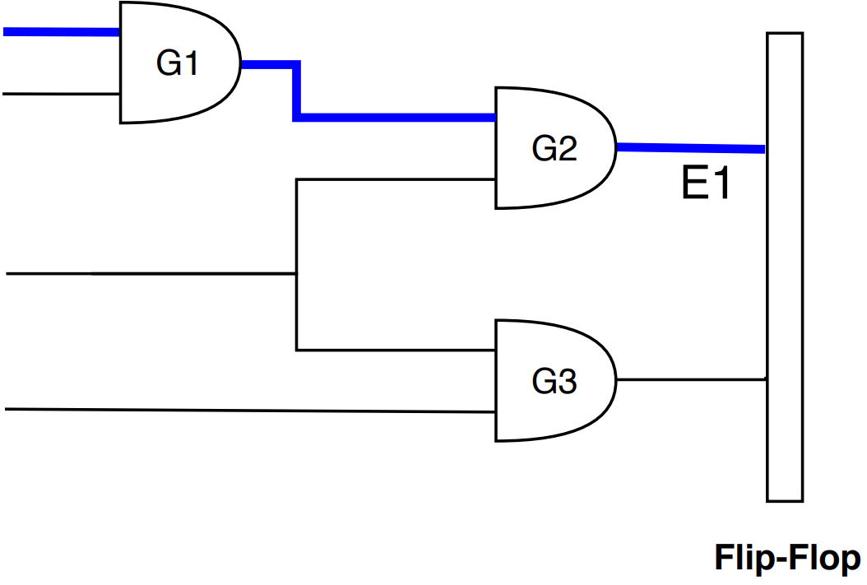
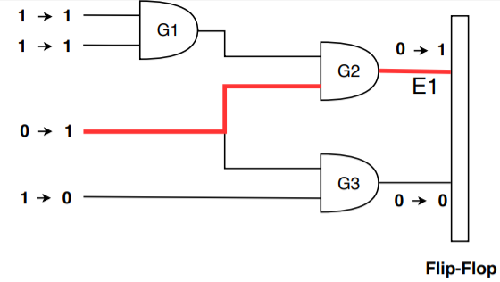
Static vs. dynamic critical paths
Depends on circuit
Depends on both circuit and inputs

Slide 8
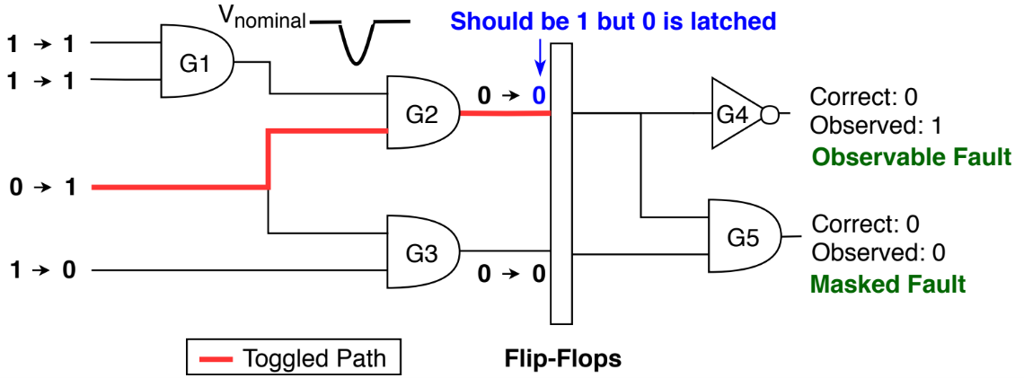
Fault masking factors
  Temporal masking
    No timing errors despite run-time variation
  Logical masking (for pipelined circuits)
E1
Notes:
In this example, a voltage droop occurs s.t the flip-flop latches the wrong value. However, if the droop is not strong enough than the timing fault would be temporally masked. Moreover, for pipelined circuits, there is also logical masking.

Slide 9
Error manifestation is complex and depends on:
  Profile of variation (i.e., magnitude and duration)
  Circuit implementation
  Operating condition (frequency, voltage, and temp.)
  Current and previous input values (app-dependent)
Notes:
Generally speaking, …
Transition: next, let me talk about how we model temporal masking

Slide 10
Modeling temporal masking requires circuit dynamic timing
  Proprietary gate-level simulators use back-annotation
  Open-source Verilog simulators lack this feature
Our solution:
static timing analysis with removal of false paths¹
[1] H. Cherupalli and J. Sartori, “Graph-based dynamic analysis: Efﬁcient characterization of dynamic timing and activity distributions,” ICCAD 2015

Slide 11
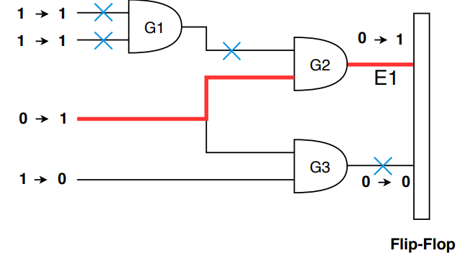
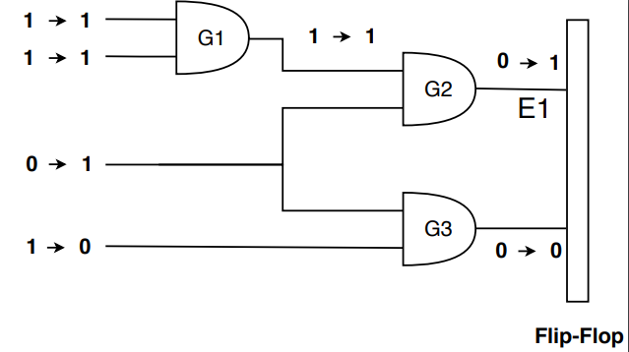
Steps:
  Run gate-level Verilog simulation with a given input pair
  Analyze value change dump to obtain false paths
  Run static timing analysis with false paths removed
  Check which endpoints have timing violation
  Generate potentially-corrupted output
Implementation: OpenTimer¹ + Icarus Verilog²
[1] T.-W. Huang and M. D. Wong, “Opentimer: A high-performance timing analysis tool,” ICCAD 2015
[2] S. Williams, “Icarus verilog,” 2006. https://iverilog.icarus.com/
Notes:
Let me explain the method with our favorite example.

Slide 12
Modeling logical masking
  Preprocessing: split pipelined circuit into stages
  At runtime, inject and propagate timing error

Slide 13
Modeling timing errors is challenging
  Value-dependent (i.e., changes across apps)
    Affects dynamic critical paths and fault masking factors
  Timing errors can affect multiple instructions
Notes:
Mention prior work does not faithfully model value-dependency

Slide 14
# of instructions affected depends on pipeline state
  Low-occupancy state (best case)
    Only one instruction in the pipeline throughout the droop’s duration
  High-occupancy state (worst case)
    Pipeline is fully utilized
Models
  Single-cycle Low-occupancy (SL)
  Single-cycle High-occupancy (SH)
  Multi-cycle Low-occupancy (ML)
  Multi-cycle High-occupancy (MH)
Duration
Pipeline State
Notes:
In this work, we model two extreme cases

Slide 15
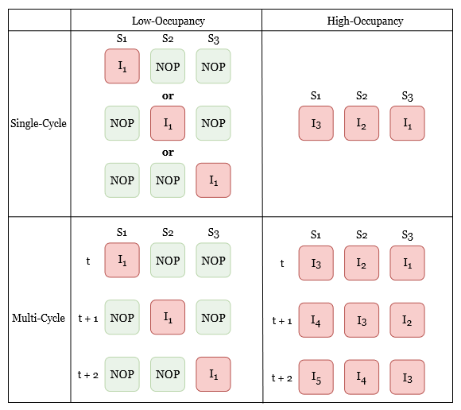
Example: a 3-stage pipeline affected by
  1-cycle droops (SL and SH)
  3-cycle droops (ML and MH)

Slide 16
Circuit-level masking → fewer errors
  Collecting statistics at the instruction level needs lots of Monte Carlo trials (i.e., evaluation time ↑)
Instruction-Level
Injector
Can be same as the error-free output
Output Value
Input Pair
Timing Error Injector
Error
Config
Circuit
Op. Condition
Var. Profile
Need to accelerate injecting instruction-level errors
Notes:
However, as I hinted before, the output value may be same as error-free value because injected timing faults can be masked either temporally or logically.
If we use traditional mc method, it is not efficient.

Slide 17
Inefficiency of simple random sampling (SRS)
  One injection per application run
  Many injected faults end up being masked
  Recall that the goal is to collect errors instead of faults
8
1
3
4
2
6
7
5
Time
Errors
Masked Faults

Slide 18
Injection-point overprovisioning
  Provide multiple injection points sorted by time
  Continue to next injection point if masked
8
1
3
4
2
6
7
5
Simple Random
Sampling
Time
1
1
1
1
2
2
2
2
Overprovisioning
Time
Errors
Masked Faults
Notes:
Now you may wonder isn’t this technique serialize the error injection campaign

Slide 19
Parallel overprovisioning
  Tasks running on the different cores are independent
  Initially, provide each core with a batch of sorted points
  Task picks up points left by previous task on same core
  When a batch is exhausted, a new batch is generated
  Synchronization is needed upon terminating experiments
Speedup is up to 11X (7X on average) with batch size = 10
1
1
1
2
Core 1
Time
1
1
1
1
Core 2
Time

Slide 20
Evaluating timing errors in terms of
  Error patterns at the instruction level
  Impact on correctness of applications
  Sensitivity studies of droop magnitude and pipeline state

Slide 21
Assumption
  Timing faults are rare random events
    Injection-point overprovisioning with 10 points at a time
    Repeat until we collect 2000 errors for each app
      Margin of error < 2.2% for 95% confidence interval
  Focus on arithmetic instructions
    Prior work shows that the EX and MEM stages
    are more sensitive to timing errors¹
    For SIMD instructions, all lanes are affected
[1] A. Rahimi, L. Benini, and R. K. Gupta, “Analysis of instruction-level vulnerability to dynamic voltage and temperature variations,” DATE 2012.

Slide 22
Evaluation
  Error models
    RB1 (single-bit flips)
    PREV (use the previous circuit output)¹
    Proposed (focus on voltage variation here)
      Circuits: Int-Add, Int-Mult, FP-Add, FP-Mult, and FP-Div
      from Synopsys DesignWare Library synthesized with 32nm tech
      Operating condition: 25°C, 400MHz, 1.05V
  Benchmark: scientific kernels and proxy applications
  Sensitivity to profile of voltage droops
    Magnitude: 20% V_{dd} (droop trough: 0.85V) and 25% V_{dd} (0.78V)
    Duration: single-cycle and multi-cycle
  Sensitivity to pipeline state
[1] A. Sampson et al. “EnerJ: Approximate data types for safe and general low-power computation,” PLDI 2011.

Slide 23
Example: a 3-stage pipeline affected by
  1-cycle droops (SL and SH)
  3-cycle droops (ML and MH)

Slide 24
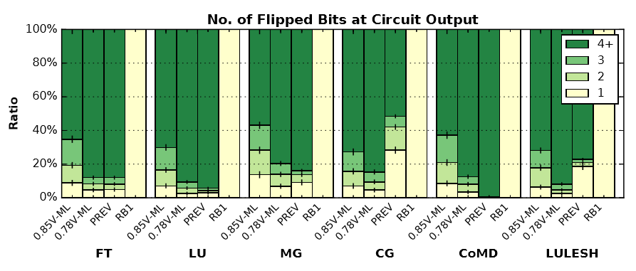
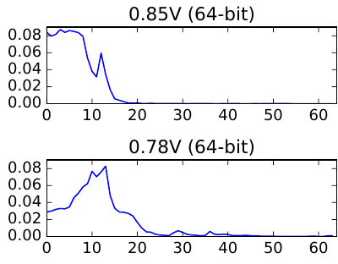
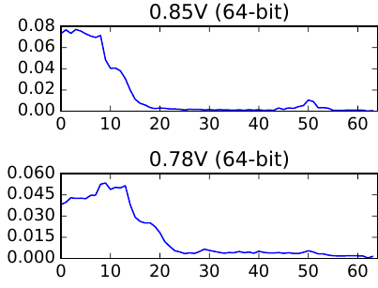
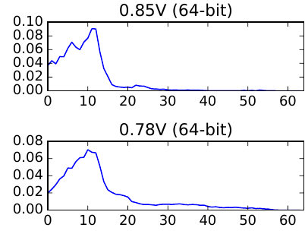
Error patterns at the instruction level
  Most errors (>60%) flip at least 4 bits
    Actual distributions depend on both app and circuit
  Bit-flip positions cluster at lower-significance bits
    Due to value locality at MSB (i.e., many MSB do not transition)
    For FP circuits, the sign and exponent fields are rarely flipped
CG
miniFE
MG
Probability
Bit positions
* Distribution of bit-flip positions instead of positions with timing violation

Slide 25
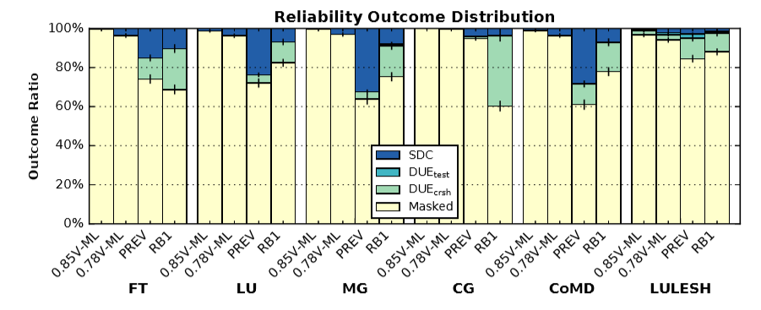
Impact on correctness of applications
  Timing errors rarely lead to DUEs
  SDC ratios increase with droop magnitude
  Neither RB1 nor PREV represents timing errors
    RB1 overestimates DUE ratios
    PREV overestimates both DUE ratios and SDC ratios
Notes:
Give some example when explaining the bullets

Slide 26
Example: a 3-stage pipeline affected by
  1-cycle droops (SL and SH)
  3-cycle droops (ML and MH)
Notes:
Should point out in the paper we only include the data for ML (i.e., one inst)
Should say which boxes
Say ML is what we put in the paper

Slide 27
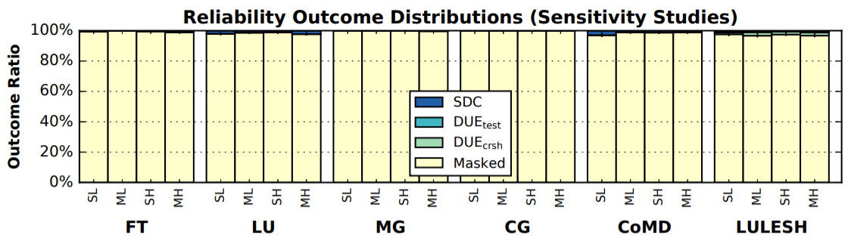
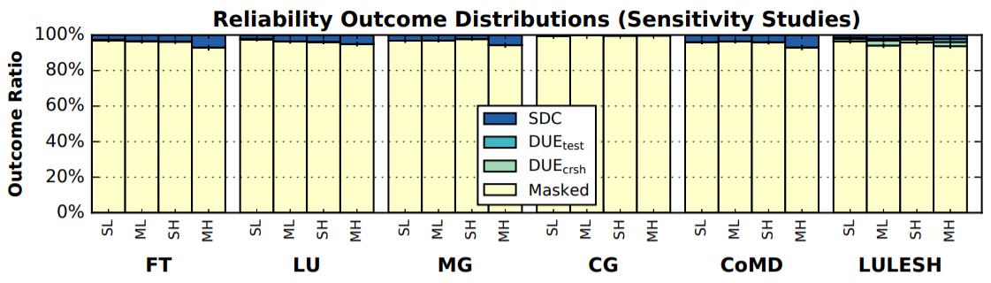
Sensitivity studies
  SL, SH, and ML lead to similar outcome distributions
    For evaluating single-cycle droops, SL is enough (faster than SH)
  MH results in higher SDC ratios
    More instructions are affected by the timing error
0.85V
0.78V
Notes:
They are similar because the error bars overlap

Slide 28
Prior Work on Modeling Timing Errors
 | Publicly Available | Dynamic Paths | Logical Masking | Frequency Tunable | V Variation | T Variation | P Variation
SWAT-Sim¹ | no | yes | yes | yes | no | no | no
VARIUS-NTV² | yes | no | no | yes | yes | no | yes
CrashTest³ | yes | no | yes | yes | no | no | no
b-HiVE⁴ | yes | yes | no | no | yes | no | no
CLIM⁵ | no | yes | no | yes | no | no | no
DAC 2016⁶ | no | yes | no | yes | yes | no | no
This Work | yes | yes | yes | yes | yes | yes | no
Can be yes
by enhancing OpenTimer
[1] Li et al.,“Accurate microarchitecture-level fault modeling for studying hardware faults,” HPCA 2009.
[2] Karpuzcu et al., "VARIUS-NTV: A microarchitectural model to capture the increased sensitivity of many cores to process variations at near-threshold voltages,” DSN 2012.
[3] Pellegrini et al., “Crashtest: A fast high-ﬁdelity fpga-based resiliency analysis framework,” ICCD 2008.
[4] Tziantzioulis et al., “b-HiVE: A Bit-Level History-Based Error Model with Value Correlation for Voltage-Scaled Integer and Floating Point Units,” DAC 2015.
[5] Jiao et al., “CLIM: A Cross-level Workload-aware Timing Error Prediction Model for Functional Units,” TC 2017.
[6] Constantins et al., “Statistical Fault Injection for Impact-Evaluation of Timing Errors on Application Performance,” DAC 2016.
Notes:
In summary, there is no publicly available tool that fulfills all the requirements

Slide 29
Conclusions
  Injection-point overprovisioning: 7X speedup (up to 11X)
  Timing errors that corrupt arithmetic circuits
  tend to flip multiple lower-significance bits
  Single-bit flips and previous values
  do not represent timing errors
  For single-cycle droops, injection outcomes
  depend only on droop magnitude
  For multi-cycle droops, injection outcomes
  depend on both droop magnitude and pipeline state
  Tool is available at https://lph.ece.utexas.edu/users/hamartia
Notes:
Timing windows
Looking to floating point circuit? Which field is more likey to flip (exponent, significand?)?

Slide 30
Backup Slides

Slide 31
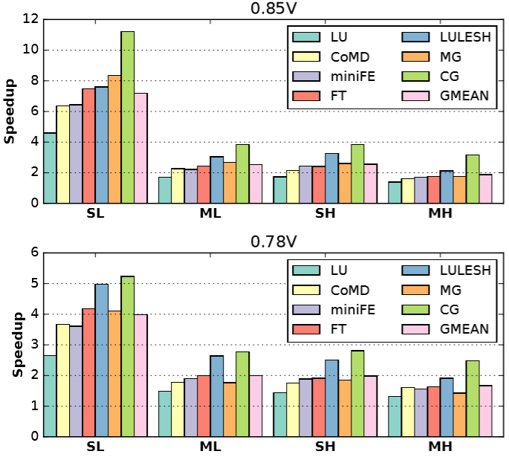
Speedup of injection-point overprovisioning

Slide 32
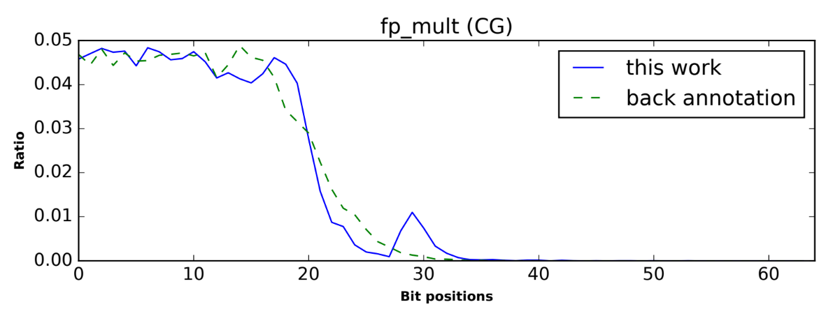
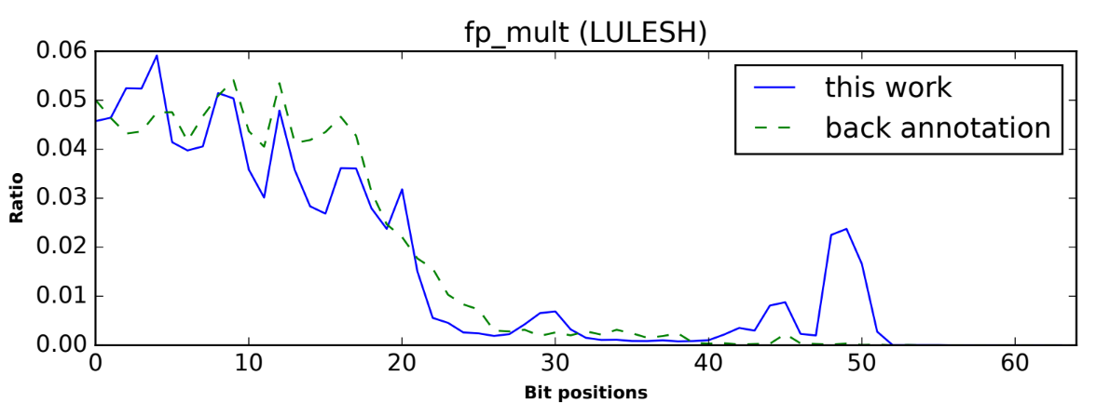
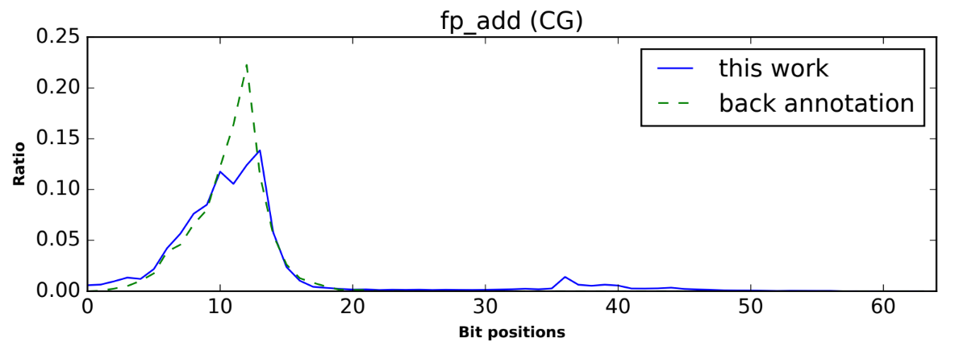
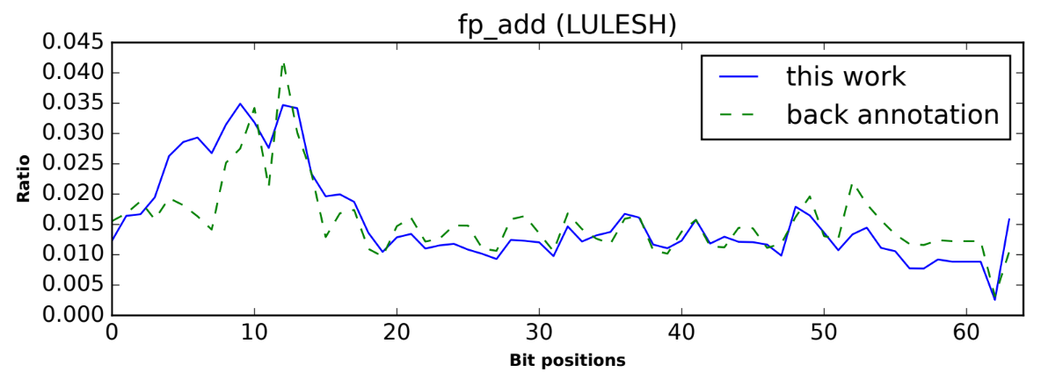
Validation
  This work vs. back-annotation with Modelsim
  Applications: CG and LULESH
  Circuits: FP multiplier and FP adder
  Op. condition: 0.78V, 400MHz, 25ºC

