Slide 1

Regularizing Irregularly Sparse
Point-to-point Communications
Oguz Selvitopi (LBNL)
Cevdet Aykanat (Bilkent University, Turkey)
November 20, 2019
SC19, Denver, Colorado

Slide 2
Intro & Motivation
Regular vs. irregular communications
  Stencils, global collectives (gather/scatter/broadcast)
  High variation among communicating processes
  Scenario
    A single process communicates with more than half of the processes
    The rest communicates with only a few processes
Goal: Improve communication performance where communication patterns are:
  Sparse and irregular
  High variance among the communicating processes
  Small and/or medium message sizes – lots of messages around

Slide 3
Intro & Motivation
Solid line: Maximum message count
Dashed line: Average message count
Top – 256 processes
Bottom – 512 processes

Slide 4
Intro & Motivation
How?
  A structured way of performing sparse and irregular communication operations
  Structure: Virtual Process Topology, VPT
  Restrict processes that can “directly” communicate
Inspired by k-ary n-cube networks
A store-and-forward algorithm to realize communication
  Input: Set of P2P messages, VPT
VPT
  Enables trade-off between
    max message count (related to overall latency)
    communication volume (related to bandwidth)
  Important parameter: VPT dimension
    Low-dimensional vs. high-dimensional

Slide 5
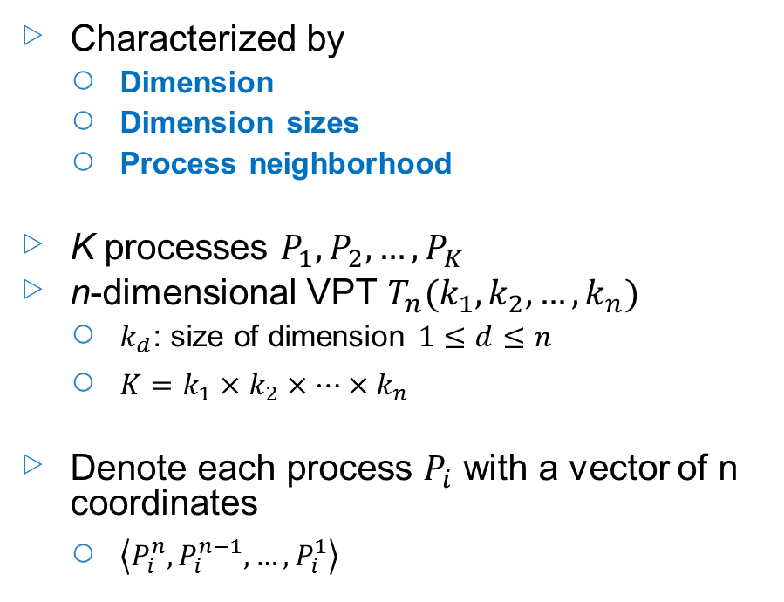
Virtual Process Topology (VPT): Basics
K=64 processes organized into 3-dimensional VPT T₃(4,4,4)
Characterized by
  Dimension
  Dimension sizes
  Process neighborhood
K processes $P_{1},P_{2},…, P_{K}$
n-dimensional VPT $T_{n}(k_{1},k_{2},…,k_{n})$
  $k_{d}$: size of dimension $1≤d≤n$
  $K=k_{1}×k_{2}×…×k_{n}$
Denote each process $P_{i}$ with a vector of n coordinates
  $\left\langle P_{i}^{n},P_{i}^{n−1},…,P_{i}^{1}\right\rangle$
2
1
3

Slide 6
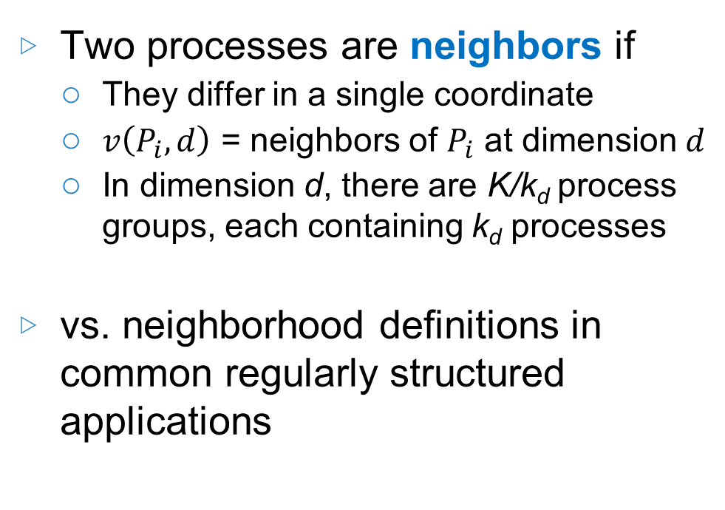
VPT: Process neighborhood
Two processes are neighbors if
  They differ in a single coordinate
  $v\left(P_{i},d\right)$ = neighbors of $P_{i}$ at dimension $d$
  In dimension d, there are K/k_{d} process groups, each containing k_{d} processes
vs. neighborhood definitions in common regularly structured applications
2
1
3
Blue: Neighbors of P_{i} along 1st dimension
Red: Neighbors of P_{i} along 2nd dimension
Orange: Neighbors of P_{i} along 3rd dimension

Slide 7
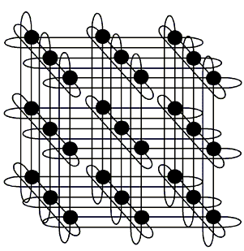
VPT vs. k-ary n-cube networks
k-ary n-cube networks
  Generalization of hypercubes
  k = # of nodes at each dimension
  n = # of dimensions
  The nodes in a dimension are connected as a 1D torus
Three basic differences
  Context: software vs. hardware
  Neighborhood definition
  Sizes of the dimensions

Slide 8
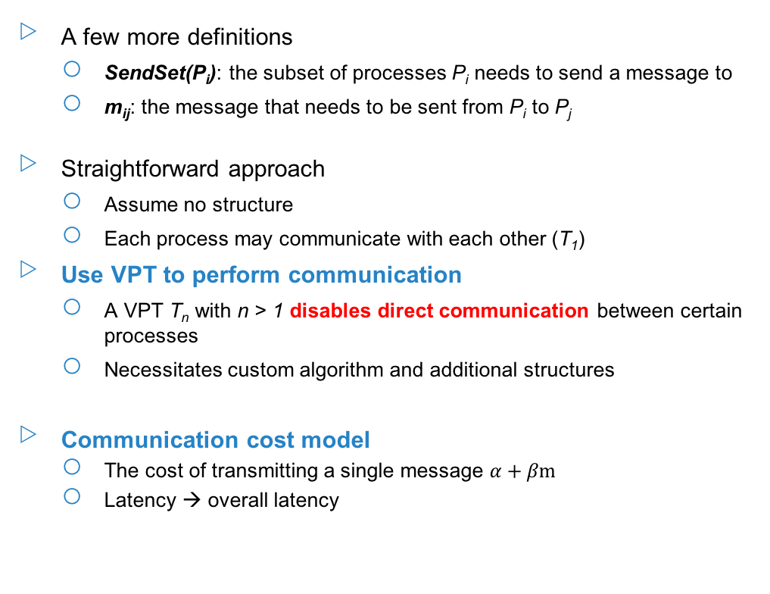
Addressed Problem
A few more definitions
  SendSet(P_{i}): the subset of processes P_{i} needs to send a message to
  m_{ij}: the message that needs to be sent from P_{i} to P_{j}
Straightforward approach
  Assume no structure
  Each process may communicate with each other (T₁)
Use VPT to perform communication
  A VPT T_{n} with n > 1 disables direct communication between certain processes
  Necessitates custom algorithm and additional structures
Communication cost model
  The cost of transmitting a single message $α+βm$
  Latency → overall latency
P₁
SendSet(P₁)
P₂
SendSet(P₂)
…
P_{K}
SendSet(P_{K})
…
MPI_Alltoallv
P₁
SendSet(P₁)
P₂
SendSet(P₂)
…
P_{K}
SendSet(P_{K})
…
Store-and-forward
algorithm
VPT T_{n}

Slide 9
Store-and-forward Algorithm: Multi-stage Communication
The need for a store-and-forward scheme
  In dimension d, P_{i} is allowed to communicate with its k_{d} - 1 neighbors v(P_{i}, d)
  What if there are processes in SendSet(P_{i}) which are not in v(P_{i}, d) for any d?
Staged execution
  n-dimensional VPT → communication proceeds in n stages
  Communication in a stage restricted to processes that are neighbors in corresponding dimension

Slide 10
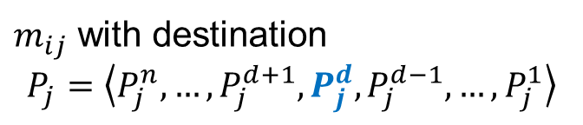
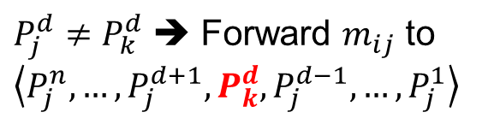

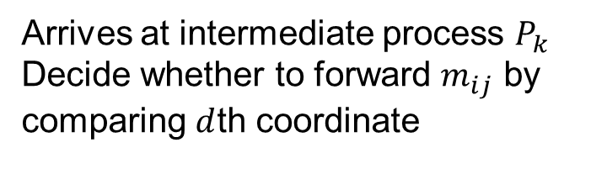

Communicating a Single Message on VPT
Message m_{ij}
  Source P_{i}, destination P_{j}
  At each stage Store or Forward
How many times a message get forwarded?
  Hamming distance
  E-cube routing for hypercubes
  Dimension-ordered deterministic routing
$m_{ij}$ with destination
$$P_{j}=\left\langle P_{j}^{n}, …, P_{j}^{d+1}, P_{j}^{d}, P_{j}^{d−1}, …, P_{j}^{1}\right\rangle$$
Stage $d$
Arrives at intermediate process $P_{k}$
Decide whether to forward $m_{ij}$ by comparing $d$th coordinate
$P_{j}^{d}=P_{k}^{d}$ ➔ Store $m_{ij}$ at this stage
$P_{j}^{d}≠P_{k}^{d}$ ➔ Forward $m_{ij}$ to
$\left\langle P_{j}^{n}, …, P_{j}^{d+1}, P_{k}^{d}, P_{j}^{d−1}, …, P_{j}^{1}\right\rangle$

Slide 11

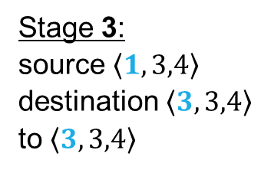

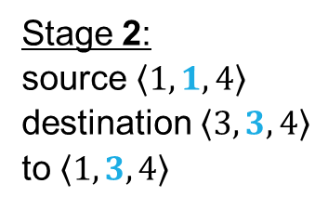
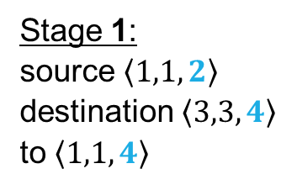



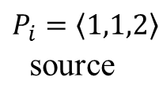
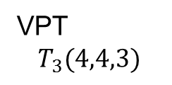
Communicating a Single Message on a VPT
VPT
$$T_{3}(4,4,3)$$
Stage 3:
source $〈1,3,4〉$
destination $〈3,3,4〉$
to $〈3,3,4〉$
Stage 2:
source $〈1,1,4〉$
destination $〈3,3,4〉$
to $〈1,3,4〉$
Stage 1:
source $〈1,1,2〉$
destination $〈3,3,4〉$
to $〈1,1,4〉$
$$P_{j}=〈3,3,4〉$$
destination
$$〈1,3,4〉$$
$$m_{ij}$$
$$〈3,1,2〉$$
2
$$〈1,1,4〉$$
$$P_{i}=〈1,1,2〉$$
source
1
3

Slide 12
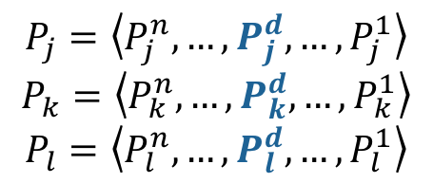
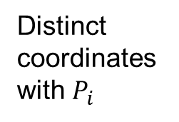
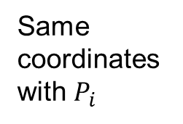
Multiple messages on VPT
$$P_{j}=\left\langle P_{j}^{n},…, P_{j}^{d},…, P_{j}^{1}\right\rangle$$
$$P_{k}=\left\langle P_{k}^{n},…, P_{k}^{d},…, P_{k}^{1}\right\rangle$$
$$P_{l}=\left\langle P_{l}^{n},…, P_{l}^{d},…, P_{l}^{1}\right\rangle$$
Consider P_{i} and its SendSet(P_{i})
  Scenario: coordinates of the processes in SendSet(P_{i}) differ only after the dth coordinate
The communication between P_{i} and its neighbor
  A single message containing a number of submessages
Submessage
  two-tuple: (destination process, message content)
Direct message between P_{i} and P_{j} → M_{ij}
Submessage with source P_{i} and destination P_{j} → (P_{j}, m_{ij})
Distinct coordinates with $P_{i}$
Same coordinates with $P_{i}$

Slide 13
Multiple messages on VPT - Example
2
1
3

Slide 14
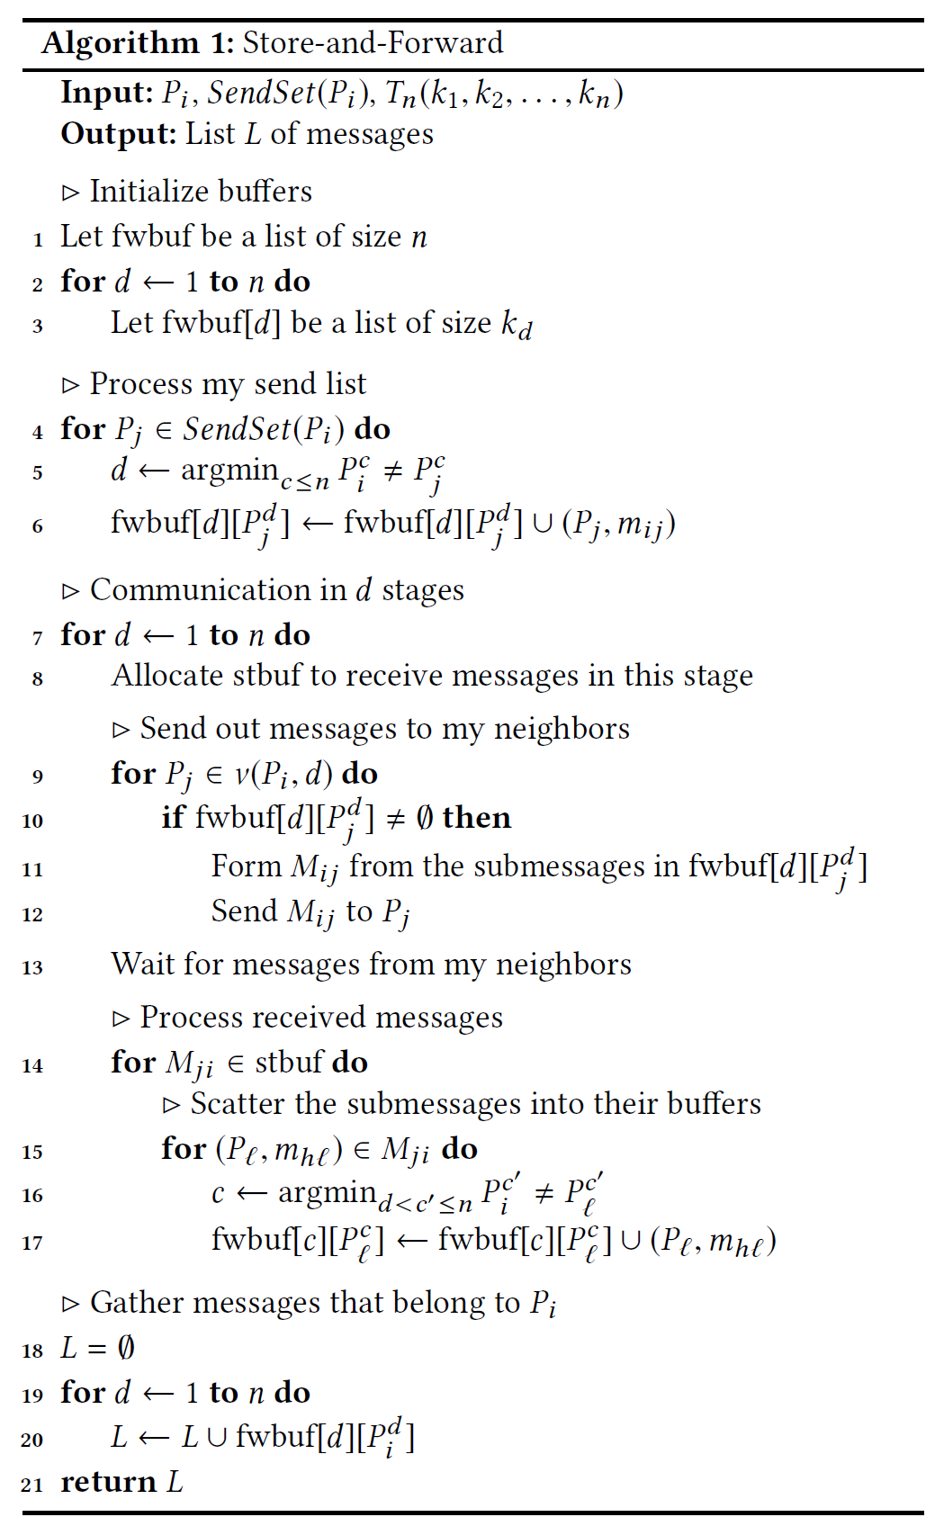
Algorithm
Buffers
  Store buffer (stbuf)
  Forward buffer (fwbuf) – n x K
fwbuf[d][x]
  Contains the submessages that will be forwarded in stage d to neighbor x
Communication operations in stage d
  Send out messages in fwbuf[d]
  Receive messages into stbuf
  Sort out the submessages in stbuf and put them in fwbuf[d’]
Initialize buffers for each dimension
Fill forward buffers with the messages in my SendSet
Communication in a stage contains three steps
Gather messages destined for me from fwbuf

Slide 15


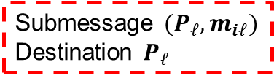

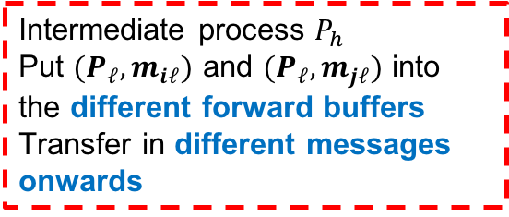


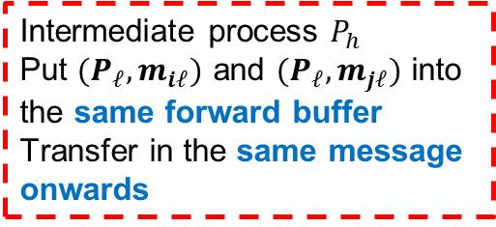

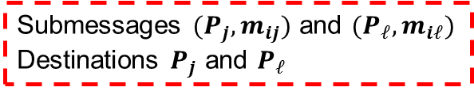
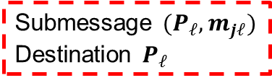


Algorithm: Observations
Scenario 1: two submessages originate from different processes but destined for the same process
Scenario 2: two submessages originate from the same process but destined for different processes
$$P_{i}$$
$$P_{j}$$
$$P_{i}$$
Submessage ${(P}_{ℓ}, m_{iℓ})$
Destination $P_{ℓ}$
Submessage ${(P}_{ℓ}, m_{jℓ})$
Destination $P_{ℓ}$
Submessages ${(P}_{j}, m_{ij})$ and ${(P}_{ℓ}, m_{iℓ})$
Destinations $P_{j}$ and $P_{ℓ}$
$$P_{h}$$
Intermediate process $P_{h}$
Put ${(P}_{ℓ}, m_{iℓ})$ and ${(P}_{ℓ}, m_{jℓ})$ into the different forward buffers
Transfer in different messages onwards
$$P_{j}$$
Intermediate process $P_{h}$
Put ${(P}_{ℓ}, m_{iℓ})$ and ${(P}_{ℓ}, m_{jℓ})$ into the same forward buffer
Transfer in the same message onwards
$$P_{ℓ}$$
$$P_{ℓ}$$
$$P_{h}$$

Slide 16
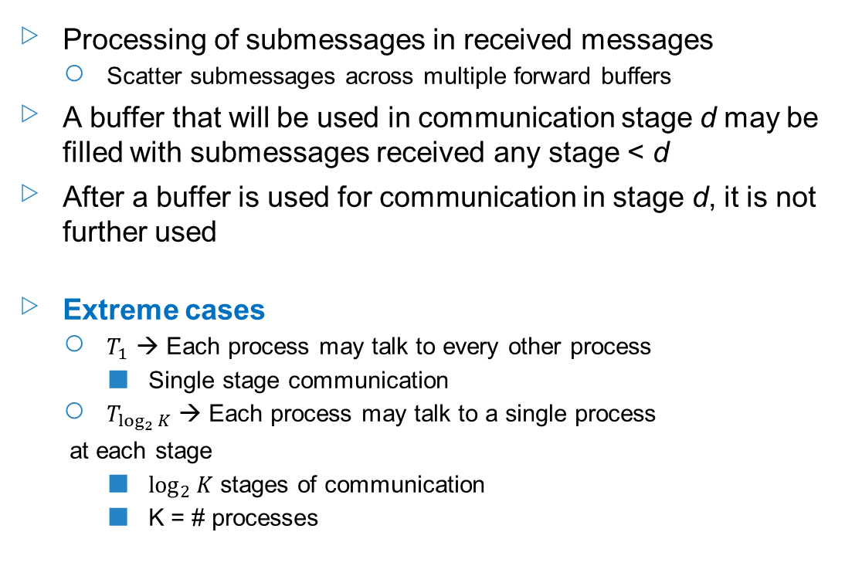
Algorithm: Observations
Processing of submessages in received messages
  Scatter submessages across multiple forward buffers
A buffer that will be used in communication stage d may be filled with submessages received any stage < d
After a buffer is used for communication in stage d, it is not further used
Extreme cases
  $T_{1}$ → Each process may talk to every other process
    Single stage communication
  $T_{\log_{2}{K}}$ → Each process may talk to a single process
  at each stage
    $\log_{2}{K}$ stages of communication
    K = # processes

Slide 17
Algorithm: Analysis
End goal: provide a flexible medium to achieve a trade-off between
  total latency (i.e., maximum message count)
  bandwidth (i.e., the amount of data communicated)
How? By controlling the dimension of the VPT
For a given # of processes, vary VPT dimension
High-dimensional VPT → Low total latency, high bandwidth cost
Low-dimensional VPT → High total latency, low bandwidth cost
Analysis metrics
  Maximum message count
  Volume of communicated data
  Buffer sizes
Analysis assumptions:
  Worst-case scenario
  Sizes of dimensions equal (k₁ = k₂ = … = k_{n} = k)
  Submessage size = s

Slide 18
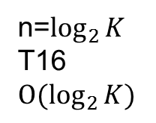
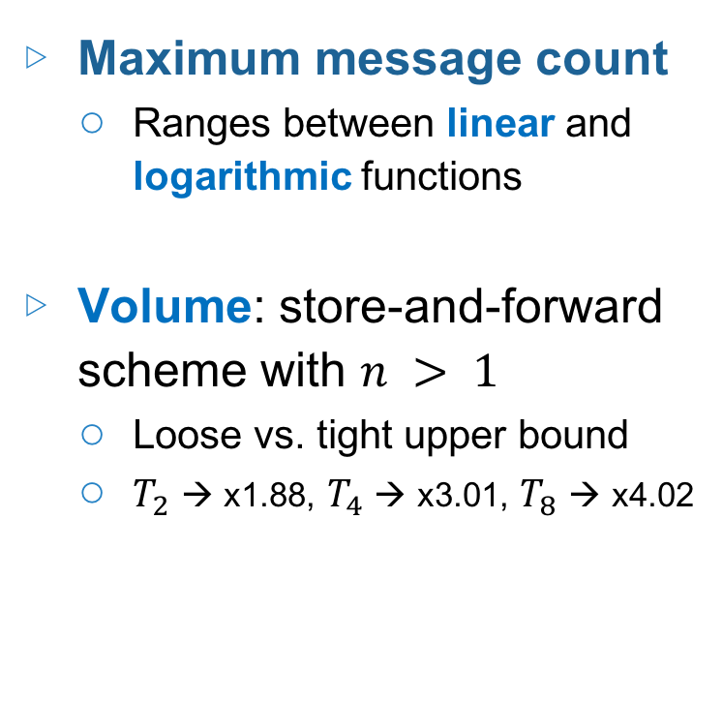
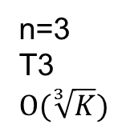
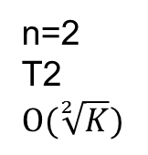
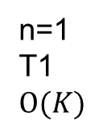
Algorithm: Analysis
Maximum message count
  Ranges between linear and logarithmic functions
Volume: store-and-forward scheme with $n > 1$
  Loose vs. tight upper bound
  $T_{2}$ → x1.88, $T_{4}$ → x3.01, $T_{8}$ → x4.02
n=1
T1
$$O(K)$$
n=2
T2
$$O(\sqrt[2]{K})$$
n=3
T3
$$O(\sqrt[3]{K})$$
…
n=$\log_{2}{K}$
T16
$$O(\log_{2}{K})$$

Slide 19
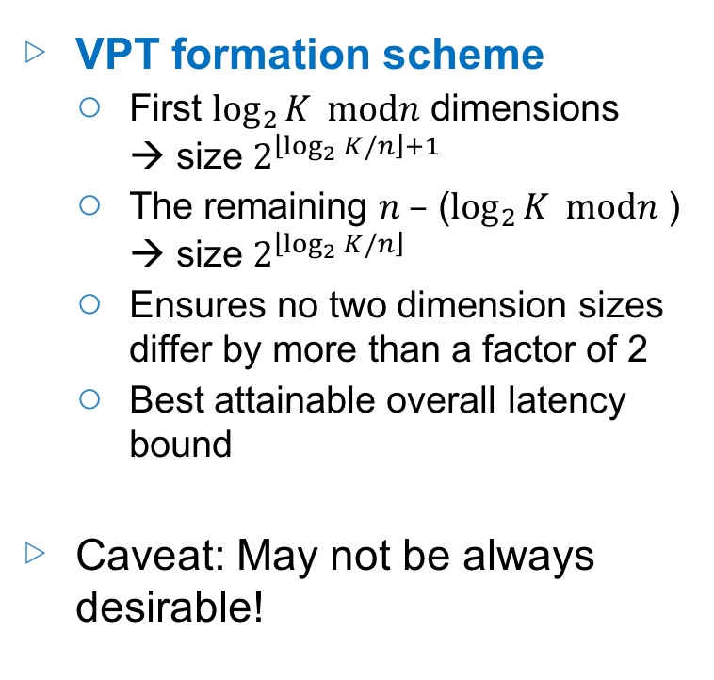
Forming VPT
Given # of processes K
  How to organize them?
  How to choose VPT parameters?
Two important aspects
  The dimension of the VPT (=n)
  The organization of the processes
    K=64, n=2 → 32x2, 16x4, 8x8
K = k₁ x k₂ x … x k_{n}
Motivation: k₁, k₂, …, k_{n} should close to each other
VPT formation scheme
  First $\log_{2}{K} modn$ dimensions → size $2^{\left\lfloor \log_{2}{K}/n\right\rfloor +1}$
  The remaining $n –$ ($\log_{2}{K} modn$ ) → size $2^{\left\lfloor \log_{2}{K}/n\right\rfloor }$
  Ensures no two dimension sizes differ by more than a factor of 2
  Best attainable overall latency bound
Caveat: May not be always desirable!

Slide 20
Experiments: Setup
Distributed sparse matrix vector multiplication (SpMV)
Schemes
  BL → Baseline (=STFW1)
  STFW → STFW2, STFW3, etc. (STFWn: VPT with dimension n)
Systems
  BlueGene/Q, Cray XC40, Cray XK7
Processes
  32 to 512 (small scale)
  4K to 16K (large scale)
Dataset
  22 latency-bound instances
  Sparsity pattern: high coefficient of variation and/or max degree ratio

Slide 21
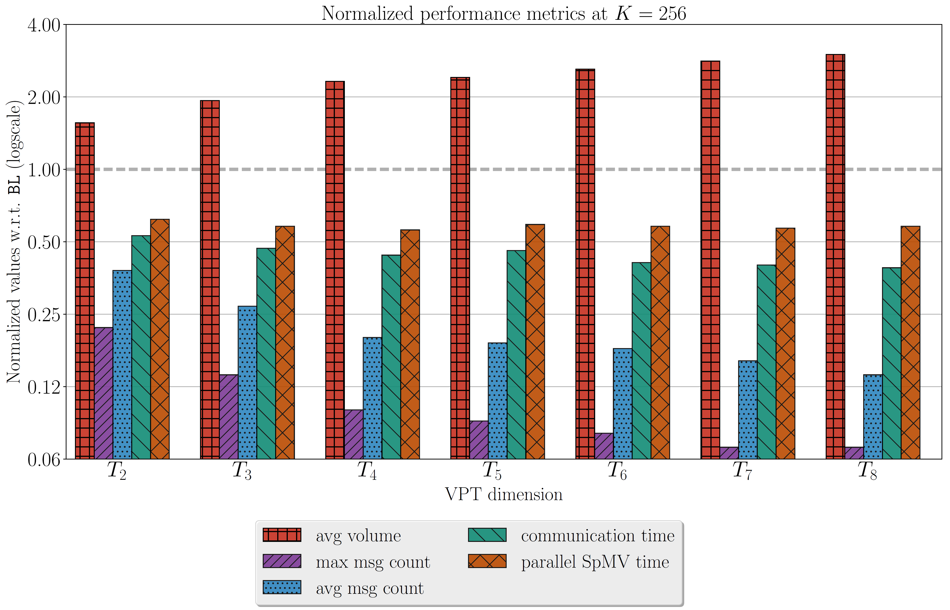
Evaluation: Performance metrics
 |  |  |  | Time (usec)
Scheme | mmax | mavg | vavg | comm | SpMV | buffer size (KB)
BL | 120.5 | 50.2 | 1181 | 825 | 1091 | 20.1
STFW2 | 26.5 | 18.8 | 1844 | 439 | 681 | 38.8
STFW3 | 16.5 | 13.4 | 2279 | 386 | 631 | 38.3
STFW4 | 11.9 | 10.1 | 2736 | 359 | 608 | 37.9
STFW5 | 11 | 9.5 | 2848 | 383 | 649 | 36.1
STFW6 | 10 | 8.8 | 3082 | 334 | 632 | 33.6
STFW7 | 9 | 7.9 | 3336 | 329 | 622 | 34.5
STFW8 | 8 | 7.2 | 3544 | 322 | 636 | 32.3
The buffer usage < 2x the buffer usage of BL!
Volume metric
vavg = average volume 1.6x-3.3x more volume than BL
Latency metrics
mmax = max msg count 4.6x-15.1x improvement
mavg = avg msg count 3x-8x improvement
Up to 61% improvement in communication time
Up to 44% improvement in overall SpMV time

Slide 22
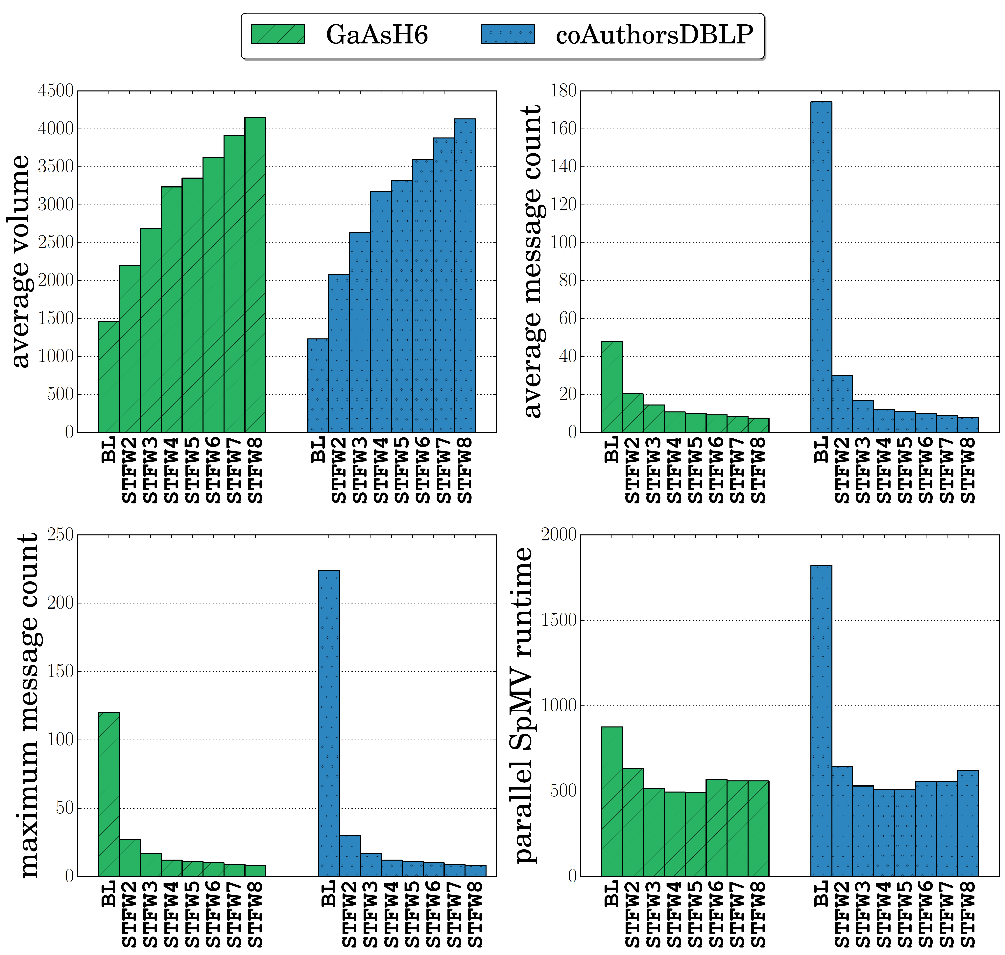
Evaluation: Performance metrics
Two different matrices
GaAsH6 and coAuthorsDBLP
Similar volume statistics
coAuthorsDBLP → more latency bound, more irregular
Turns irregular communication operations into regular operations
Makes total latency cost much more predictable and uniform!

Slide 23
Effect on Scalability

Slide 24
Communication Performance (large scale)
Torus network – 16K processes
Dragonfly network – 4K processes
Scheme | mmax | mavg | vavg | Comm time
BL | 1054.9 | 137.6 | 425 | 8220
STFW2 | 160.6 | 61.0 | 683 | 1109
STFW3 | 65.1 | 34.4 | 887 | 498
STFW4 | 41.8 | 24.3 | 1064 | 391
STFW8 | 20 | 13.9 | 1568 | 510
STFW9 | 19 | 13.9 | 1601 | 491
STFW13 | 15 | 11.4 | 1917 | 694
STFW14 | 14 | 10.5 | 2017 | 696
Scheme | mmax | mavg | vavg | Comm time
BL | 486.6 | 105.5 | 819 | 1419
STFW2 | 86.1 | 43.7 | 1271 | 294
STFW3 | 39.0 | 25.0 | 1682 | 221
STFW4 | 26.1 | 18.1 | 2024 | 238
STFW7 | 17.0 | 13.0 | 2594 | 199
STFW8 | 16.0 | 12.8 | 2663 | 270
STFW11 | 13.0 | 10.9 | 3098 | 289
STFW12 | 12.0 | 9.8 | 3312 | 387
95% improvement in communication time
86% improvement in communication time
mmax max message count
mavg average message count
vavg average volume (words)

Slide 25
Communication Performance (large scale)
Torus network – 16K processes
Matrix details
medium
low
high

Slide 26
Conclusions
Regularize sparse and irregular communication operations
  Organize processes via virtual process topology
  Parameters control the trade-off between latency and bandwidth costs
  Applicable to common settings, easy to integrate
  Store-and-forward algorithm on the VPT
    Issues: buffer usage, formation scheme
Future work
  Mapping of processes onto VPT
  Mapping of VPT to physical topology

Slide 27
Questions?

