Slide 1


Significantly Improving Lossy Compression Quality Based on an Optimized Hybrid Prediction Model
Xin Liang(University of California, Riverside)
Sheng Di (Argonne National Laboratory)
Sihuan Li (University of California, Riverside)
Dingwen Tao (University of Alabama)
Bogdan Nicolae(Argonne National Laboratory)
Zizhong Chen (University of California, Riverside)
Franck Cappello (Argonne National Laboratory & UIUC)

Slide 2
Outline
Motivation
Background
Hybrid Prediction Design
  Overview
  Efficient Coefficient Encoding via inter-block consecutiveness
    Regression coefficient encoding
    Transform coefficient encoding
  Transform-based compressor as a predictor and adaptive selection
Evaluation
  Rate-distortions
  Parallel Performance
Future Work
Notes:
1

Slide 3
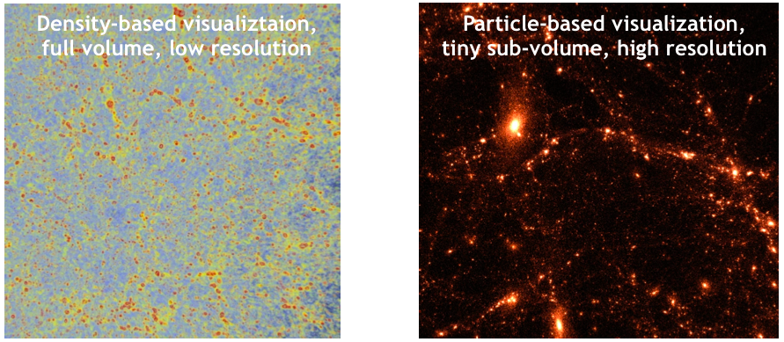
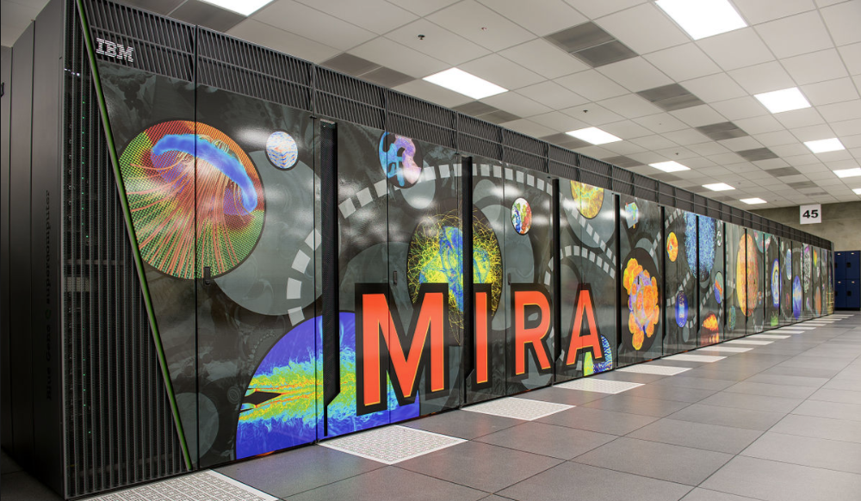
Motivation – Storage Capacity and I/O
Extremely large amount of data are produced by today’s extreme scale scientific simulations
  CESM (Climate Simulation)
    2.5 PB raw data produced
    Data reduction of about a factor at least 10 is needed (A. Baker et al., HPDC’16)
  HACC (Cosmology Simulation)
    20 PB data: a single 1-trillion-particle simulation
    Mira @ ANL: 26 PB storage, peak IO 240GB/s
    20 PB / 26 PB ~ 80%, writing time > 24 hours
Two partial visualizations of HACC simulation data: coarse grain on full volume or full resolution on small sub-volumes
Notes:
2

Slide 4
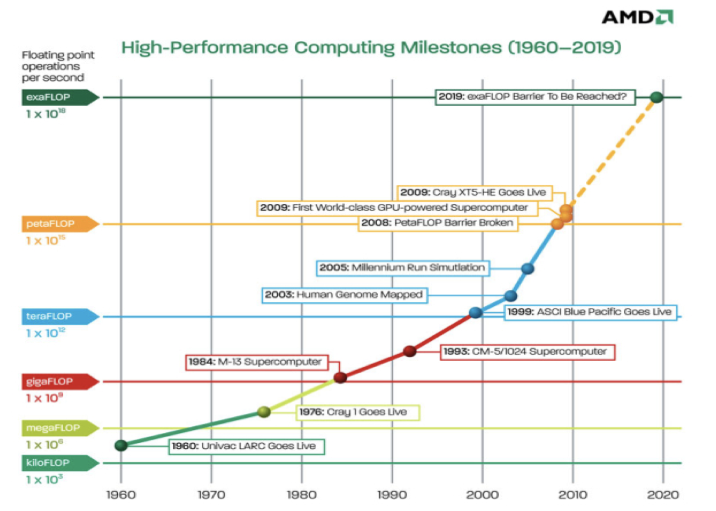
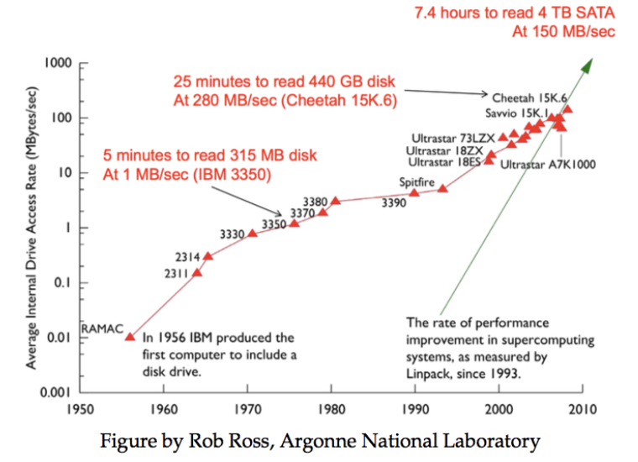
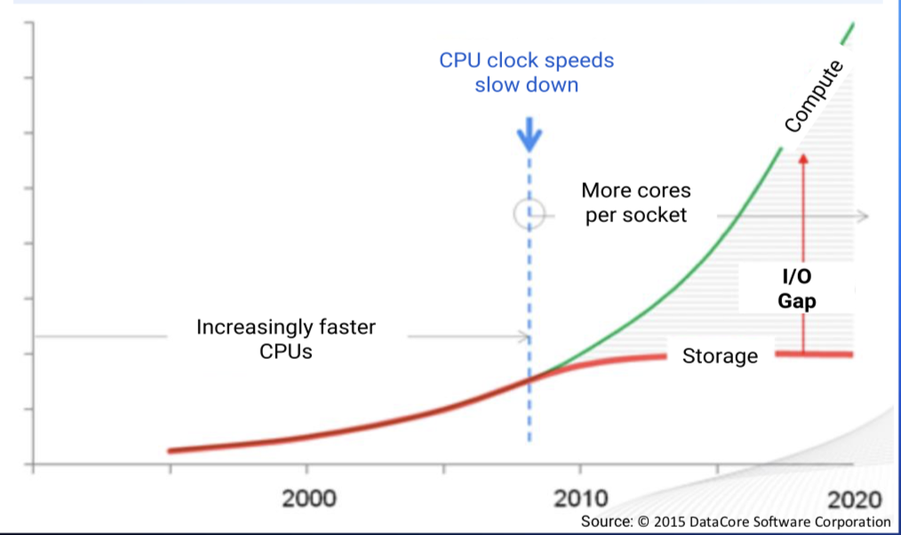

Motivation – I/O Bottleneck
The I/O bottleneck is caused by the unevenly increased performance for computing and I/O
  Fast increased computing power
    > 10¹⁰$×$ from 1960 to 2010
  Slowly increased IDA rate
    < 10⁶$×$ from 1960 to 2010
  Over 10⁴$×$ gap between computing power and I/O
Figure from AMD, 2010
Notes:
3

Slide 5
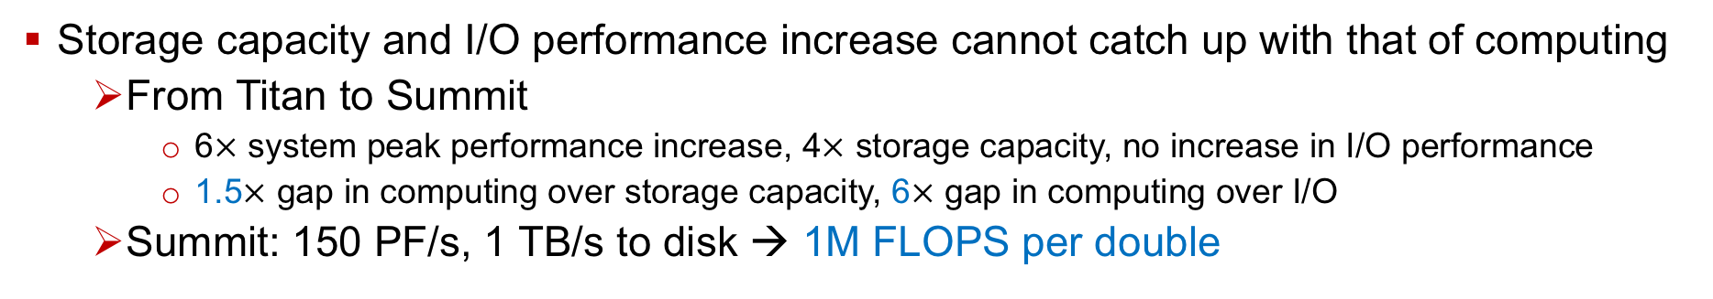
Motivation – I/O Bottleneck in supercomputers
Figure and table from I. Foster (ANL)
Storage capacity and I/O performance increase cannot catch up with that of computing
  From Titan to Summit
    6$×$ system peak performance increase, 4$×$ storage capacity, no increase in I/O performance
    1.5$×$ gap in computing over storage capacity, 6$×$ gap in computing over I/O
  Summit: 150 PF/s, 1 TB/s to disk → 1M FLOPS per double
Notes:
5

Slide 6
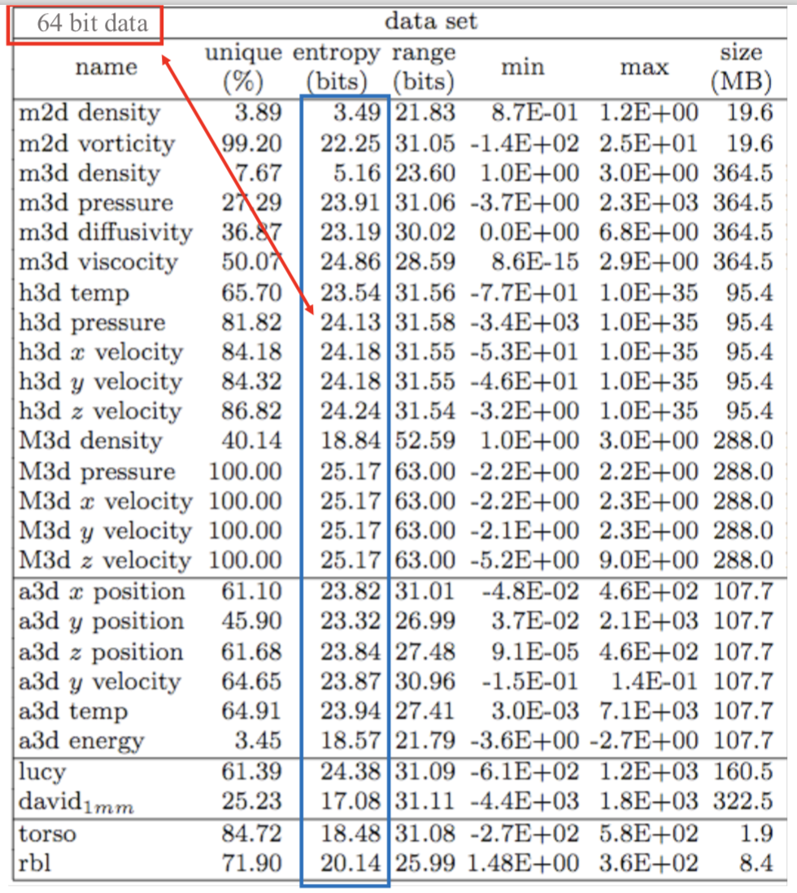
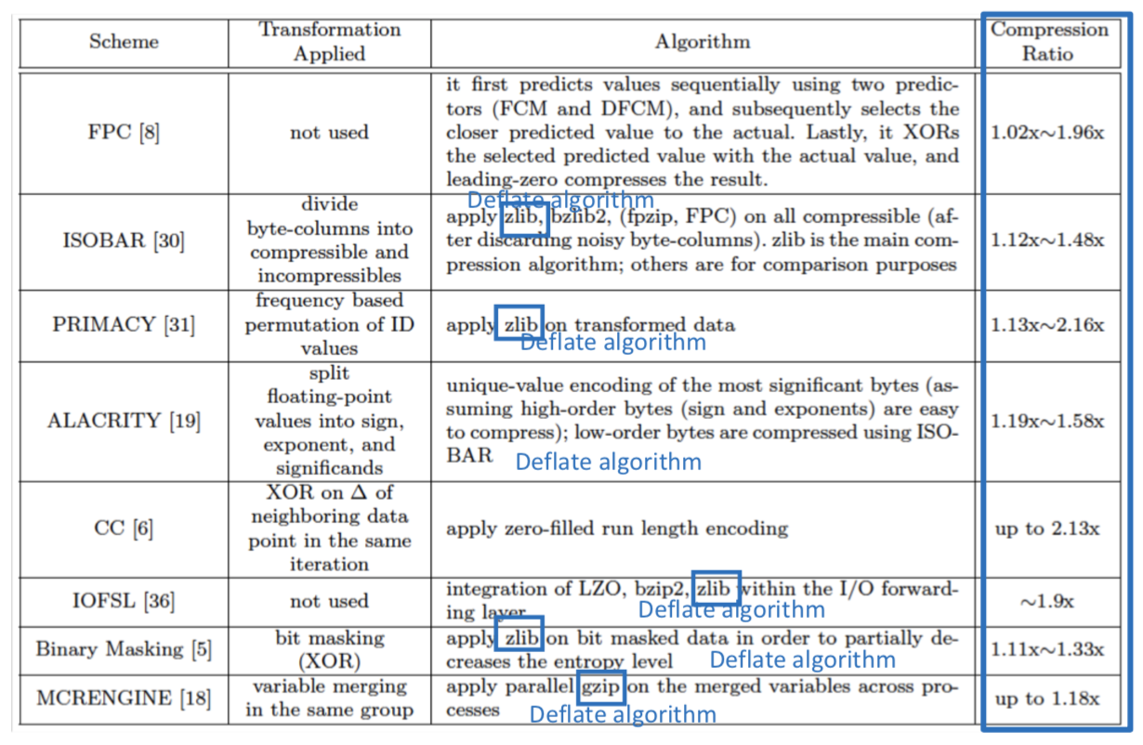
Motivation – Why Not Lossless Compression
Lossless compression cannot lead to a high reduction ratio on scientific data
  Directly applying encoding to scientific data does not work efficiently
  Neither do advanced lossless compressors which exploit further redundancy
Fast and efficient compression of floating-point data.
P. Lindstrom et al. (TVCG’06)
Data compression for the Exascale Computing Era Survey.
S. Son et al. (Supercomputing frontiers and innovations 2014)
Notes:
6

Slide 7
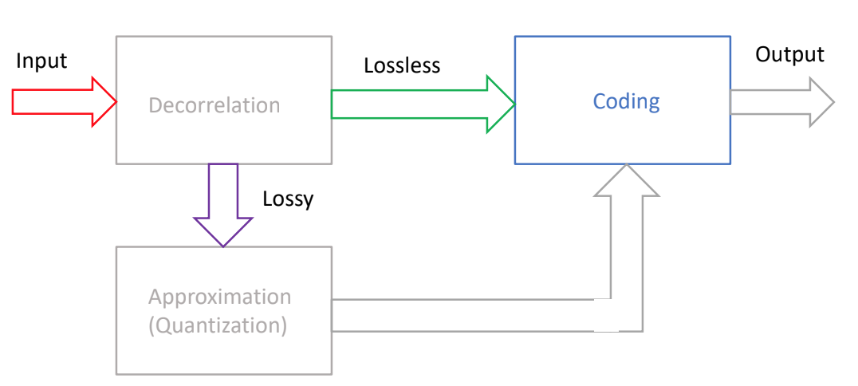
Motivation – Lossy Compression
Reduces data accuracy to reach higher compression ratios (typically 1 order of magnitude or more) than lossless compression
  If such compression ratios cannot be achieved, use lossless compression
  Essentially Trade-off between data size and data accuracy
Specific requirements for usefulness in the context of scientific data
  Error-bounded compression: controlling the accuracy of the decompressed data
  Fast compression/decompression performance: to be used for in-situ analysis
Notes:
7

Slide 8

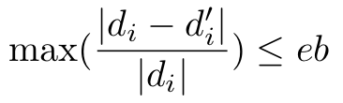

Background – Lossy Compression Requirements
Absolute error bound
  Targets: guarantee point-wise errors such that
  Often used for scalar field data
Relative error bound
  Targets: guarantee point-wise relative errors such that
  Often used for vector field data
Peak Signal-to-Noise Ratio ( PSNR =) )
  Targets: maximize compression ratios given the same PSNR
  Often used for visualization
Notes:
8

Slide 9
Background – Existing Lossy Compressors
Prediction-based compressors
  ISABELA
    Sorting + curve fitting. Relative error bound only. Time-consuming because N log N complexity on sorting.
  FPZIP
    Lorenzo predictor + arithmetic encoding. Relative error bound only.
  SZ
    Multi-algorithm predictor + linear quantization + Huffman encoding + lossless encoding.
Transform-based compressors
  Vapor
    Wavelet transform. No error control.
  ZFP
    Customized, well-tuned transform. High throughput.
Notes:
8

Slide 10
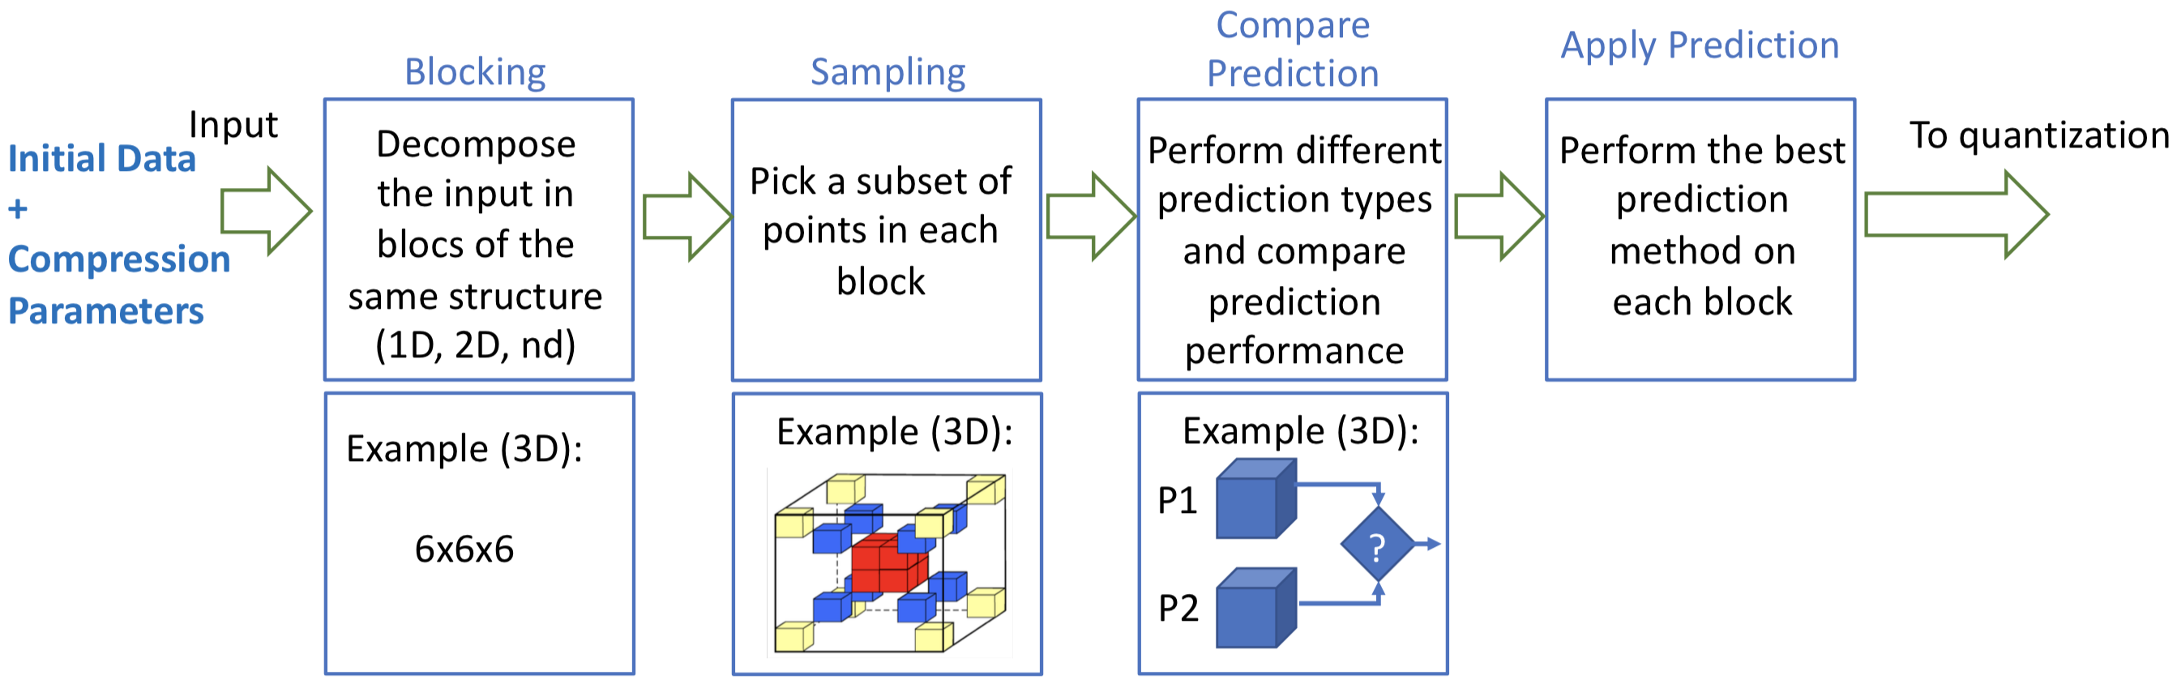
Background – SZ
Prediction-based compressor
  Multi-algorithm predictor for decorrelation
  Linear quantization to respect the error bound
SZ pipeline
Figure from Franck Cappello
Notes:
9

Slide 11
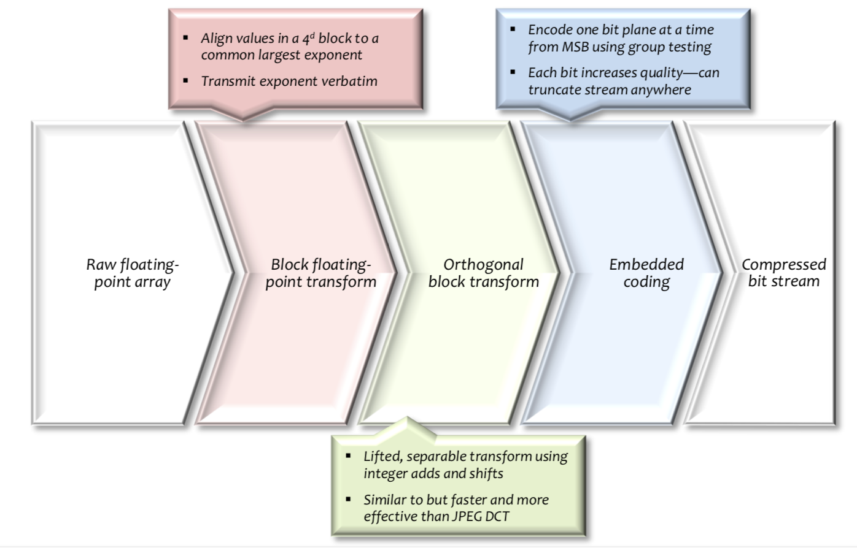
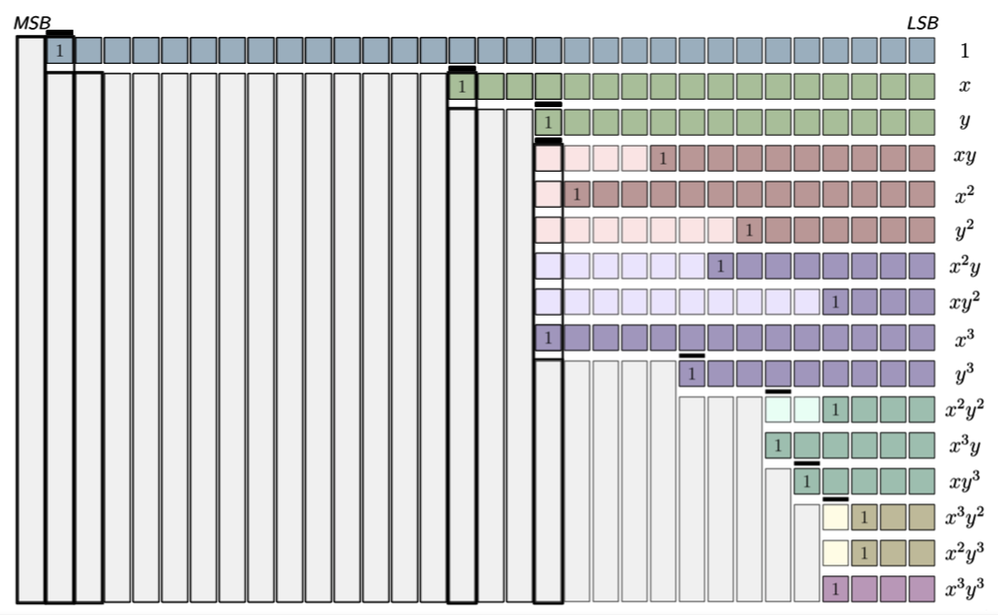
Background – ZFP
Transform-based compressor
  Orthogonal transform for decorrelation
  Exponent align and truncation to respect the error bound
Embedded encoding
Figure from Peter Lindstrom
ZFP pipeline
Figure from Peter Lindstrom
Notes:
10

Slide 12
Background – Comparison
Neither of them is always better than the other
  Datasets, data fields, error settings, … all matter
  Qualify usually measured by rate-distortion graph
    Y axis: distortion (PSNR)
    X axis: bit-rate, average bits per value in compressed format
    The more upper left the curve, the better the result
QMCPack
NYX baryon density
NYX temperature
Notes:
11

Slide 13
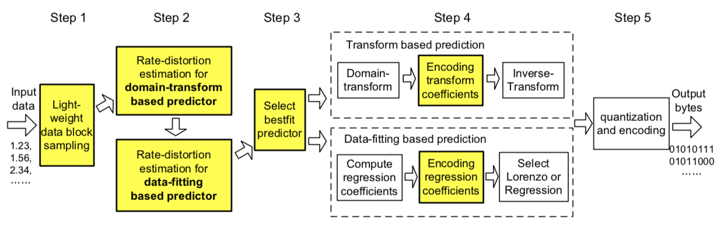
Overview
Observations
  Predication-based and transform-based compressors are adept at different datasets and/or different error settings
    Prediction-based ones on relatively high or low PSNR
    Transform-based ones on median PSNR
Unify the two models by leveraging a transform-based compressor as a predictor
  Adaptively select models according to datasets and settings
  Further improving the coefficient encoding by using the spatial correlations across blocks
    Adaptively select encoding mechanism for block coefficients
Notes:
13

Slide 14

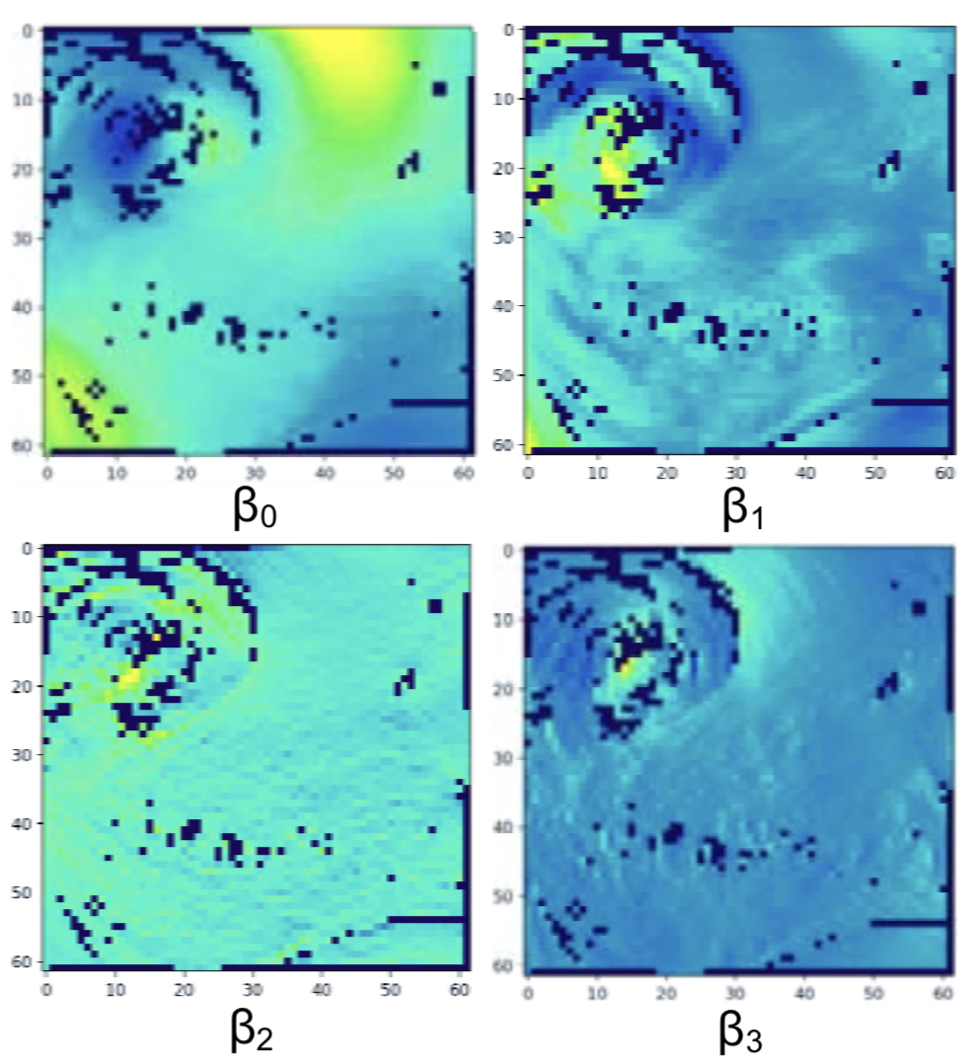
Efficient Coefficient Encoding - Regression
Limitations on Regression Coefficient Encoding
  Low efficiency
    Isolated compression on the coefficient data
Observations on the visualization of coefficients
  Consecutiveness across blocks
    Compressible by inter-block correlation
  Use embedded SZ for coefficient compression
    Group coefficients
      Stronger inter-block correlation than natural order
      Distinguish between intercepts and slopes
    Error-bounded feature
      Ensure accurate prediction by decompressed coefficients
Binary Representation
Visualization of regression coefficients
Black pixels indicate Lorenzo blocks
Notes:
14

Slide 15
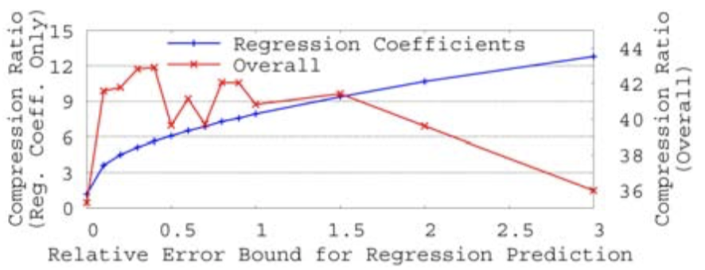
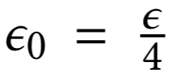
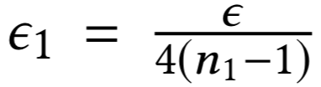
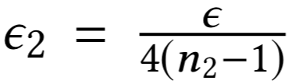
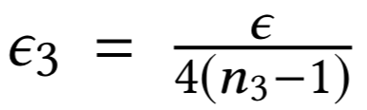

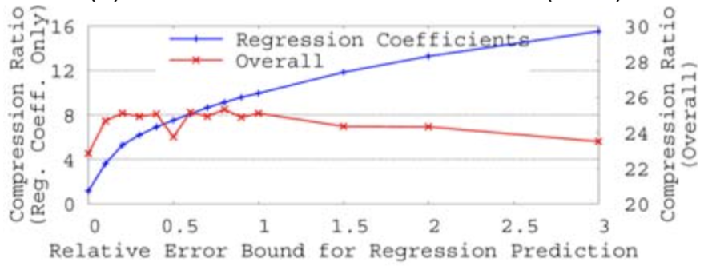
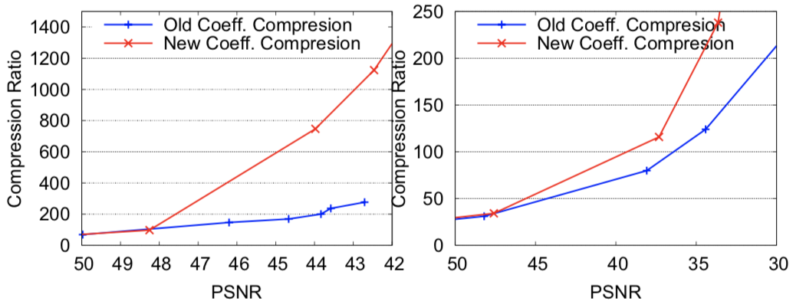
Efficient Coefficient Encoding - Regression
Efficient Regression Coefficient Encoding
  Apply SZ on grouped regression coefficients
    Linearized 1D prediction
  Adaptive error bound setting
    Different error bounds for intercepts and slopes
Impact of relative regression error bound
Uf48
PRECIPf48
Uf48
PRECIPf48
Notes:
15

Slide 16
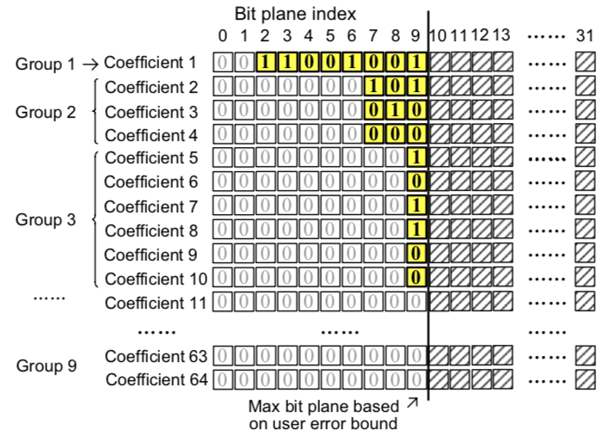
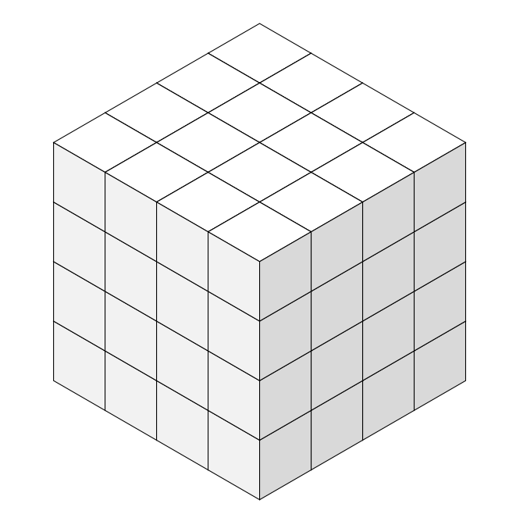
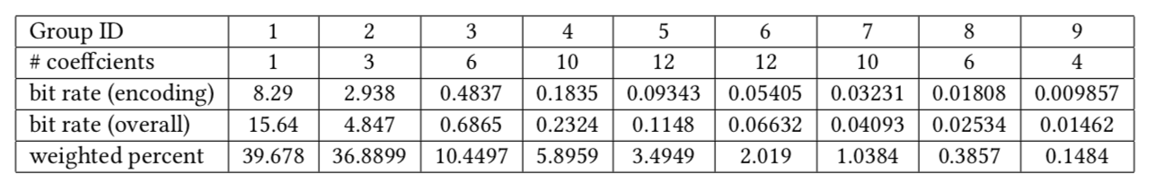
Efficient Coefficient Encoding - Embedded Encoding
Limitations on Embedded Encoding
  Biased storage composition
    First a few groups occupy most of storage
  Many meta bits besides encoding bits
    Sign bits: mark sign of current data
    Group bits: mark occurrence of group
    Skip bits: mark end of bit plane
4
3
5
2
4
6
1
3
5
7
Transform
2
4
6
Energy
2
3
5
8
3
4
7
3
4
6
9
4
5
8
4
5
7
9
5
6
9
6
8
7
Storage Decomposition of the Transform Coefficients on NYX Velocity_x (eb: 6e-3)
Group 1: 8 + 1 + 1 + 5 = 15 bits
Group 2: 3*3 + 2 + 1 + 2 = 14 bits
Group 3: 6*1 + 3 + 1 + 1 = 11 bits
40 bits in total
> 75%
Notes:
17

Slide 17
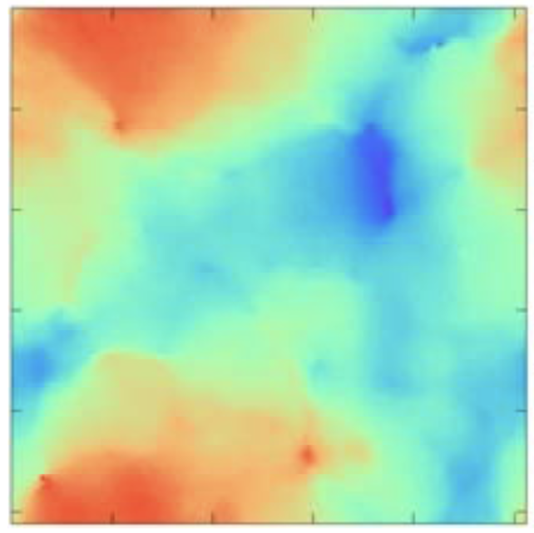
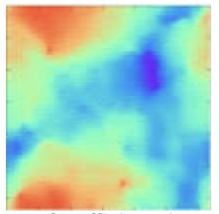
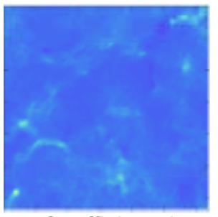
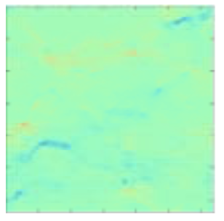
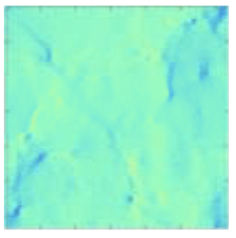
Efficient Coefficient Encoding - Embedded Encoding
Limitations on Embedded Encoding
  Biased storage composition
    First a few groups occupy most of storage
  Many meta bits besides encoding bits
    Sign bits: mark sign of current data
    Group bits: mark occurrence of group
    Skip bits: mark end of bit plane
Observations on the visualization of coefficients
  Consecutiveness across blocks
    Compressible like reg coefficients
  Use SZ for coefficient compression
    Error-bounded feature
      Respect error bound
    Multi-dimensional prediction
      Enable higher compression ratios
NYX Velocity_x, original data
Coefficient 1
Coefficient 2
Coefficient 3
Coefficient 4
Notes:
18

Slide 18
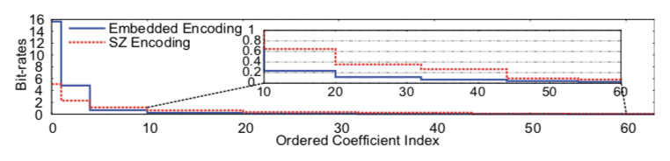
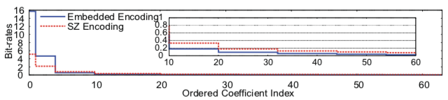
Efficient Coefficient Encoding - Embedded Encoding
Adaptive transform coefficient encoding
  SZ Encoding for high-energy coefficients
    More efficient when encoding bits are large
  Embedded Encoding for low-energy ones
    More efficient when encoding bits are small
  Threshold determined by sampling
SZ Encoding
Real Bit Rates of Coefficients Compression
Embedded Encoding
Estimated Bit Rates of Coefficients Compression
Group 1: 8 + 1 + 1 + 5 = 15 bits
Group 1: 5.1 bits
Group 2: 3*3 + 2 + 1 + 2 = 14 bits
Group 2: 3*2.3 = 6.9 bits
Group 3: 6*1 + 3 + 1 + 1 = 11 bits
40 23 bits in total
Notes:
20

Slide 19
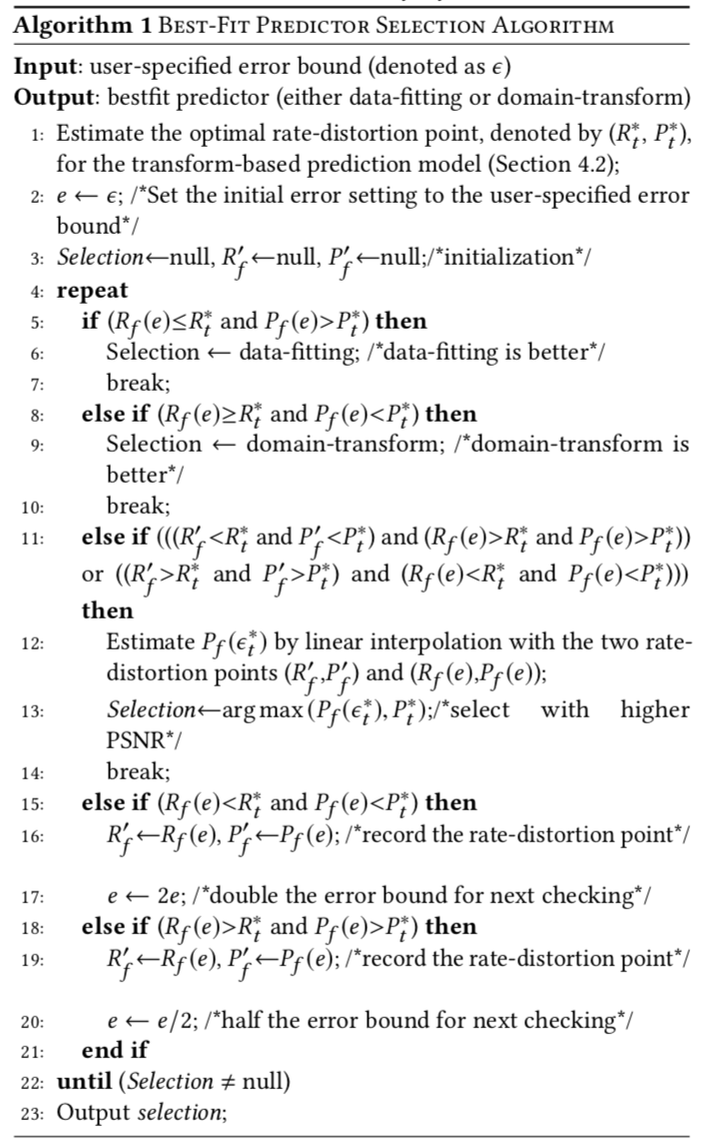
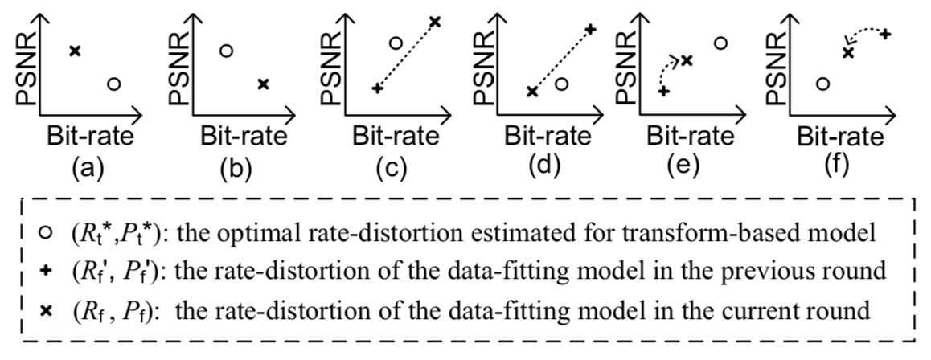
Hybrid Prediction Scheme
Transform-based Compressor as a Predictor
  Error setting estimation
    Select highest bit-rate decay over MSE increase
  Adaptive predictor selection
    Transform-based rate-distortion estimation
    Prediction-based rate-distortion approaching
      Repeat in case (e)(f); Stop and select in case (a)-(d)
Notes:
22

Slide 20

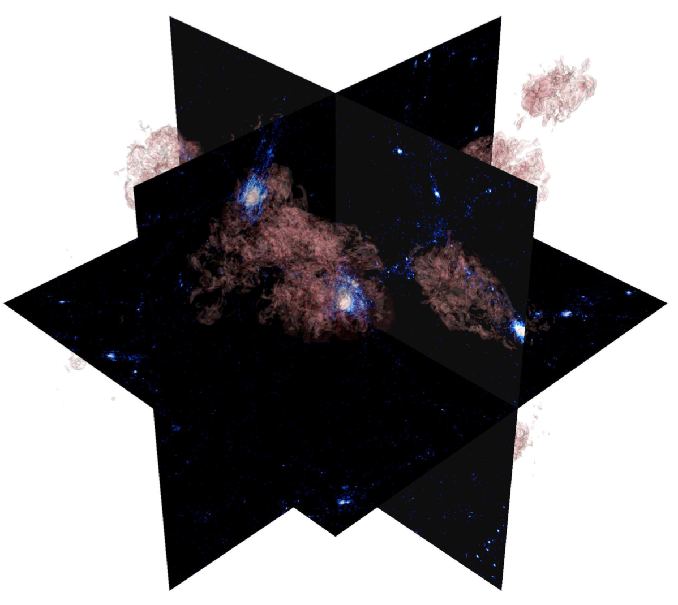
Evaluation – Setup
Platform: Bebop @ ANL
  Up to 256 nodes, each with two Intel Xeon E5-2695 v4 processors and 128 GB of memory, and each processor with 18 cores
  GPFS with two I/O nodes in total
Datasets from scientific simulations
  Hurricane ISABEL
    100x500x500, 13 fields, 1.2 GB/core
  NYX
    512x512x512, 6 fields, 3 GB/core
  SCALE-LETKF
    98x1200x1200, 12 fields, 6.3 GB/core
Santa Barbara Cluster Simulation
Almgren, Ann S., et al. "Nyx: A massively parallel AMR code for computational cosmology." The Astrophysical Journal 765.1 (2013): 39.
Notes:
23

Slide 21
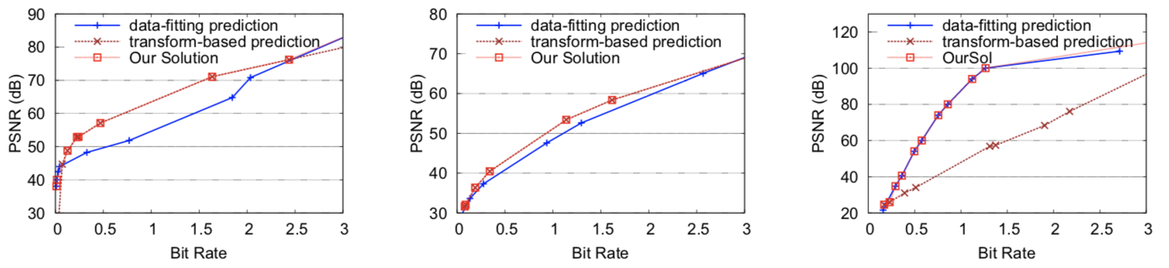
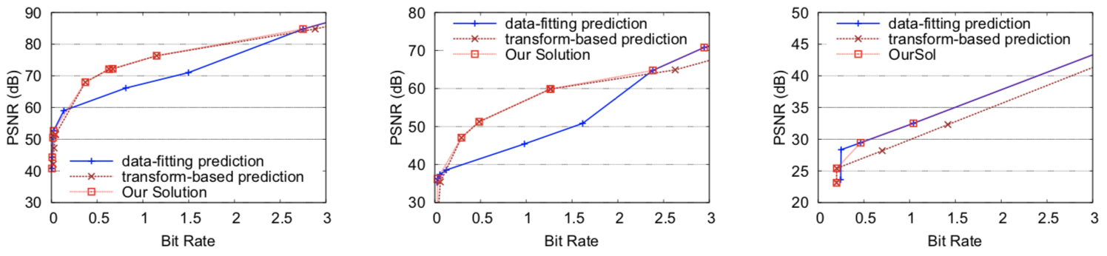
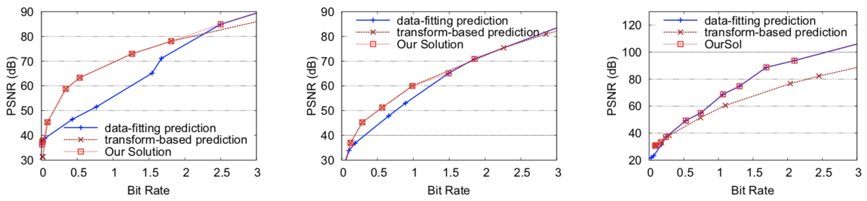
Evaluation – Rate-distortion (1)
Accuracy of Adaptive predictor selection
  Hurricane
    Uf48
    PRECIPf48
    QCLOUDf48
  NYX
    Velocity_x
    Baryon_density
    Dark_matter_density
  SCALE-LETKF
    RH
    QR
    QI
Notes:
24

Slide 22
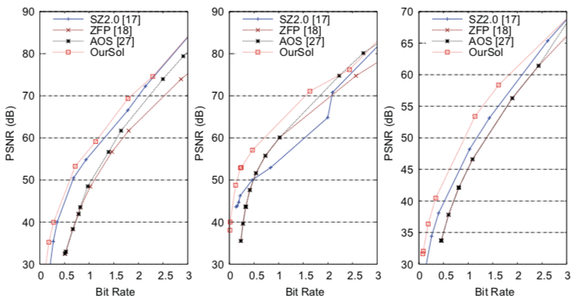
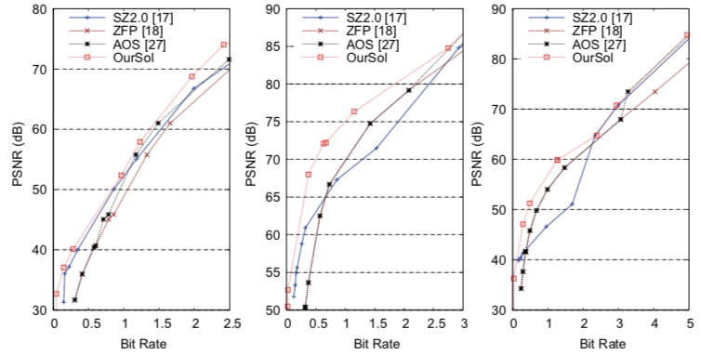
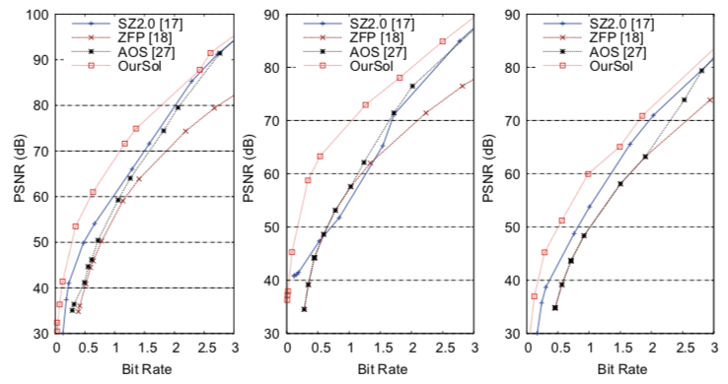
Evaluation – Rate-distortion (2)
Rate-distortion Comparisons with state-of-the-art
  Rate-distortion on each dataset
    One overall (fixed error bound)
    Two typical fields
Hurricane
overall
Uf48
PRECIPf48
NYX
SCALE-LETKF
overall
velocity_x
baryon_density
overall
RH
QR
Notes:
25

Slide 23
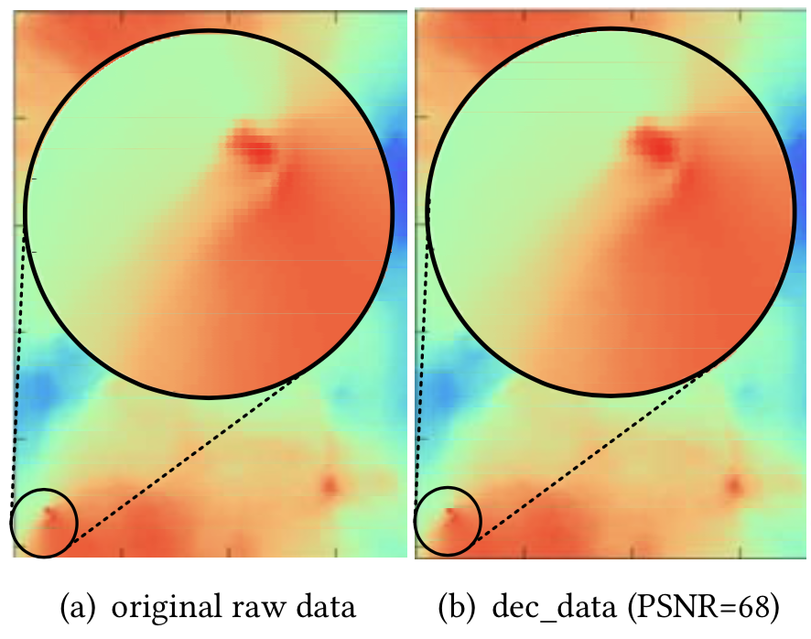
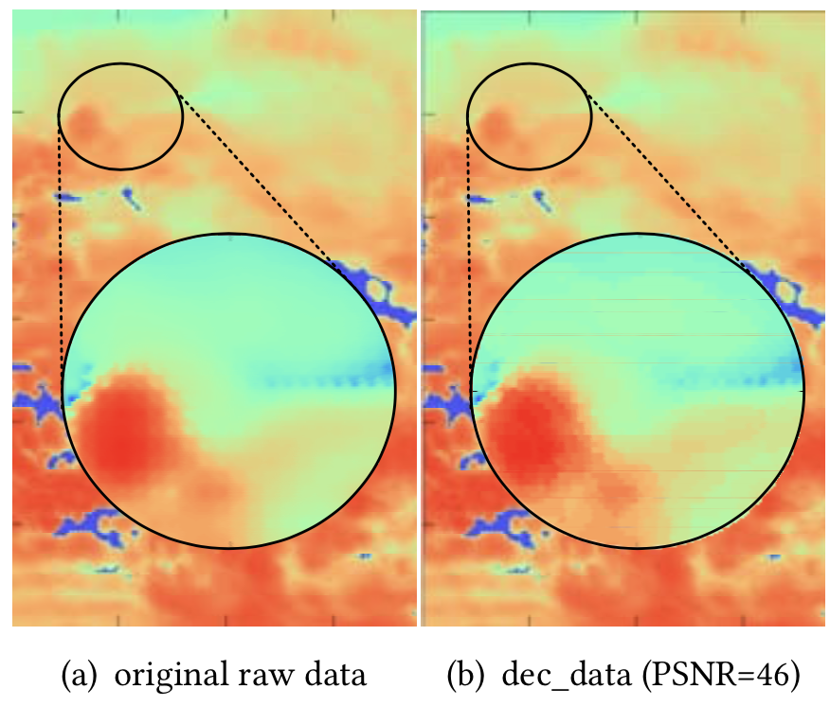
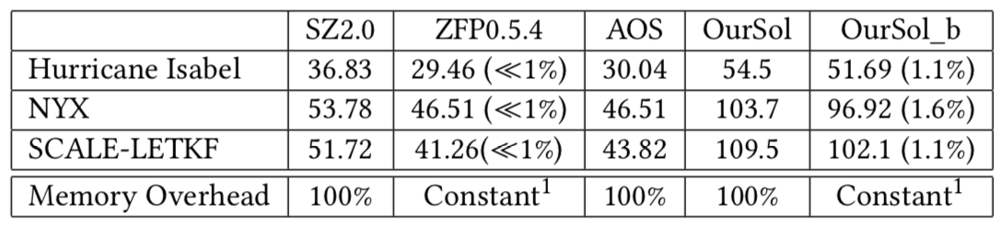
Evaluation – Parallel Performance (1)
Fixed PSNR for each data field
  Original data: ~60
  Logarithmic data: ~40
Single core results
  OurSol: the proposed solution
  OurSol_b: the proposed solution with block segmentation
NYX velocity_x
Compression ratios and memory overhead
SCALE-LETKF QS
Notes:
26

Slide 24
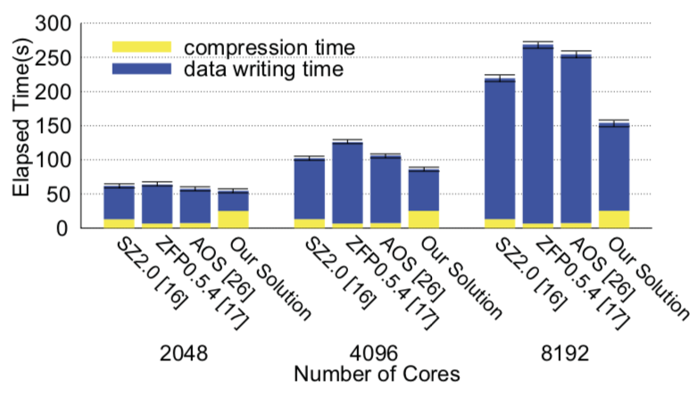
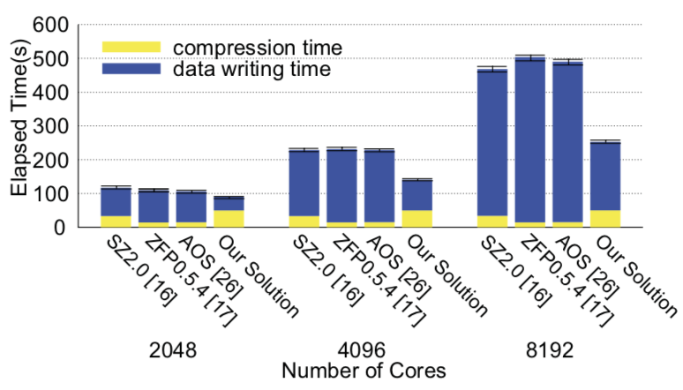
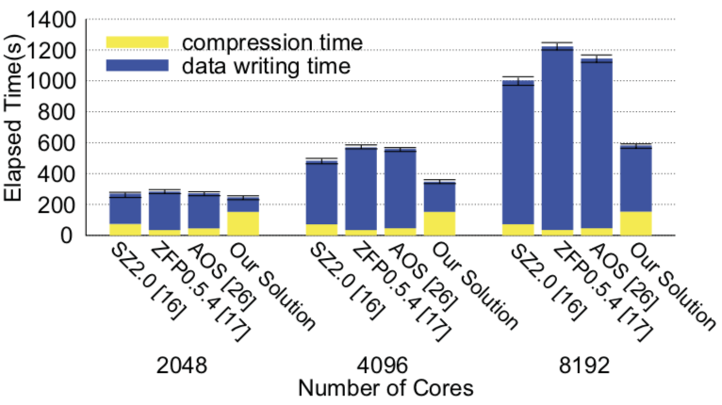
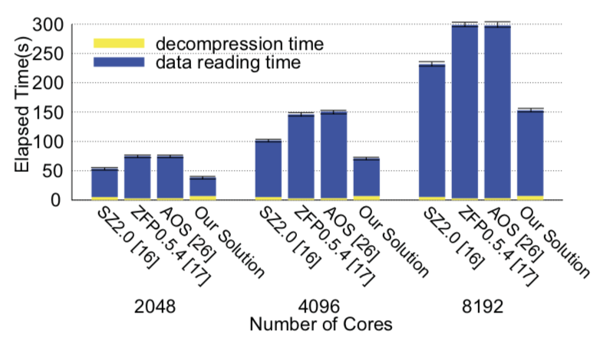
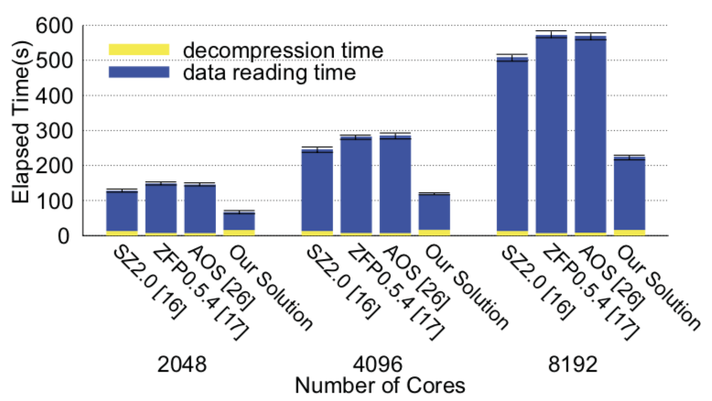

Evaluation – Parallel Performance (2)
Data dumping performance (compression + writing)
Hurricane
NYX
SCALE-LETKF
Data loading performance (reading + decompression)
Hurricane
NYX
SCALE-LETKF
Notes:
26

Slide 25
Future Work
Adopt more efficient predictor selection
  Finer-grained, e.g. block granularity
  Better selection strategy, e.g. machine learning based selectors
Explore better predictors
  Neural network-based predictors, self-adaptive predictors etc.
End-to-end evaluation on analysis other than visualization
  Feature extraction, halo finding etc.
Notes:
27

Slide 26


Thanks
This research was supported by the
Exascale Computing Project (17-SC-20-SC),
a joint project of the U.S. Department of Energy’s Office of Science and National Nuclear Security Administration, responsible for delivering a capable exascale ecosystem, including software, applications, and hardware technology, to support the nation’s exascale computing imperative.

Slide 27
Thank you !
Any Questions?

Slide 28
Backup

Slide 29



Motivation – Data Transmission and Streaming
Extremely large amount and high generation speed of experimental data from scientific instruments
  APS (Advanced Photon Source @ ANL)
    150 TB/Specimen 𝗑 100 Specimen = 15 PB
    Network bandwidth 100 GB/s → Transfer time > 43 hours
  LCLS (Linear Coherent Light Source @ Stanford)
    250 GB/s acquisition speed vs 25 GB/s writing bandwidth
    90% of data will be discarded
Data systems for the linac coherent light source. Thayer et al. (2017)

Slide 30
Motivation – Compression and Scientific Data
Lossless compression
  The data is compressed and decompressed in such a way that the decompressed data is identical to the initial data
  Examples: GZIP
Lossy compression
  The data is altered during compression: some piece of information is removed (lost), the original data cannot be retrieved
  If user can control the accuracy of the compressed data, then lossy compression is a trade-off between compression factor and loss of accuracy
  Examples: JPEG
Scientific data are usually floating-point data
  The ending mantissa looks very random
This is what we need to compress
(bit map of 128 floating point numbers)
Floating point data set
(numerical simulation
of the brain):
Random
(noise)
Sign+
Exponent
Mantissa
Source: Leonardo Bautista Gomez (BSC)

