Slide 1

CARE: Compiler-Assisted Recovery from Soft Failures
What kind of resilience can we get for free ?
Chao Chen
Greg Eisenhauer, Santosh Pande, Qiang Guan
Notes:
The title of my paper is “CARE: Compiler Assisted Recovery from Soft Failures”, but for the presentation, I’m want you to think of this as having an alternative title, “What kind of resilience can we get for free?”

Slide 2
Outline
Background
Related Work
The Insight
How CARE works
Some More Details
Evaluation Results

Slide 3
Outline
Background
Related Work
The Insight
How CARE works
Some More Details
Evaluation Results

Slide 4

Transient Fault
Cosmic Rays
Heat Flux
Faulty operation
Corrupt data
Temporary v.s. Permanent
Hardware can continue normal operations when fed with new data
Notes:
A transient fault is a one-off faulty operation that results in corrupted data. It may be caused by a voltage transient, a cosmic ray or whatever, but the important thing is that it’s a temporary, not a permanent failure and it has consequences for our data. Transient faults might happen in the memory system, where we have nice hardware techniques like parity codes to detect and even correct them, or they might happen in the CPU or FPU where such techniques typically do not apply.

Slide 5


Transient Fault
In Memory System
In Compute Logic
Protection with Parity Codes
  ECC, IBM Chipkill
No efficient techniques
Wrong outputs of instructions
Notes:
Transient faults might happen in the memory system, where we have nice hardware techniques like parity codes to detect and even correct them, or they might happen in the CPU or FPU where such techniques typically do not apply.

Slide 6

How Likely to Experience Transient Faults ?
Increasing concern due to undesirable side-effects of
1. Smaller Transistor
2. Higher Density
3. Lower Voltage
Projected Daily Transient Errors for Exa-scale [Olivera SC’17]
  With ECC Memory
Negative impact on long running scientific applications
Notes:
Reasonable people may differ on the likelihood of the occurrence of these events, but two things are clear: First, they do occur, and second, as we push towards petascale, increase the numbers of cores and try to hold down power consumption, they become more likely.
this assumes ECC, so this is actually an estimate of non-memory transient faults

Slide 7
Transient Faults in Different Units
More overheads
Detection is free
1. FPU → Incorrect Outputs
2. ALU → Process Crashes
Require more frequent checkpoint
The job is killed, resubmitted
Referred as SDCs
Core math computation
Referred as Soft Failures
Branch and address computation
How to recover from them?
Bunch studies on SDCs [SC12, PPoPP13, SC14, HPDC17…]
Lose the computations
Checkpoint freq ~ f(1/MTBF)
Rescue with checkpoint
Show you a free online recovery method: CARE

Slide 8
Outline
Background
Related Work
The Insight
How CARE works
Some More Details
Evaluation Results

Slide 9
State-of-the-art Methods
LetGo [Fang HPDC’17] & RCV [Fan PLDI’14]
Based on Heuristics
  skip the crashed instruction
  return a “fake” value, e.g., 0, for memory-load instructions
  do nothing for memory-store instructions
Not truly “repair” a crash/corrupted data
Lead to SDCs (another challenge problem)
CARE is to repair the crash by exploring program properties
Notes:
they *don’t* try to recalculate the corrupted address, but instead they just focus on providing something that might help the program make it to normal termination

Slide 10
Outline
Background
Related Work
The Insight
How CARE works
Some More Details
Evaluation Results

Slide 11
No Heuristics, Accuracy is Achievable
Majority (~93%) of these failures manifest as SIGSEGV
  Stencil codes, complex address computations
for (int i = in; i < out; i++)
for (int j = 1; j < mth[i]; j++)
for (int k = 1; k < mz; k++) {
int ij = igrid[i] + j - ig;
zo[i] += 0.25 * den[k + ij * (mz + 1)];
den[k + ij * (mz + 1)] =
0.25 * den[k + ij * (mz + 1)]
* markeri[k - 1 + ij * mz];
}
>80% operations for accessing arrays
Potential crash points → Memory access instructions
Address computations are available in source code
  → Repair by replaying related computations

Slide 12
Outline
Background
Related Work
The Insight
How CARE works
Some More Details
Evaluation Results

Slide 13
Overview of CARE
Recover from SIGSEGV failures by replaying computations
repair
1. Accurate, not introduce SDCs
2. High recovery rate (~83%)
3. Fast failure recovery (ms)
4. Easy to use, no code changes
CARE
How does CARE identify related computations ?
How to replay these computations ?
How to repair corrupted program state (register)?
5. Lightweight, zero runtime cost

Slide 14

Identify Related Computations
Clone address computations for each memory access at compile time
Recovery Kernels:
Functions with params
Params retrieved
from process
for (int i = in; i < out; i++)
for (int j = 1; j < mth[i]; j++)
for (int k = 1; k < mz; k++) {
int ij = igrid[i] + j - ig;
zo[i] += 0.25 * den[k + ij * (mz + 1)];
……
}
void* RK1(float *den, int igrid, int i,
int j, int k, int mz, int ig) {
int ij = igrid[i] + j - ig;
return (void*)(den + k + ij * (mz + 1));
}
All of kernels:
→Shared library →Dynamically loaded

Slide 15

Challenges for Executing a Kernel at Runtime?
How to find the correct recovery kernel ?
How to get values for parameters ?
The Challenge: different view of program at different stage
mzeta = a + b;
phitmp[(mzeta + 1) * k] = …;
……
phi[grid[k] + a + b] = …;
void* RK1 (int *phitmp, int a, int b, int k) {
return (void*)(phitmp + (a * b + 1) * k);
}
void* RK2 (int *phi, int *grid, int a, int b, int k) {
return (void*)(phi + grid[k] + a + b);
}
During building
……
0x40080: mov %eax, (%rcx)
……
0x50068: mov %ebx, (%rdx)
During Runtime

Slide 16



Synchronization via Debug Mechanism
Uses debug data <file, line, col> as a key to an instruction
Creates a Debug Entry for each parameter
Compile phase
Compile phase
key | kernel | params
<f1, l1, c1> | rk1 (int *, int, int) | a, i, k
<f2, l2, c2> | rk2 (float *, int) | m, j
Values for Params
PC
Line Table
PC

Slide 17
How to Repair the Corrupted State?
Key: find what is the corrupted state ?
  No knowledge when building kernels
Disassemble the corrupted instruction
→ Get the address operand
offset(%base, %index, scale)
x-86 Assembly
//index = rcx, base = rsi
%rcx = (NewAddr – offset - %rsi)/scale
Computed by CARE

Slide 18
Outline
Background
Related Work
The Insight
How CARE works
Some More Details
Evaluation Results

Slide 19
Requirements for Recovery Kernels
Contain as many instructions as possible
→ improve the coverage
The values for all parameters are available
→ the kernel is executable

Slide 20
The Challenge for Building Recovery Kernels
The interference from code optimization
Its location is reused by other variable, and value not available in registers
k = z +1;
for (int i = 0; i < n; i++)
for (int j = 1; j < m; j++)
phitmp[i * k +j] = …
void* kernel (int *phitmp, int i, int j, int z) {
k = z +1;
return (void*)(phitmp + i * k + j);
}
void* kernel (int *phitmp, int i, int j, int k) {
return (void*)(phitmp + i * k + j);
}
How to guarantee the availability of parameters at compile-time?

Slide 21
Rescue with Liveness Analysis
S1: a = add b, c
S2: store m, &d
S3: e = sub a, 9
…
S1: a = add b, c
S2: store m, &d
S3: e = sub m, 9
…
Liveness analysis
Live Variables
a is live at S2
a is dead at S2
Live variable: A variable is live at some point p if from p to end the variable is used before it is redefined else it is dead.
Compiler optimizes out dead values
→→ All parameters for a kernel should be live at the corresponding memory access instruction

Slide 22
Prototype (Proof-of-concept)
LLVM-6.0
Intel Xeon E5
Ubuntu 18.04
SLOC: ~11000
Support for: -O0 and -O1
Multi-language support
Code available at:
https://github.com/kandycs/CARE

Slide 23
Illustration of Building Recovery Kernels
// A[(b+c)*(m-n)+k] = …
……
%44 = add nsw i32 %42, %43
%sub161 = sub nsw i32 %add160, %29
……
%sub169 = sub nsw i32 %44, %29
%mul170 = mul nsw i32 %add66, %sub169
%add171 = add nsw i32 %mul170, %k.0
%idx172 = sext i32 %add171 to i64
%aidx173 = GEP i64, i64* %12, i64 %idx172
store i64 %46, i64* %aidx173, align 8
i64* kernel( %12, %k.0, %add66, %44, %29) {
%sub169 = sub nsw i32 %44, %29
%mul170 = mul nsw i32 %add66, %sub169
%add171 = add nsw i32 %mul170, %k.0
%idx172 = sext i32 %add171 to i64
%aidx173 = GEP i64, i64* %12, i64 %idx172
ret %aidx173
}
Param
NO
YES
isCloneable?
Stmt
True: all operands are live (or can be computed from live values) at the memory access instruction
False: otherwise
LLVM IR
Stop when meet PhiNode,Aguments,
GlobalVariable, AllocaInst
Note: please refer to paper for more information

Slide 24
Outline
Background
Related Work
The Insight
How CARE works
Some More Details
Evaluation Results

Slide 25
Evaluation Setup
Platform:
Chameleon (TACC)
Upto 64 nodes (1536 cores)
4 HPC Workloads:
GTC-P
HPCCG
MiniMD
CoMD
Questions to Answer:
  How many SIGSEGV faults can CARE repaired ?
  How quickly for CARE to repair a fault ?
  What is the impact to HPC applications ?

Slide 26

Fault Model & Methodology
MOV CX, AX
Random Dynamic Instruction
Bitflip instruction
result
10000 injections
per workload
Trace execution
path
Run experiments for -O0 and -O1 with two different sets of injections, since they have different instruction sets
Note: please refer to the paper for details

Slide 27
How likely a transient fault results in SIGSEGV ?
1500~4100 soft failures
Breakdown based on symptoms
 | SIGSEGV | SIGBUS | SIGABRT | Other
HPCCG | 3322 | 32 | 22 | 33
CoMD | 2195 | 57 | 41 | 146
MiniMD | 4028 | 6 | 25 | 6
GTC-P | 1196 | 49 | 375 | 24
~93% (up to 98%) as SIGSEGV

Slide 28
Results for Building Kernels
How many kernels it builds ?
What is its overheads, time for building these kernels?
 | GTC-P | HPCCG | MiniMD | CoMD
# Kernels | 2786 | 255 | 2611 | 1143
Avg. # IR instructions | 19.18 | 2.51 | 8.2 | 2.63
Compile-time overhead (sec) | 226.89 | 35.538 | 57.528 | 14.665
2.67 (77%)
1.43 (53%)
1.52 (61%)
1.17 (49%)
Static one-time compile time overhead

Slide 29
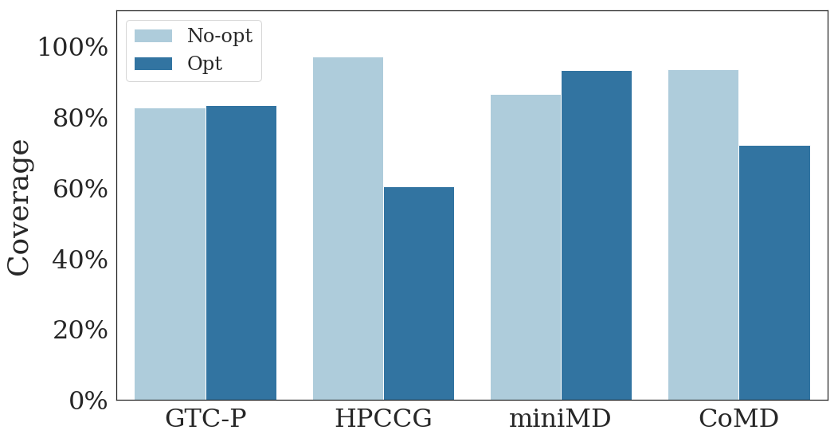
How Many Failures are Recovered ?
Avg. ~83.45% (SIGSEGV failures for each workload)
LetGo : 62%
// source code
int i, j, k;
…
i = j + k;
array[i] = …
Note:
No-opt = -O0
Opt = -O1
// LLVM IR, O1
i = add j, k
GEP array, i
More targets, Multiple locs
// LLVM IR, O0
i = alloca …
j = load …
k = load …
t1 = j + k
store t, i
t2 = load i
GEP array, t2
// LLVM IR O0
t1 = load i
GEP array, t1
t1 = add, t1, 1
store t2, i
j + k in the def-use-chain
// source code
for (int i; i < n; i++)
array[i] = …
// LLVM IR O1
GEP array, i
i = add i, 1
Few targets, One location
j + k not in the def-use-chain

Slide 30
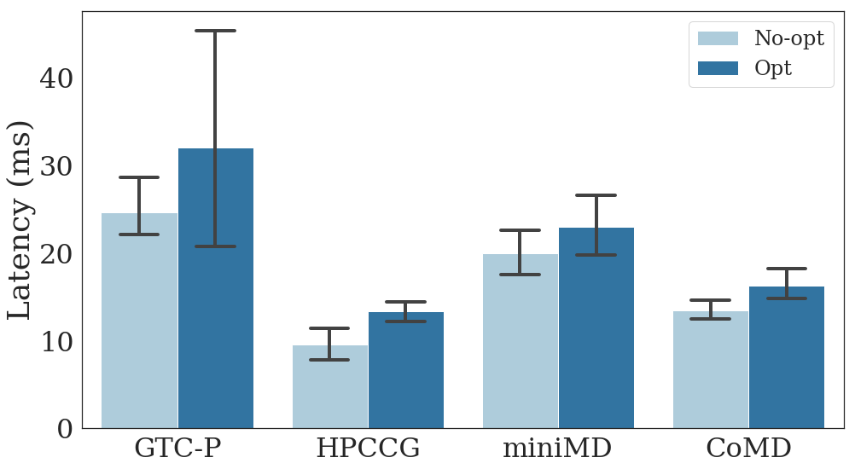
How Quickly Can CARE Repair a Fault ?
Dozens of ms, Varies based on kernel size and # params
Note:
No-opt = -O0
Opt = -O1

Slide 31
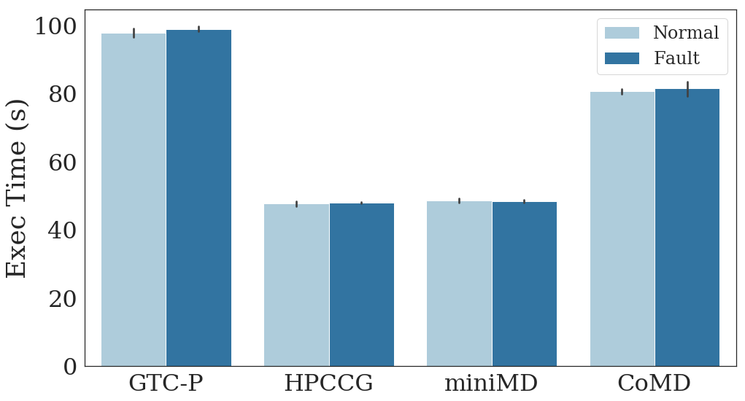
How Can CARE Help Parallel Applications ?
Mask the Impacts: Apps finished jobs as if no faults
No differences
Note:
One-fault per run

Slide 32
How About Libraries ?
Rebuild libraries from the source codes with CARE
Preliminary Results for BLAS
  Popular linear algebra library for scientific applications and machine learning
  Test program sblat1 as the driver
  Only a subset of routines evaluated
 | # of kernels | Coverage | Recovery Time | Impact to app (Normal / Fault)
BLAS | 10931 | 83.49% | 5.7(ms) | 4.67(s)/4.59(s)
sblat1 | 187

Slide 33
Conclusion
CARE is a viable and efficient approach to recover from soft failures
1. Zero runtime overhead
2. Low compile overhead
3. Fast failure recovery
4. High coverage
5. Accurate
6. Easy to use

Slide 34
Thank you & Q/A
Source Code: https://github.com/kandycs/CARE
Notes:
Tell people

Slide 35
References
[Li SC12] Dong Li, Jeffrey S. Vetter, and Weikuan Yu. 2012. Classifying Soft Error Vulnerabilities in Extreme-scale Scientific Applications Using a Binary Instrumentation Tool. In Proceedings of the International Conference on High Performance Computing, Networking, Storage and Analysis (SC ’12).
[Chen PPoPP13] Zizhong Chen. 2013. Online-ABFT: An Online Algorithm Based Fault Tolerance Scheme for Soft Error Detection in Iterative Methods. In Proceedings of the 18th ACM SIGPLAN Symposium on Principles and Practice of Parallel Programming (PPoPP ’13).
[Cher SC14] Chen-Yong Cher, Meeta S. Gupta, Pradip Bose, and K. Paul Muller. 2014. Understanding Soft Error Resiliency of BlueGene/Q Compute Chip Through Hardware Proton Irradiation and Software Fault Injection. In Proceedings of the International Conference for High Performance Computing, Networking, Storage and Analysis (SC ’14).
[Fan PLDI14] Fan Long, Stelios Sidiroglou-Douskos, and Martin Rinard. 2014. Automatic Runtime Error Repair and Containment via Recovery Shepherding. In Proceedings of the 35th ACM SIGPLAN Conference on Programming Language Design and Implementation (PLDI ’14). ACM, New York, NY, USA.
[Di TPDS16] Sheng Di and Franck Cappello. 2016. Adaptive Impact-Driven Detection of Silent Data Corruption for HPC Applications. IEEE Transactions on Parallel and Distributed Systems 27, 10 (Oct. 2016), 2809–2823.
[Fang HPDC17] Bo Fang, Qiang Guan, Nathan Debardeleben, Karthik Pattabiraman, and Matei Ripeanu. 2017. LetGo: A Lightweight Continuous Framework for HPC Applications Under Failures. In Proceedings of the 26th International Symposium on High-Performance Parallel and Distributed Computing (HPDC ’17). ACM, New York, NY, USA,
[Cal HPDC17] Jon Calhoun, Marc Snir, Luke N. Olson, and William D. Gropp. 2017. Towards a More Complete Understanding of SDC Propagation. In Proceedings of the 26th International Symposium on High-Performance Parallel and Distributed Computing (HPDC ’17).
[Oliveira SC17] Daniel Oliveira, Laércio Pilla, Nathan DeBardeleben, Sean Blanchard, Heather Quinn, Israel Koren, Philippe Navaux, and Paolo Rech. 2017. Experimental and Analytical Study of Xeon Phi Reliability. In Proceedings of the International Conference for High Performance Computing, Networking, Storage and Analysis (SC ’17).

