Slide 1


Topology-Custom UGAL Routing on Dragonfly
  Shafayat Rahman
  Saptarshi Bhowmik
  Yevgeniy Ryasnianskiy
  Xin Yuan
  Michael Lang

Slide 2
Contributions
Dragonfly is a dominant topology in HPC, and UGAL is the preferred routing
We showed: the performance of UGAL can be significantly improved on many instances of DF, specially the ones that have “smaller” number of groups, by customizing the set of paths in UGAL
We call this improved version of UGAL as Topology-Custom UGAL (T-UGAL)
Notes:
Cray Cascade architecture, deployed in Trinity in Los Alamos, and Titan in Oak Ridge.
Cray Slingshot architecture also uses DF, which is for future.

Slide 3
Contributions
We developed a multi-step scheme to compute the custom set to non-minimal paths for a given topology
We showed that T-UGAL offers significant performance improvement over conventional UGAL on many DF topologies
Notes:
Cray Cascade architecture, deployed in Trinity in Los Alamos, and Titan in Oak Ridge.
Cray Slingshot architecture also uses DF, which is for future.

Slide 4
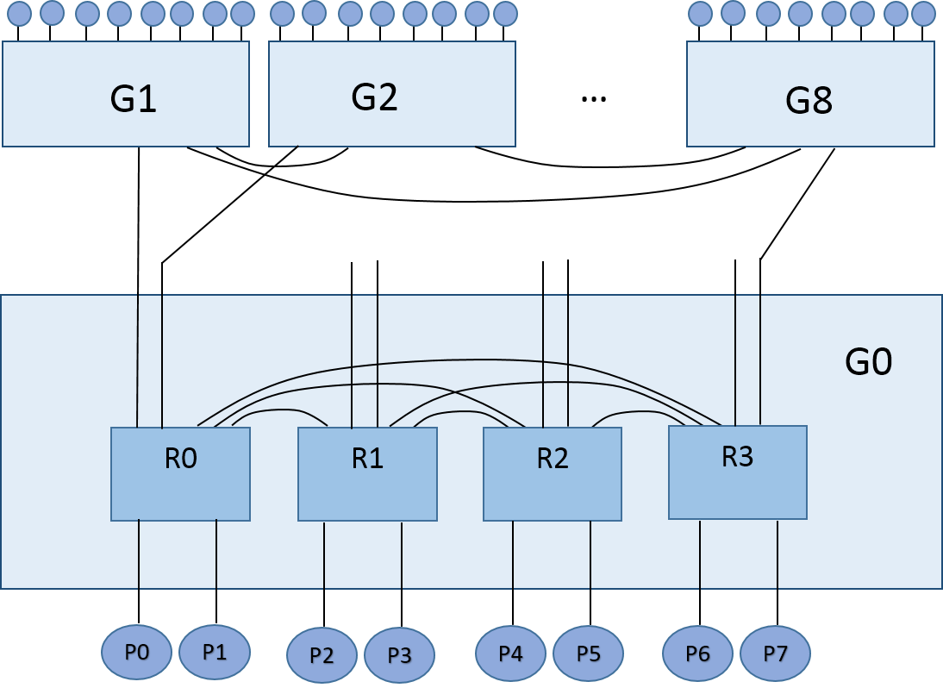
Dragonfly Topology
Notes:
In real life, its possible to have
: variable number of groups
: variable number of global links between groups
For example, full-sized DF has only one global link between the groups. But Cray Cascade has multiple (four, or two in some cases).

Slide 5
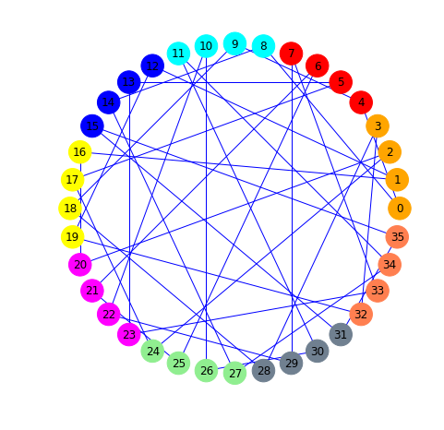
Dragonfly

Slide 6
Minimal Routing in Dragonfly
S
D

Slide 7
Non-Minimal (VLB) Routing in Dragonfly
I₁
S
D

Slide 8
Non-Minimal (VLB) Routing in Dragonfly
I₁
S
D
I₂

Slide 9
Adaptive (UGAL-L) Routing in Dragonfly
I₁
S
D

Slide 10
Adaptive (UGAL-L) Routing in Dragonfly
I₁
S
D

Slide 11
Adaptive (UGAL-L) Routing in Dragonfly
I₁
S
D

Slide 12
Routing in Dragonfly
The method to decide VLB paths in UGAL does NOT adapt to the network topology.
The question is: are ALL the VLB paths in DF are absolutely necessary to achieve sufficient path diversity?
Notes:
There exists many 3, 4 and 5 hops VLB paths along with the regular 6-hop paths.

Slide 13
Intuition
In many practical instances of Dragonfly, the number of groups is less than the theoretical maximum for that configuration
This may lead to more than one global links between the groups
More global links between groups lead to:
  More than one minimal path between s-d pairs
  More variations in VLB paths lengths
Notes:
There exists many 3, 4 and 5 hops VLB paths along with the regular 6-hop paths.

Slide 14
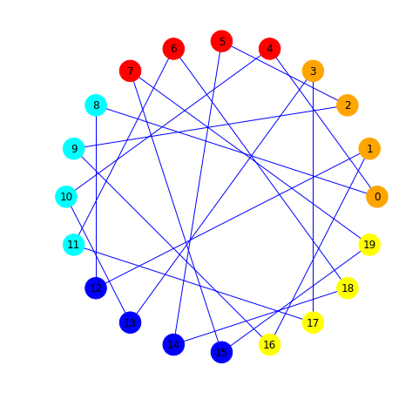
Intuition

Slide 15
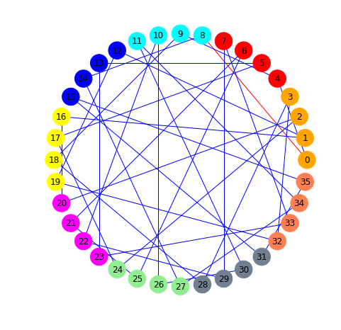

Intuition

Slide 16
Intuition
S
D
I
Notes:
Traditional 6 hop path

Slide 17
Intuition
Notes:
5 hop paths

Slide 18
Intuition
Notes:
4 hop paths

Slide 19
Intuition
It might be possible to use only the shorter non-minimal paths, and achieve sufficient path-diversity even for the adversarial traffic patterns
Using shorter paths leads to less resource consumption, and may lead to overall improvement in performance
Notes:
Can we provide a table here with the percentage of smaller paths in a certain DF topology?

Slide 20
Intuition
We try to find a set of VLB paths for each DF topology that:
  Reduces the average path length
  And provides sufficient path-diversity for any adversarial traffic pattern
Once found, we restrict UGAL to select non-minimal paths from only this set

Slide 21
Challenge
How to ensure “sufficient” path diversity?

Slide 22
Challenge
How to ensure “sufficient” path diversity?
We know the most demanding traffic pattern for Dragonfly: Adversarial Shift.

Slide 23
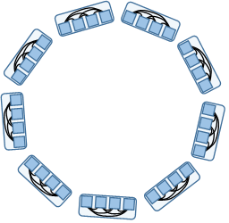
Shift Traffic Pattern in DF

Slide 24
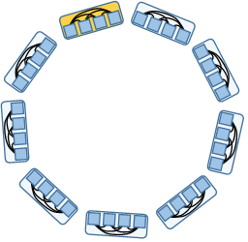
Shift Traffic Pattern in DF

Slide 25
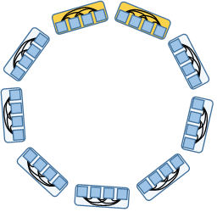
Shift Traffic Pattern in DF

Slide 26
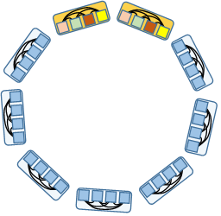
Shift Traffic Pattern in DF

Slide 27
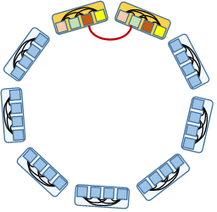
Shift Traffic Pattern in DF

Slide 28
Shift Traffic Pattern in DF
An adversarial shift pattern quickly consumes all the available b/w on the direct links between two group
This will force UGAL to switch to VLB paths
If T-UGAL can support such patterns (better than, or at least as good as UGAL), it is reasonable to assume that it will handle any other non-adversarial pattern.

Slide 29
T-UGAL: Properties
T-UGAL has the same routing mechanism as in UGAL
T-UGAL uses the same set of minimal paths as in UGAL
T-UGAL uses a subset of VLB (non-minimal) paths used in UGAL
  The set of paths (T-VLB) is customized for the underlying topology
  Has an average path length of as small as possible

Slide 30
Computing T-VLB: Steps
Identify of the most demanding traffic patterns for DF
Initialize candidate T-VLB path sets.
Perform a coarse-grain performance estimation of T-VLB candidate path sets.
  Choose the top-performing ones as the interim candidate sets.
Consider augmenting the interim candidate pool with strategic choices

Slide 31
Computing T-VLB: Steps
For each interim candidate set:
  Perform load-balance analysis
  Perform load-balance adjustments
Evaluate the adjusted candidates through simulation.
  Choose the highest performing candidate set as the final path set.

Slide 32
Step 1: Identify the Most Demanding Traffic Patterns
We consider two types of adversarial shift traffic patterns
  Type-1 Set: Deterministic
  Type-II Set: Non-deterministic

Slide 33
Type-I Sets

Slide 34
Type-I Sets

Slide 35
Type-I Sets

Slide 36
Type-I Sets

Slide 37
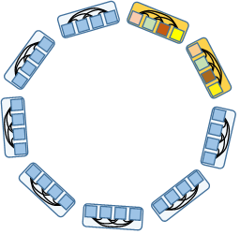
Type-I Sets

Slide 38
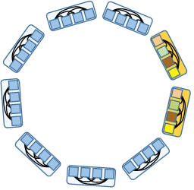
Type-I Sets
Notes:
Shift by (1,0) => 1 group, 0 router.

Slide 39
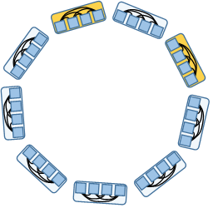
Type-I Sets

Slide 40
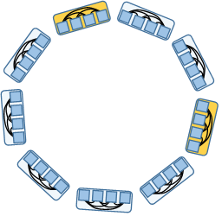
Type-I Sets

Slide 41
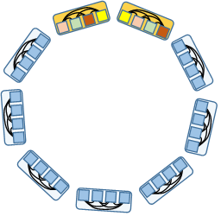
Type-I Sets

Slide 42

Type-I Sets

Slide 43
Type-I Sets
Each group shifts to one other group
Additionally, nodes in the source group can also shift in a specific way to nodes in the destination group
(g-1)*a number of possible patterns

Slide 44

Type-II Sets

Slide 45
Type-II Sets

Slide 46

Type-II Sets

Slide 47
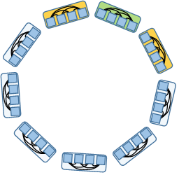
Type-II Sets

Slide 48
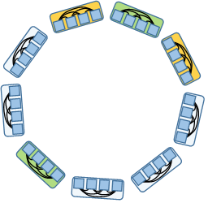
Type-II Sets

Slide 49
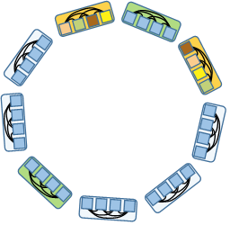
Type-II Sets

Slide 50
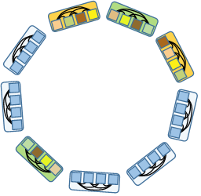
Type-II Sets

Slide 51
Type-II Sets
Type-2 Set:
  A random permutation is done at group level
  For each group pair, a router level permutation is done
  Virtually unlimited number of such permutations are possible.
We consider 20 of them, randomly picked.
Notes:
Any other pattern will be more “uniform” in comparison to these
So they should be possible to be handled at least as effectively as UGAL.

Slide 52
Step II: Coarse-grain Performance Estimation
Starts with many candidate VLB path subsets
Uses a performance model to estimate the potential throughput of the candidate VLB path subsets, for each traffic pattern selected
Chooses the ones with best estimated performance as interim candidates

Slide 53
Step II: Coarse-grain Performance Estimation
The performance estimation model used is a modified version of model 3 proposed by Mollah et al.
It is quite accurate and efficient
* Md Atiqul Mollah et al., "Modeling UGAL on the Dragonfly Topology," the SC17 workshop on Performance Modeling, Benchmarking and Simulation of High Performance Computer Systems (PMBS17), Denver, Co, November 11, 2017

Slide 54
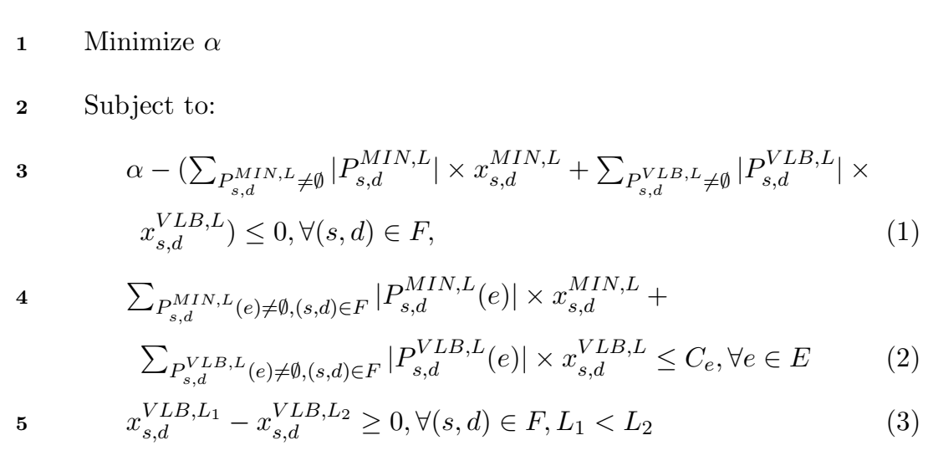
Step II: Coarse-grain Performance Estimation

Slide 55
Step II: Coarse-grain Performance Estimation
Notation | Explanation
3-hop paths | All paths 3-hop or less
10% 4-hop paths | All paths 3-hop or less, plus 10% 4-hop paths
… | …
90% 4-hop paths | All paths 3-hop or less, plus 90% 4-hop paths
4-hop paths | All paths 4-hop or less
10% 5-hop paths | All paths 4-hop or less, plus 10% 5-hop paths
… | …
90% 5-hop paths | All paths 4-hop or less, plus 90% 5-hop paths
5-hop paths | All paths 5-hop or less
10% 6-hop paths | All paths 5-hop or less, plus 10% 6-hop paths
… | …
90% 6-hop paths | All paths 5-hop or less, plus 90% 6-hop paths
6-hop paths | All paths 6-hop or less
Notes:
For each of the points, we collect model performance of type_1 and type_2 set traffic patterns.
We take their average.
We select the points that give the best performance prediction + some more points in its vicinity. These will be the inputs in Step 3.

Slide 56
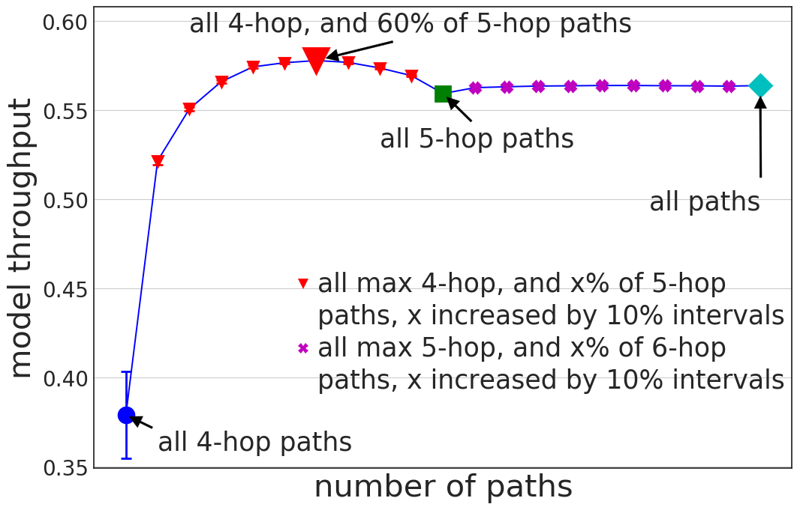
Step II: Coarse-grain Performance Estimation
Notes:
dfly(4,8,4,9) network
interim candidate sets: 40%, 50%, 60% and 70%

Slide 57
Step II: Coarse-grain Performance Estimation
Notes:
dfly(4,8,4,9) network
interim candidate sets: 40%, 50%, 60% and 70%

Slide 58
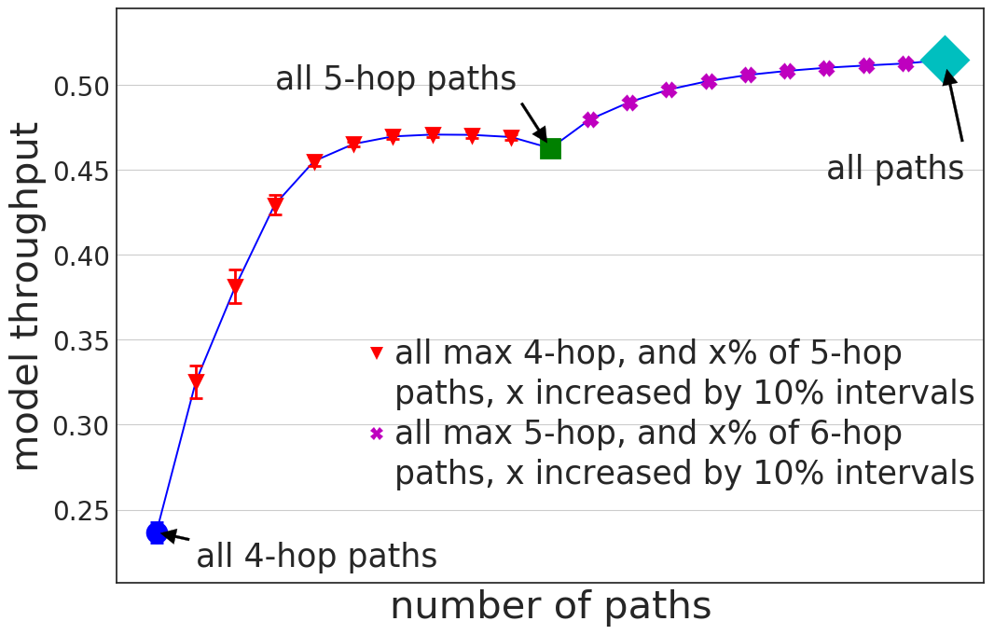
Step II: Coarse-grain Performance Estimation
Notes:
dfly(4,8,4,33) network

Slide 59
Step III: Interim candidate set augmentation and analysis
We may add some deterministic “strategic choice” path sets
  We were randomly selecting x% of n-hop links before
  However, sometimes deterministically selection the paths may lead to better load-balancing
We considered two deterministic 50% 5-hop sets.
Notes:
So for our example dfly(4,8,4,9) network, we considered six candidate sets: 40%, 50%, 60% and 70% random 5-hop paths, plus two deterministic strategic choices.

Slide 60
Deterministic Strategic Choice: 1
Sets of paths with 2-hop min paths followed by 3-hop min paths
S
D
S
I
D
I
Notes:
4 hop paths

Slide 61
Deterministic Strategic Choice: 1I
Sets of paths with 3-hop min paths followed by 2-hop min paths
S
I
D
S
D
I
Notes:
4 hop paths

Slide 62
Step III: Interim candidate set augmentation and analysis
For each interim candidate set:
  Perform load-balance analysis
  Perform load-balance adjustments
Notes:
Load-balance analysis is need for T-UGAL because some T-UGAL does not use all the paths. So this may lead to overusing of some links.
We perform load-balance analysis by calculating link-usage analysis for all the links with the assumption that:
Each candidate VLB path is equally likely to be taken by a packet between an SD pair
A packet is equally likely to be between any SD pair
We perform load-balance adjustments by removing over-used paths. (Could take more sophisticated approach, but it works, so why bother?)

Slide 63
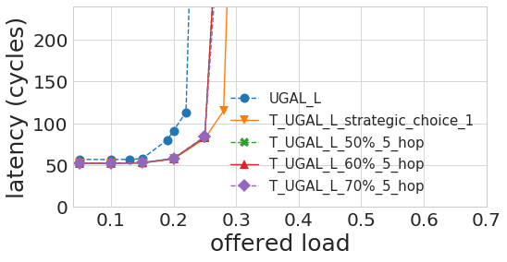
Step IV: Simulation
Finalize T-VLB through simulation.
Notes:
Simulation is done for adversarial traffic and highest performing candidate set is chosen finally.
The selection is validated with:
Different version of UGAL
Different traffic patterns

Slide 64
Deterministic Strategic Choice: 1
Sets of paths with 2-hop min paths followed by 3-hop min paths
S
D
S
I
D
I
Notes:
4 hop paths

Slide 65
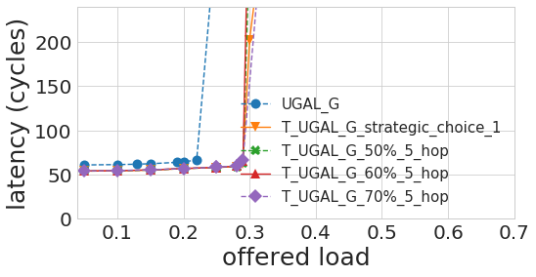
Step IV: Simulation
Finalize T-VLB through simulation.
Notes:
Simulation is done for adversarial traffic and highest performing candidate set is chosen finally.
The selection is validated with:
Different version of UGAL
Different traffic patterns

Slide 66
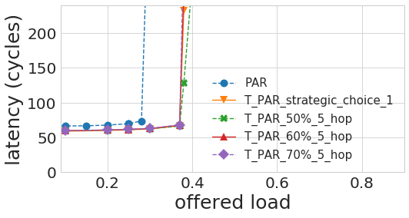
Step IV: Simulation
Finalize T-VLB through simulation.
Notes:
Simulation is done for adversarial traffic and highest performing candidate set is chosen finally.
The selection is validated with:
Different version of UGAL
Different traffic patterns

Slide 67
Performance Study
Performance of T-UGAL was analyzed and validated through simulation
Varying parameters:
  Dragonfly topology
  Adaptive routing scheme
  Traffic pattern

Slide 68
Dragonfly Topology
Topology | No. of PEs | No. of switches | No. of groups | Links per group pair
dfly(4,8,4,33) | 1056 | 264 | 33 | 1
dfly(4,8,4,17) | 544 | 135 | 17 | 2
dfly(4,8,4,9) | 288 | 72 | 9 | 4
dfly(13,26,13,27) | 9126 | 702 | 27 | 13
Notes:
DF topologies used in the experiments

Slide 69
Adaptive Routing Schemes
Existing Routing Scheme | Upgraded Routing Scheme
UGAL-L | T-UGAL-L
UGAL-G | T-UGAL-G
PAR | T-PAR
Notes:
Routing Schemes Considered

Slide 70
Traffic Patterns
Traffic Patterns
Adversarial Shift
Uniform Random
Random Permutation
Shift + Uniform mixed (Space-domain)
Shift + Uniform mixed (Time-domain)

Slide 71
Booksim 2.0
Parameter | Value
No. of virtual channels | 4 for UGAL-L and UGAL-G 5 for PAR
Buffer size | 32
Link latency | 10 cycles (local) 15 cycles (global)
Router internal speedup | 2
Notes:
Simulator settings

Slide 72
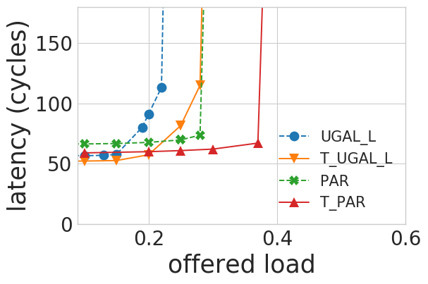
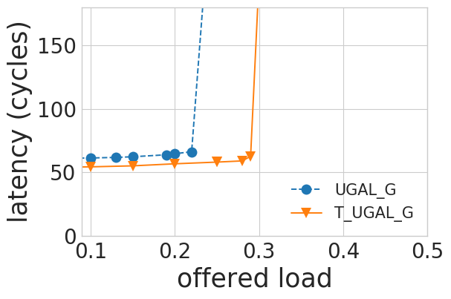
Shift(2,0), df(4,8,4,9)
Notes:
Shift pattern shift by (2,0), a 8 g 9

Slide 73
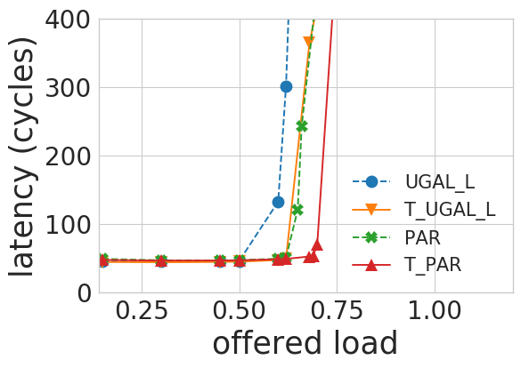
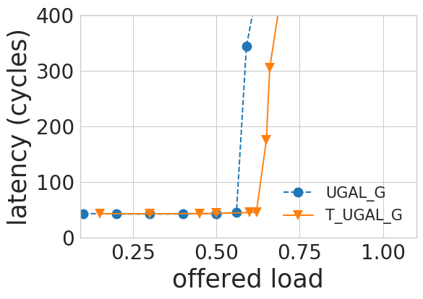
Random Permutation, df(4,8,4,9)
Notes:
Rperm, a 8 g 9

Slide 74
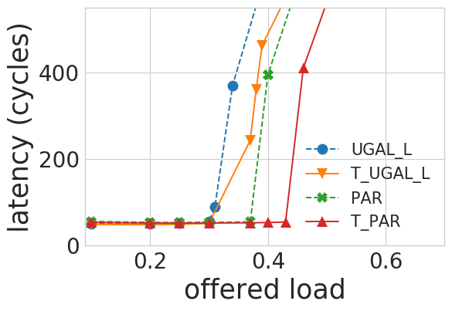
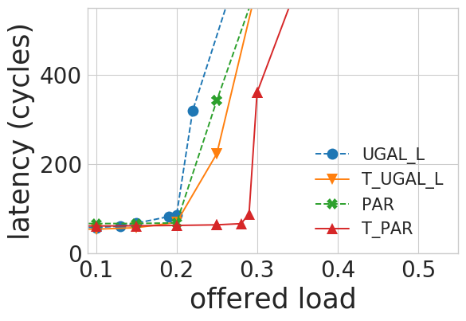
Shift+Uniform Mixed (Space Domain), df(4,8,4,17)
Notes:
PE-based shift-uniform. 25% shift, vs 75% shift. A8 g 17.

Slide 75
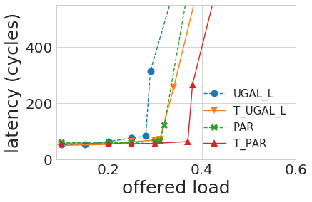
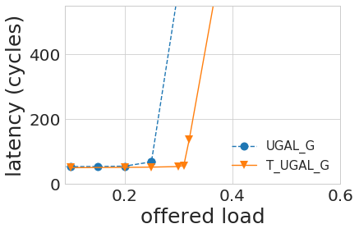
Shift+Uniform Mixed (Time Domain), df(4,8,4,17)
Notes:
Time-based shift-uniform. 50% shift. A8 g 17.

Slide 76
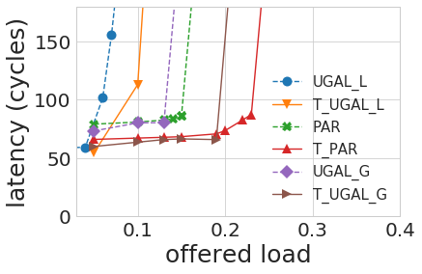
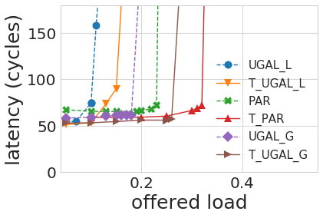
df(13,26,13,27)
Notes:
Large network. A26 g27. Shift by 1 group, vs Pe-based Mixed(50% shift)

Slide 77
Summary: T-UGAL in Dragonfly
We proposed T-UGAL routing for Dragonfly
We developed a general scheme for any DF topology to obtain the set of VLB paths, T-VLB, to be used in T-UGAL
We demonstrated that T-UGAL achieves significant performance improvement over UGAL for a broad range of DF topologies

Slide 78


