Slide 1



Exploiting Reuse and Vectorization in Blocked Stencil Computations
on CPUs and GPUs
Tuowen Zhao¹, Protonu Basu², Samuel Williams³, Mary Hall¹, Hans Johansen³
¹University of Utah, {ztuowen,mhall}@cs.utah.edu
²Facebook, protonu@fb.com
²Lawrence Berkeley National Laboratory, {swwilliams,hjohansen}@lbl.gov

Slide 2
This research was supported by the Exascale Computing Project (17-SC-20-SC), a joint project of the U.S. Department of Energy’s Office of Science and National Nuclear Security Administration, responsible for delivering a capable exascale ecosystem, including software, applications, and hardware technology, to support the nation’s exascale computing imperative.
This research used resources in Lawrence Berkeley National Laboratory and the National Energy Research Scientific Computing Center, which are supported by the U.S. Department of Energy Office of Science’s Advanced Scientific Computing Research program under contract number DE-AC02-05CH11231.

Slide 3
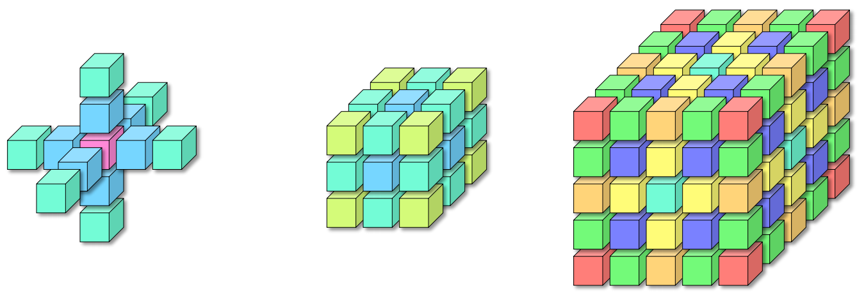
Stencil computation
Introduction: Stencil
Solve partial differential equations
  Points are computed using neighbors
  Neighboring stencil applications exhibits reuse
Low order stencil
  Lower accuracy, low arithmetic intensity (FLOP per byte) typically memory bound
High order stencil
  Higher accuracy, high arithmetic intensity and could be compute bound
Diameter of stencil related to order of stencil
Blocking to exploit locality to reduce data movement
  Iteration blocking (Tiling)
Notes:
Diameter 5, 7, 13

Slide 4
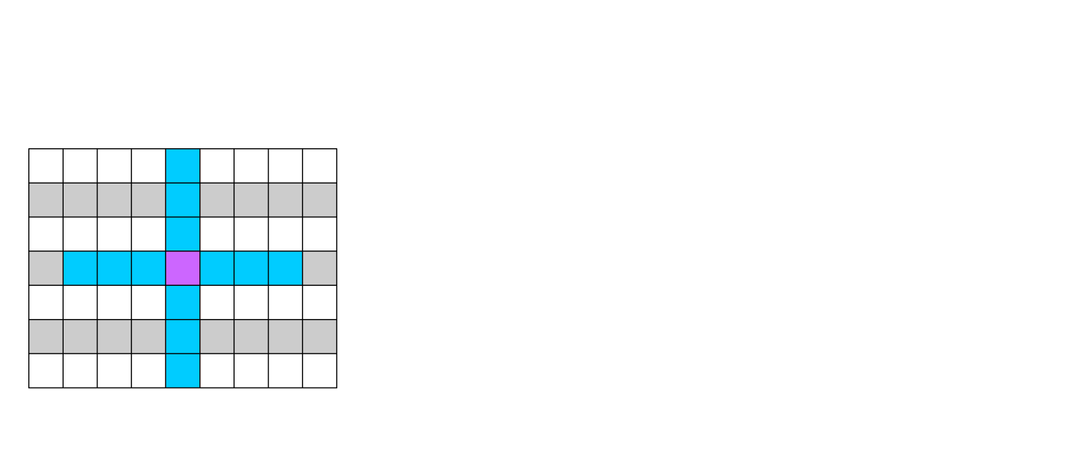
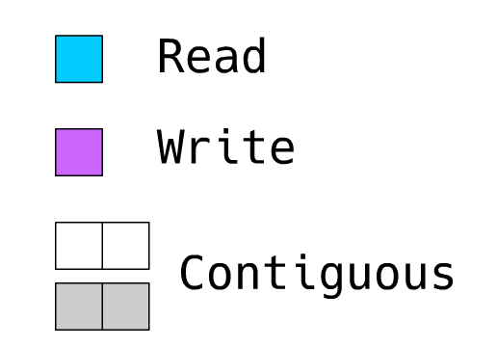
Stencil － Strided memory accesses
Introduction: Blocking
Limits parallelism
Problem exacerbated with tiling
Hardware prefetching streams
TLB entries
Worst case usage (cube-shaped):
  ~ diameter in 2D
  ~ diameter² in 3D

Slide 5
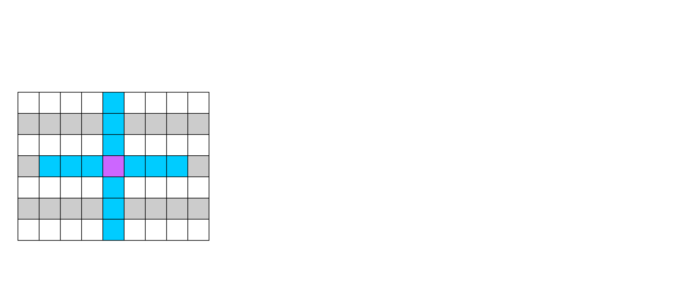
Stencil － Strided memory accesses
Introduction: Blocking
Limits parallelism
Problem exacerbated with tiling
Hardware prefetching streams
TLB entries
Worst case usage (cube-shaped):
  ~ diameter in 2D
  ~ diameter² in 3D

Slide 6
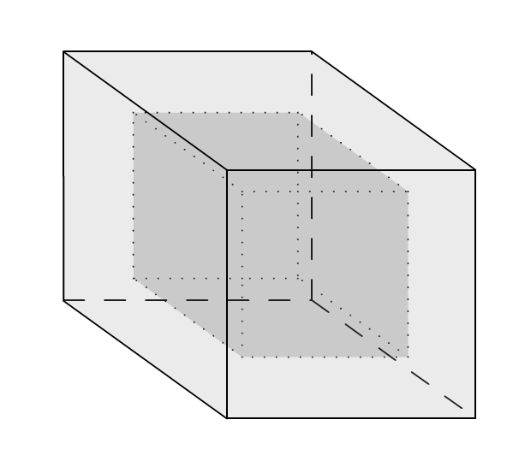
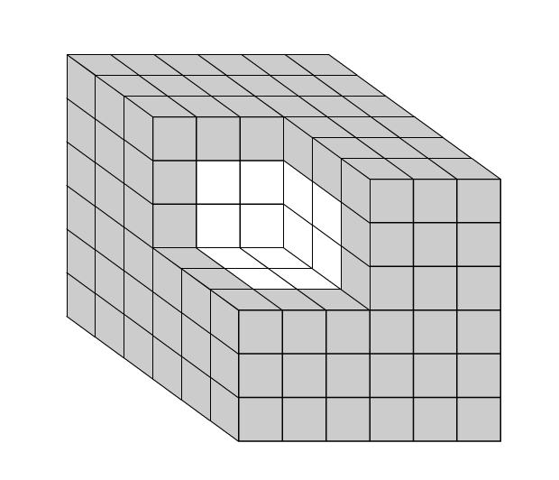
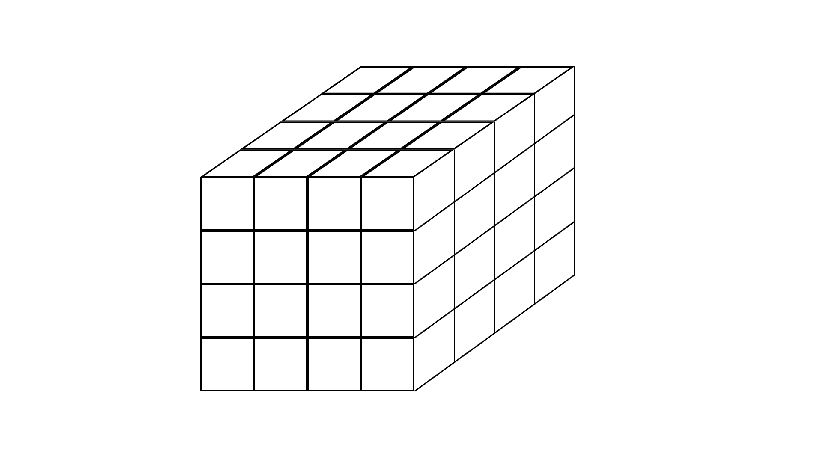
Fine-grained data blocking — Bricks
Introduction: Blocking
Logically nearby elements made physically nearby
Data decomposition of the per-process domain into fixed size “bricks”
Each brick is stored contiguously without per-brick ghost cells
6x6x6 collection of 4x4x4 bricks

Slide 7
Bricks — Abstraction for performance portability
Unit of data
  Compact for vertical data movement
  Predictable alignment
Unit of parallel work
  Fixed-iteration space
Configurable brick size for different applications and architectures
Flexible compute schedule
Notes:
Small, predictable alignment, fixed-iteration space, flexible computation schedule

Slide 8
Brick library example
Introduction: Blocking
Operate on brick-ed input/ouput array “In/Out”
Accesses outside of brick “b” are automatically resolved
Stencil expression for code generation expressed in Python
Brick<Dim<8,8>, Dim<2,2>> In(&brickInfo, brickStorage, 0);
...
for (long b: allbricks)
for (long j = 0; j < 8; ++j) for (long i = 0; i < 8; ++i)
Out[b][j][i] = In[b][j][i] * coeff[0] +
In[b][j][i+1] * coeff[1] +
In[b][j][i-1] * coeff[2] +
In[b][j+1][i] * coeff[3] +
In[b][j-1][i] * coeff[4];

Slide 9
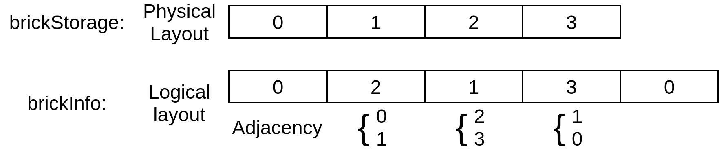
Assembling bricks
Introduction: Blocking
Indirection from logical to physical layout
  Bricks’ neighboring information are stored as adjacency list “brickInfo”
  Bricks are stored consecutively by-index in “brickStorage”
Array-of-structure-of-array
1D brick layout

Slide 10
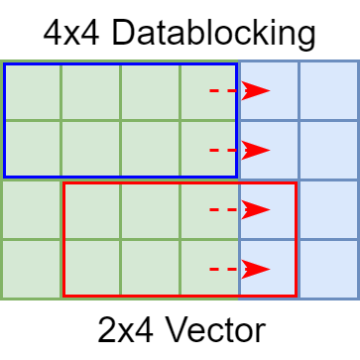
Data blocking introduces challenges
Introduction: Blocking
Extra indexing cost
  Which data block
  What is the index within the block
Vectorization difficulties
  Multidimensional
  Discontinuous

Slide 11
Contributions
Overview
Vectorization for tiling and fine-grained data blocking
  Exploit reuse
  Use multidimensional (folded) vectors abstraction
Achieve performance gains and portability for both CPUs and GPUs using fine-grained data blocking
Leverage associative reordering — Some operations are associative and commutative in stencil computation, such as addition* and multiplication.
*Floating point addition are not truly associative.

Slide 12
Associative Reordering by Shifting
Overview
for (long i = ti; i < ti + 8; ++i)
Out[i] = In[i] * coeff[0] + In[i+1] * coeff[1] + In[i-1] * coeff[2];
Three terms; Shift by -1, -2, 0; Reused!
double buf[8]; // buffer for partial results
buf[0] += In[ti-1] * coeff[2]; ... // 2 peeled iterations
for (long i = 2; i < 8; ++i) {
buf[i-1] += In[ti+i-1] * coeff[0];
buf[i-2] += In[ti+i-1] * coeff[1];
buf[i] += In[ti+i-1] * coeff[2];
}
buf[8] += In[ti+8] * coeff[0]; ... // 2 peeled iterations
out[ti:ti+8] = buf[0:8]; // write back
Notes:
Any term related to iteration can be reused by adding a shift

Slide 13
A complex stencil kernel
Overview
Stencil kernel might not be associative as a whole
Need per-operator way of identifying and leveraging associativity
flux[irho][k][j][i] =
-dxinv0 * (
ALP * cons[imx][k][j][i + 1] - ALP * cons[imx][k][j][i - 1] +
BET * cons[imx][k][j][i + 2] - BET * cons[imx][k][j][i - 2] +
GAM * cons[imx][k][j][i + 3] - GAM * cons[imx][k][j][i - 3] +
DEL * cons[imx][k][j][i + 4] - DEL * cons[imx][k][j][i - 4]);
flux[irho][k][j][i] += ...;
...
Hypterm kernel from Compressible Navier-Stokes computation (CNS)

Slide 14
Overview
Overview
Isolate operators with reuse potential
Group operators into stages
  better utilize machine resource and capture cross-operator reuse
Generate vectorized computation for both CPUs and GPUs
Step 0: Preparation
Step 1: Identify reuse
Step 2: Grouping Ops
Step 3: Code Generation

Slide 15
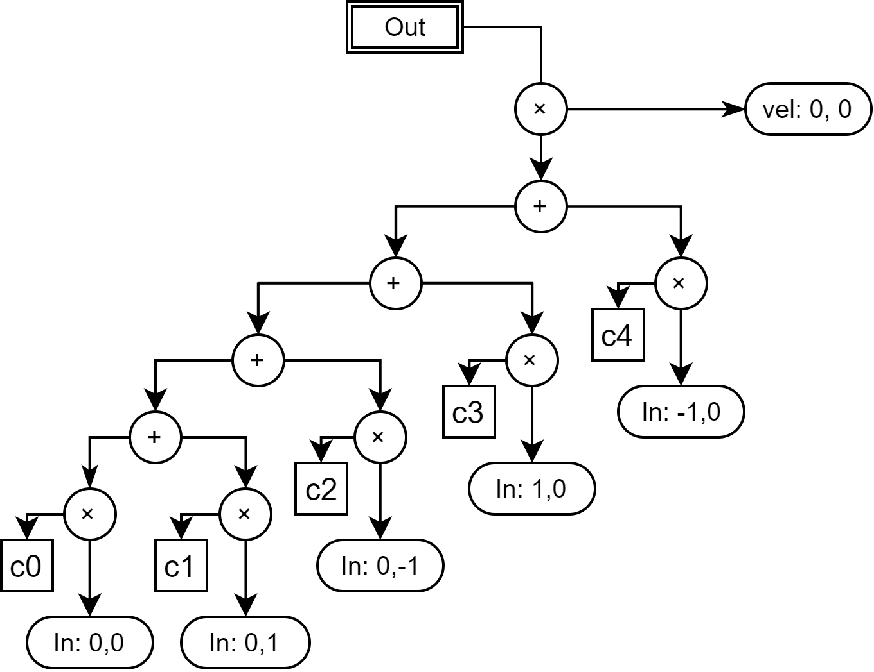
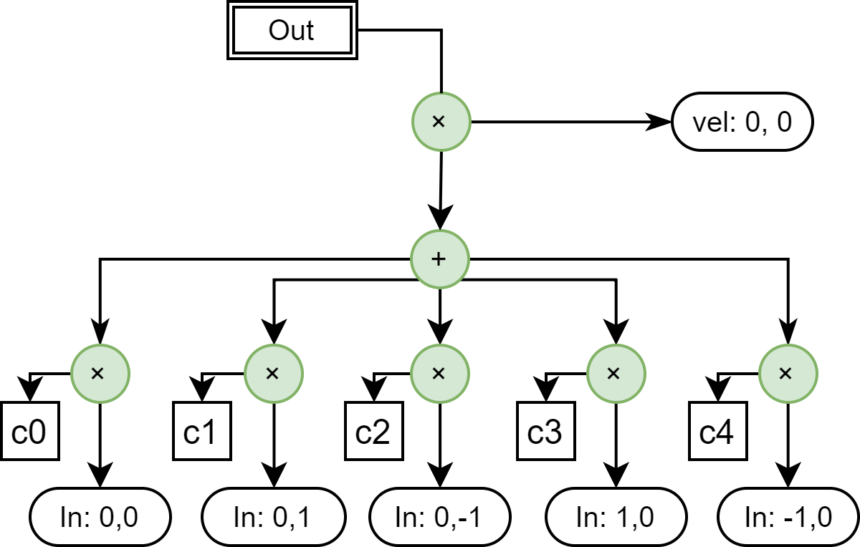
Use associativity to capture reuse
Step 0: Preparation
Starting from expression directed acyclic graph (Expr-DAG).
Merge consecutive associative operators of the same category
Expressed as reduction of terms e.g. addition as accumulation
for (j = tj; j < tj + 8; ++j)
for (i = ti; i < ti + 8; ++i) {
c = In[j][i] * coeff[0]
+ In[j][i+1] * coeff[1]
+ In[j][i-1] * coeff[2]
+ In[j+1][i] * coeff[3]
+ In[j-1][i] * coeff[4];
Out[j][i] = c * vel[j][i];
}
Expr-DAG
Reduction
Notes:
Commutative monoid

Slide 16

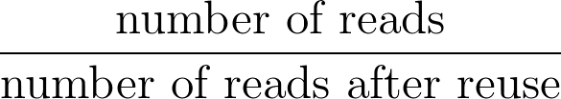
Inspecting DAG with Post-order Traversal
Step 1: Identify Reuse
(1)

Slide 17
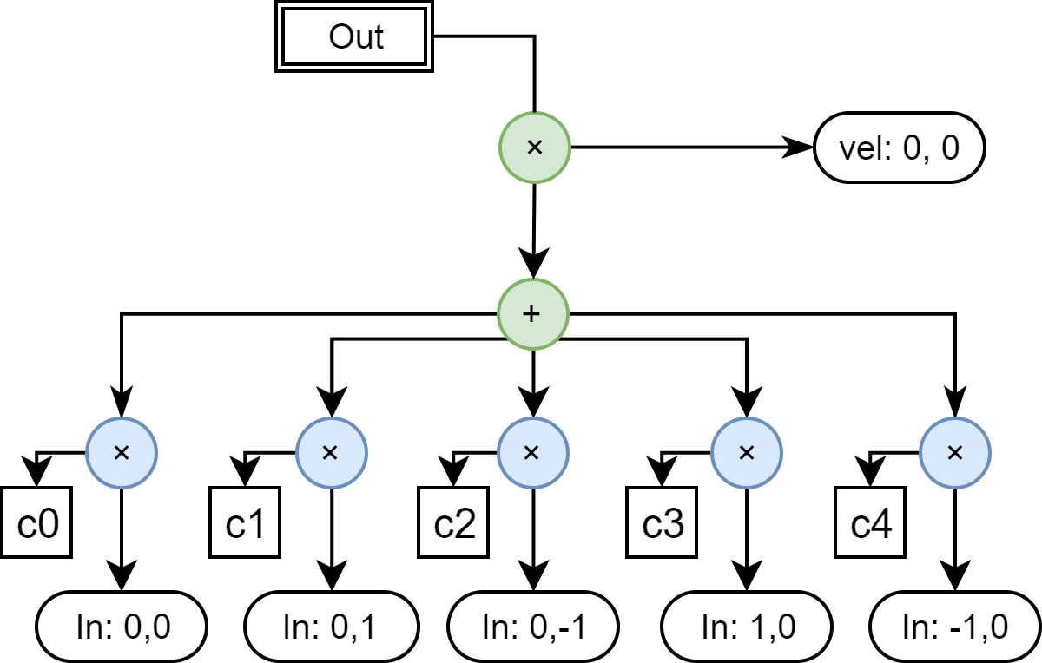
Inspecting DAG with Post-order Traversal
Step 1: Identify Reuse
Eq.1 = 1

Slide 18
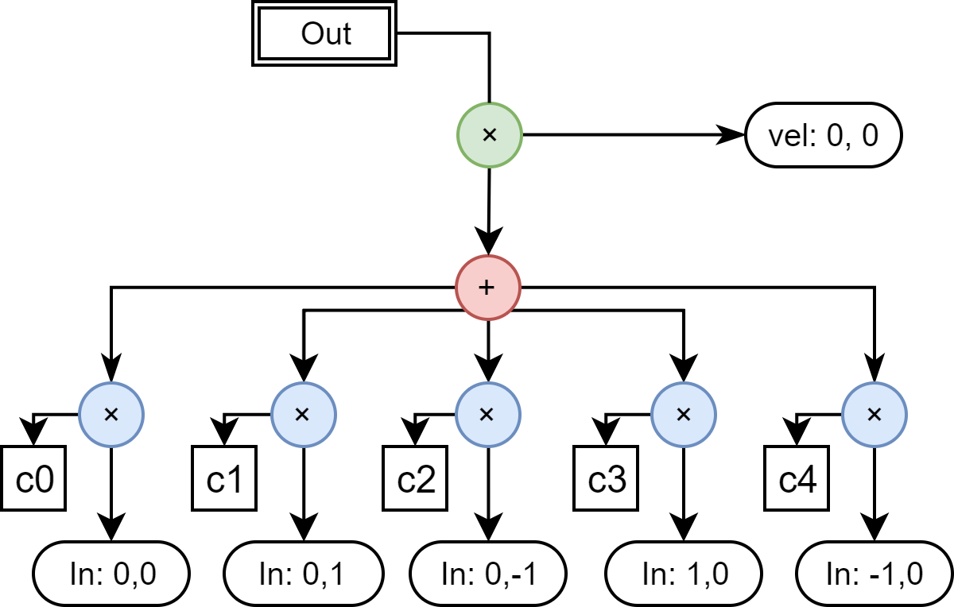
Inspecting DAG with Post-order Traversal
Step 1: Identify Reuse

Slide 19
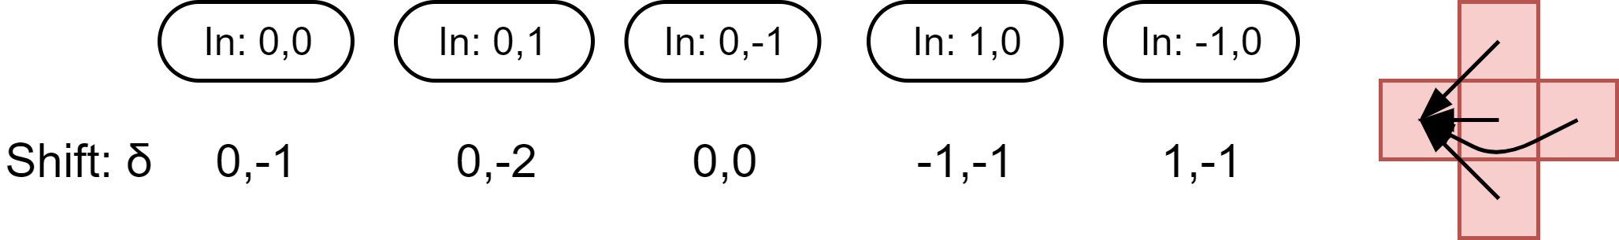
Greedy Algorithm
Step 1: Identify Reuse
Every term of the associative operator is reduced to the reads and offset
Iterating over the terms
  Move around by adding shift to offsets so that at least one of the reads is reused
  Update results if moving results in more reuse
If after trying all terms yielded improvement goto 2, else return
Notes:
Necessary condition of optimal shift:
Either a term have no common input grid with any other term or this term have at least one input reused after applying the shifts
n^4log n blocking size have no effect

Slide 20
Inspecting DAG with Post-order Traversal
Step 1: Identify Reuse
Eq.1 = 5

Slide 21
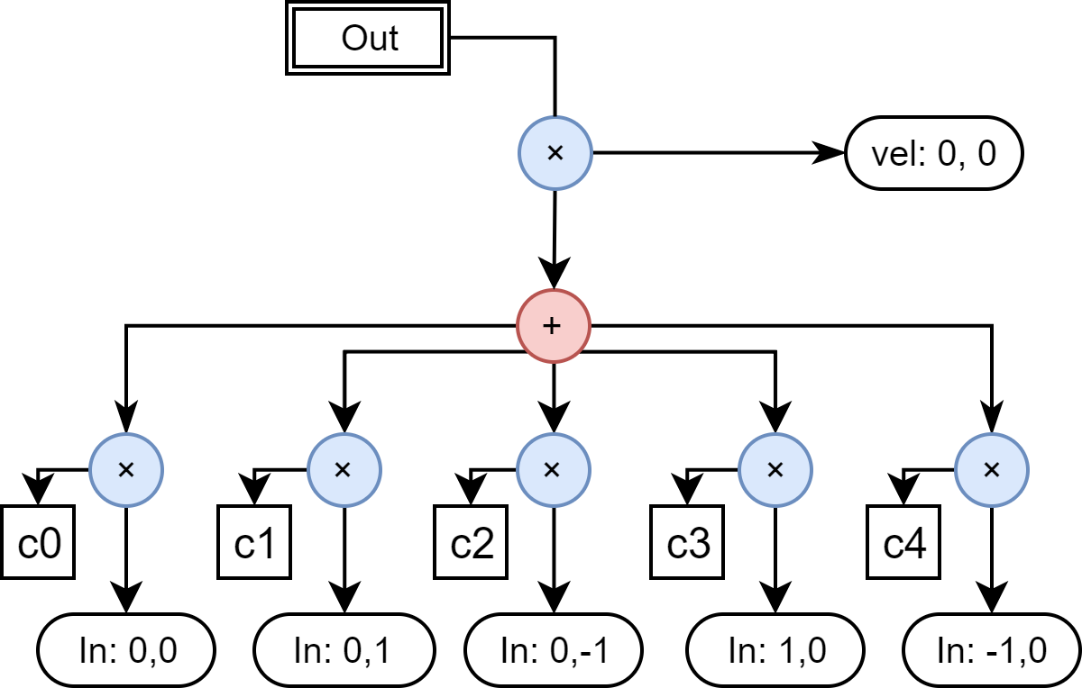
Inspecting DAG with Post-order Traversal
Step 1: Identify Reuse

Slide 22
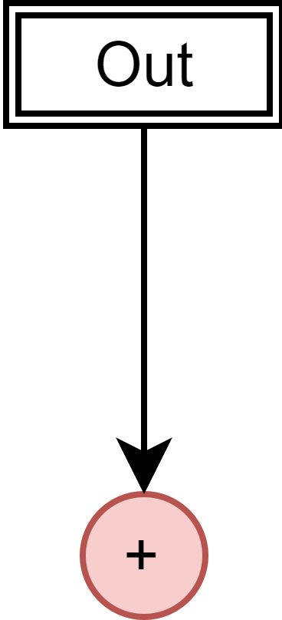
From DAG to Stages
Step 2: Grouping Ops
A group of operators is a stage that is computed together
  Write-back, reused partial results, and reordered operators
  They are marked in DAG and edges are contracted to form a dependency graph
Transform

Slide 23
Grouping operators
Step 2: Grouping Ops
Grouping operators helps improve utilization of hardware resources and capitalize on reuse across operators, expressed as:
Greedy algorithm used again to determine cross operator reuse
Topological sort to preserve dependencies
Break down complex stencils into stages of simpler stencils while keeping expressions without reuse intact
(2)

Slide 24
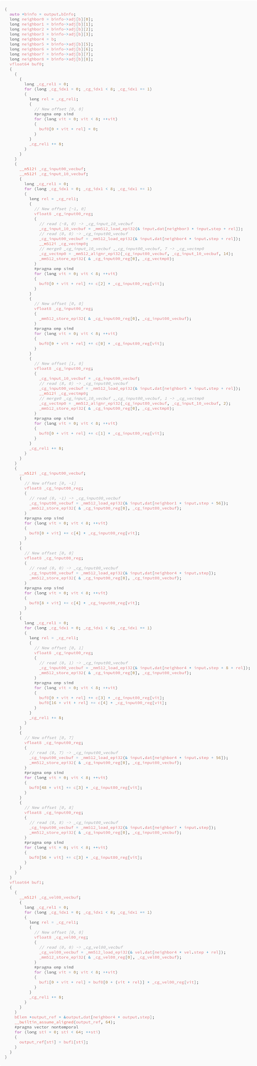
Code generation
Step 3: Code Generation
Stage 1
Vectorization
Loop bounds
Optimizations
Stage 2

Slide 25
Multidimensional Vector Abstraction
Step 3: Code Generation
Applies to both CPU (vector) and GPU (warp)
Support operations:
  Vector load from / store to consecutive memory
  Element-wise vector operation: “vadd”
  Vector align — shifting across vector lane: “alignr” on CPU, “shfl” on CUDA GPU
  Vector select/mask — merging two vectors based on predicate/mask
Trading extra cache usage and inefficiencies in data copy for few extra vector manipulation during computation
Notes:
≠ eliminate ghost zone

Slide 26
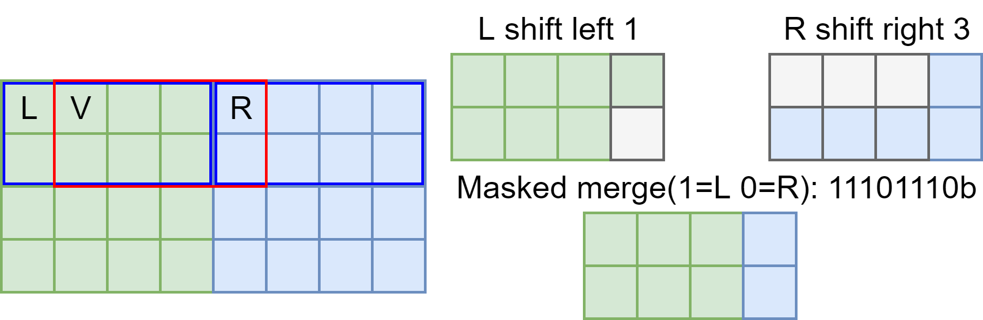
Merging vectors for unaligned read
Step 3: Code Generation
No need for per-brick ghostzone
Reuse of input === reuse of index computation & vector operations
Notes:
AVX512 2x4 double

Slide 27
Experiments
Experiments
Intel Xeon Gold 6130 (Skylake-X: SKX)
Intel Xeon Phi 7250 (Knights Landing: KNL)
Nvidia P100 (Pascal: P100)
Using synthetic and real stencils (HPGMG, CNS)
Baseline: parallelized, tiled, vectorized

Slide 28
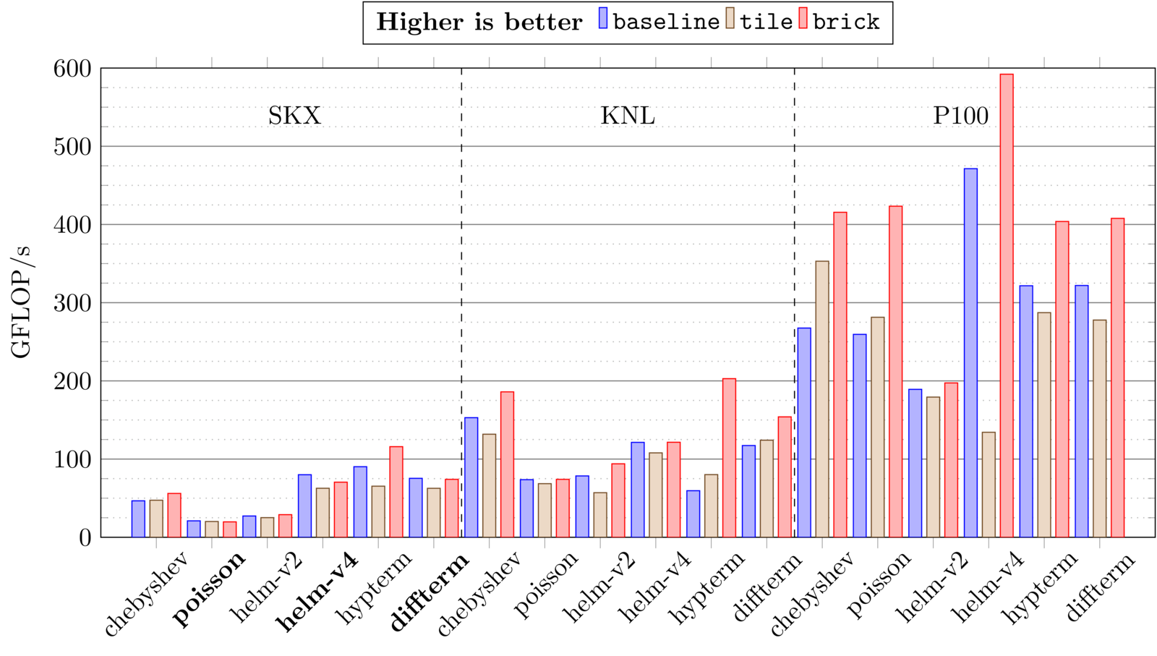
Experiments - Real stencils
Experiments
Maximum
Average
1.2x
~1.06x
3.4x
~1.52x
1.6x
~1.33x
Notes:
Explain implementations.
We are able to achieve speedup for blocked stencils. Especially when used with data blocking often achieves the best performance across all platforms.

Slide 29
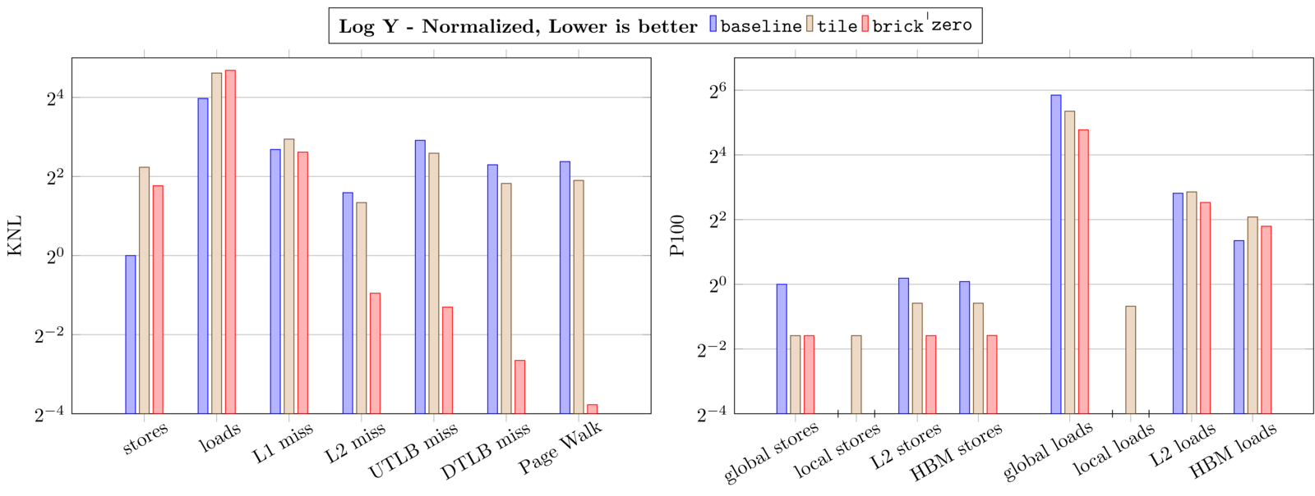
Hypterm: Hardware counters
Experiments
Notes:
Normalized to stores, represent page

Slide 30
Hypterm: Hardware counters
Experiments
12x
18x
30x
70x
5x
2.6x
Much better cache locality
Much less TLB pressure
Much better register reuse
Notes:
Normalized to stores, represent page

Slide 31
Related work
Associative reordering
  Stock, Kevin, et al. 2014
Matrix multiplication
  Goto, Kazushige, et al. 2008
Coarse grained data blocking
  Unat, Didem, et al. 2016
Fine grained data blocking for stencils
  Jayaraj, Jagan. 2013
    Briquette, require stencils that can be split into 1D stencils
  Yount, Charles, et al. 2016
    Vector folding, only vector-lengthed and uses unrolling

Slide 32
Conclusion & Future Work
Vector code generation exploit reuse of vectors for stencil computations, particularly beneficial for high-order stencils
Enabling performance portable stencil computation with fine-grained data blocking
Add more code generation optimization
Support other architectures
Use bricks to optimize MPI communication

